Slide 1
ASA Challenge Submission: Drawing Insights with 2022 LAPD Call for Service Data paired with ACS Data, focused on LA County in the year 2022
Authors: Anthony Wolfe and David Rodriguez
Advisor: Bethany Johnson

Slide 2
Problem Statement
The problem we formulated after reviewing the challenge statement and data sets was: How can we optimize the allocation of emergency resources based on what we know from Call for Service Data, coupled with another data set that could help provide some details on LA County’s population and other important variables.
Disclaimer: We didn’t start this project as soon as we planned, so with the few days we had, we decided to focus on LAPD calls reported in 2022 as a start to an ongoing effort to drill into this problem (we’ll continue to expand on this after submission). I figured that LAPD represents a large portion of the CA population, and since our lives began and exist in CA, it seemed to make sense to direct our attention there.

Slide 3
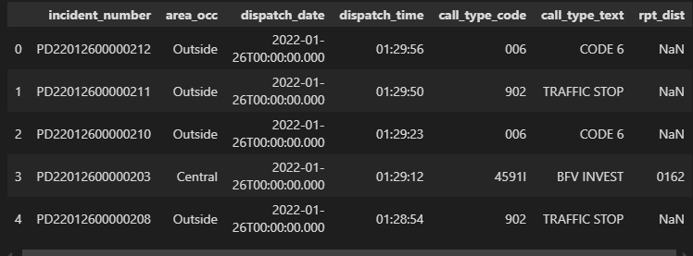
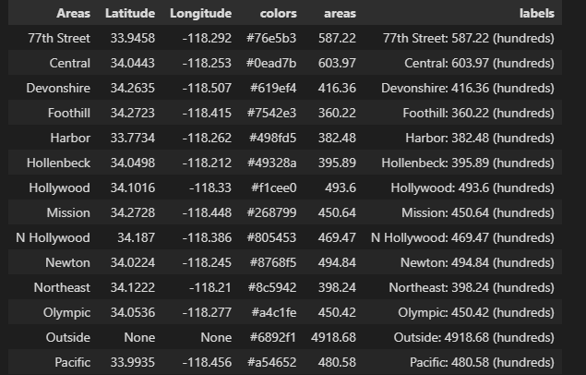
Data Overview (1) – LAPD CFS 2022
The table above is what the LAPD calls for service table looks like for 2022, containing variables such as the area, dispatch date & time, the call type, and more
The table below is defined by myself to map out the reports geographically, which contains the estimated latitudes and longitudes, report frequency in hundreds, and randomly assigned colors for mapping

Slide 4
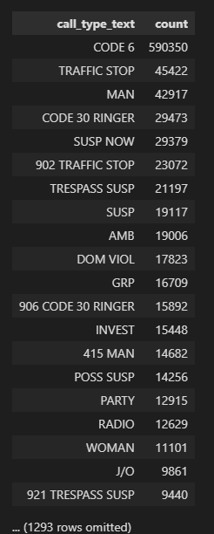
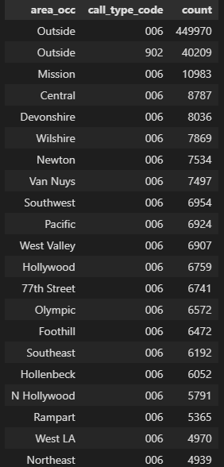
Data Overview (2) – LAPD CFS 2022
The table on the left groups our LAPD 2022 Call for Service data by call type description, sorted descending by the frequency of those reports
The table on the right does the same but by area and call type, drilling down the most common types of reports in certain areas
Note: “Outside” can be described simply as surrounding cities and areas not formally supervised by LAPD stations
* Lots of Code 6’s *
* Code 6’s outside of LA are most common report*

Slide 5
Methodology
A
Obtain CFS Data
Exhaust dataset value alone by performing statistical analysis
B
Obtain ACS Data
C
Join Datasets somehow or correlate variables from both
Exhaust joined dataset value by performing statistical analysis on both
Exhaust dataset value alone by performing statistical analysis
My first step was to drill down as much as possible into the data I had available from LAPD 2022
Next step was to do the same for ACS data related to LA County in 2022
Finally, we correlate variables from both or join the tables in order to draw insights from them together

Slide 6
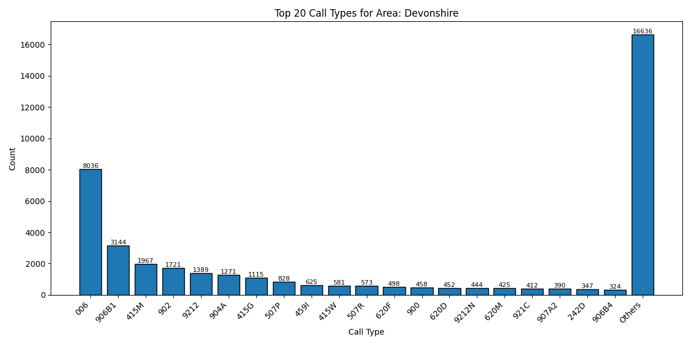
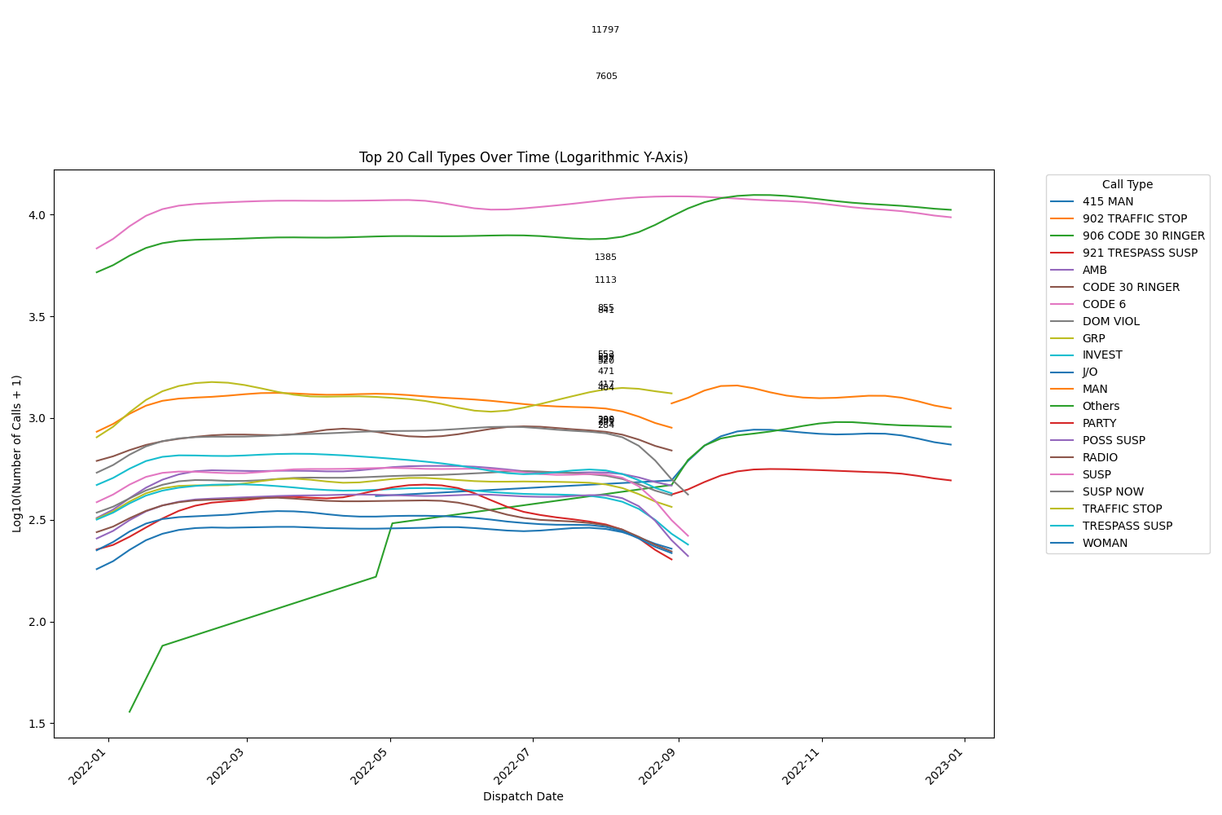
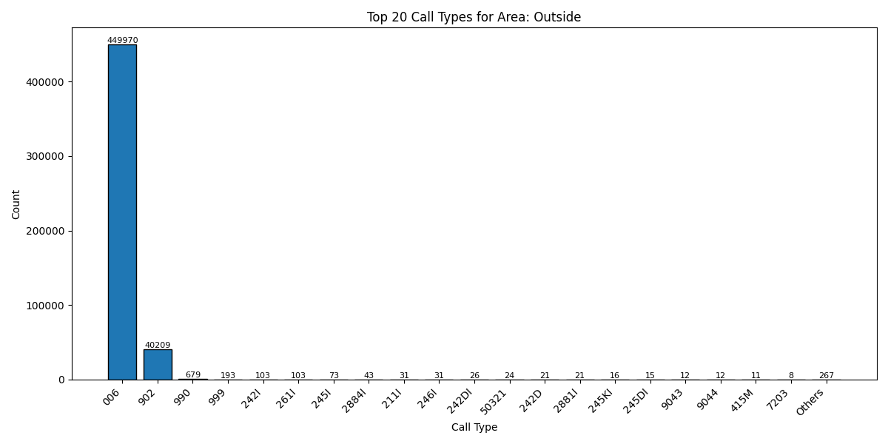
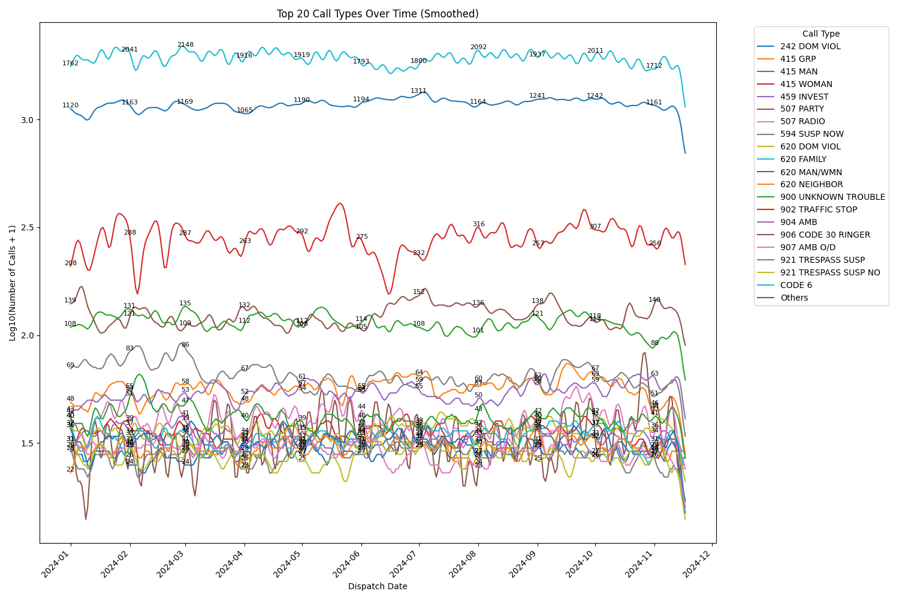
Exploratory Data Analysis – LAPD CFS 2022 (1)
Bar charts to describe common call types for LA and area-specific
Line Plots to describe Trends Over the year for certain reports

Slide 7
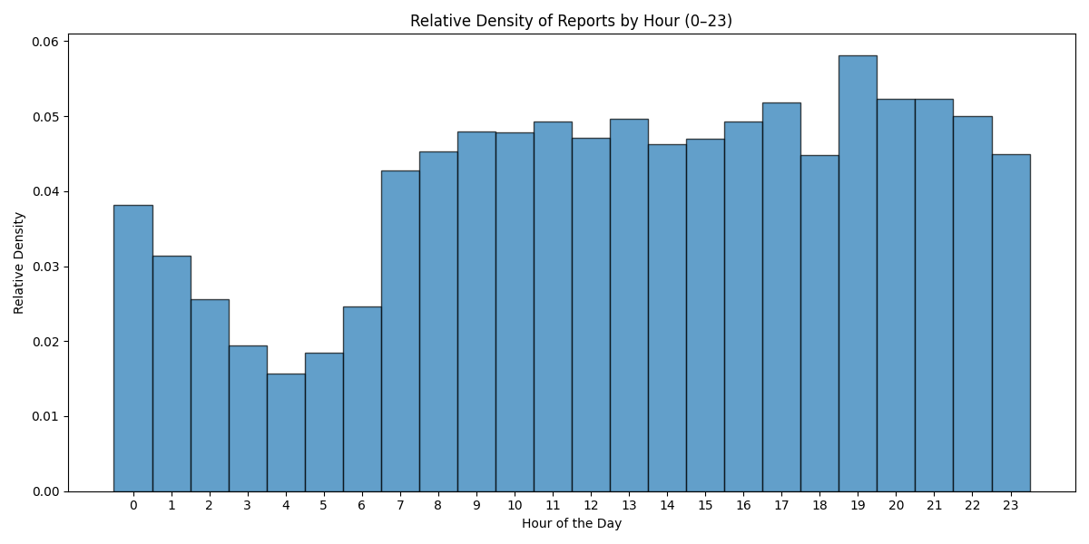
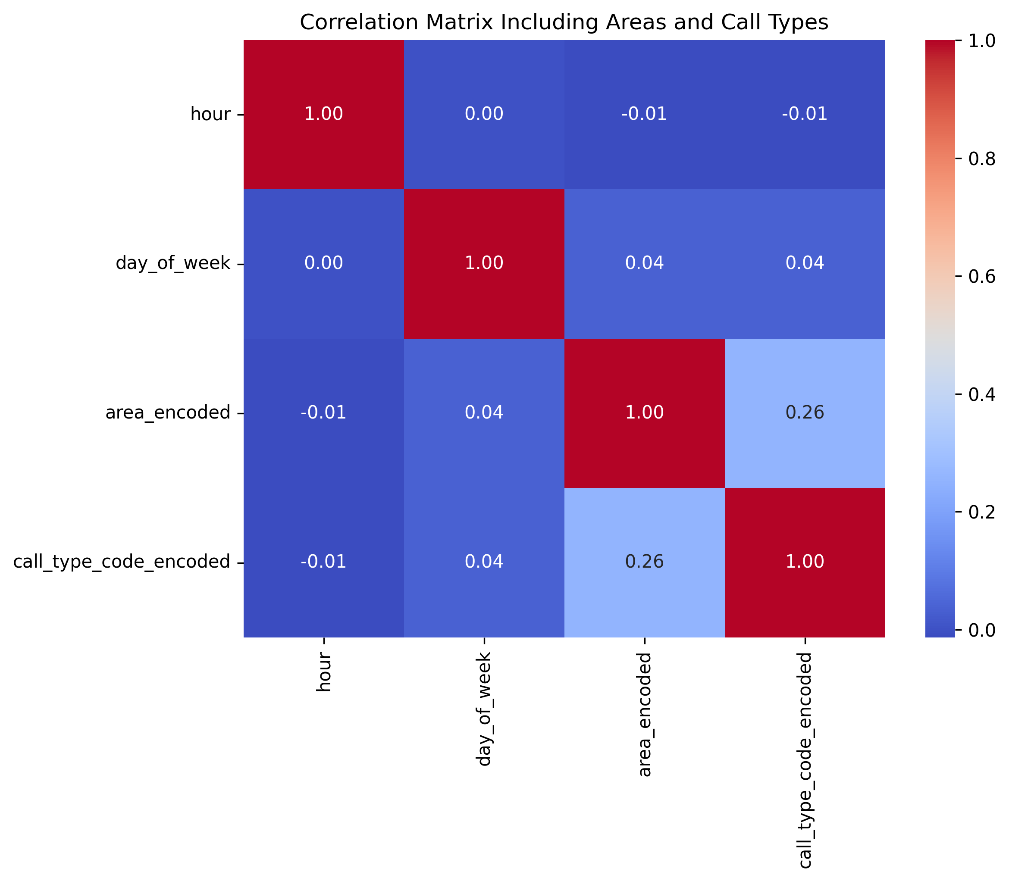
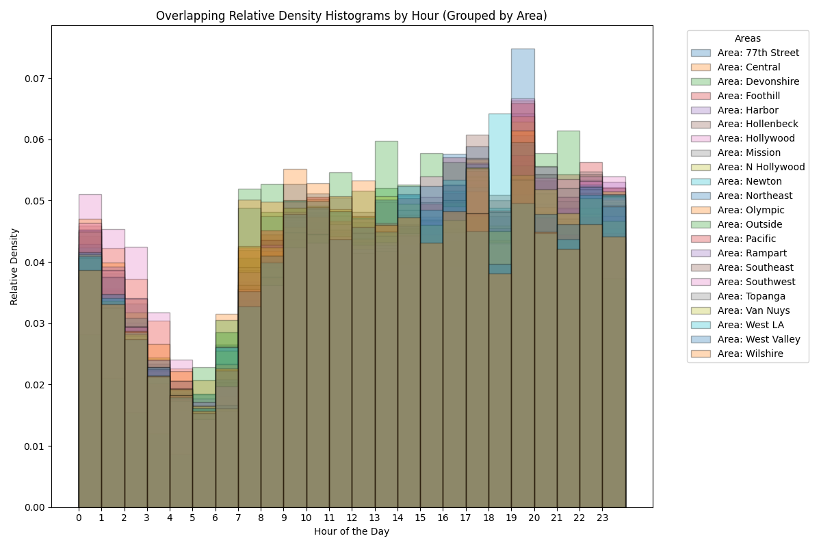
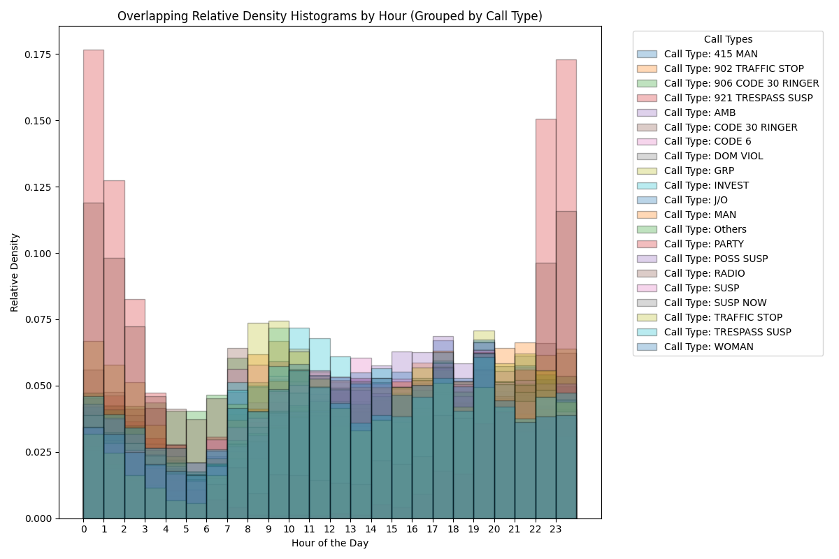
Exploratory Data Analysis – LAPD CFS 2022 (2)
Histograms to describe the probability of reports occurring at certain times of the day (also by area and by call type
Correlation matriX to describe association between variables in the data set (or aggregated values)

Slide 8
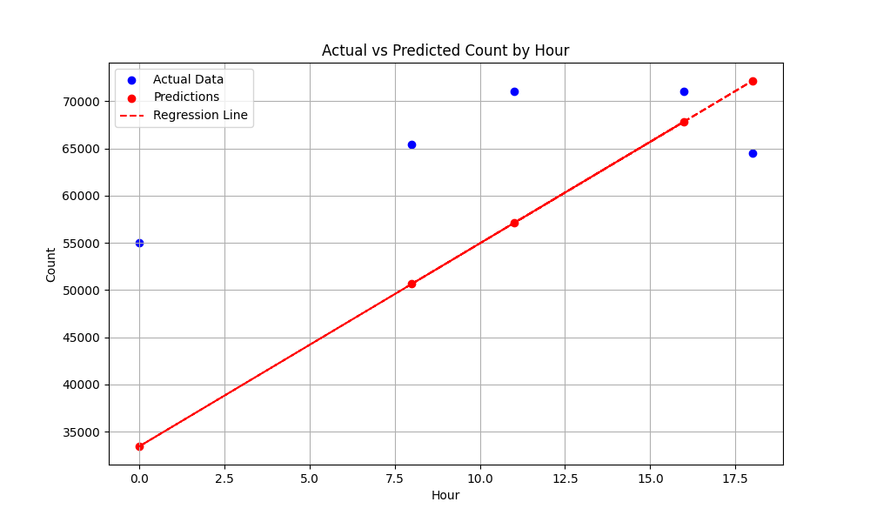
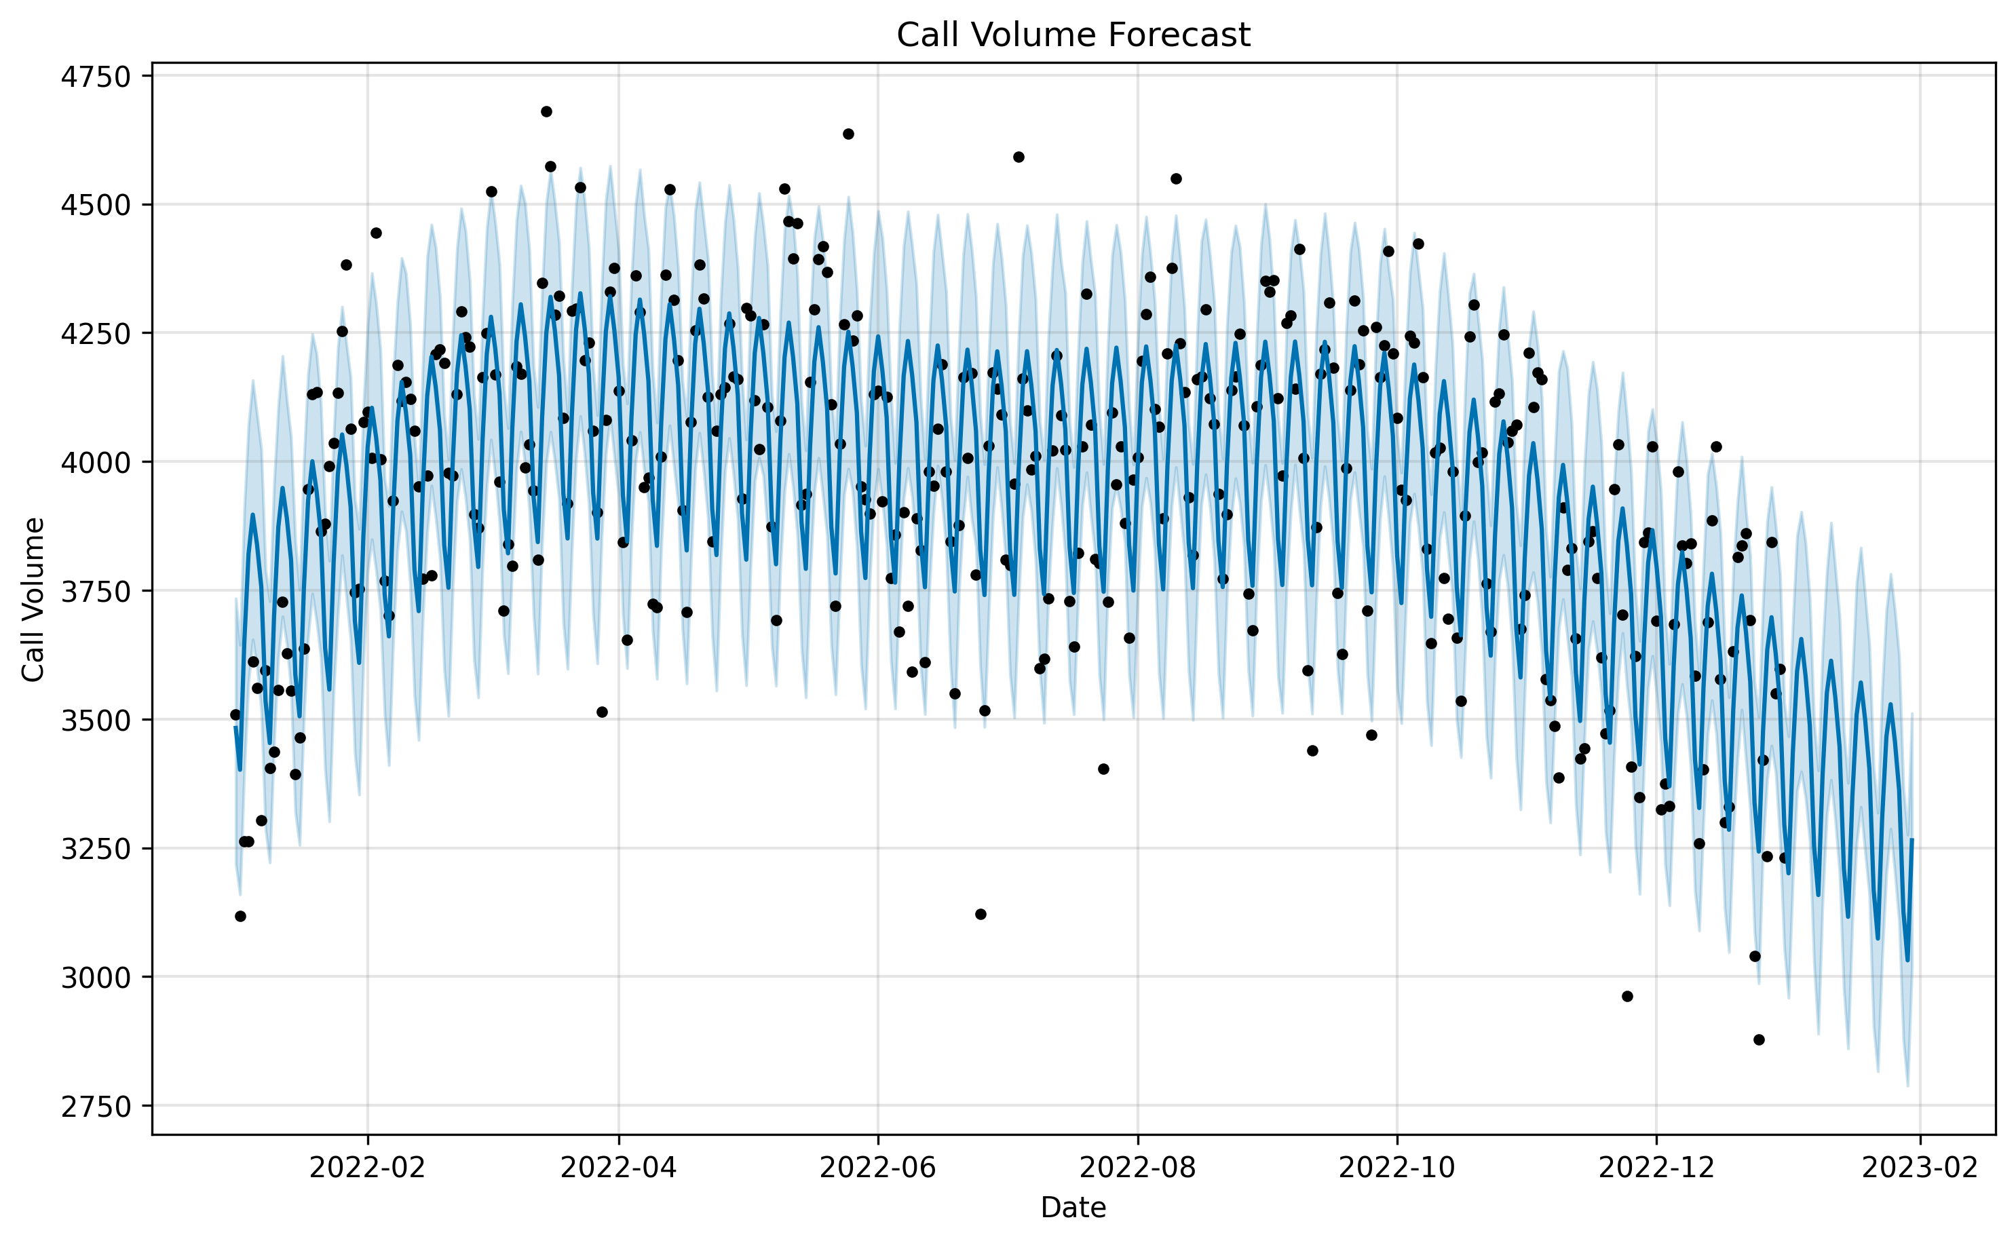
Inferential Data Analysis– LAPD CFS 2022
Use Linear Regression and forecasting to predict likely call volume over time and over year
Perform statistical tests
(anova, tukey, and chi squared)
Anova null: no difference between hours of day and call volume
Anova alt: difference between them
Chi^2 null: no association between area and call type
Chi^2 alt: association between area and call type
Results for both tests had a ~0 p-value and indicate both alt hypothesis are true. However, this is with a large dataset and should be taken with extreme caution (perform your own tests or allow me to continue my research to evaluate if this can be true)
* More details found in repo *

Slide 9
Results of Analysis
Insights drawn from the previous table manipulations and visualizations
Most common reported call code for any area is 006, followed by traffic stops, followed by disturbances by men
006 means once officer arrives on scene, when a unit is conducting a field investigation, and no assistance is anticipated
Most common area that reports come from are ‘Outside’ LA, followed by Central, followed by 77th street
Most common report for any area is 006 for outside la area
Almost all reports or call services from outside LA are either 006 or traffic stops, other calls are year;
All reported calls don’t seem to follow many trends throughout the year; However, some do reduce and increase during middle of the year and end/beginning of the year
Most calls generally occur around the evening (8pm holds the most)
When grouped by code: interesting insights emerge, such as the fact that most parties and trespassing calls occur in the late hours of the night or early hours of the morning
When grouped by area: interesting insights emerge, such as the fact that 77th street experiences the most calls during peak hours, or that Hollywood receives the most calls during the early hours of the morning.
Slight correlation between area and call type in correlation matrix
Developed a couple models to predict call volume in certain hours (positive trend) and one to forecast call volume for a foreseeable future (few months give or take)

Slide 10
Challenges, Conclusion, & Next Steps
Conclusion:
Although we didn’t start ahead of time to collect extra data sources to support our effort towards optimizing emergency response resource allocation, I believe a lot of interesting insights can be extracted from this singular calls for service data set. With a time series, some of the previous analytics could be reinforced or further shown.
Next Steps:
I think the appropriate next steps would be to collect more data, crime statistics and resource allocation for emergency services in LA that could help us reduce the level of policing required in certain areas
Also, I should collect data across the span of some years to conduct some analysis on them alone to see if any patterns or trends emerge
We should potentially think about performing bootstraps and hypothesis tests using a subset of the data, which could help us represent the general population of reports and therefore avoid any significance US, compare high volume of data records. We could also split it such that some data is used to sample and other data will be used to test for future models
Drill into other cities and counties that aren’t LA, try to find emerging trends and draw insights from the US, compare regions and such
Technical Details found in the repository
Download folder from there or view other png’s produced while analyzing

