Slide 2
The problem
In an embedded system, the I2C chip is communicating with a touch screen interface.
The application periodically checks the messages coming over I2C and landing in an intermediate buffer.
The touch screen interface expects a response from the application to confirm receiving every message.
Messages are sent periodically; a new message is never sent until the old one is processed.
The I2C interface works on a byte-by-byte basis, the message payload is 8 bytes.
For simplicity, let’s assume that the time taken to process the message, is exactly the time taken to transport it. (8 microseconds).

Slide 3

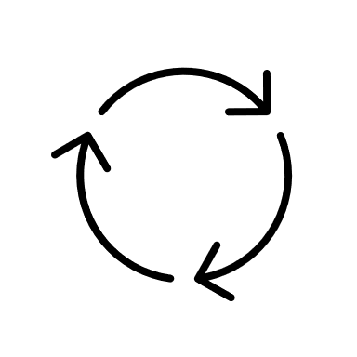




I2C driver
Application
- decrypt / deserialize
- process data
- take a decision based on data
- respond

Slide 4



t=16
t=32
t

Slide 5
t=8
t=16
t=24
t

Slide 6
What’s the tradeoff?
- Faster processing time
- Heavier memory usage
$$$$
Requirements (RTOS)
Priorities

