Slide 1
Java Annotation Patterns Engine
Xingyi Song and Mehmet Bakir
13th GATE Course, Module 2

Slide 2
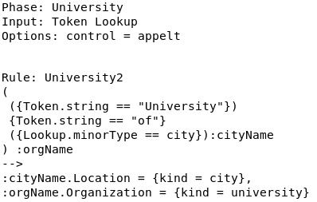
JAPE
Java Annotation Patterns Engine
Specially developed pattern matching language for GATE
JAPE allows you to recognise regular expressions in annotations on documents
Gazetteer lists are designed for annotating simple, regular features
recognising e-mail addresses using just a gazetteer would be impossible

Slide 3
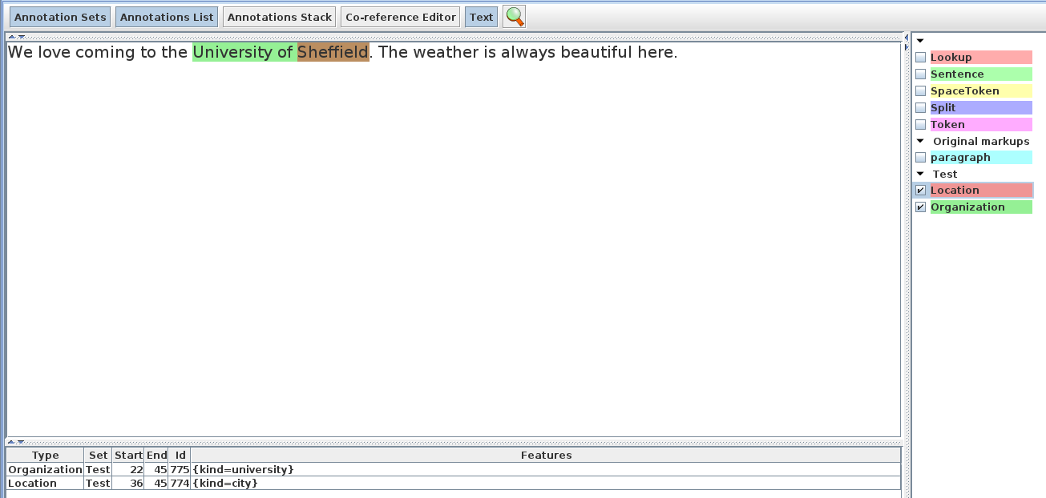
Annotations

Slide 4
JAPE
Each JAPE rule consists of
Header
Rule Name
LHS which contains patterns to match
RHS which describe the actions of matched pattens
Header
Rule Name
LHS Rule
RHS Rule

Slide 5

JAPE Headers
Each JAPE file must contain a set of headers at the top
They contain Phase name, set of Input annotations and other Options
Phase name makes up part of the Java class name for the compiled RHS actions, so it must contain alphanumeric characters and underscores only, and cannot start with a number
Rules in the same phase compete for input
Rules in separate phases run independently

Slide 6
JAPE Headers
The Input Annotations list contains a list of all the annotation types you want to use for matching on the LHS of rules in that grammar phase
If an annotation is listed in Input but not used in the rules, it can block the matching (e.g Split)
If no input is included, then all annotations are used

Slide 7
JAPE Headers
The matching style controls
Which rule gets applied
How much document content is ‘consumed’
Which location to attempt matching next

Slide 8

LHS of the rule
LHS is everything before the arrow
It describes the pattern to be matched, in terms of annotations and (optionally) their features
Each annotation is enclosed in curly brackets

Slide 9
Universities
A simple LHS rule matches Universities
The rule looks for specific words such as “University of” followed by the name of a city
To match a string of text, use the “Token” annotation and the “string” feature
{Token.string == "University"}
The gazetteer might contain the word “Sheffield” in the list of cities
The gazetteer matches will be output as “Lookup” annotation
{Lookup.minorType == city}

Slide 10
LHS of the rule
The pattern combination that you want to label is enclosed in round brackets, followed by a colon and the label
The label name can be any legal name you want: it's only used within the rule itself

Slide 11
JAPE RHS
The label on the RHS must match a label on the LHS

Slide 12
JAPE RHS
The label on the RHS must match a label on the LHS
Generate an annotation with type “Location”

Slide 13
JAPE RHS
The label on the RHS must match a label on the LHS
Generate an annotation with type “Location”
Add feature to the new generated annotation

Slide 14
JAPE RHS
Features and values are optional, and you can have as many as you like
All the following are valid:
:orgName.Organization = {}
:orgName.Organization = {kind=university}
:orgName.Organization = {kind=university, rule=University1}

Slide 15
Hands On
Create first JAPE application
Load “ANNIE” for some basic annotations
Right Click “Processing Resources”
New --> “JAPE Transducer”
In grammarURL select the jape file located at “JAPE/grammar/university1.jape”
Right Click Language Resources
New --> “GATE Document”
Select “JAPE/corpus/university1.txt”
Right Click the newly created document
Select “New corpus with this document”
Double click ANNIE under Applications
Remove ANNIE NE Transducer (by using the left hand side arrows)
Remove ANNIE OrthoMatcher
Move the JAPE PR (by using the right hand side arrows)
Set the corpus and run

Slide 16
Hands On
Short cut
Right click the “Applications”
Select “Restore Application from File”
Select “JAPE/main.xgapp”

Slide 17
Operators on the LHS
Operators include
| OR
* zero or more occurrences
? zero or one occurrence
+ one or more occurrences
Use round brackets to delimit the range of the operators
({Lookup.minorType == city} | {Lookup.minorType == country})
({Lookup.minorType == city} | {Lookup.minorType == country})+

Slide 18
Operators on the LHS
({Lookup.minorType == city} | {Lookup.minorType == country})+
One or more cities or countries in any order and combination
({Lookup.minorType == city} | ({Lookup.minorType == country})+)
One city OR one or more countries

Slide 19
Hands On
How to find universities with name
University of Sheffield
University of Sheffield UK
University of UK
University of US
University of Sheffield US
Short cut:
In JAPE_Examples
Disable uni1
Enable uni2

Slide 20
Multi-constraint statements
Just separate the constraints with a comma
Equal to and
{Lookup.minorType == city, Lookup.minorType1 == country}
Make sure that all constraints are enclosed within one pair of curly brackets
{Lookup.minorType == city, Lookup.minorType1 == country} -- and
{Lookup.minorType == city} {Lookup.minorType1 == country} -- sequence
({Lookup.minorType == city} | {Lookup.minorType1 == country}) -- or

Slide 21
Hands On
Exclude universities with country that is not from United Kingdom
University of US
University of Sheffield US
Short cut (half solution):
In JAPE_Examples
Disable uni2
Enable uni2and

Slide 22
Negative constraints
You can use the ! operator to indicate negation
{Lookup.minorType == city, Lookup.minorType1 != country}
Lookup.minorType is city expect Lookup.minorType1 is not country
{Token.orth == upperInitial, !Lookup}
Token.orth is upperInitial but not a Lookup annotation
{Lookup.minorType != country}
This matches ANY annotation except a Lookup whose minorType is “country”

Slide 23
Hands On
Exclude universities with country that is not from United Kingdom
University of US
University of Sheffield US
“uni2and” solution create a false positive annotation
How to solve it?
Short cut:
In JAPE_Examples
Disable uni2and
Enable uni2not

Slide 24
Hands On
How to find universities with name
University of Sheffield
University of Sheffield UK
University of UK
University of Nice Weather Sheffield UK
Short cut (half solution):
In JAPE_Examples
Disable uni2not
Enable uni3

Slide 25
Hands On
How to find universities with name
University of Sheffield
University of Sheffield UK
University of UK
University of Nice Weather Sheffield UK
Use “Input” to make rule aware sentence split
Short cut (half solution):
In JAPE_Examples
Disable uni3
Enable uni3Split

Slide 26
Other operators
We can also use the comparison operators >, >=. < and <=
{Token.length > 3} matches a Token annotation whose length is an integer greater than 3
You can specify ranges when you don't know the exact number of occurrences of something
({Token})[2,5] will find between 2 and 5 consecutive Tokens

Slide 27
Hands On
How to find universities with name
University of Sheffield
University of Sheffield UK
University of UK
University of Nice Weather Sheffield UK
Short cut (full solution):
In JAPE_Examples
Disable uni3Split
(uni4toklen) Solution1: use Token.length > 3
(uni4numtok) Solution2: use Token[0, 2]
(uni4) Solution 3: Token.orth == upperInitial

Slide 28
Other operators
You can also use =~ and ==~ to match regular expressions
{Token.string ==~ "[Dd]ogs"} matches a Token whose string feature value is (exactly) either “dogs” or “Dogs”
{Token.string =~ "[Dd]ogs"} is the same but matches a Token whose string feature contains either “dogs” or “Dogs” within it
Similarly, you can use !=~ and !~

Slide 29
Hands On
How to find universities with name
University of Sheffield
University of Sheffield UK
University of UK
University of Nice Weather Sheffield UK
Universidade de Coimbra
“Universidade” and “University” share “Universi”
Short cut (half solution):
In JAPE_Examples
Disable uni4
Enable regex

Slide 30
Contextual operators
The contextual operators “contains” and “within” match annotations within the context of other annotations
{Organization contains Lookup} matches if an Organization annotation completely contains a Lookup annotation.
{Lookup within Organization} matches if a Lookup annotation lies completely within an Organization annotation
The difference between the two is that the first annotation specified is the one matched
In the first example, Organization is matched
In the second example, Lookup is matched

Slide 31
Combining operators
You can combine operators of different types, e.g.
{Person within {Lookup.majorType == organization}}
{!Person within {Lookup.majorType == organization}}
{Person within {Lookup.majorType != organization}}
{Person contains {!Lookup}, Person within {Organization}}
But be sure you know what you're doing, as it can get quite complicated!

Slide 32
Hands On
Based on regex,
How to find city within university?
How to find university contains city?
Short cut :
In JAPE_Examples
Keep regex
Enable Annotation Set Transfer
We need it to transfer Annotations from output to input set
Enable citywithin
Enable unicontain

Slide 33
Copying Feature Values to the RHS
JAPE provides simple support for copying feature values from the LHS to the RHS
(
{Lookup.majorType == location}
):loc
-->
:loc.Location = { type = :loc.Lookup.minorType}
if more than one Lookup annotation is covered by the label, then one of them is chosen at random to copy the feature value from

Slide 34
Copying String and length to the RHS
JAPE provides simple support for copying feature values from the LHS to the RHS
(
{Lookup.majorType == location}
):loc
-->
:loc.Location = { string = :loc.Lookup@string, size = :loc@length}
@string : Copy the text string of the annotation
@length: Copy the text string length of the annotation

Slide 35
Hands On
Check regex for how to copy features

Slide 36
JAPE
Each JAPE rule consists of
Header
Rule Name
LHS which contains patterns to match
RHS which describe the actions of matched pattens
Header
Rule Name
LHS Rule
RHS Rule

Slide 37
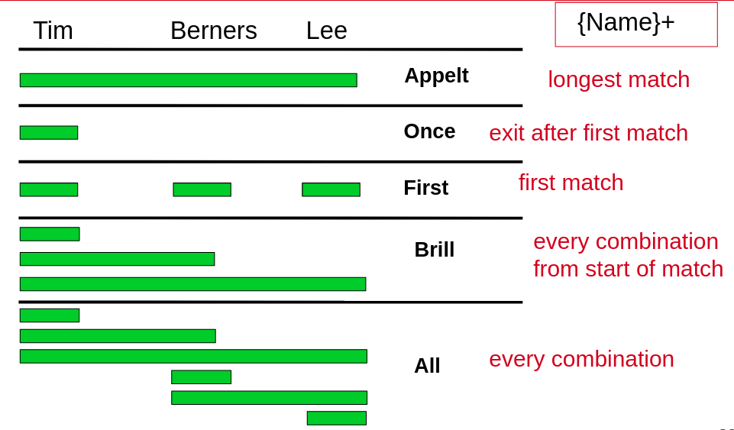
Control

Slide 38
Hands On
Based on regex,
How to find city within university?
How to find university contains city?
What if we put citywithin and unicontain into one file?
Short cut :
In JAPE_Examples
Disable citywithin
Disable unicontain
Enable control_appelt

Slide 39
Hands On
No city annotation anymore
Appelt find the longest match and stop
Recommend put rules for different tasks into different files
We can change control to all
Short cut :
Disable control_appelt
Enable control_all

Slide 40
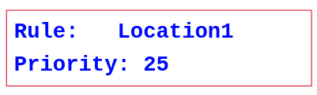
Appelt style
In the appelt style, which rule to apply is selected in the following order:
longest match
explicit priority
Higher numbers have greater priority
If no explicit priority parameter, default value is -1
rule defined first
Once a match has fired, matching continues from the next offset following the end of the match

Slide 41
Hands On
Example of rule defined first matches
Short cut :
In JAPE_Examples
Disable control_all
Enable control_first
(Create University1)
Example of rule with priority
Short cut :
In JAPE_Examples
Disable control_first
Enable control_priority
(Create University2)

Slide 42
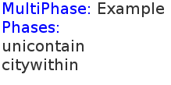
Multiphase
The multiphase transducer lists the other JAPE to be loaded
all you need to load is this file
For example if we want load both unicontain and citywithin
Short cut example can be found in “multiphase”

Slide 43
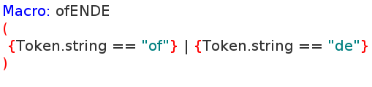
Using a macro in a rule
Macros provide an easy way to reuse long or complex patterns
The macro is specified once at the beginning of the grammar, and can then be reused by simply referring to its name, in all future rules
Short cut example can be found in “macro”

Slide 44
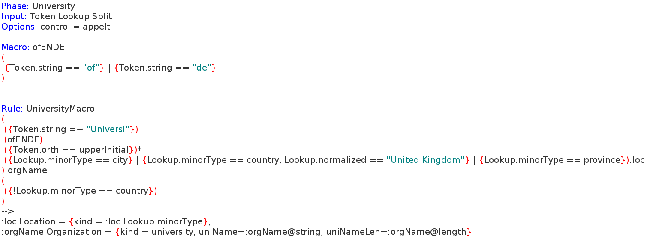
Using a macro in a rule

Slide 45
Advanced JAPE
Include Java in RHS JAPE
Delete annotations from the input
More complex feature
Collect statistics
Don’t worry if you are not a (Java) developer
This section will show you a number of ‘recipes’ which you can edit slightly for specific task

Slide 46
Advanced JAPE
The pre-defined variables available to Java RHS blocks are:
doc The document currently being processed (String).
inputAS The AnnotationSet specified by the inputASName runtime parameter to the JAPE
outputAS The AnnotationSet specified by the outputASName runtime parameter to the JAPE
bindings The bindings map AnnotationSet.

Slide 47
Advanced JAPE
Main Document API Calls
Obtain the document content
DocumentContent getContent();
Get the default annotation set
AnnotationSet getAnnotations();
Get the names for the annotation sets
AnnotationSet getAnnotations(String name);

Slide 48
Hands On
Print document content to Message tab
String docContent = doc.getContent().toString();
System.out.println(docContent);
Short cut:
Disable regex
Disable Annotation Set Transfer
Disable multiphase and macro
Enable java1

Slide 49
Advanced JAPE
Main Document API Calls
Obtain the document content
DocumentContent getContent();
Get the default annotation set
AnnotationSet getAnnotations();
Get the names for the annotation sets
AnnotationSet getAnnotations(String name);

Slide 50
Advanced JAPE
Main AnnotationSet API Calls
Get annotation by ID
Annotation get(Integer id);
Get all annotations of one type
AnnotationSet getAnnotations(String type)
Get all annotations starting at a given location, or right after.
AnnotationSet getAnnotations(Long offset)
Get all annotations that overlap an interval
AnnotationSet getAnnotations(Long startOffset, Long endOffset)
Combined get methods
Get by type and feature constraints
AnnotationSet getAnnotations(String type, FeatureMap constraints)

Slide 51
GATE Annotations
Have a start and an end Node (gate.Node);
Main Annotation methods:
Get its type
String getType();
Get start node
Node getStartNode();
Get end node
Node getEndNode();
Get Feature
FeatureMap getFeatures();
Main Node methods
Get offset
Long getOffset();

Slide 52
Hands On
Print Annotations sets
AnnotationSet TestAnnoInDoc = doc.getAnnotations("Test");
System.out.println(TestAnnoInDoc);
System.out.println(outputAS);
Short cut:
Disable java1
Enable java2

Slide 53
Hands On
Remove city and country Lookup annotation from input set if they are overlap with “new” university annotation
and Create new Lookup annotation with
Original features
Put a new feature “haveUni” with value “name of the university”
Short cut:
Disable java2
Enable removeuni

Slide 54
More About JAPE JAVA
If you want know more about GATE JAVA API
Module 8: GATE Embedded
JAPE Document: https://gate.ac.uk/userguide/chap:jape
JAVA Document: https://jenkins.gate.ac.uk/job/gate-core/javadoc/index.html

