Slide 1

Convention over Configuration
Torkel Ödegaard
Blog: www.codinginstinct.com
Email: torkel.odegaard@gmail.com
Twitter: @torkelo

Slide 2
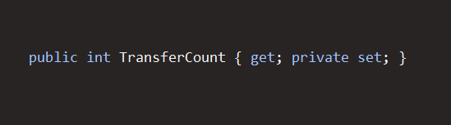
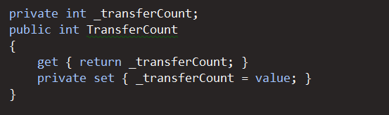
Ceremony vs Essence

Slide 3
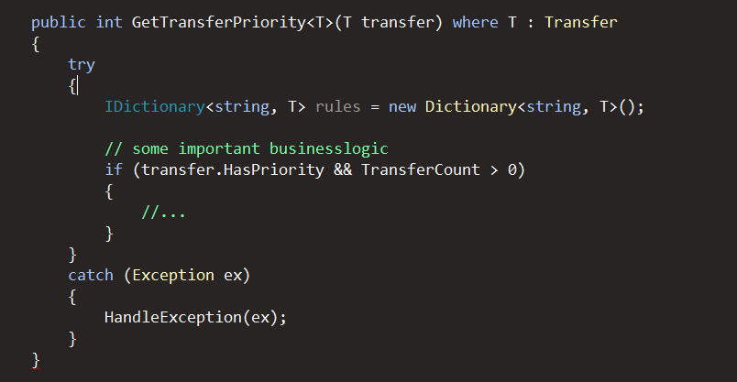
Ceremony vs Essence

Slide 4
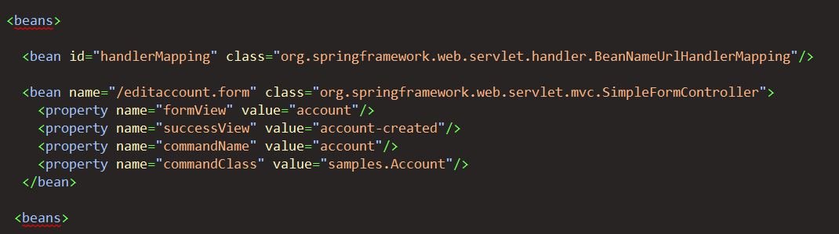
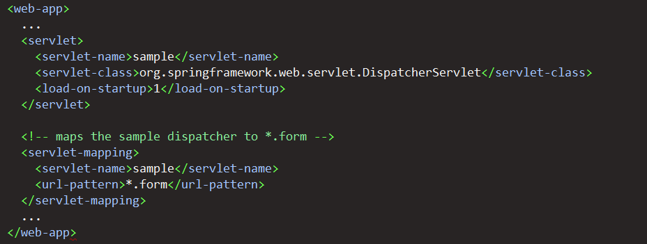
CoC in Frameworks

Slide 5
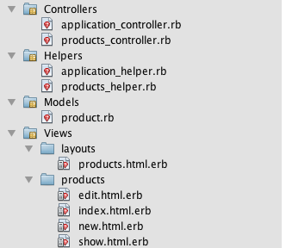
Ruby on Rails

Slide 6
Demo

