Slide 1

Convention over Configuration
Torkel Ödegaard
Blog: www.codinginstinct.com
Email: torkel.odegaard@gmail.com
Twitter: @torkelo

Slide 2
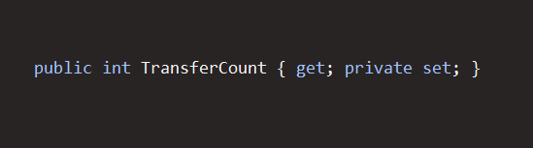
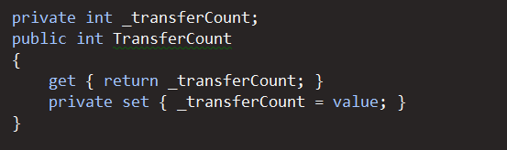
Ceremony vs Essence

Slide 3
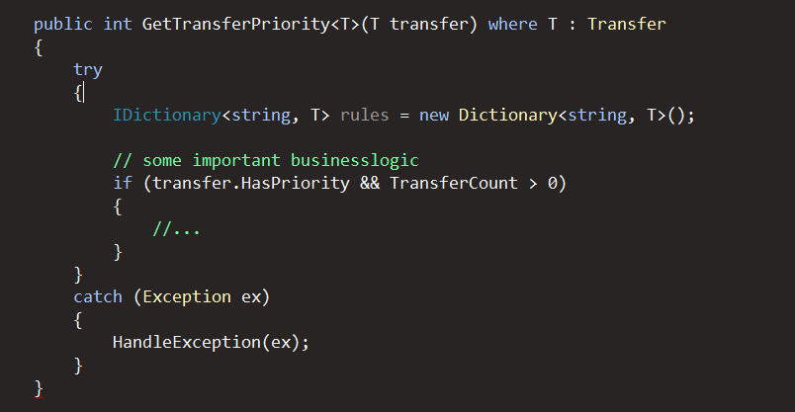
Ceremony vs Essence

Slide 4
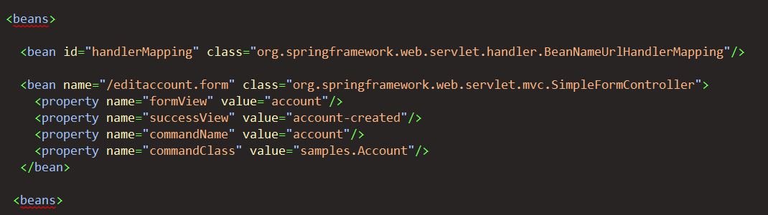
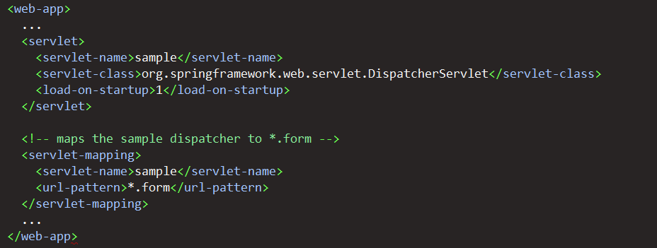
CoC in Frameworks

Slide 5
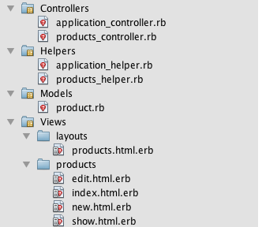
Ruby on Rails

Slide 6
Demo

Slide 7
www.codinginstinct.com
http://github.com/torkelo/pimpmycode
MSDN Article: Design For Convention Over Configuration – (Jeremy D Miller)
http://msdn.microsoft.com/en-us/magazine/dd419655.aspx
Build Your Own MVVM Framework (Rob Eisenberg)
http://live.visitmix.com/MIX10/Sessions/EX15
Caliburn Micro
http://caliburnmicro.codeplex.com/

