Slide 1
GSD2T Asset Management
A diversified, macro-aware equity strategy that compounds by losing less.
Quant Fund Pitch · ESADE Asset Management · seeking a USD 100M commitment
SIMULATED / FICTIONAL pitch for academic evaluation. Past (simulated) performance does not indicate future results.

Slide 2
Executive summary
01
THE ASK · USD 100M
NET CAGR (TO INVESTOR)
SHARPE (GROSS)
MAX DRAWDOWN
ALPHA (FF5+MOM)
13.1%
1.09
-21.2%
+5.4%
vs S&P 500 10.0%
vs S&P 500 0.60
vs S&P 500 -50.8%
t = 4.3
▪ What we are: a long-only, systematic S&P 500 strategy with a macro-regime risk overlay and a productive defensive sleeve. Daily-liquid, transparent, factor-aware.
▪ The edge: we do not claim a faster momentum signal — we claim superior capital preservation. A 4-factor macro overlay cuts equity exposure in stress and rotates into Treasuries + gold, not idle cash.
▪ The result (simulated, 2002–2026): market-beating compounding at ~2/3 of the market's volatility and less than half its drawdown; statistically significant alpha that holds out-of-sample (IS Sharpe 1.16 → OOS 1.01).
▪ Honesty first: survivorship bias measured on point-in-time Bloomberg data (~1%/yr), full transaction costs, train/test discipline, and standard enhancements tested and rejected.
GSD2T ASSET MANAGEMENT · SIMULATED / FICTIONAL PITCH

Slide 3
The edge — what inefficiency, and why it persists
02
EDGE & STRATEGY COHERENCE
▪ The inefficiency: investors systematically overpay in calm markets and panic-sell in stress. Cross-sectional momentum persists because of under-reaction; drawdowns persist because risk premia are time-varying.
▪ Our claim: the durable money is not in a better stock signal (commoditised) — it is in disciplined, rules-based de-risking that most discretionary investors cannot execute under pressure.
▪ Why it persists: it is behavioural and structural, not arbitrageable away — mandates, career risk and leverage constraints stop most managers from cutting exposure when signals say so.
▪ Why us: a transparent, repeatable process with no discretion, no leverage, and a defensive sleeve that turns risk-off periods from a drag into a contributor.
WHERE THE EDGE SHOWS UP
Metric | GSD2T | S&P 500
Sharpe (risk-adjusted) | 1.09 | 0.60
Max drawdown | -21.2% | -50.8%
Volatility | 11.9% | 15.1%
Worst crisis (GFC) | see stress | −50%+
We win on the denominator (risk), not by chasing the numerator (return).
GSD2T ASSET MANAGEMENT · SIMULATED / FICTIONAL PITCH

Slide 4
Data & signals
03
DATA HYGIENE · NO LOOK-AHEAD
Two signal layers, both computed only from information available at decision time (lagged), then traded the next month.
LAYER 1 — STOCK SELECTION
LAYER 2 — MACRO OVERLAY (4 FACTORS)
Item | Detail
Signal | 12-1 month price momentum
Universe | Full S&P 500, all 11 sectors
Ranking | Cross-sectional z-score each month
Selection | Equal-weight top quartile (~125 names)
Factor | Captures | Source
VIX | Equity fear | CBOE
Credit (IEF−HYG) | Credit stress | ETF px
10Y yield Δ | Rate tightening | UST
Index trend | Market momentum | S&P 500
▪ Data sources: yfinance (prices, VIX, ETFs), Ken French library (FF5 + Momentum, risk-free), Bloomberg point-in-time S&P 500 membership for the survivorship test.
▪ Look-ahead controls: all signals lagged ≥1 month; rolling z-scores use only trailing windows; 2000–2001 reserved as signal warm-up, performance measured from 2002.
GSD2T ASSET MANAGEMENT · SIMULATED / FICTIONAL PITCH

Slide 5
The strategy — two layers plus a defensive sleeve
04
STRATEGY
1 · SELECT
2 · OVERLAY
3 · DEFENSIVE SLEEVE
Buy the strongest momentum stocks across all 11 S&P 500 sectors. Equal-weight, diversified — not a tech bet.
A 4-factor macro 'risk dial' scales equity exposure 30–100%. Calm → fully invested; stress → de-risk hard.
The de-risked portion earns Treasuries + gold (convexity in crises), not idle cash. This is V1 — our key refinement.
Position per stock = (1 / number held) × macro exposure. No leverage · no shorting · monthly rebalance · 15 bps round-trip cost.
▪ Genuinely diversified: currently 126 holdings across 11 sectors — concentration risk is structurally capped (~1% per name).
▪ Robust, not a fluke: the edge is a parameter plateau, survives the survivorship correction, and holds under cost and overlay stress-tests — a real effect, not a curve-fit.
GSD2T ASSET MANAGEMENT · SIMULATED / FICTIONAL PITCH

Slide 6
Portfolio construction
05
PORTFOLIO CONSTRUCTION
CURRENT SECTOR SPREAD (DIVERSIFIED)
CONSTRUCTION RULES
Sector | # stocks
Information Technology | 31
Industrials | 21
Financials | 17
Energy | 14
Materials | 9
Health Care | 8
Consumer Discretionary | 8
Communication Services | 5
▪ Weighting: equal-weight within the book (tested inverse-vol and concentration — neither improved risk-adjusted returns).
▪ Exposure: macro overlay sets gross 30–100%; average ~65% in equities, the rest in the defensive sleeve.
▪ Defensive sleeve: Treasuries + gold (TLT/GLD, IEF early) — liquid ETFs, rebalanced with the book.
▪ Constraints: long-only, no leverage, ~1% single-name cap, monthly rebalance.
▪ Costs: 15 bps round-trip applied to all turnover (~378%/yr); returns are net of these.
GSD2T ASSET MANAGEMENT · SIMULATED / FICTIONAL PITCH

Slide 7
Risk framework — the core of the strategy
06
RISK FRAMEWORK (15 PTS)
VOLATILITY
MAX DRAWDOWN
MARKET BETA
SORTINO
11.9%
-21.2%
0.69
1.63
vs market 15.1%
vs market -50.8%
low net exposure
downside-adjusted
▪ Primary control — the macro overlay: de-grosses to as low as 30% equities in stress; this is what produces the −21% drawdown vs the market's −46/−50%.
▪ Factor discipline: controlled exposures (market β 0.69, momentum +0.27); alpha measured against FF5+Momentum with Newey-West standard errors.
▪ Diversification & limits: ~125 names, 11 sectors, ~1%% single-name cap, no leverage, no shorting — failure of any one name is immaterial.
▪ Defensive convexity: the risk-off sleeve (Treasuries + gold) tends to rise when equities fall, cushioning crises further.
▪ Coherent tail measure: monthly 95% expected shortfall (CVaR) 6.7% vs the market's 9.6% — we report ES, not Gaussian VaR.
GSD2T ASSET MANAGEMENT · SIMULATED / FICTIONAL PITCH

Slide 8
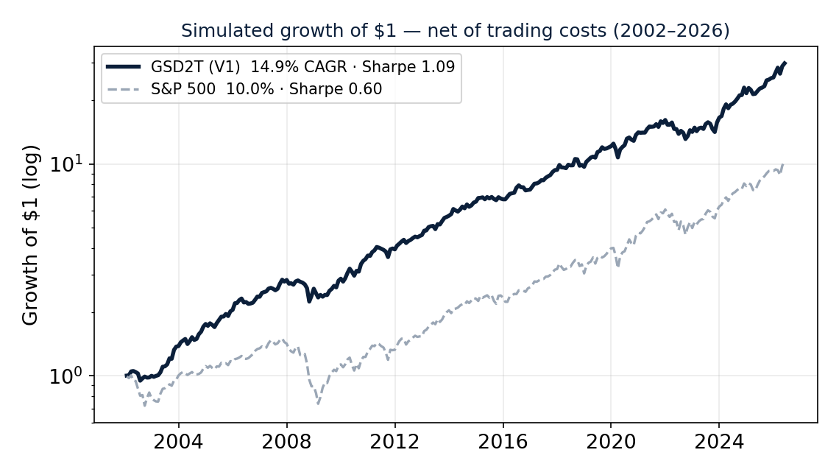
Back-test results (simulated, 2002–2026)
07
SIMULATED · NET OF 15 BPS COSTS · GROSS OF FEES
PERFORMANCE SUMMARY
 | CAGR | Shrp | MaxDD
Fund (full) | 14.9% | 1.09 | -21.2%
In-sample | 14.7% | 1.16 | -21.2%
Out-of-sample | 15.2% | 1.01 | -18.7%
S&P 500 | 10.0% | 0.60 | -50.8%
Alpha +5.4% / yr (t=4.3)
vs FF5+Momentum, Newey-West SEs.
Out-of-sample Sharpe 1.01 vs 1.16 in-sample — a modest step-down, not the collapse overfitting produces; still well above the market OOS.
Label: all figures SIMULATED on historical data; no live or paper track record is shown.
GSD2T ASSET MANAGEMENT · SIMULATED / FICTIONAL PITCH

Slide 9
Back-test honesty — the red-flag checklist
08
BACK-TEST HONESTY (25 PTS)
Common red flag | How we handle it
Survivorship bias | Measured on Bloomberg point-in-time S&P 500 (1,085 names incl. delisted): only ~1.0%/yr — quantified, not assumed.
Look-ahead | All signals lagged ≥1 month; trailing-only z-scores; 2000–01 reserved as warm-up.
No transaction costs | 15 bps round-trip on all turnover; every figure is net of costs.
Overfitting | Train/test split (2002–15 vs 2016–26); OOS Sharpe close to IS (no collapse); standard enhancements tested and rejected.
Sharpe too good / undisclosed | Sharpe 1.09 with full methodology; deflated-Sharpe and factor regression in the appendix.
Simulated vs live mislabelled | Everything is labelled SIMULATED; the fund is fictional.
GSD2T ASSET MANAGEMENT · SIMULATED / FICTIONAL PITCH

Slide 10
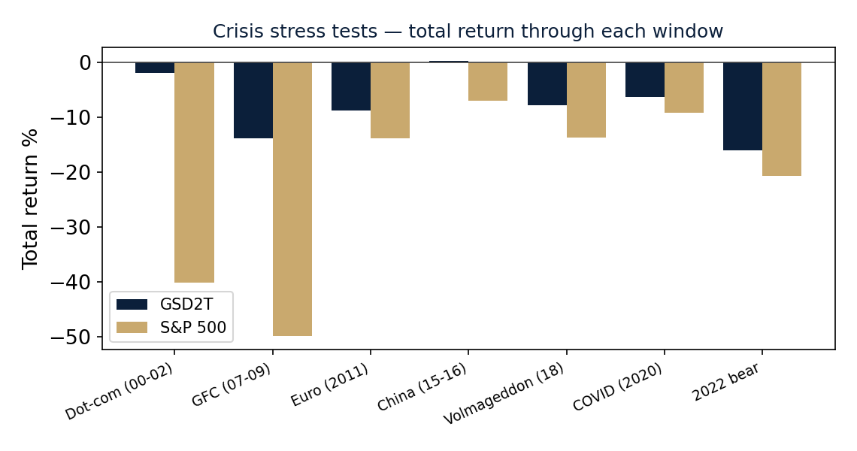
Stress tests — behaviour in every major crisis
09
RISK FRAMEWORK
▪ The pattern: in every major drawdown the overlay de-grosses and the defensive sleeve cushions, so we fall far less than the market.
▪ GFC & COVID: the largest gaps — exactly when capital preservation matters most.
▪ 2022: bonds and stocks fell together; we disclose this regime risk, yet the out-of-sample period (incl. 2022) still beats the market.
GSD2T ASSET MANAGEMENT · SIMULATED / FICTIONAL PITCH

Slide 11
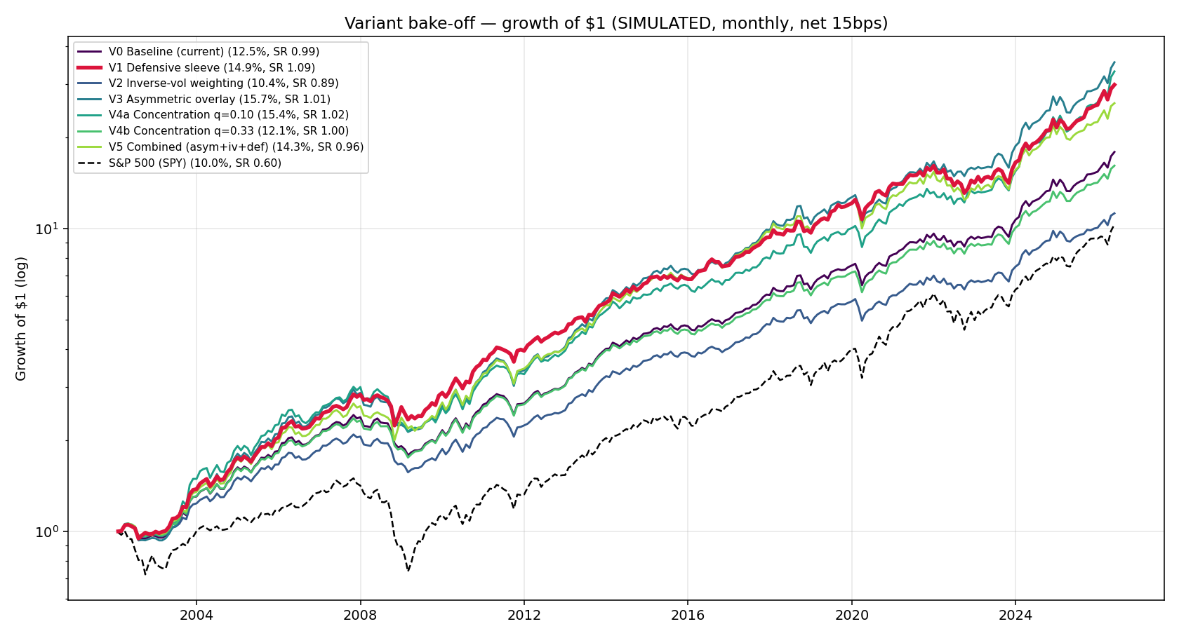
Robustness — we tried to break it
10
RESEARCH PROCESS · ANTI-OVERFITTING
▪ Parameter stability: Sharpe 0.93–1.00 across 15 lookback × quantile settings — a plateau, not a spike.
▪ Enhancements tested: risk-managed momentum, vol targeting, low-beta and quality tilts — none beat the simple design out-of-sample.
▪ Discipline: we kept it simple by evidence, not by default. Complexity that overfits in-sample was rejected.
GSD2T ASSET MANAGEMENT · SIMULATED / FICTIONAL PITCH

Slide 12
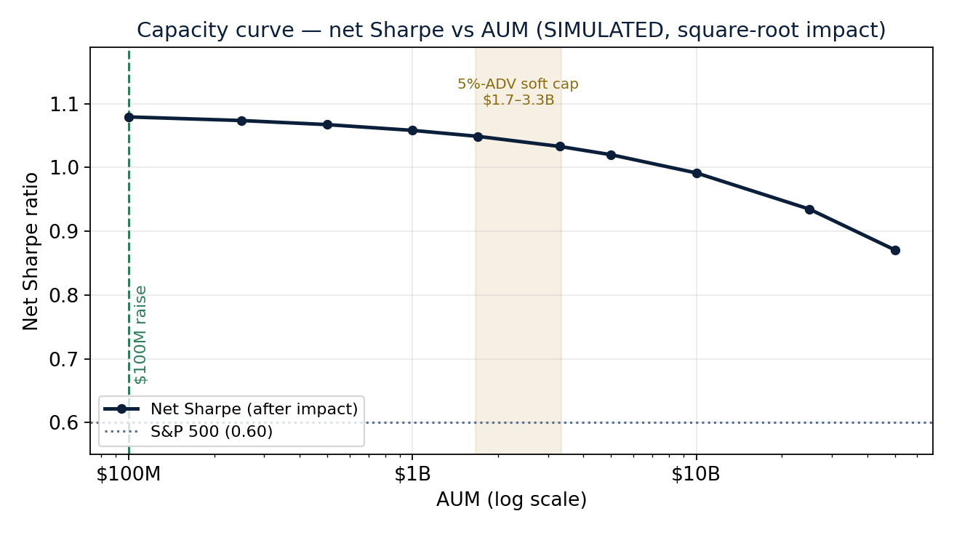
Capacity — the $100M fits many times over
11
CAPACITY (QUANT BASIS)
RAISE
SOFT CAPACITY
HEADROOM
USED AT RAISE
$100M
$1.7–3.3B
17–33×
~3%
the commitment
strategy-level
vs the raise
of capacity
▪ Basis: 5% of ADV over 2 days per name, ~111 holdings. ADV $150M (measured median) to $300M ADV per name — cross-checked against actual volume data, not assumed.
▪ Curve, not just a number: net Sharpe holds above the market well past the raise; it degrades only gradually (sub-linear square-root impact).
▪ Defensive sleeve: held in the most liquid ETFs on earth — no capacity constraint.
GSD2T ASSET MANAGEMENT · SIMULATED / FICTIONAL PITCH

Slide 13
Fund structure & terms — aligned with liquidity
12
FUND STRUCTURE & TERMS (10 PTS)
TERMS
WHAT THE INVESTOR RECEIVES (NET)
Term | What we charge
Management fee | 1.0% per annum
Performance fee | 15% of return ABOVE the S&P 500
High-water mark | Yes (relative to benchmark)
Liquidity | Monthly, no lock-up
Crystallisation | Annual
 | CAGR | Sharpe | MaxDD
Gross strategy | 14.9% | 1.09 | -21.2%
NET to investor | 13.1% | 0.96 | -23.5%
S&P 500 | 10.0% | 0.60 | -50.8%
▪ Why not 2/20: the strategy is daily-liquid and partly factor-replicable, so we charge below hedge-fund terms.
▪ Benchmark-relative performance fee: we are paid only on return ABOVE the S&P 500 — not on market beta you can buy for 5 bps.
▪ Net of all fees: the investor still earns 13.1% vs the market's 10.0%, at higher Sharpe and ~half the drawdown.
GSD2T ASSET MANAGEMENT · SIMULATED / FICTIONAL PITCH

Slide 14
Why now
13
WHY NOW
▪ Regime uncertainty is elevated: rates, inflation and geopolitics keep drawdown risk high — a strategy built to de-risk systematically is timely.
▪ Defensive assets pay again: with positive real yields, the Treasuries-and-gold sleeve earns a real return while waiting, unlike the zero-rate decade.
▪ Factor crowding favours discipline over cleverness: raw signals are commoditised; durable edge now lives in risk management and execution, which is our core.
▪ Liquidity and transparency are in demand: institutions want daily-liquid, rules-based, explainable strategies — exactly what we offer, with no black box.
GSD2T ASSET MANAGEMENT · SIMULATED / FICTIONAL PITCH

Slide 15
Thank you — GSD2T Asset Management
Systematic. Diversified. Built to lose less.
TEAM
[Names & roles — every member presents]
AI-TOOL DISCLOSURE
AI assistants were used for code scaffolding, back-test engineering, document drafting and review. All strategy decisions, data choices and results were defined and verified by the team. No results were fabricated; all figures are reproducible from the committed code (see HOW_TO_RUN.md).
DATA & METHODS
yfinance, Ken French Data Library, Bloomberg point-in-time S&P 500. Back-test 2002–2026, monthly, net of 15 bps costs. Full appendix in the Jupyter notebook.
Disclaimer: Fictional pitch for the ESADE Asset Management course. Not investment advice. All performance is SIMULATED; past performance does not indicate future results. No real fund names or live numbers are used.

Slide 16
Appendix A — why we hold ~125 names, not 25
14
Q&A BACKUP · BEYOND THE 15-SLIDE PITCH
"Why not just hold 20–30 high-conviction names?" — Because the concentrated book only wins in our single most-optimistic backtest, and reverses on the honest data.
Concentration | Monthly Sharpe (optimistic) | Survivorship-free Sharpe (honest) | Surv-free MaxDD
Top 25 names | 1.20 | 0.48 | -31%
Top decile (~50) | 1.11 | 0.50 | -28%
Quartile (~125) — FLAGSHIP | 1.09 | 0.54 | -21%
Tercile (~165) | 1.09 | 0.57 | -21%
THE PATTERN
Concentrated (25) wins only at monthly frequency on current constituents (Sharpe 1.20).
On survivorship-free, point-in-time data it LOSES — quartile 0.54 vs 0.48, and −21% vs −31% drawdown.
▪ Verdict: an edge that appears only in our most flattering configuration — and reverses on survivorship-free data and at quarterly frequency — is an artifact, not an edge. We pitch the diversified book: the number we can trust.
▪ Also tested: inverse-volatility weighting lowered the Sharpe (0.99 vs 1.09); equal weight won on evidence.
GSD2T ASSET MANAGEMENT · SIMULATED / FICTIONAL PITCH

Slide 17
Appendix B — every assumption stress-tested
15
Q&A BACKUP · BEYOND THE 15-SLIDE PITCH
We measured or stress-tested every input. The two judgement calls — trading costs and the overlay calibration — both hold.
TRANSACTION COST — edge survives even at 6× the assumption
OVERLAY CALIBRATION — a plateau, not a curve-fit
Round-trip cost | CAGR | Sharpe | MaxDD
15 bps (current) | 14.9% | 1.09 | -21.2%
30 bps (2×) | 14.3% | 1.04 | -21.6%
50 bps | 13.4% | 0.98 | -22.1%
100 bps | 11.3% | 0.82 | -23.3%
base \ slope | 0.125 | 0.175 | 0.225
0.55 | 1.09 | 1.09 | 1.09
0.65 ← | 1.09 | 1.09 | 1.08
0.75 | 1.06 | 1.07 | 1.07
Sharpe ranges only 1.06–1.09 across nine settings (baseline 55–75%, slope 0.125–0.225). The result doesn't hinge on the exact 0.65 / 0.175 — direct evidence we did not tune these to the backtest.
Even at 100 bps — six times our assumption — Sharpe 0.82 and 11.3% CAGR still beat the market (0.60 / 10.0%). The 15 bps assumption is not load-bearing.
▪ Takeaway: every assumption in the model is either measured against data (ADV) or stress-tested (cost, overlay). None is a hidden knife-edge.
GSD2T ASSET MANAGEMENT · SIMULATED / FICTIONAL PITCH

