Slide 1
Project 8: Slow Dynamics and High Variability in Networks with Clustered Connections
Kirill Shchegelskiy and Tormod Hellen

Slide 2
Introduction
Most real-world networks are not uniform
Most simulated networks are uniform
We need to make the architecture of the network more complicated to imitate the real world better
Clusters!

Slide 3
Uniform network
Integrate-and-fire neurons
4000 excitatory neurons
1000 inhibitory neurons
Inhibitory connections probability 0.5
Excitatory connections probability 0.2

Slide 4
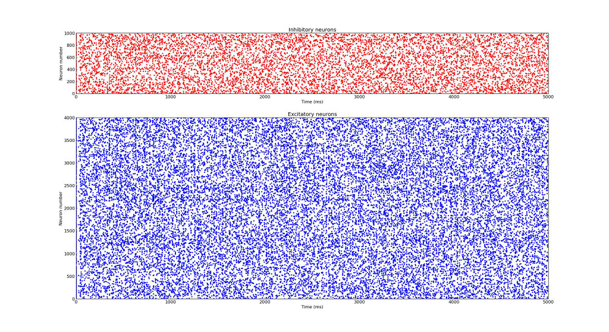
Asynchronous behaviour of the unifrom network

Slide 5
Clustered network
Integrate-and-fire neurons
4000 excitatory neurons
1000 inhibitory neurons
50 clusters of 80 excitatory neurons each
Increased connection probability in the cluster
is the ratio controlling neuronal clustering

Slide 6
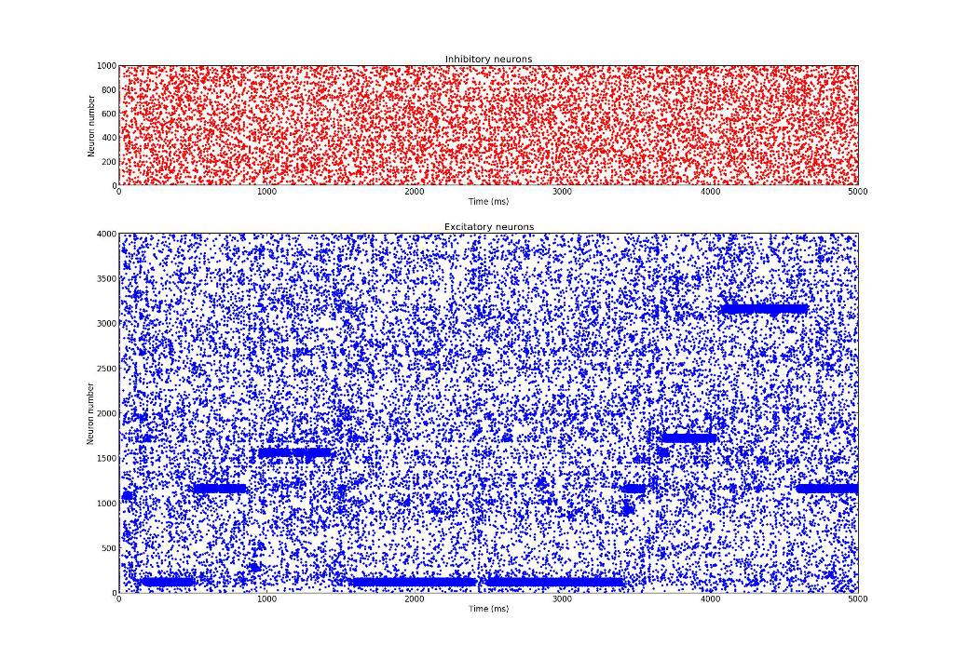
Behaviour of the clustered network

Slide 7
Fano factor
A quantative measure of network instability
Defined as a ratio of variance over the mean value of the number of spikes
Expectations are over repeated trials of the same network over random initial conditions
Computed over 100 ms time window

Slide 8
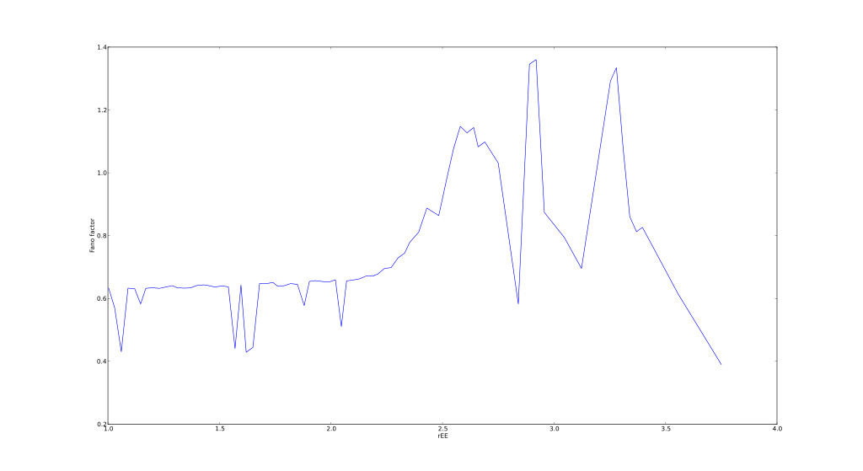
Fano factor over

Slide 9
Thanks for your attention!

