Slide 1
Lucida
November 28, 2016

Slide 2
Directory
Overview
Introduction:
Infrastructure for Intelligent Web Services
Architecture
Features:
Consistency
Flexibility
Scalability
Demo

Slide 3
Overview
Lucida is a speech and vision based intelligent personal assistant (IPA) developed in Clarity Lab at the University of Michigan. It is a state­-of-­the-­art infrastructures to study emerging intelligent web services in large scale systems.
Web: http://lucida.ai
Github: https://github.com/claritylab/lucida
Google Group: https://groups.google.com/forum/#!forum/lucida-users

Slide 4
Introduction: Infrastructure for Intelligent Web Services
As Intelligent Personal Assistants such as Apple Siri, Google Now, Microsoft Cortana, and Amazon Echo continue to gain traction, web-service companies are now providing image, speech, and natural language processing web services as the core applications in their datacenters. These emerging applications require machine learning and are known to be significantly more compute intensive than traditional cloud based web services, giving rise to a number of questions surrounding the designs of server and datacenter architectures for handling this volume of computation.

Slide 5
Introduction: Infrastructure for Intelligent Web Services
Lucida is the next generation of Sirius, the first open source intelligent personal assistant that was developed by Clarity Lab at the University of Michigan.

Slide 6
Introduction: Infrastructure for Intelligent Web Services
Research questions arise as complex systems with multiple AI services are built.
On the system side, how to combine individual components into an eco-system with easy scalability and maximum flexibility? How to dynamically scale service instances up and down based on the current load?
On the AI side, how does the accuracy of each individual component affect the end-to-end accuracy which decide? How to choose each AI component so that the end-t-end accuracy is maximized?

Slide 7
Architecture: List View
Web Front End
Command Center (CMD)
Core AI services:
Image Matching (IMM)
Automatic Speech Recognition (ASR)
Question Answering (QA)
Calendar Events Retrieval (CA)
Database
Caching
Digit Recognition (DIG)
Face Recognition (FACE)
Image Classification (IMC)

Slide 8
Web Front End
(HTML, CSS, JavaScript)
REST
Command Center (Python)
Query Classifier
Database Module
Web Controllers
Thrift Module
RPC (Thrift)
Web Socket
Caching
(Memcached)
IMM (C++)
ASR (C++)
QA (Java)
CA (Java)
RPC
RPC (Thrift)
Database (MongoDB)
DjiNN and Tonic Suite
FACE (C++)
DIG (C++)
IMC (C++)

Slide 9
Architecture: Command Center (CMD)
The service manager that connects the back end to the front end.
Written in Python, involves the following major modules:
Web Controller: Servers web pages;
Database: Stores and retrieves from the database component;
Caching: Stores and retrieves from the caching layer;
Query Classification: Classifies input text query into a set of services needed;
Thrift: Sends query to and receives response from back-end services through Thrift, an RPC framework supporting multiple languages.

Slide 10
Features
Consistency
Flexibility
Scalability

Slide 11
Feature: Consistency
Backend services communicate with each other through Thrift.
Standardized interface to be implemented by backend services:
See details in the top-level readme.
include "lucidatypes.thrift"
service LucidaService {
void create(1:string LUCID, 2:lucidatypes.QuerySpec spec);
void learn(1:string LUCID, 2:lucidatypes.QuerySpec knowledge);
string infer(1:string LUCID, 2:lucidatypes.QuerySpec query);
}

Slide 12
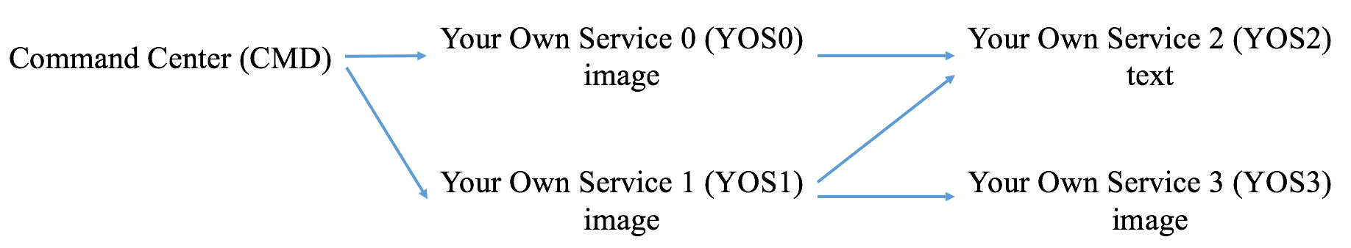
Feature: Flexibility
Arbitrarily complex service combinations can be specified to CMD.
CMD sends a service graph to backend services:
Services are responsible for further routing queries to other services.
All the complexities are wrapped in the standardized interface.
See details in the top-level readme.

Slide 13
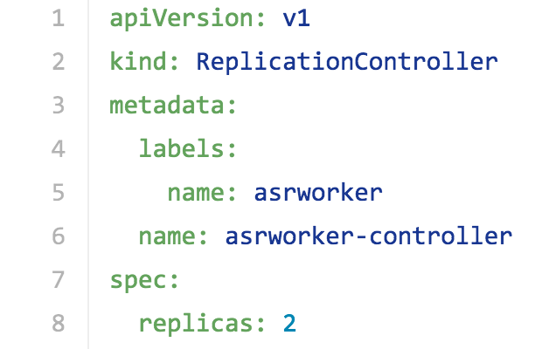
Feature: Scalability
Rely on Docker and Kubernetes for easy and scalable deployment.
Specify the number of instances when services are started:
See details in tools/deploy.
In future, can support automatic scaling based on current load
from CMD.

Slide 14
Demo
Set up the Lucida eco-system following “Lucida Local Development” or “Lucida Docker Deployment” of the top-level readme.
In the next slides, we are going to demo:
Image Matching
Question Answering
Image Matching + Question Answering
Calendar
Digit Recognition
Face Recognition
Image Classification

Slide 15

Demo Image Matching
1. Add at least one image under the “Learn” tab.

Slide 16
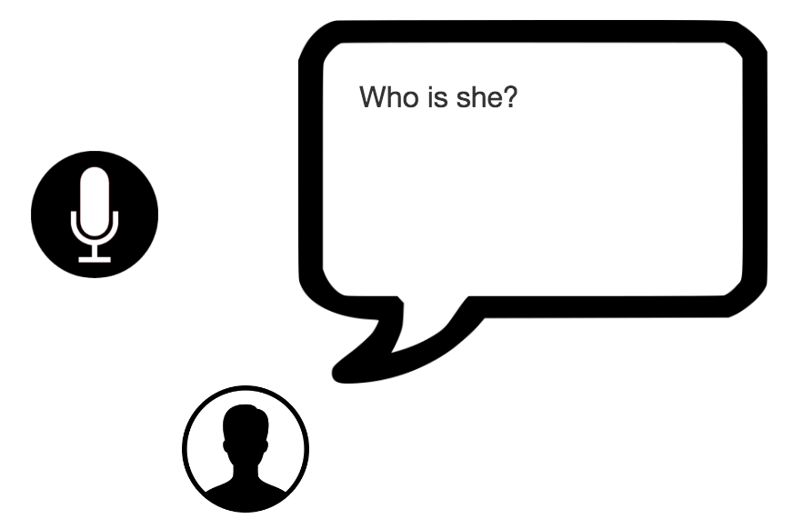
Demo Image Matching
2. Navigate to the “Infer” tab. Ask one of the following questions:
Who is he?
Who is she?
Who’s in the image?
Match this image.
Which photo in my collection
is similar to this?
In fact, this step is optional. You can directly go to step 3.

Slide 17

Demo Image Matching
3. Upload one image that you want to match.
4. Click the “Ask” button.

Slide 18

Demo Question Answering
1. Add at least one piece of text under the “Learn” tab.
For example, “Johann is 25 years old.”

Slide 19
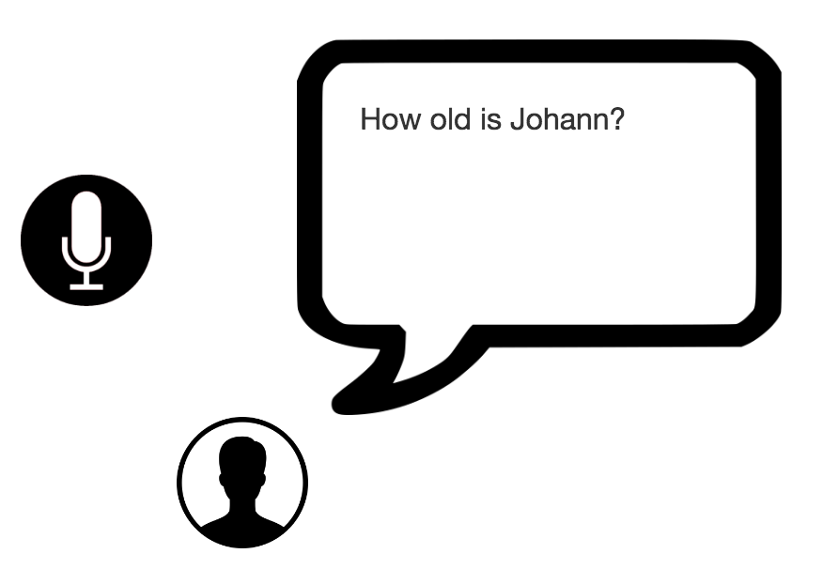
Demo Question Answering
2. Navigate to the “Infer” tab. Ask one question related to the knowledge you added in step 1.
For example, “How old is Johann?”
3. Click the “Ask” button.

Slide 20
Demo Question Answering
4. Go back to the “Learn” tab. Add a Wikipedia page URL:
For example, https://en.wikipedia.org/wiki/University_of_Michigan

Slide 21
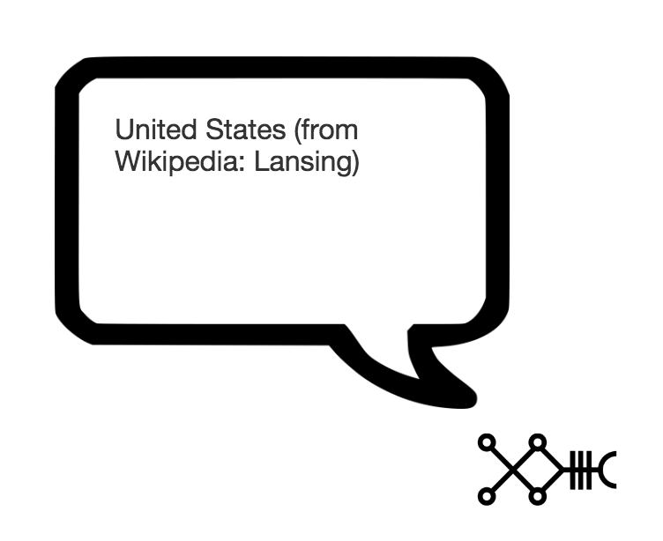
Demo Question Answering
5. Go back to the “Infer” tab. Ask a question related to the knowledge you added in step 4:
For example, “Where is the University of Michigan located?”
6. Click the “Ask” button.

Slide 22
Demo Question Answering
7. Ask one of the following questions:
Who is the last emperor of China?
Who discovered the South Pole?
Who invented the telephone?
Who is the Greek mathematician that developed geometry?
When was the Munich agreement made?
When did Mike Tyson win the title?
Where is the River Nile located?
8. Click the “Ask” button.

Slide 23
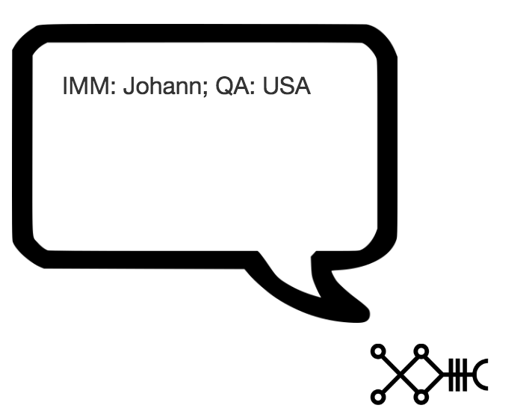
Demo Image Matching + Question Answering
2. Navigate to the “Infer” tab. Ask the following question and upload the image with “Johann” in it.
Where was he born?
3. Click the “Ask” button.

Slide 24
Demo Calendar
0. We assume you have some events on your Google Calendar.
1. Navigate to the “Infer” tab and ask one of the following questions:
What am I going to do tomorrow?
What is my plan next Monday?
What is on my schedule next Tuesday afternoon?
What did I do last weekend?
What was on my Google Calendar last year?
What was on my schedule last Christmas?
2. Click the “Ask” button.

Slide 25
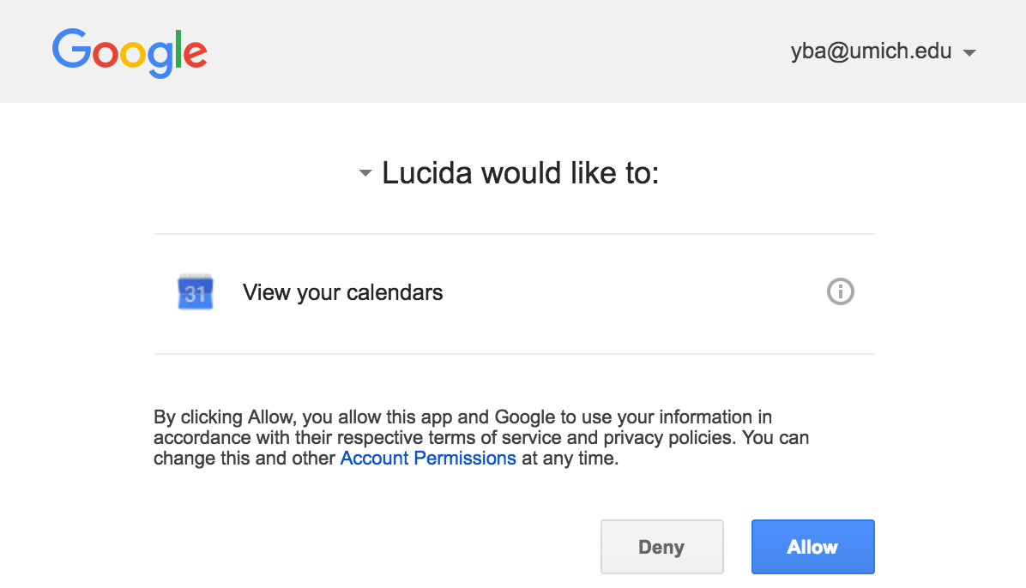
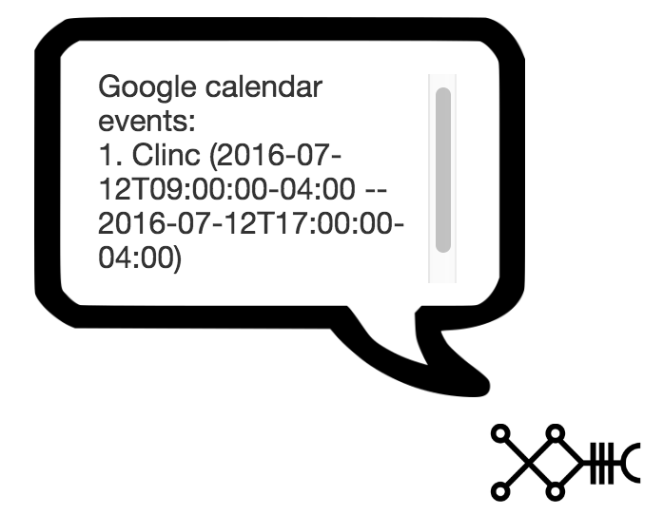
Demo Calendar
3. Allow the pop-up window and click “Allow”:

Slide 26
Demo Digit Recognition
1. Navigate to the “Infer” tab and ask one of the following questions:
What digit is in the image?
Lucida, what is this number?
2. Upload one of the following JPEG images:
3. Click the “Ask” button.

Slide 27
Demo Face Recognition
1. Navigate to the “Infer” tab and ask one of the following questions:
Who is this famous star?
Do you know this celebrity?
2. Upload an image of JPEG format with a celebrity in it.
3. Click the “Ask” button.

Slide 28

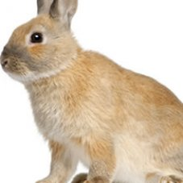
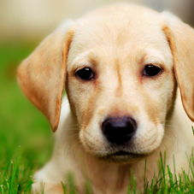
Demo Image Classification
1. Navigate to the “Infer” tab and ask one of the following questions:
What is this thing?
What is the animal?
2. Upload one of the following JPEG images:
3. Click the “Ask” button.

Slide 29
Thank you!
Please leave your feedback in our Github repository or Google group!

