Slide 1
Symposium 2019.04.17.
Financial time series modeling and forecasting with deep neural networks
Torner Márton - Semester project

Slide 2
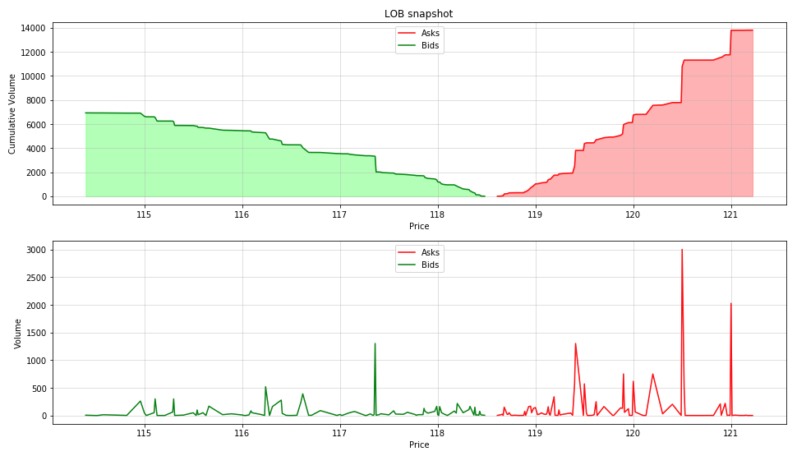
Limit Order Book snapshots

Slide 3
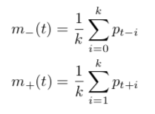
Labels
Binary
UP
DOWN
Trinary
UP
NO_MOVE (stationary)
DOWN
Binary
m-(t) < or > m+(t)
Trinary
Threshold (volatility)

Slide 4
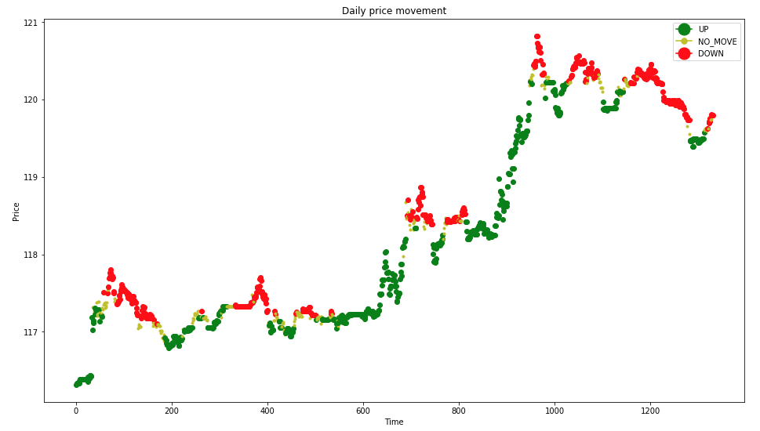
Labels

Slide 5
Preprocessing
Standard scaling
Fit on train set
Transform train and test set
Problem
Solution
Sliding window
Fit on [X_{t-100}, ..., X_{t-1}]
Transform X_{t}

Slide 6
Scaling problem

Slide 7

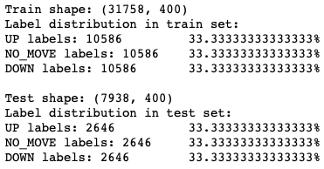
Label distribution
Before: “random”
After: 33% each

Slide 8
Results

Slide 9
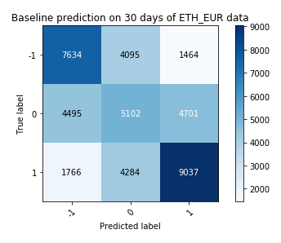
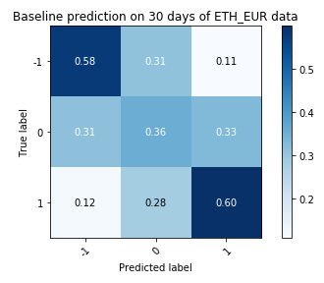
Historical mean

Slide 10
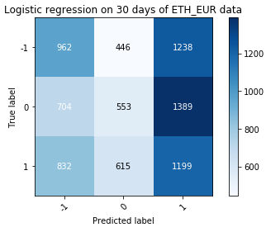
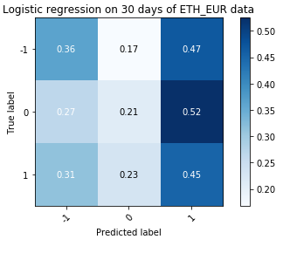
Logistic Regression R² score = 34.19

Slide 11
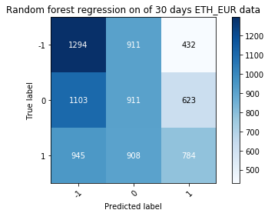
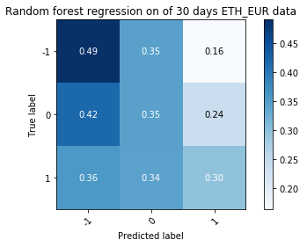
Random Forest Regression R² score = 38.1

Slide 12
Work
Last 2 weeks
The above shown
WAMP and VWAP calculation
Parameterizable cli script for data preparation
Depth
Window size
Alpha
Plans
Some corrections
Deep learning solution
Start finishing report

Slide 13
Thanks for your attention!

