Slide 1
Symposium 2019.04.17.
Financial time series modeling and forecasting with deep neural networks
Semester project

Slide 2
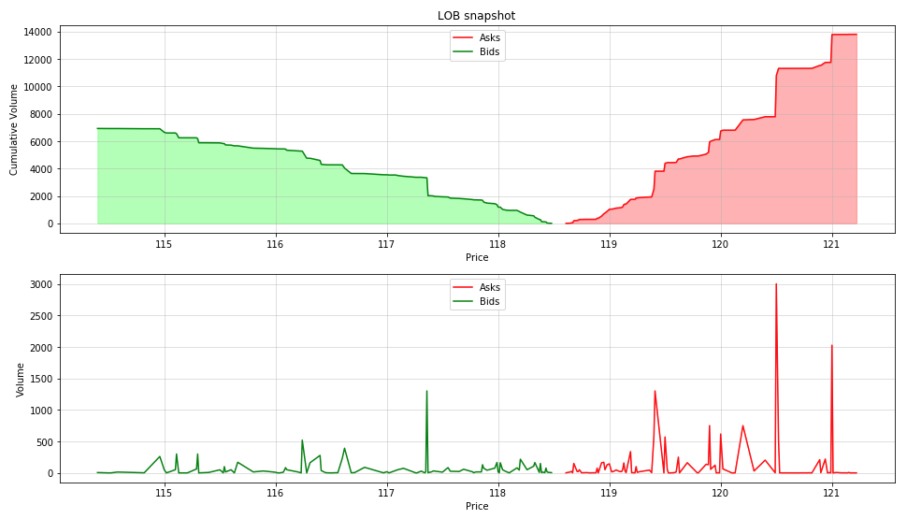
Limit Order Book snapshots

Slide 3
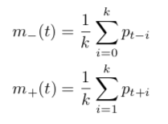
Labels
Binary
UP
DOWN
Trinary
UP
NO_MOVE (stationary)
DOWN
Binary
m-(t) < or > m+(t)
Trinary
Threshold (volatility)

Slide 4
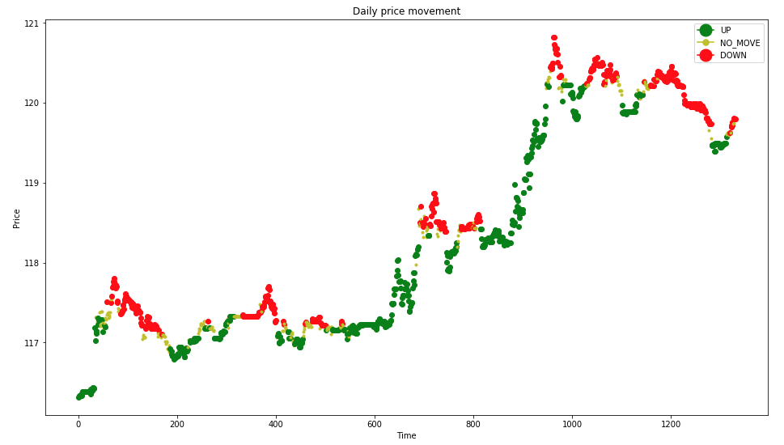
Labels

Slide 5
Preprocessing
Standard scaling
Fit on train set
Transform train and test set
Problem
Solution
Sliding window
Fit on [X_{t-100}, ..., X_{t-1}]
Transform X_{t}

Slide 6
Scaling problem

Slide 7

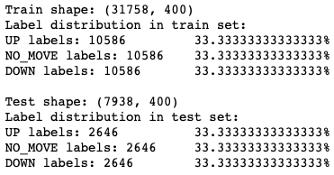
Label distribution
Before: random
After: 33% each

Slide 8
Results

Slide 9
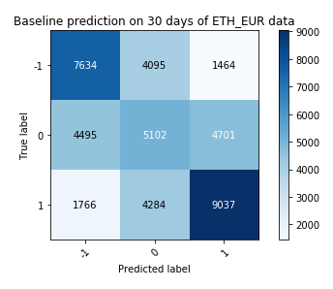
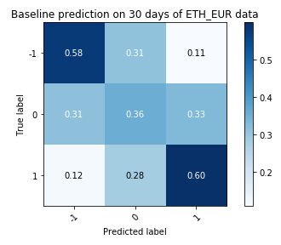
Historical mean

Slide 10
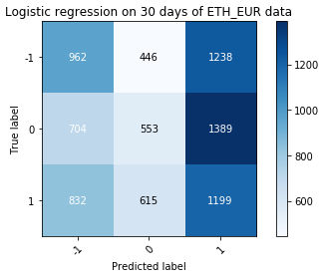
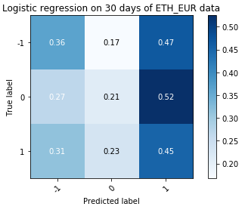
Logistic Regression R² score = 34.19

Slide 11
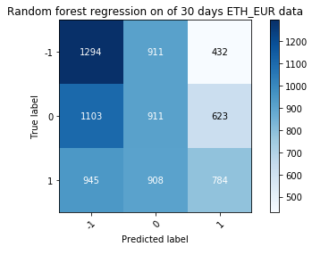
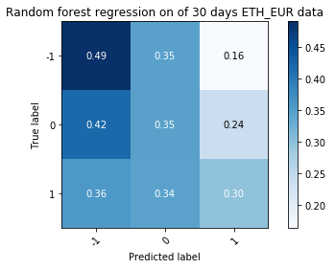
Random Forest Regression R² score = 38.1

Slide 12
Work
Last 2 weeks
The above shown
Parameterizable cli script for data preparation
Depth
Window size
Alpha
Plans
Some corrections
Deep learning solution
Start finishing report

Slide 13
Thanks for your attention!

