Slide 1
Why High Performance Computing ?
Why do we bother ?
We all have different drivers …….

Slide 2
It’s all about wall clock time
Some problems are harder than others
Look up N versus NP on youtube
Scaling with size, wall time grow with problem size N like:
  N, N², N³ etc in lucky cases N * logN (look up Fourier transform vs FFT)
  However, some scale like X^{N} (look up travelling salesman)
<nummer>
Inf 9380
Notes:
<nummer>

Slide 3
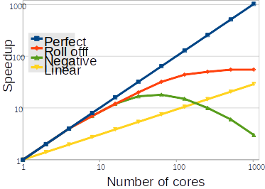
It’s all about wall clock time
Assume 24 hours wall time on a 4 core laptop
Betzy would be the same in 2 seconds
In an ideal world ☺
julia> 3600*24*4/172000
2.0093023255813955
<nummer>
Inf 9380
Notes:
<nummer>

Slide 4
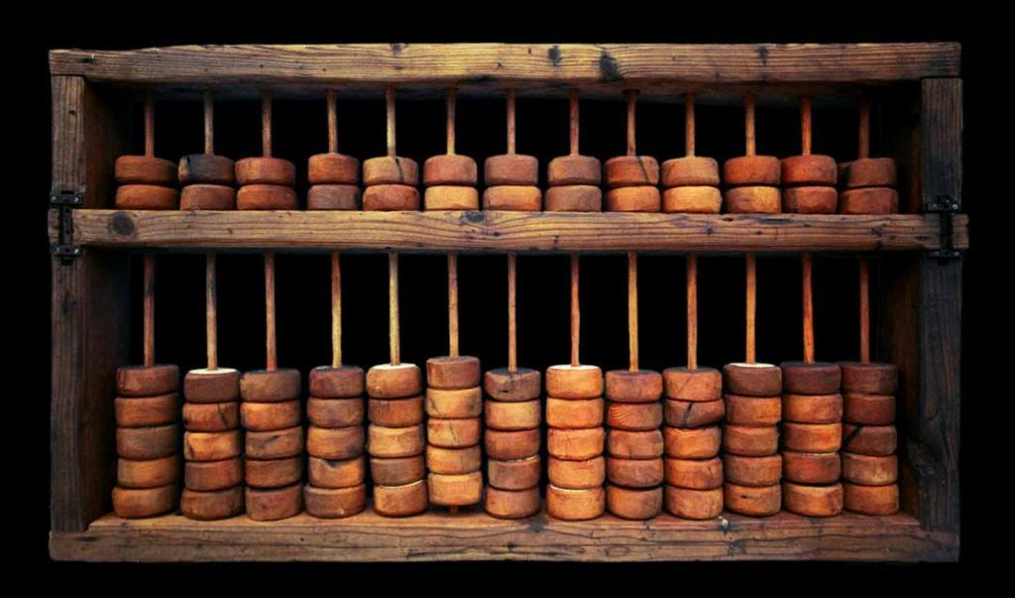
High Performance Computing
Since ancient times - think of the abacus – arithmetic & memory
<nummer>
Inf 9380
Notes:
<nummer>

Slide 5
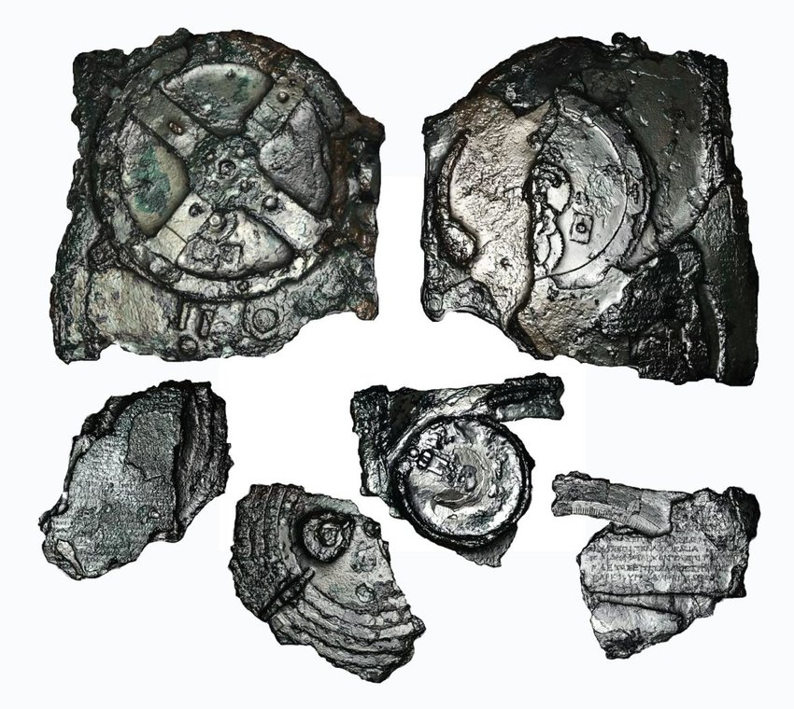
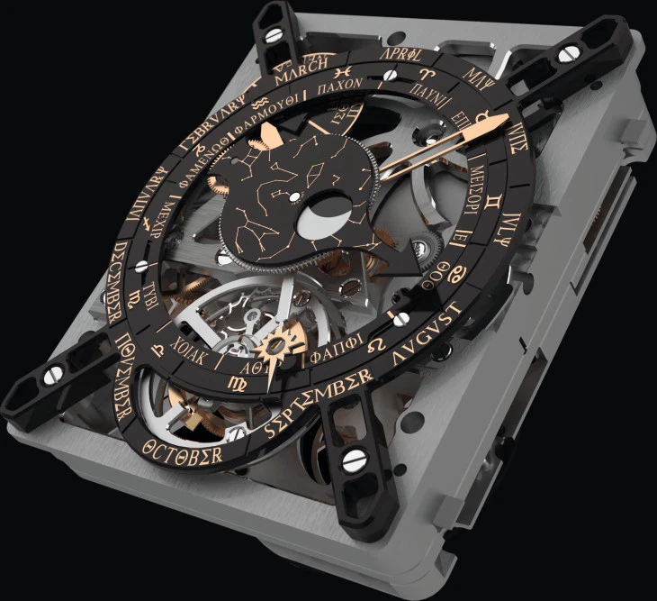
High Performance Computing
Since ancient times – naviation aid
<nummer>
Inf 9380
Notes:
<nummer>

Slide 6
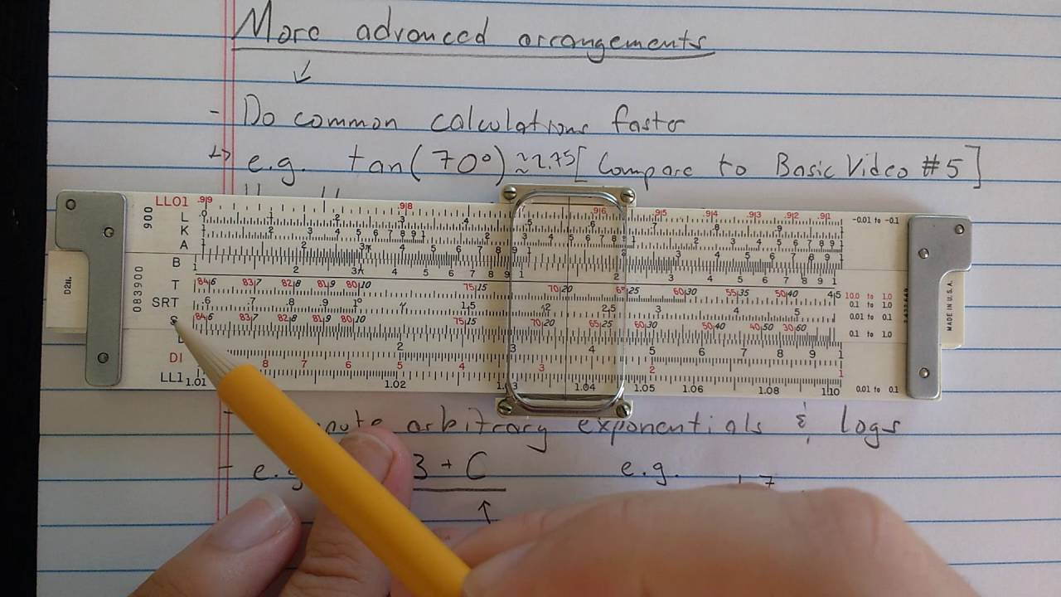
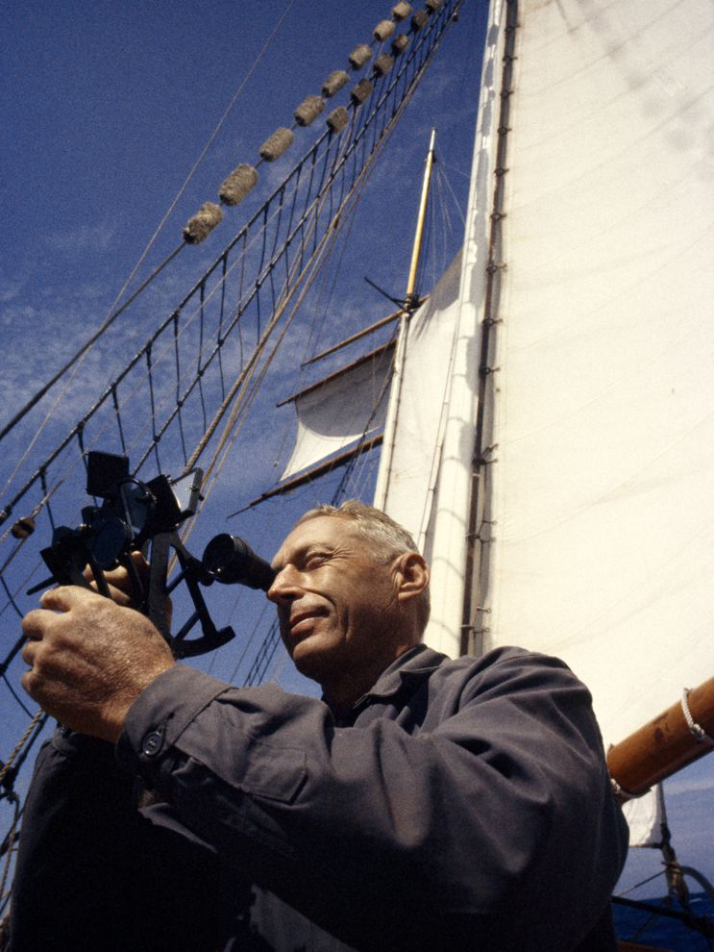
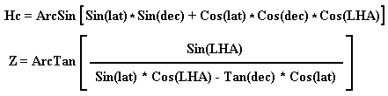
High Performance Computing
Since ancient times –to your grandmother’s device
<nummer>
Inf 9380
Notes:
<nummer>

Slide 7
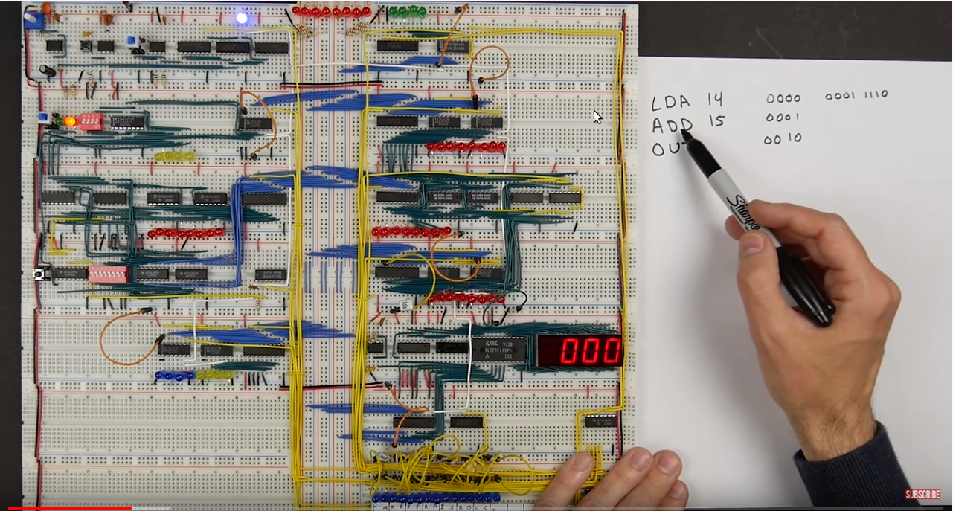
Make your own CPU
https://eater.net/
https://youtu.be/dXdoim96v5A
Next step would be the book:
“From Chips to System” by
Rodnay Zaks
<nummer>
Inf 9380
Notes:
<nummer>

Slide 8
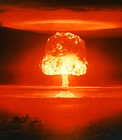
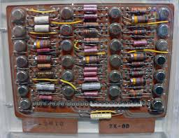
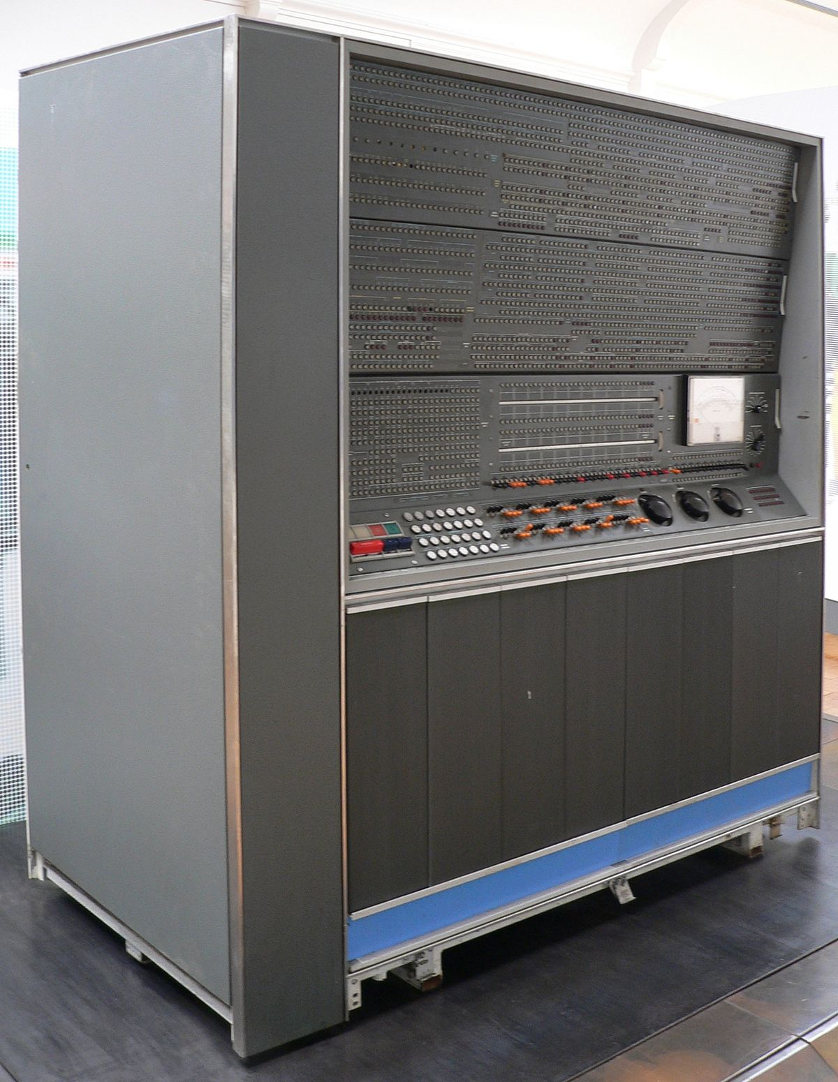
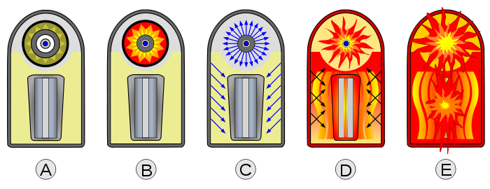
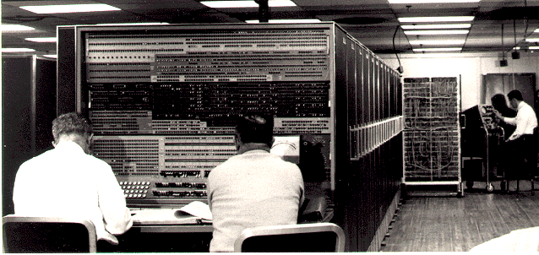
In early 1955, Dr. Edward Teller of the University of California Radiation Laboratory wanted a new scientific computing system for three-dimensional hydrodynamic calculations.
https://en.wikipedia.org/wiki/Thermonuclear_weapon
https://en.wikipedia.org/wiki/IBM_7030_Stretch

Slide 9
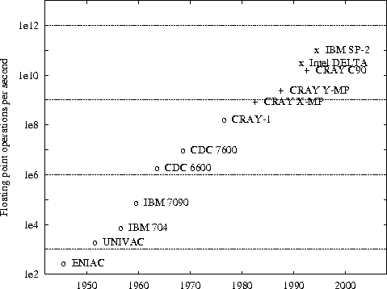
Background
Historically the development have been growing exponentially
Milestones (floating point operations per sec):
CDC6600 (1964) : 3 M
Star 100 (1971) : 100 M
Cray-1 (1976) : 80(140) M
Cray-YMP (1988) : 333 M
Cray-T90 (1995) : 1.8 G
NEX SX-6 (2001) : 8 G
Pentum 3.8 (2006) : 7 G
Interlagos (2011) : 220 G
Kepler II (2013): 1.4 T
NVIDIA V100(2019): 7.5 T

Slide 10
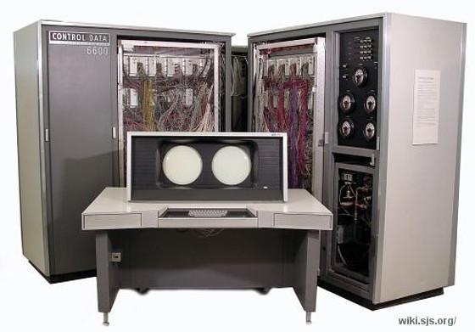
High Performance Computing
CERN CDC 6600 - 1965
https://videos.cern.ch/record/43172
<nummer>
Inf 9380
Notes:
<nummer>

Slide 11
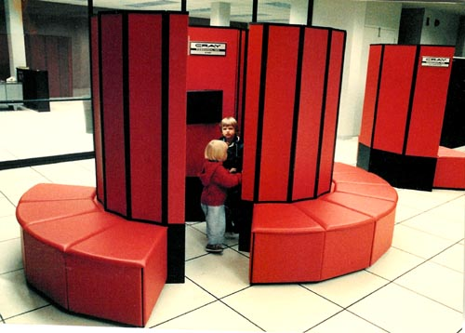
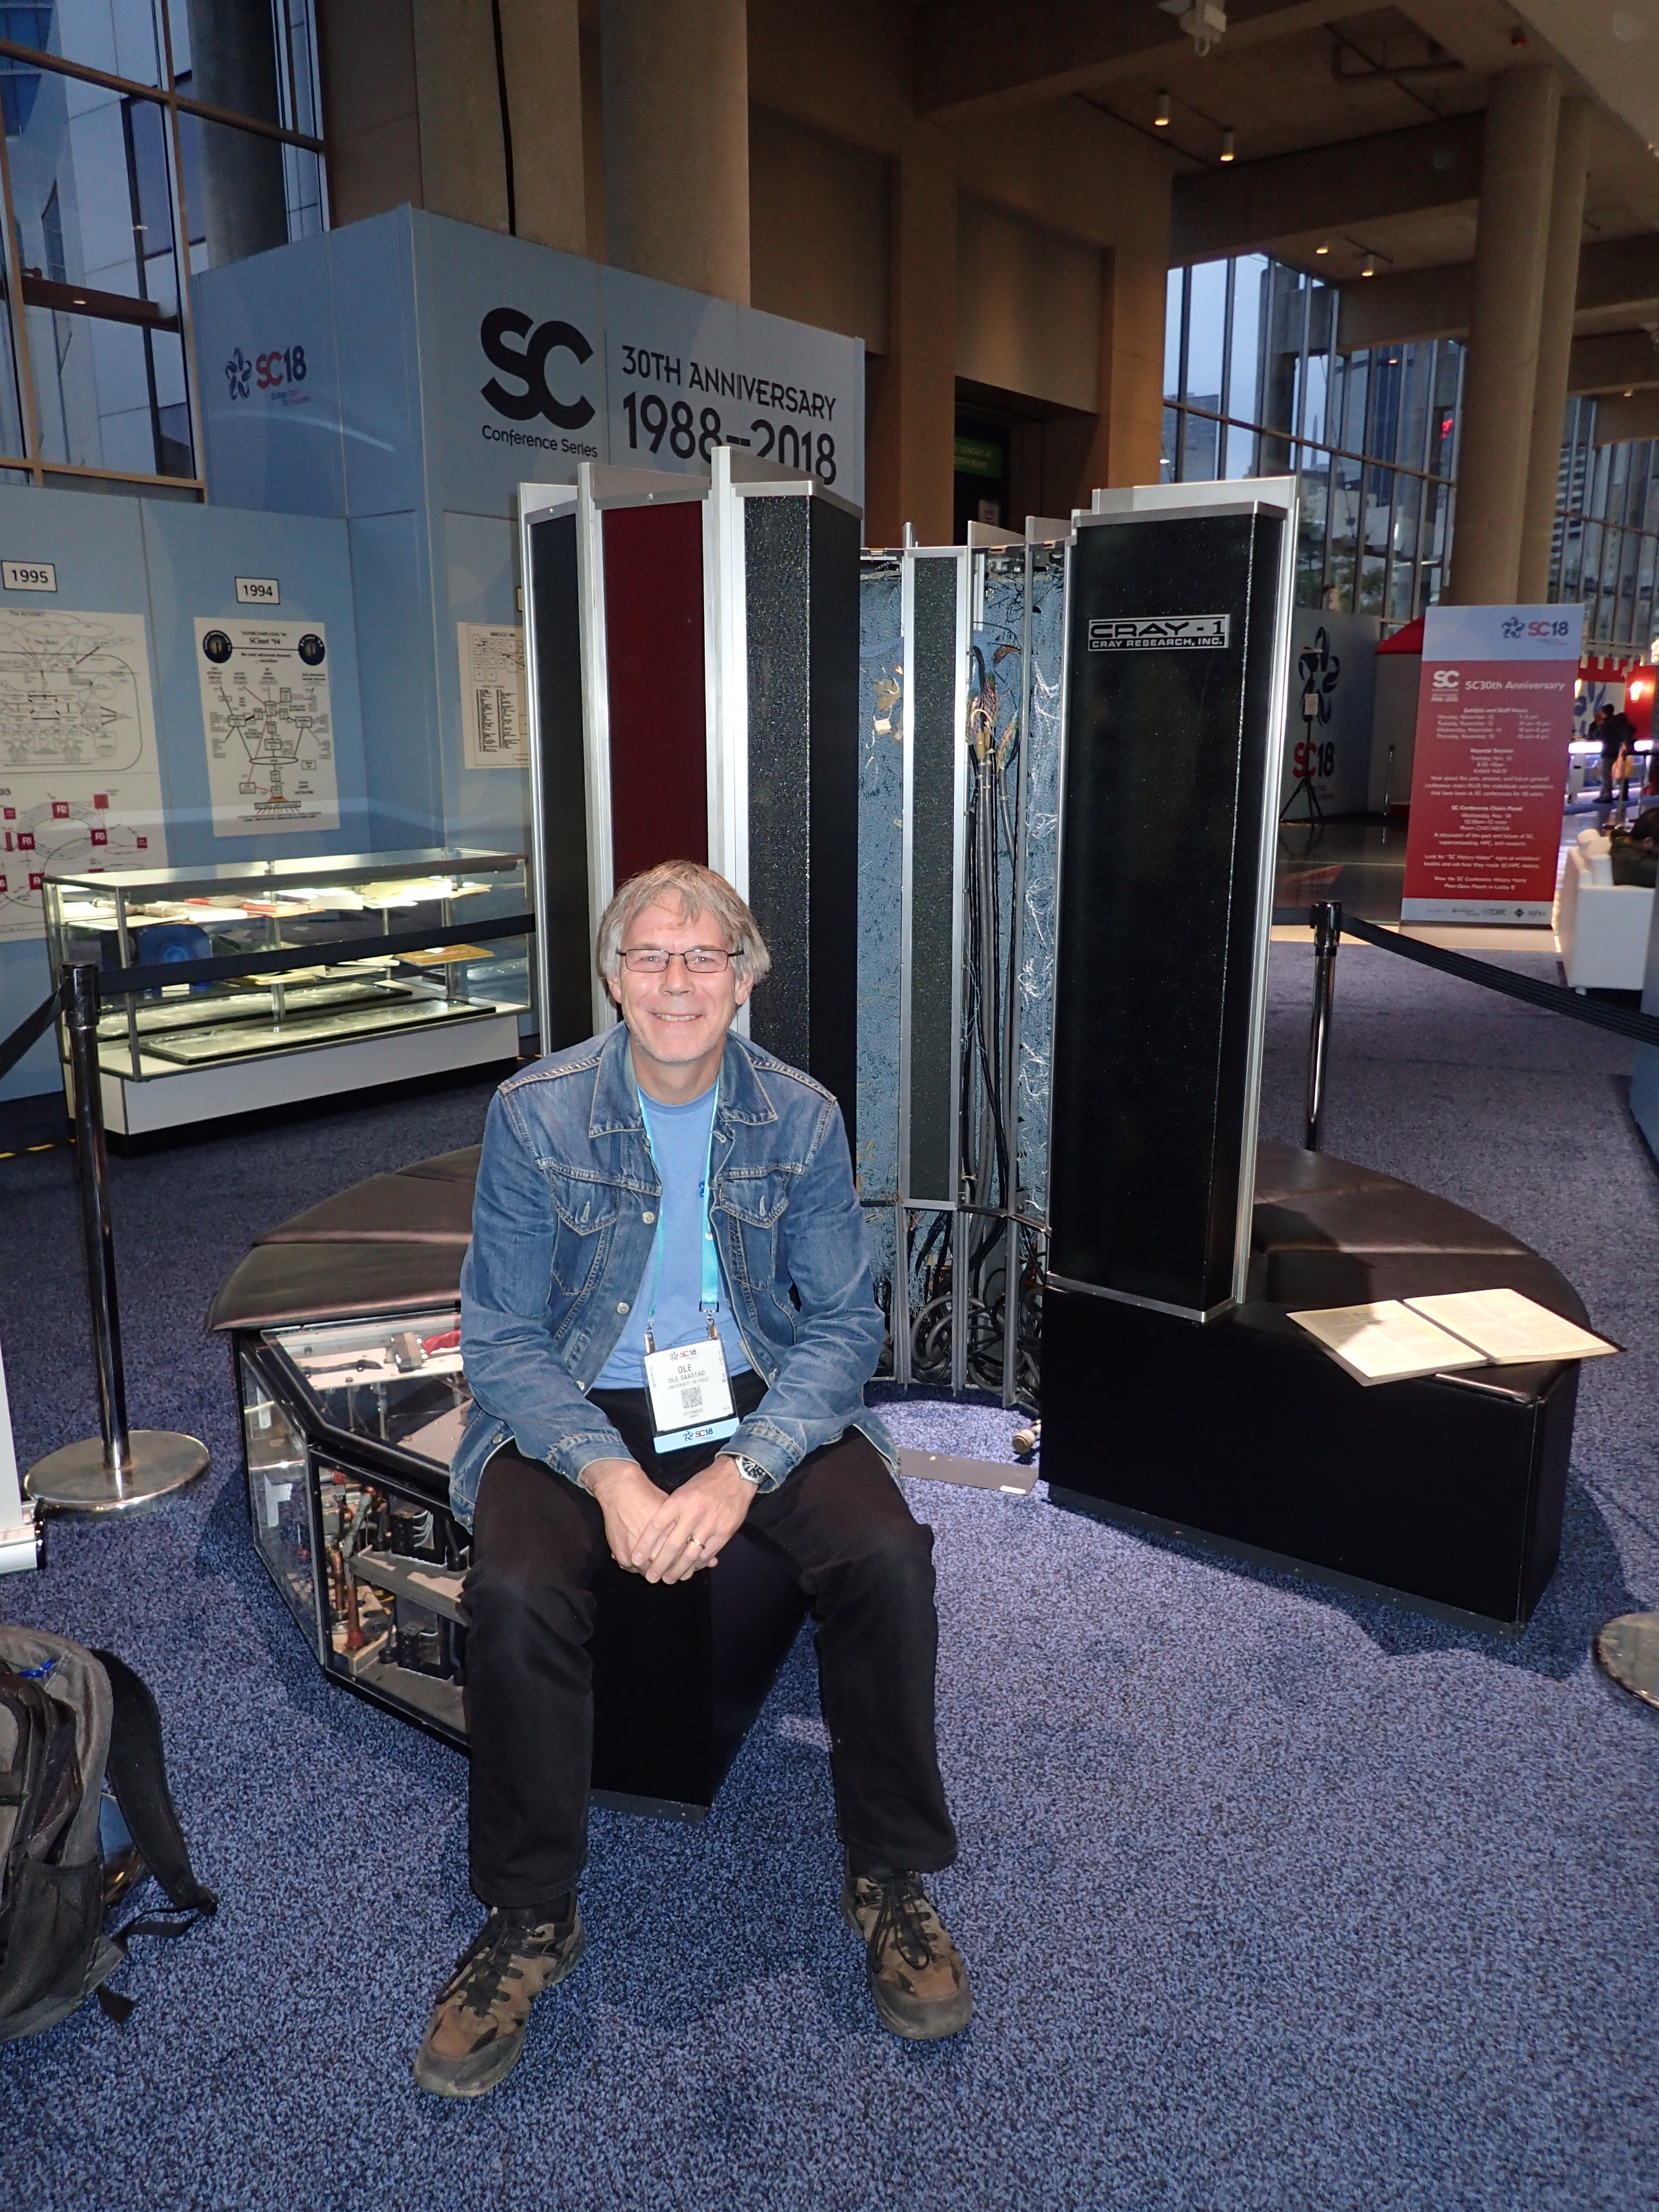
High Performance Computing
Since ancient times - to grandfather’s device (1976)
Historically only 64 bits
Floating point numbers.
<nummer>
Inf 9380
Notes:
<nummer>

Slide 12
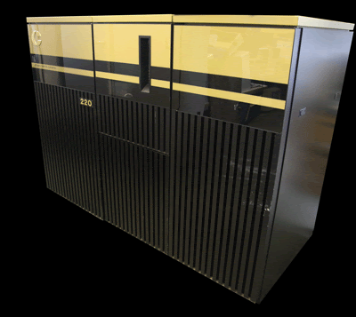
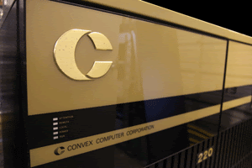
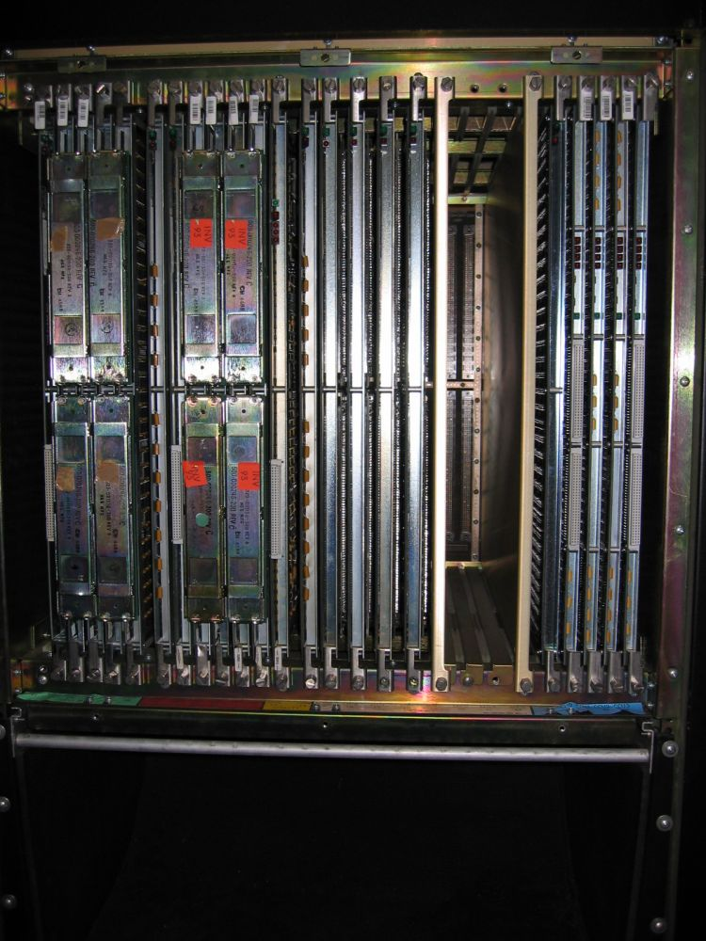
Supercomputer at UiO – Convex 220 – a vector supermini – end of an era
https://www.usit.uio.no/om/it-historien/forskning/convex.html

Slide 13
Why a supercomputer is Super !
Fast Memory !
Memory at the same speed as the CPU
One 64 bit number from memory per CPU clock cycle!
You do the math with todays systems:
100 ns access time, 2 GHz CPU clock
<nummer>
Inf 9380
Notes:
<nummer>

Slide 14
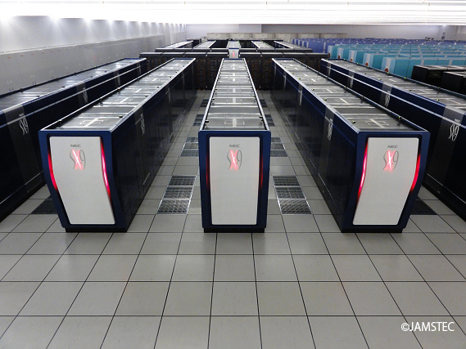
Earth Simulator
https://www.top500.org/lists/2002/06/
https://en.wikipedia.org/wiki/Earth_Simulator

Slide 15
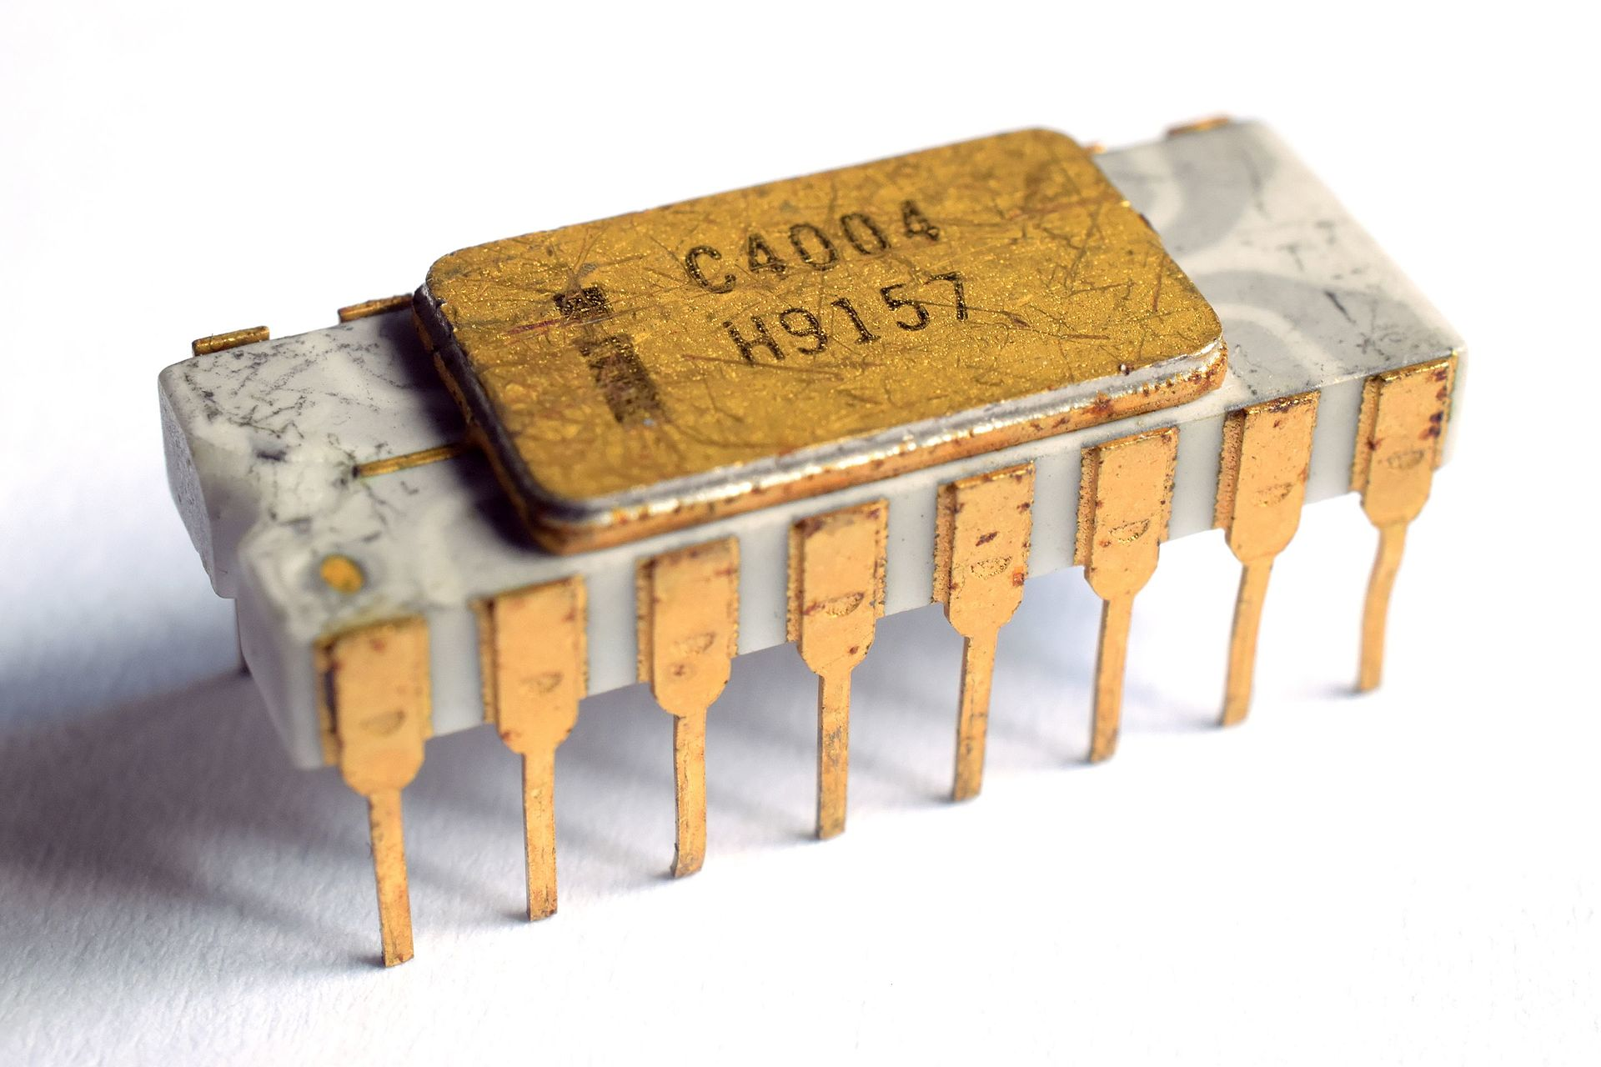
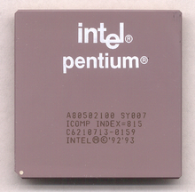
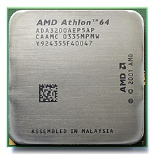
Mircoprocessor development
4 bit
The microprocessors started in 1971 with the Intel 4004
The arrival of Pentium processor suddenly make it possible to run scientific code on microprocessors
The high price tag of supercomputers and long queue times sparked innovation
How much memory can you address using 32 bits?
32 bit
64 bit
<nummer>
Inf 9380
Notes:
<nummer>

Slide 16
Mircoprocessor development
The microprocessors has very low performance
However, time to solution is the important metric
Thomas Sterling and Donald Becker at NASA compiled the first Beowulf cluster in 1994
Linux/UNIX operating system – and ever since
<nummer>
Inf 9380
Notes:
<nummer>

Slide 17
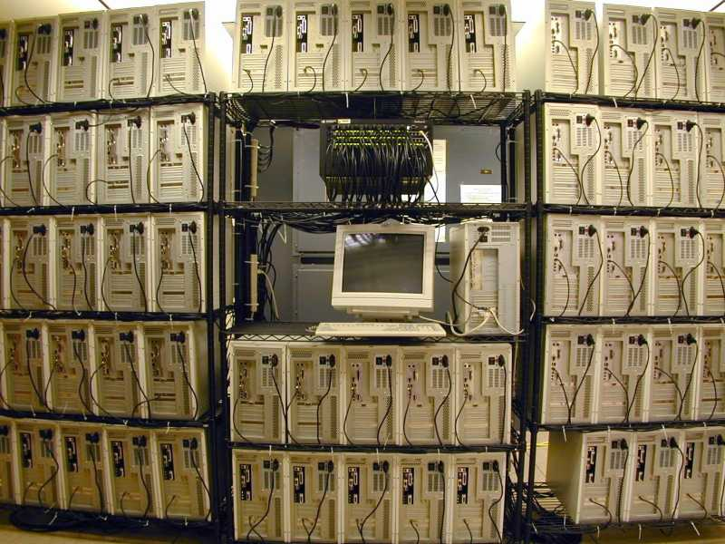
Microprocessors triumph

Slide 18
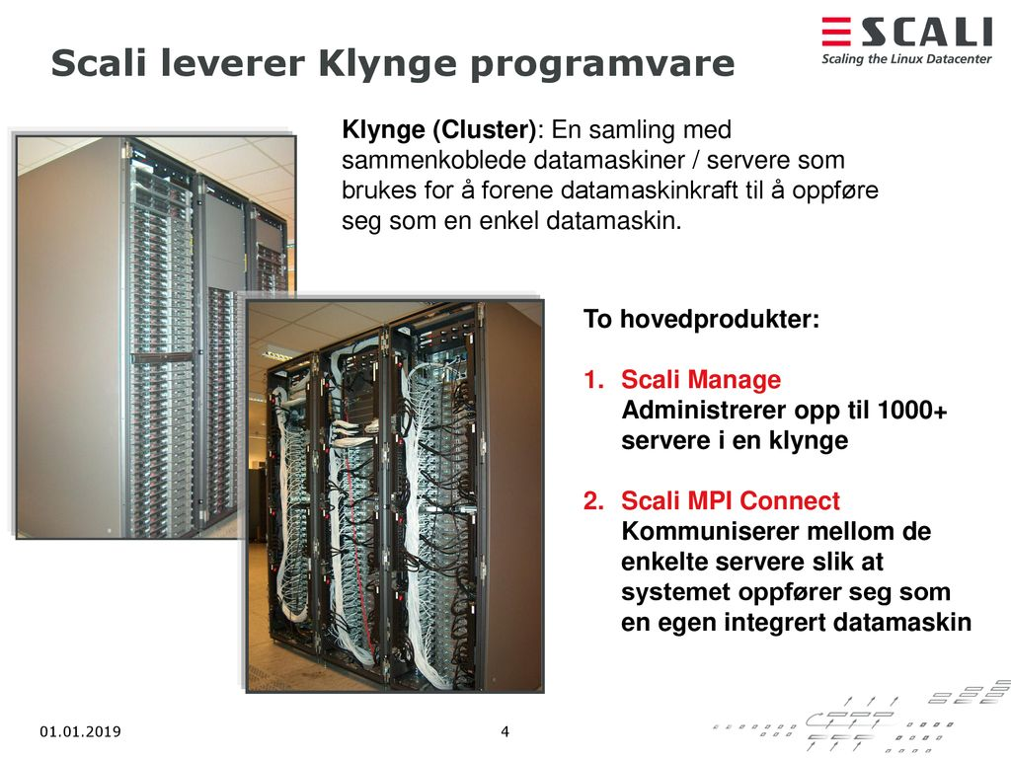
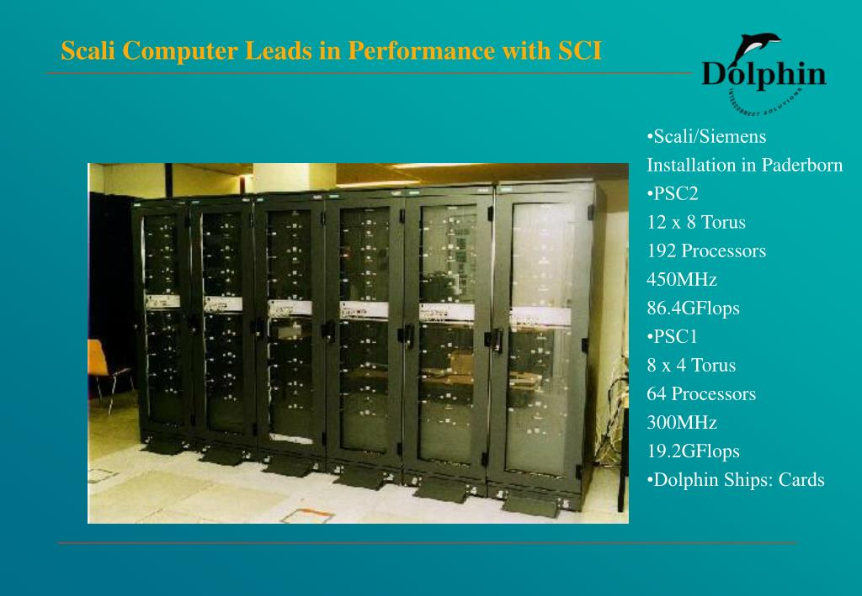
Norway in the forefront of Cluster business
<nummer>
Inf 9380
Notes:
<nummer>

Slide 19
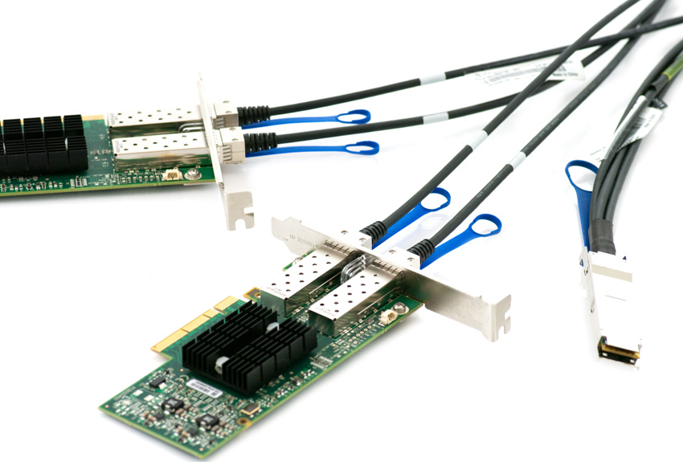
Interconnect – communication
Ethernet has very high latency and low bandwidth
Many interconnects available in early 2000
Today only InfiniBand
200 Gbits/s ≈ 20 Gbytes/s
1 μs latency
<nummer>
Inf 9380
Notes:
<nummer>

Slide 20
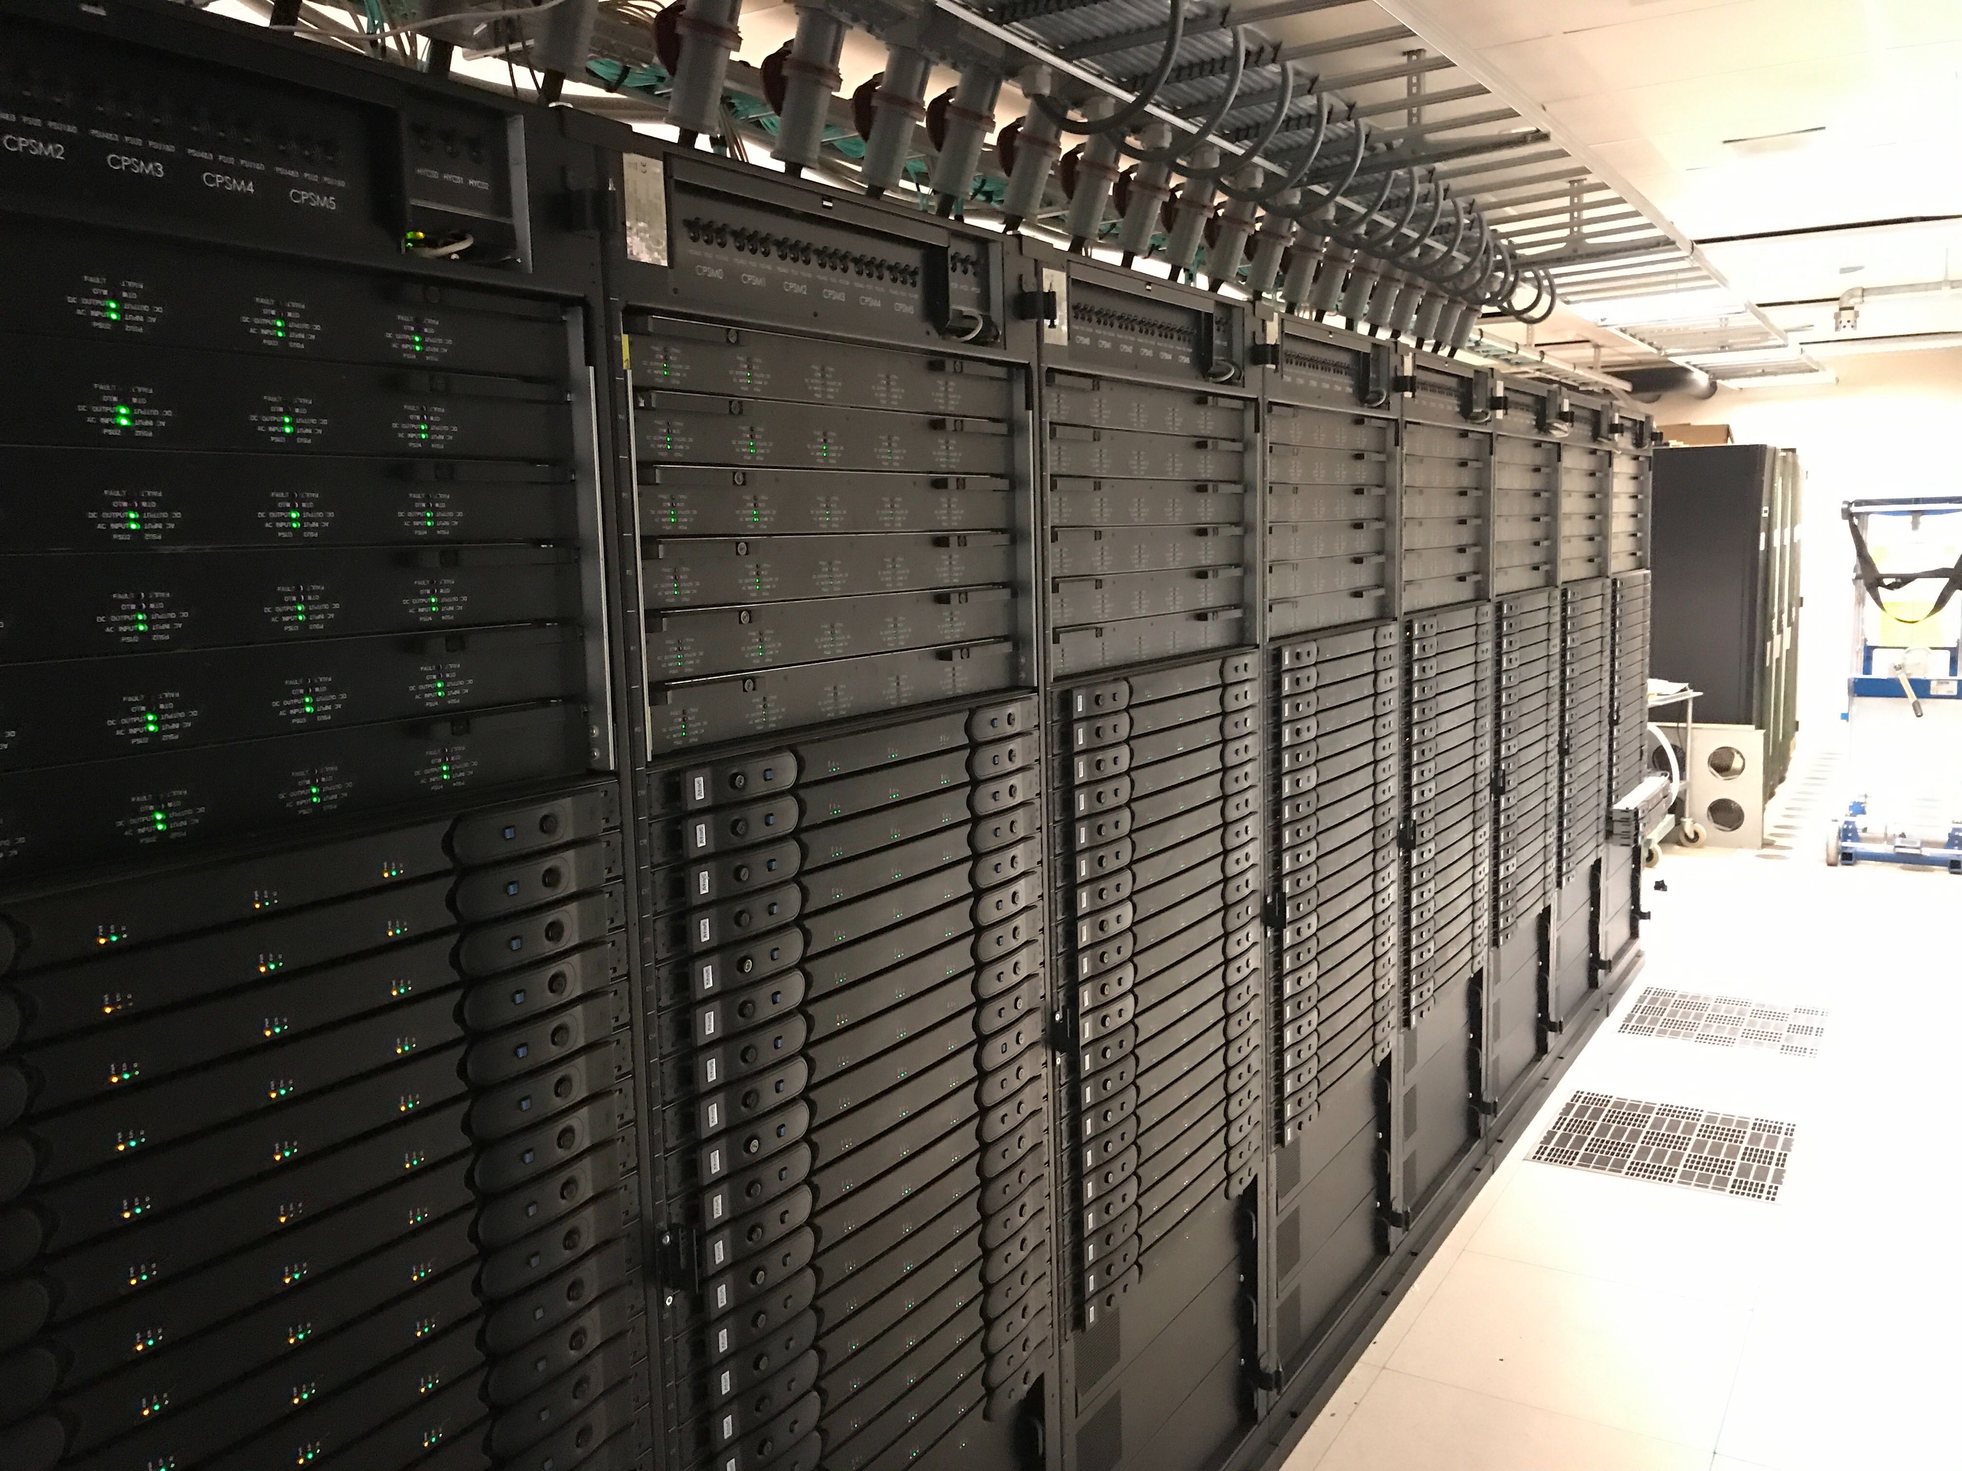
High Performance Computing
Today we use clusters of nodes and 100k+ CPUs or cores
Betzy have 172k cores
From fast processors in
in Cray 1 to Betzy’s even
faster processors in
huge numbers.
One word stand out:
PARALLEL
<nummer>
Inf 9380
Notes:
<nummer>

Slide 21
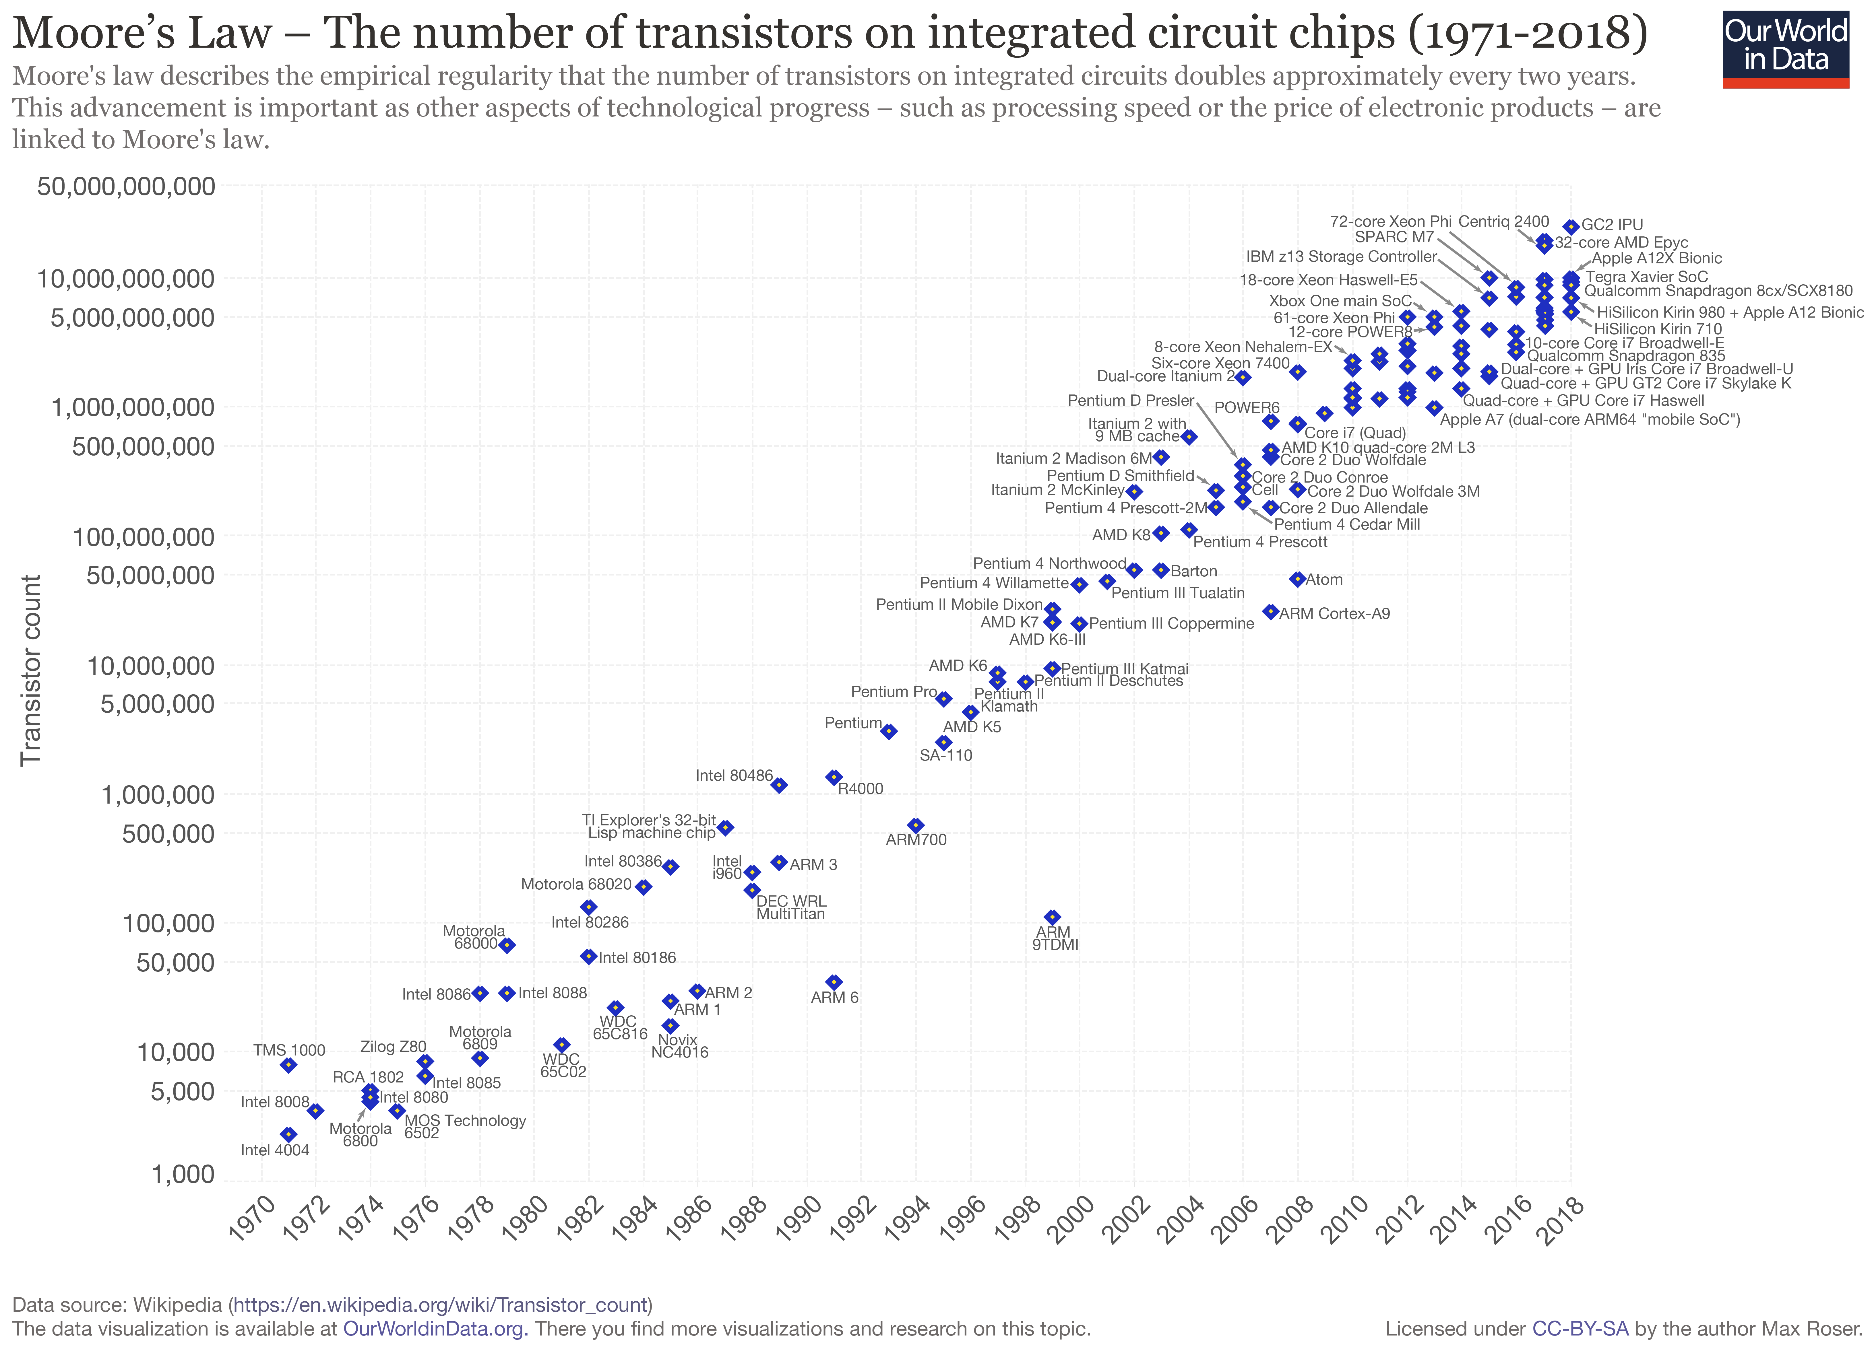
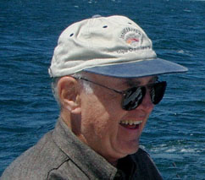
Moore's law
«Transistor count on a chip doubles every two years»

Slide 22
Background
Just after 2000 each single CPU did not become any faster
Mores law did not keep up with performance.
It is about transistor density, not performance.
Performance could not be bought by buying faster CPUs,
an all time high was reached with Intel Prescott at 3.8 GHz
Parallel programming became a necessity – you are here !

Slide 23
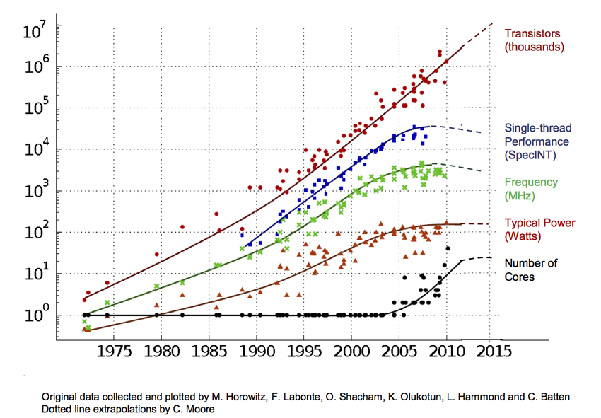
Background – processor development

Slide 24
High Performance Computing – today
New data types to deal with, Cray 1 had only 64 bits types
Classical only 64 bits data types: 64 bits floating point,
64 bits integer, 64 bits logical
Today we have 64, 32, 16 and 8 bits floating point,
8,16,32,64 bits integers, characters and bytes.
Combination of the above (with addition of software data
types, 128 bits etc, BCD (decimal32 and decimal64).
<nummer>
Inf 9380
Notes:
<nummer>

Slide 25
Large memory and data types
Large memory introduces the int/long or I4/I8 problem,
32 bit or 64 bit integers.
The ilp64 – concept Integer, Long, Pointer all 64 bits
(more common is lp64 where integers are just 32 bits, this is the default).
Large loop counters can no longer be accommodated using 4 byte / 32 bits integers.
C : long yield 64 bits integers (assume it can hold an address/pointer)
F77 : INTEGER*8
Fortran90/2008 : integer(i8), where i8 is set : i8 = selected_int_kind(16) (at
least 16 digit integer)

Slide 26
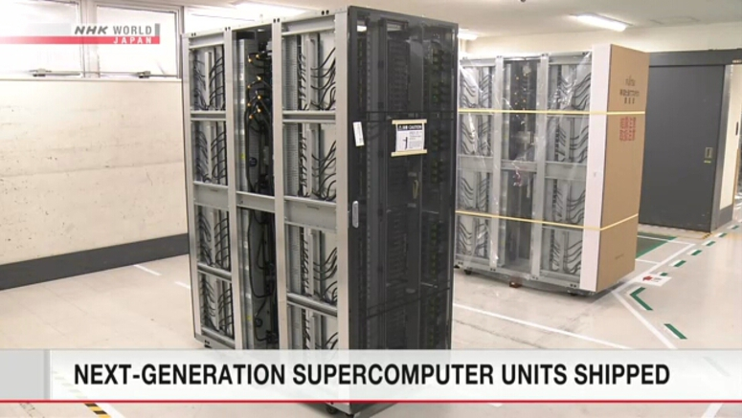

High Performance Computing
Memory bandwith often a bottleneck (most of the time)
Today 2020 the Fugaki nodes from Fujitsu have 1 TB/sec
<nummer>
Inf 9380
Notes:
<nummer>

Slide 27
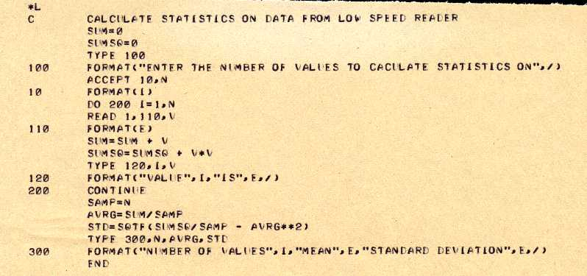

High Performance Computing – programming
In the beginning there was only one language for science
<nummer>
Inf 9380
Notes:
<nummer>

Slide 28
High Performance Computing
And now in a 2018 version
which is not your
grandfather’s FORTRAN
Fortran has the advantage
that it is preventing you from
the many mistakes very
common in C/C++
module my_mod
subroutine set(p, name, iage)
class(person) :: p
character(len=*) :: name
integer :: iage
p%name = name
p%iage = iage
write (0,*) ’set’
end subroutine
subroutine out(p)
class(person) :: p
write (0,*) p%name, p%iage
end subroutine
end module
<nummer>
Inf 9380
Notes:
<nummer>

Slide 29
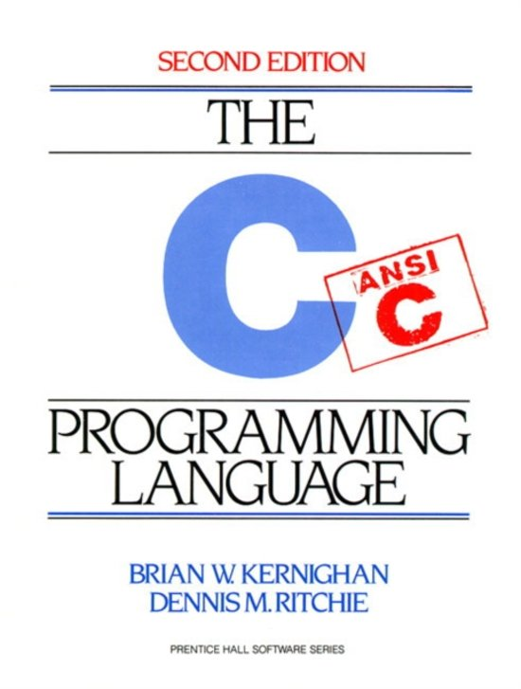
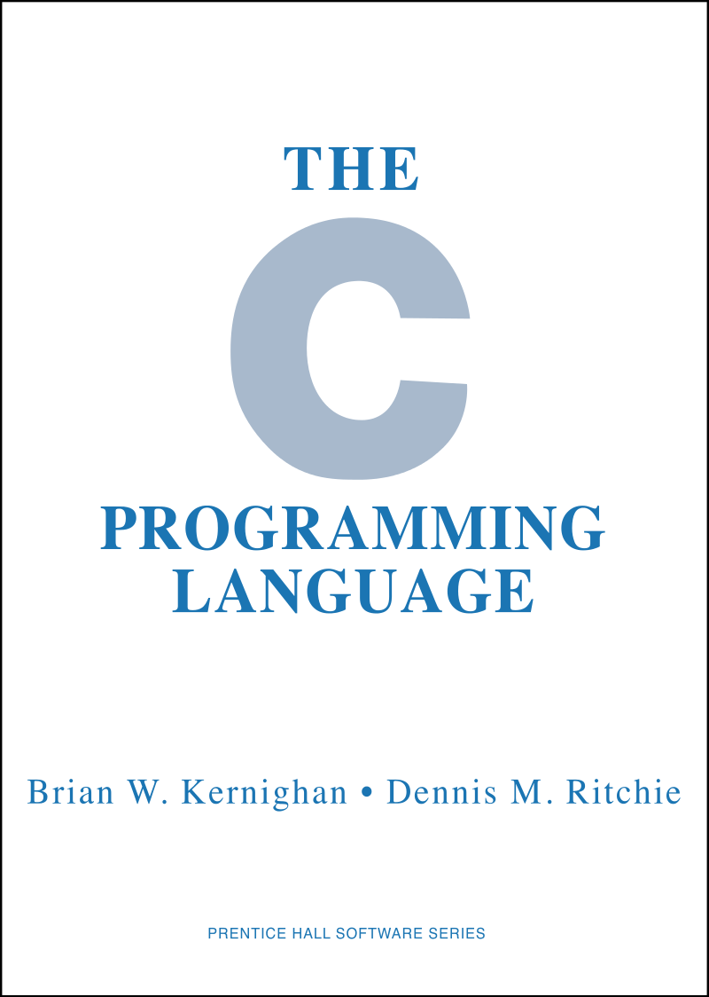
High Performance Computing
The C programming language
Many libraries
are written in C
Excellent for
HPC – if you
know what to do
<nummer>
Inf 9380
Notes:
<nummer>

Slide 30
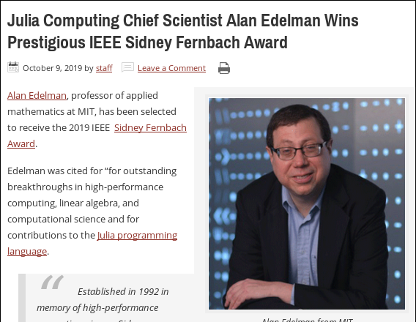

2019 Sidney Fernbach Award
“For outstanding breakthroughs in high performance computing, linear algebra, and computational science and for contributions to the Julia programming language.”
julia> a=0+1im
0 + 1im
julia> a^a
0.20787 + 0.0im

Slide 31

High Performance Computing
Python is yet another high productivity language
Today Python3 is only version supported
High productivity
Everybody knows
From $5 modules to
supercomputers
Not high performance
<nummer>
Inf 9380
Notes:
<nummer>

Slide 32
High Performance Computing
Run the examples in directory “languages”
time -p <program>
Note the difference in wall time
What language would you like for your task ?
<nummer>
Inf 9380
Notes:
<nummer>

Slide 33
High Performance Computing
Python is yet another high productivity language
Now Python3 is only version supported
High productivity
All know it
From $5 modules to
supercomputers
Not high performace
<nummer>
Inf 9380
Notes:
<nummer>

Slide 34
High Performance Computing
Explore the example code in the directory
“datatypes”
Look for range, precision, max, min, size (in bytes) etc.
Follow hints in the file instructions.txt
<nummer>
Inf 9380
Notes:
<nummer>

