Slide 1
Why High Performance Computing ?
Why do we bother ?

Slide 2

High Performace
Computing
PARALLEL = speedup ?
”Why is Abel not faster
than my laptop ?”
<nummer>
Inf 9380
Notes:
<nummer>

Slide 3
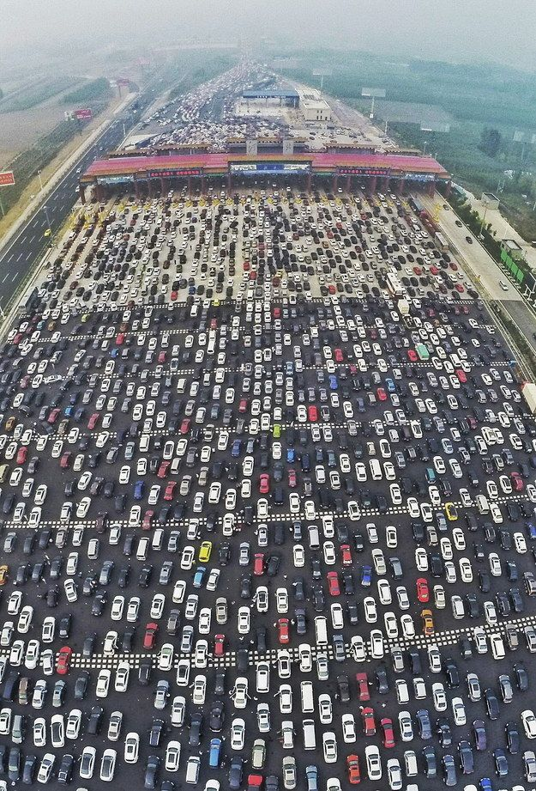
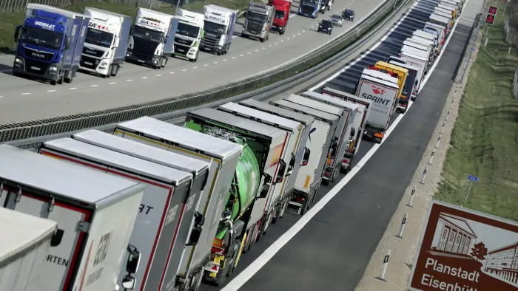
High Performace Computing
Vector unit do SIMD – Single Instruction Multiple Data
<nummer>
Inf 9380
Notes:
<nummer>

Slide 4
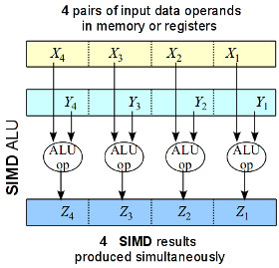
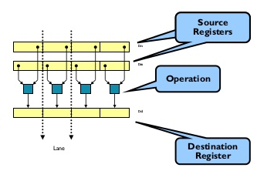
Simplest parallel execution is the SIMD
<nummer>
Inf 9380
Notes:
<nummer>

Slide 5
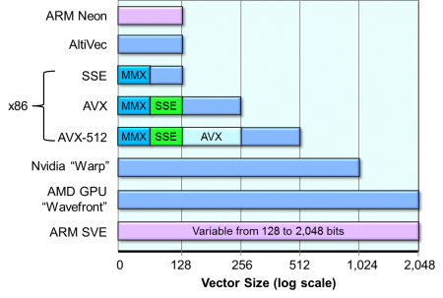
Width/length of the vector unit
Design
Some use 128 bits, other 256, 512 and some think of 2048.
<nummer>
Inf 9380
Notes:
<nummer>

Slide 6
High Performace Computing
SIMD or Vector executional units are here to stay,
all processors have vector units
We need to make full use of them
Help the compiler to vectorize the loops
(with SIMD it’s mostly loops)
<nummer>
Inf 9380
Notes:
<nummer>

Slide 7
We are forced to program in parallel !
We have no choice.
To utilize many cores is a challenge!
«We don't do it because it's easy, we do it because it's hard»

Slide 8
Scaling – Amdahl's law
Amdahls law, formulated in 1967
P is the fraction of the program that show a speedup S
What does it mean ?
P parallel fraction
N number of cores

Slide 9
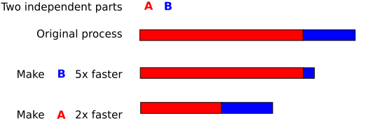
Scaling – Amdahl's law
P fraction of program that is parallel
N number of processors/cores/cpus
Setting N very large, 
No matter how many processors we use the run time cannot be shorter than the serial part.
Which part to work on?

Slide 10
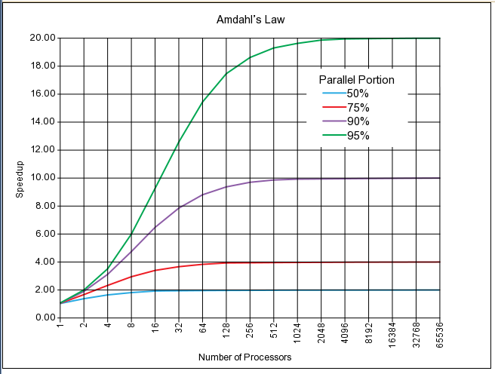
Amdahl's law

Slide 11
Scaling – Gustafson's law
Gustafsons law from 1988 :
any sufficiently large problem can be efficiently parallelized.
S is speedup, P number of cores and a fraction of serial code, in ideal world a = 0
Big problems might scale well, large machine for large problems !

Slide 12
Analogy using cars :
Amdahl's Law:
Suppose a car is traveling between two cities 60 miles apart, and has already spent one hour traveling half the distance at 30 mph. No matter how fast you drive the last half, it is impossible to achieve 90 mph average before reaching the second city. Since it has already taken you 1 hour and you only have a distance of 60 miles total; going infinitely fast you would only achieve 60 mph.
Gustafson's Law:
Suppose a car has already been traveling for some time at less than 90mph. Given enough time and distance to travel, the car's average speed can always eventually reach 90mph, no matter how long or how slowly it has already traveled. For example, if the car spent one hour at 30 mph, it could achieve this by driving at 120 mph for two additional hours, or at 150 mph for an hour, and so on.

Slide 13
High Performace Computing
How do we use the vector units ?
<nummer>
Inf 9380
Notes:
<nummer>

Slide 14
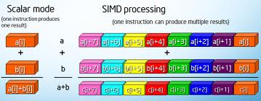
Compiler usage
Parallel – 16 to 128 cores in a node
  Vectorisation
  OpenMP
  MPI
More focus on vectorisation

Slide 15
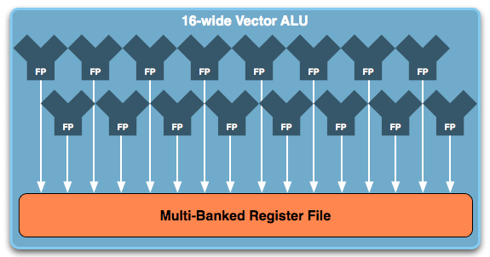
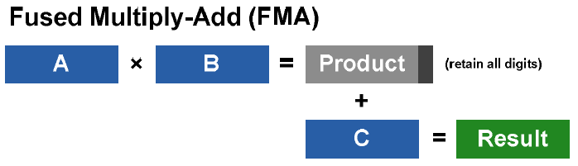
Programming with vector processors
Current processors have up to 64 cors
  Need at least 64 threads  OpenMP & MPI
  256 bits vector unit
  Fused Multiply add

Slide 16
Programming for vector processors
Vectorization vital for performance
  Scalar code perform at 1/16 performance
OpenMP 4.0 introduced SIMD directives
All OpenMP programming facilities now apply to SIMD
Vectorization is made easier with OpenMP

Slide 17
Programming for Vector units
OpenMP SIMD - vectorization
Single program, multiple data
Vector units are becoming increasingly more important
AVX / AVX2 256 bits = 4 dp and 8 sp floats
AVX512 has 512 bits vector = 8 dp and 16 sp floats
Vector fused multiply add double vector performance

Slide 18
Programming - OpenMP 4.0
OpenMP 4.0 SIMD
!$omp simd reduction(+:sum)
do i = 1,n
x = h*(i-0.5)
sum = sum + f(x)
enddo
pi = h*sum

Slide 19
Programming – OpenMP 4.0 (and newer)
OpenMP 4.0 SIMD
function f(x)
!$omp declare simd f
real(8) :: f
real(8) :: x
f = (4/(1+x*x))
end function f

Slide 20
High Performace Computing
Vectorization is mostly done automatically by the compiler
The compiler is playing it safe !
You need to hint the compiler about dependencies
In addition, write the code to enable vectorization
<nummer>
Inf 9380
Notes:
<nummer>

Slide 21
High Performace Computing
Hands on
Directory SIMD contains examples and instructions
Run the codes and compile a report of findings
<nummer>
Inf 9380
Notes:
<nummer>

Slide 22
High Performace Computing
Hands on
Did you get the correct answer ?
Did you get the reduction right ?
Did you see any speedup ?
Did you change the compiler optimization flags?
Did the speedup differ ?
Did you collect your findings in a report for future reference ?
<nummer>
Inf 9380
Notes:
<nummer>

Slide 23
High Performace Computing
More on vectorization, in depth :
Two presentations are uploaded
  vectorizing-fortran-using-openmp-4.x-filling-the-simd-lanes.pdf
  NERSC-VectorTrainingOct2014.pdf
  More in depth about vectorization, focus on Intel tools
<nummer>
Inf 9380
Notes:
<nummer>

