Slide 1
Computer Arithmetic and Architecture
Introduction
Abdulrahman Azab
18, April 2016

Slide 2
Binary number and logic operations

Slide 3
Binary Adder & Subtractor

Slide 4
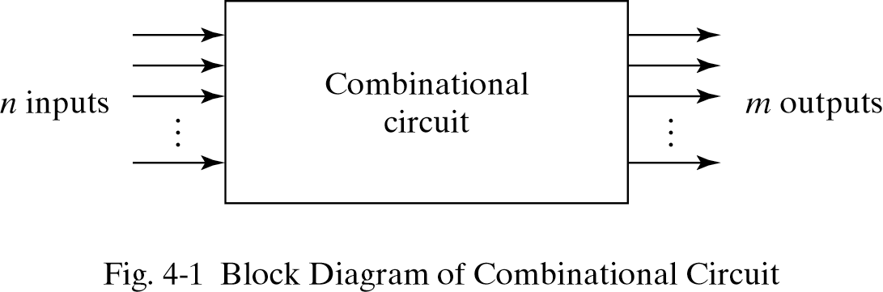

Slide 5
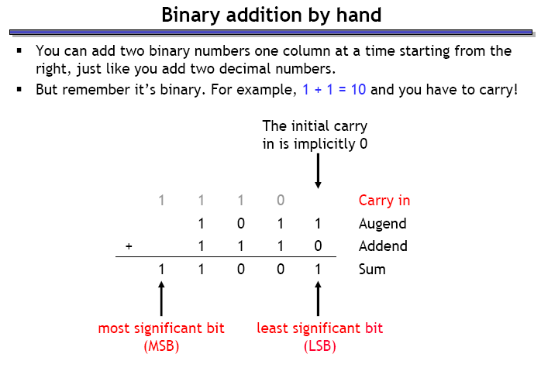

Slide 6
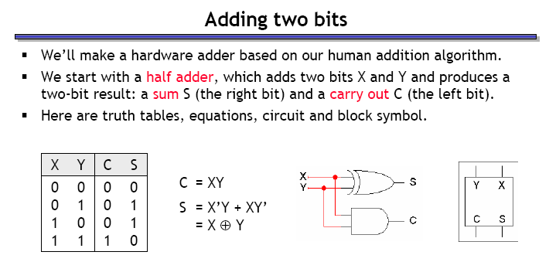
HALF ADDER

Slide 7
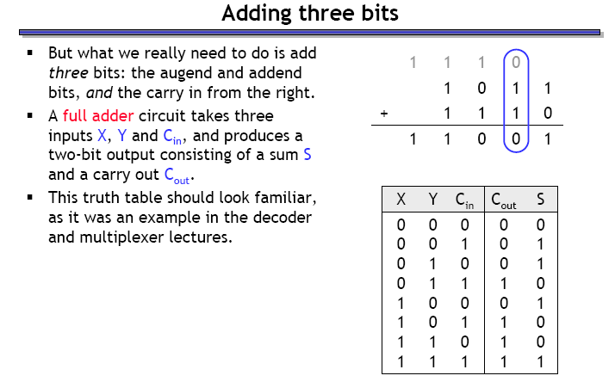
FULL ADDER

Slide 8
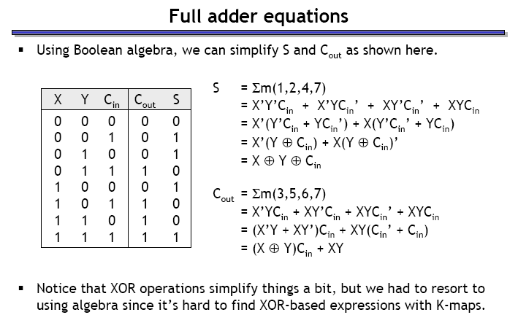

Slide 9
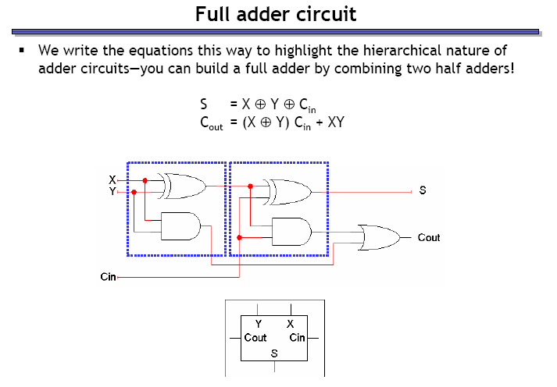

Slide 10
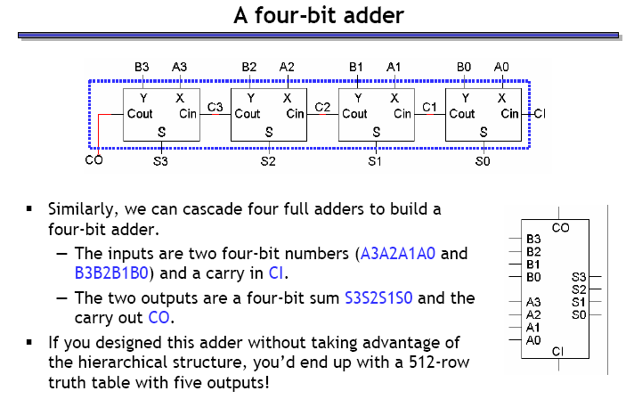

Slide 11
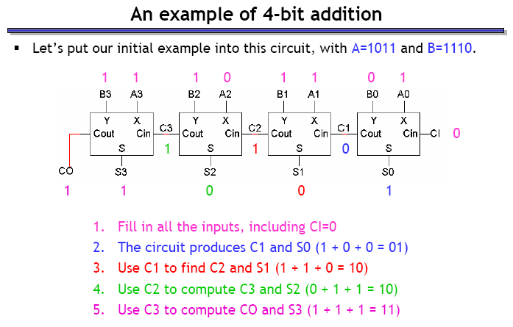

Slide 12
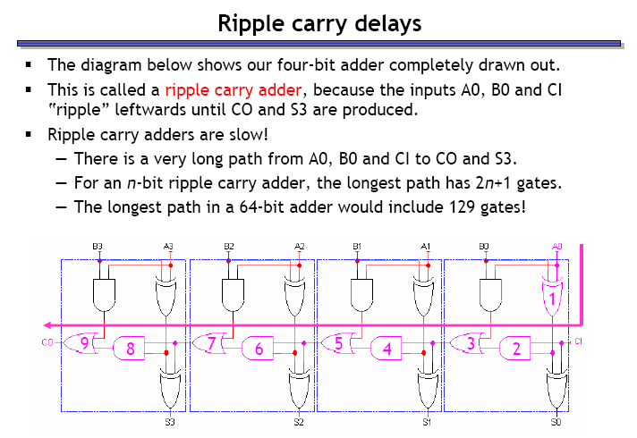

Slide 13
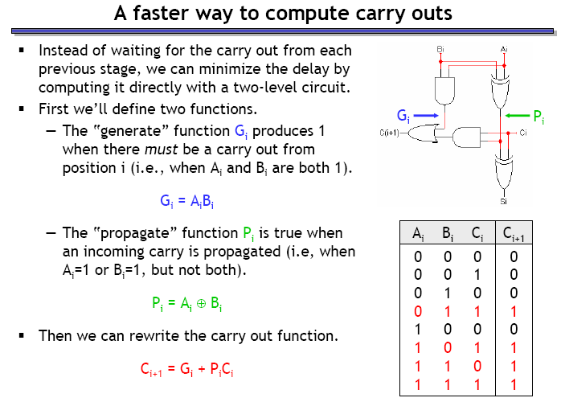

Slide 14
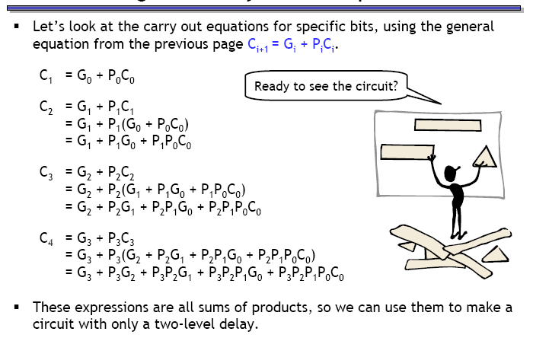

Slide 15
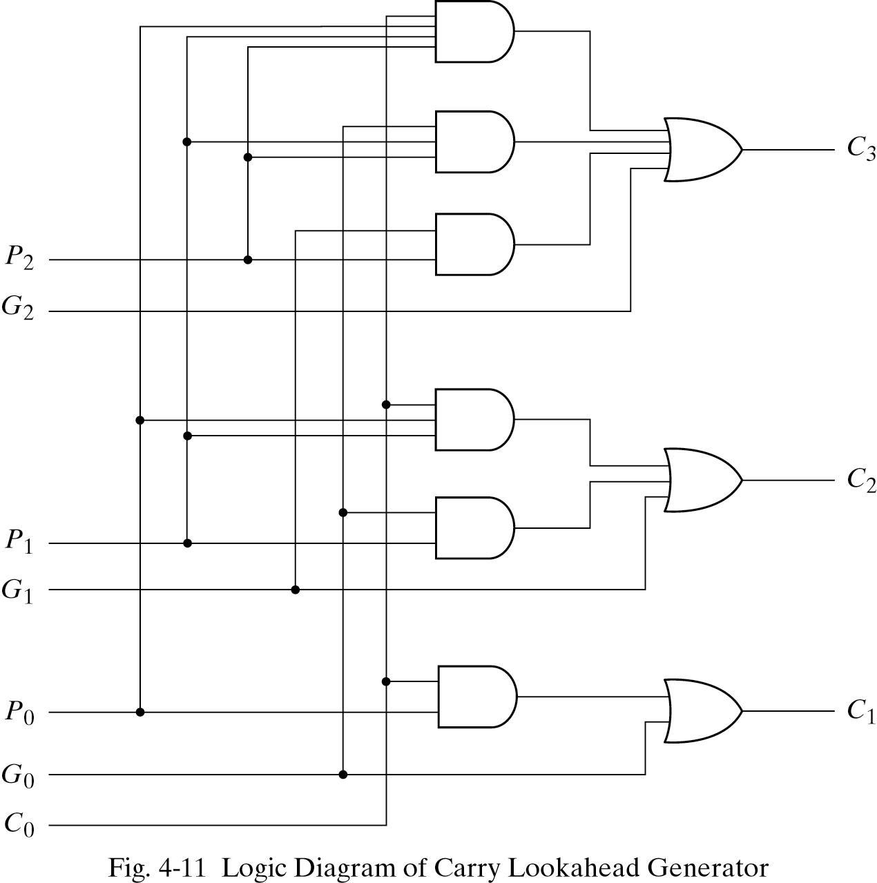

Slide 16
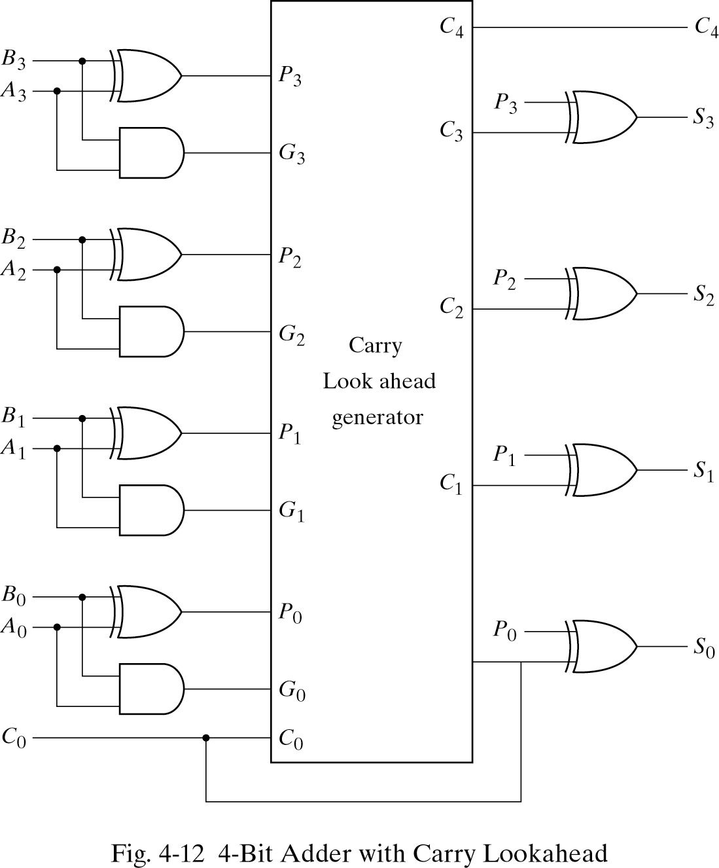

Slide 17
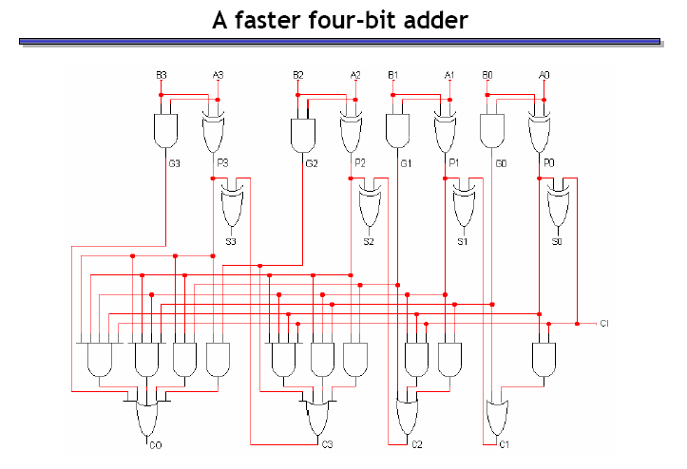

Slide 18
Binary Adder/Subtractors
The subtraction A-B can be performed by taking the 2's complement of B and adding to A.
The 2's complement of B can be obtained by complementing B and adding one to the result.
A-B = A + 2C(B)
= A + 1C(B) + 1
= A + B’ + 1

Slide 19
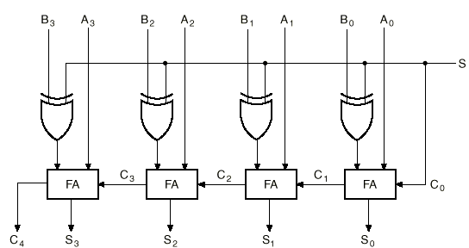
4-bit Binary Adder/Subtractor
XOR gates act as programmable inverters

Slide 20
4-bit Binary Adder/Subtractor (cont.)
When S=0, the circuit performs A + B. The carry in is 0, and the XOR gates simply pass B untouched.
When S=1, the carry into the least significant bit (LSB) is 1, and B is complemented (1’s complement) prior to the addition; hence, the circuit adds to A the 1’s complement of B plus 1 (from the carry into the LSB).

Slide 21
4-bit Binary Adder/Subtractor (cont.)
S=0
B₃
B₂
B₁
B₀
0
S=0 selects addition

Slide 22
CPU Architecture

Slide 23
CPU

Slide 24
CPU Function
CPU must:
  Fetch instructions
  Interpret/decode instructions
  Fetch data
  Process data
  Write data
Notes:
22

Slide 25
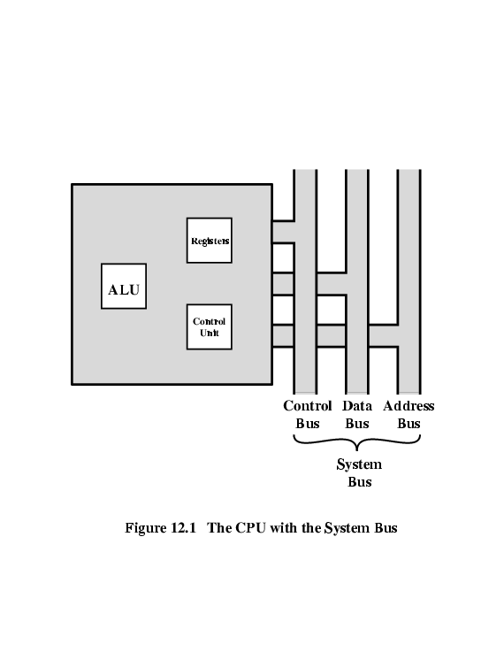
CPU With Systems Bus

Slide 26
Registers
CPU must have some working space (temporary storage) - registers
Number and function vary between processor designs - one of the major design decisions
Top level of memory hierarchy
Notes:
23

Slide 27
User Visible Registers
General Purpose
Data
Address
Condition Codes
Notes:
24

Slide 28
General Purpose Registers (1)
May be true general purpose
May be restricted
May be used for data or addressing
Data: accumulator (AC)
Addressing: segment (cf. virtual memory), stack (points to top of stack, cf. implicit addressing)
Notes:
25

Slide 29
General Purpose Registers (2)
Make them general purpose
  Increased flexibility and programmer options
  Increased instruction size & complexity, addressing
Make them specialized
  Smaller (faster) but more instructions
  Less flexibility, addresses implicit in opcode
Notes:
26

Slide 30
How Many GP Registers?
Between 8 - 32
Less = more memory references
More takes up processor real estate
See also RISC
Notes:
27

Slide 31
How big?
Large enough to hold full address
Large enough to hold full data types
But often possible to combine two data registers or two address registers by using more complex addressing (e.g., page and offset)
Notes:
28

Slide 32
Condition Code Registers – Flags
Sets of individual bits, flags
  e.g., result of last operation was zero
Can be read by programs
  e.g., Jump if zero – simplifies branch taking
Can not (usually) be set by programs
Notes:
29

Slide 33
Control & Status Registers
Program Counter (PC)
Instruction Register (IR)
Memory Address Register (MAR) – connects to address bus
Memory Buffer Register (MBR) – connects to data bus, feeds other registers
Notes:
30

Slide 34
Program Status Word
A set of bits
Condition Codes:
  Sign (of last result)
  Zero (last result)
  Carry (multiword arithmetic)
  Equal (two latest results)
  Overflow
Interrupts enabled/disabled
Supervisor/user mode
Notes:
31

Slide 35
Supervisor Mode
Intel ring zero
Kernel mode
Allows privileged instructions to execute
Used by operating system
Not available to user programs
Notes:
32

Slide 36
Other Registers
May have registers pointing to:
  Process control blocks (see OS)
  Interrupt Vectors (see OS)
N.B. CPU design and operating system design are closely linked
Notes:
33

Slide 37


Slide 38
MC68000 and Intel registers
Motorola:
  Largely general purpose registers – explicit addressing
  Data registers also for indexing
  A7 and A7’ for user and kernel stacks
Intel
  Largely specific purpose registers – implicit addressing
  Segment, Pointer & Index, Data/General purpose
  Pentium II – backward compatibility

Slide 39
Indirect Cycle
Same address can refer to different arguments (by changing the content of the location the address is pointing to)
Indirect addressing requires more memory accesses to fetch operands
Can be thought of as additional instruction subcycle

Slide 40
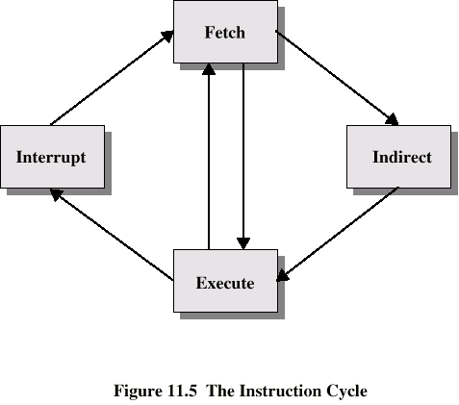
Instruction Cycle with Indirect

Slide 41

Instruction Cycle State Diagram

Slide 42
Data Flow (Instruction Fetch)
PC contains address of next instruction
Address moved to MAR
Address placed on address bus
Control unit requests memory read
Result placed on data bus, copied to MBR, then to IR
Meanwhile PC incremented by 1

Slide 43

Data Flow (Fetch Diagram)

Slide 44
Data Flow (Data Fetch)
IR is examined
If indirect addressing, indirect cycle is performed
  Rightmost n bits of MBR (address part of instruction) transferred to MAR
  Control unit requests memory read
  Result (address of operand) moved to MBR

Slide 45

Data Flow (Indirect Diagram)

Slide 46
Data Flow (Execute)
May take many forms, depends on instruction being executed
May include
  Memory read/write
  Input/Output
  Register transfers
  ALU operations

Slide 47
Data Flow (Interrupt)
Current PC saved to allow resumption after interrupt
Contents of PC copied to MBR
Special memory location (e.g., stack pointer) loaded to MAR
MBR written to memory according to content of MAR
PC loaded with address of interrupt handling routine
Next instruction (first of interrupt handler) can be fetched

Slide 48

Data Flow (Interrupt Diagram)

Slide 49
Prefetch
Fetch involves accessing main memory
Execution of ALU operations do not access main memory
Can fetch next instruction during execution of current instruction, cf. assembly line
Called instruction prefetch
Notes:
36

Slide 50
Improved Performance
But not doubled:
  Fetch usually shorter than execution (cf. reading and storing operands)
    Prefetch more than one instruction?
  Any jump or branch means that prefetched instructions are not the required instructions
Add more stages to improve performance
Notes:
37

Slide 51
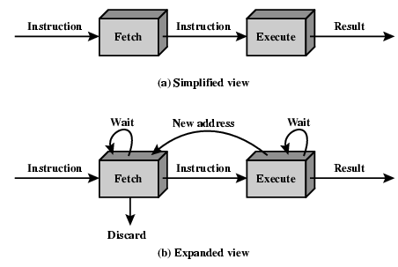
Two Stage Instruction Pipeline

Slide 52
Pipelining (six stages)
Fetch instruction
Decode instruction
Calculate operands (i.e., EAs)
Fetch operands
Execute instructions
Write result
Overlap these operations
Notes:
38

Slide 53
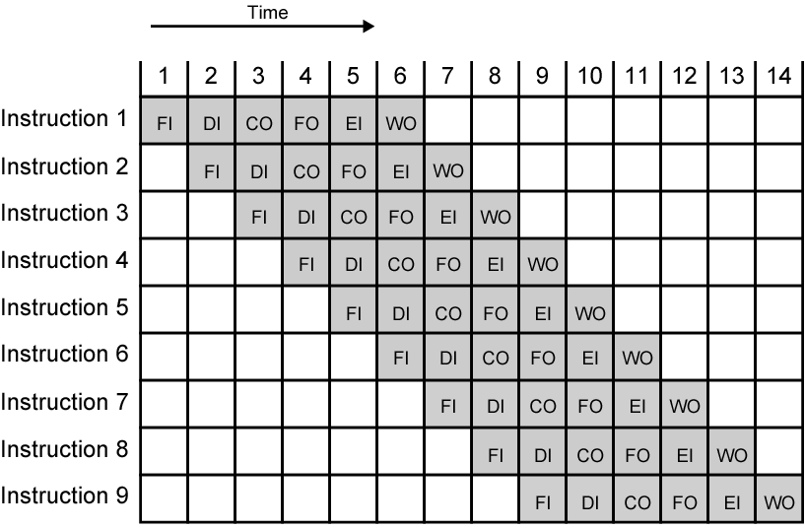
Timing Diagram for Instruction Pipeline Operation (assuming independence)
Notes:
39

Slide 54
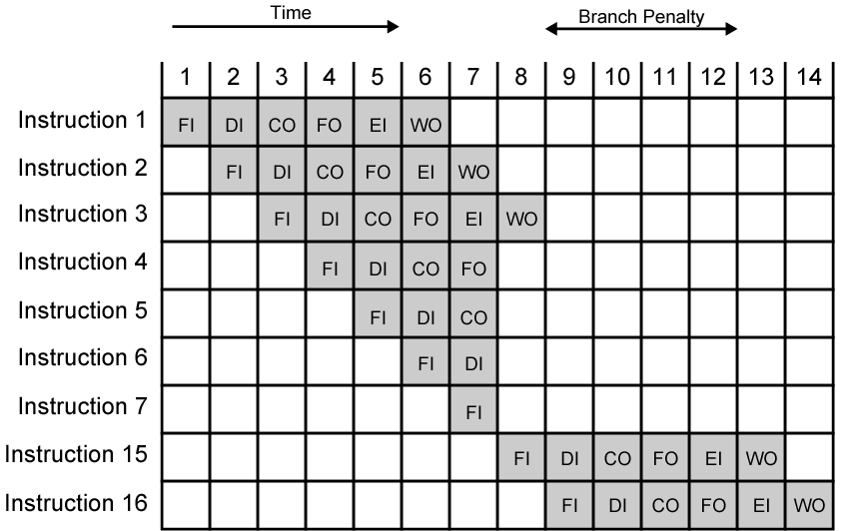
The Effect of a Conditional Branch/Interrupt on Instruction Pipeline Operation
Notes:
40

Slide 55
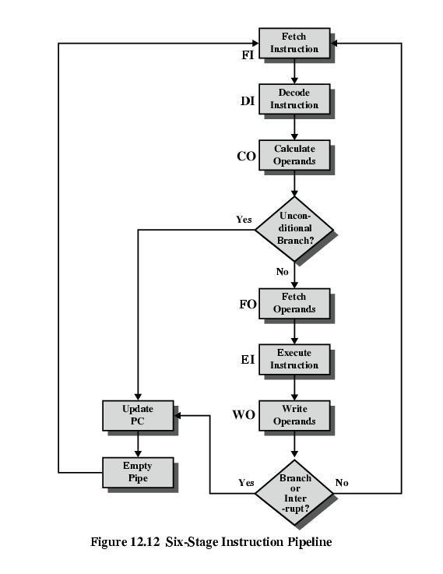
Six Stage
Instruction Pipeline

Slide 56
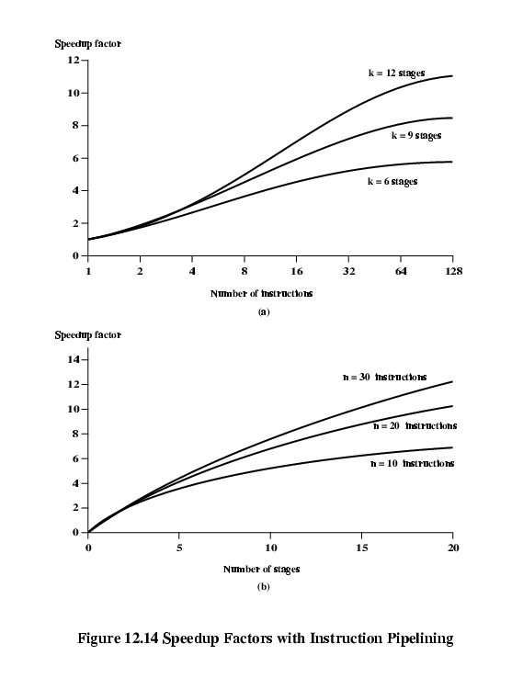
Speedup Factors with Instruction
Pipelining: nk/(n+k-1)
(ideally)

Slide 57
Dealing with Branches
Prefetch Branch Target
Loop buffer
Branch prediction
Delayed branching (see RISC)
Notes:
41

Slide 58
Prefetch Branch Target
Target of branch is prefetched in addition to instructions following branch
Keep target until branch is executed
Used by IBM 360/91
Notes:
43

Slide 59
Loop Buffer
Very fast memory
Maintained by fetch stage of pipeline
Check buffer before fetching from memory
Very good for small loops or jumps
cf. cache
Notes:
44

Slide 60
Branch Prediction (1)
Predict never taken
  Assume that jump will not happen
  Always (almost) fetch next instruction
  VAX will not prefetch after branch if a page fault would result (OS v CPU design)
Predict always taken
  Assume that jump will happen (at least 50%)
  Always fetch target instruction
Notes:
45

Slide 61
Branch Prediction (2)
Predict by Opcode
  Some instructions are more likely to result in a jump than others
  Can get up to 75% success
Taken/Not taken switch
  Based on previous history
  Good for loops
Delayed branch – rearrange instructions (see RISC)
Notes:
46

Slide 62
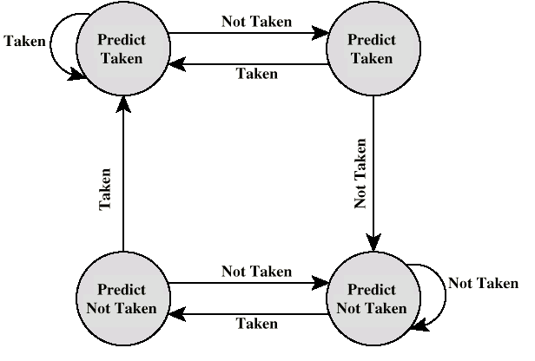
Branch Prediction State Diagram (two bits)

Slide 63
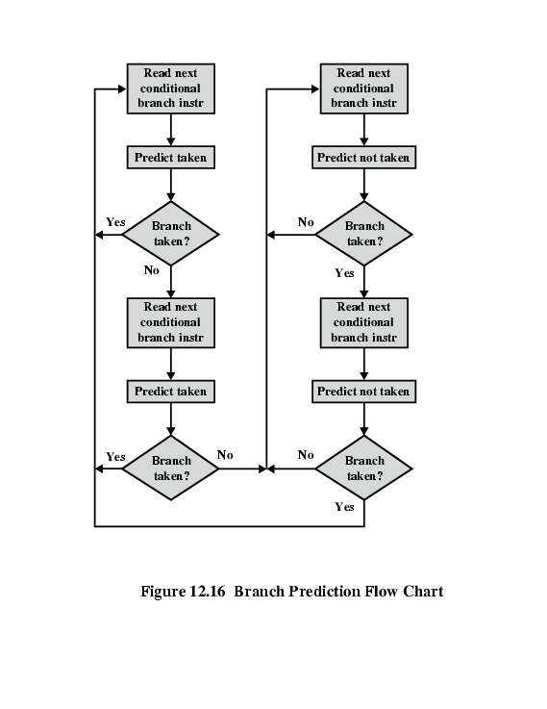
Branch Prediction Flowchart

Slide 64
Intel 80486 Pipelining
Fetch
  Put in one of two 16-byte prefetch buffers
  Fill buffer with new data as soon as old data consumed
  Average 5 instructions fetched per load (variable size)
  Independent of other stages to keep buffers full
Decode stage 1
  Opcode & address-mode info
  At most first 3 bytes of instruction needed for this
  Can direct D2 stage to get rest of instruction
Decode stage 2
  Expand opcode into control signals
  Computation of complex addressing modes
Execute
  ALU operations, cache access, register update
Writeback
  Update registers & flags
  Results sent to cache

Slide 65
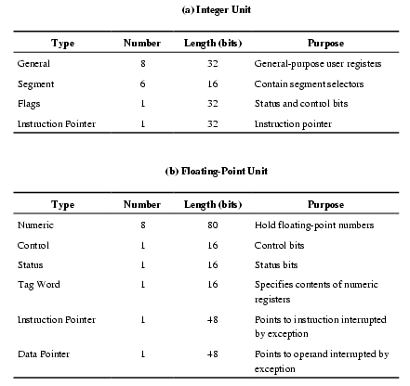
Pentium 4 Registers

Slide 66
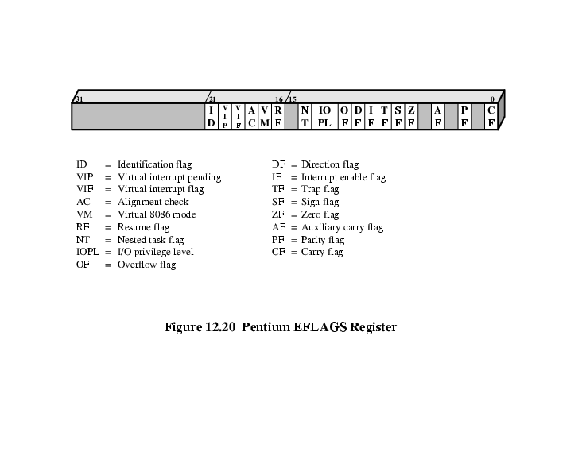
EFLAGS Register

Slide 67
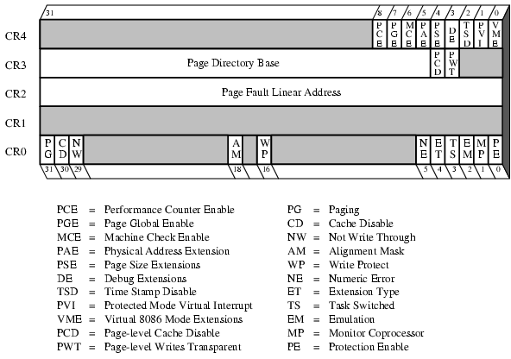
Control Registers

Slide 68
Pentium Interrupt Processing
Interrupts (hardware): (non-)maskable
Exceptions (software): processor detected (error) or programmed (exception)
Interrupt vector table
  Each interrupt type assigned a number
  Index to vector table
  256 * 32 bit interrupt vectors (address of ISR)
5 priority classes: 1. exception by previous instruction 2. external interrupt, 3.-5. faults from fetching, decoding or executing instruction

