Slide 1
High Performance Computing
Introduction
Abdulrahman Azab
18, April 2016

Slide 2
What is it?

Slide 3
How does it work?

Slide 4
Top500

Slide 5
What is Parallel Computing?
Traditionally, software has been written for serial computation:
  To be run on a single computer having a single Central Processing Unit (CPU);
  A problem is broken into a discrete series of instructions.
  Instructions are executed one after another.
  Only one instruction may execute at any moment in time.

Slide 6

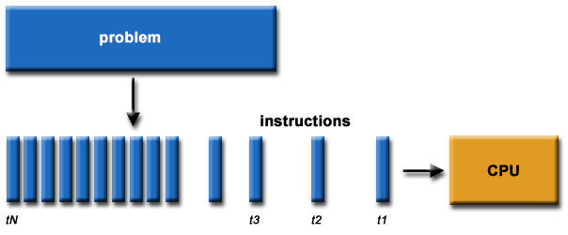

Slide 7
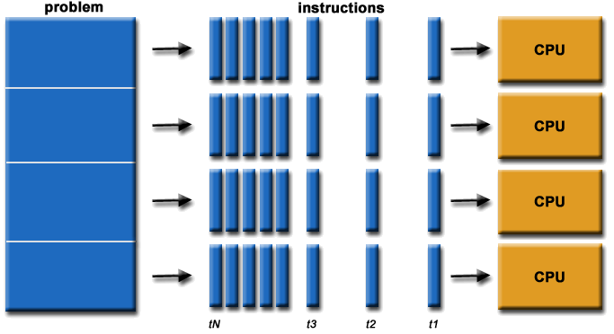
What is Parallel Computing?
In the simplest sense, parallel computing is the simultaneous use of multiple compute resources to solve a computational problem.
  To be run using multiple CPUs
  A problem is broken into discrete parts that can be solved concurrently
  Each part is further broken down to a series of instructions
Instructions from each part execute simultaneously on different CPUs

Slide 8
Why Parallel Computing?
  Save time - wall clock time
  Solve larger problems
  Provide concurrency (do multiple things at the same time)
  Taking advantage of non-local resources - using available compute resources on a wide area network, or even the Internet when local compute resources are scarce.
  Cost savings - using multiple "cheap" computing resources instead of paying for time on a supercomputer.
  Overcoming memory constraints - single computers have very finite memory resources. For large problems, using the memories of multiple computers may overcome this obstacle.

Slide 9
Concepts

Slide 10
Von Neumann Architecture
For over 40 years, virtually all computers have followed a common machine model known as the von Neumann computer. Named after the Hungarian mathematician John von Neumann.
A von Neumann computer uses the stored-program concept. The CPU executes a stored program that specifies a sequence of read and write operations on the memory.

Slide 11
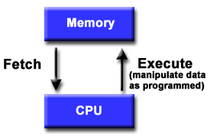
Basic Design
Basic design
  Memory is used to store both program and data instructions
  Program instructions are coded data which tell the computer to do something
  Data is simply information to be used by the program
A central processing unit (CPU) gets instructions and/or data from memory, decodes the instructions and then sequentially performs them.

Slide 12
Flynn's Classical Taxonomy
There are different ways to classify parallel computers. One of the more widely used classifications, in use since 1966, is called Flynn's Taxonomy.
Flynn's taxonomy distinguishes multi-processor computer architectures according to how they can be classified along the two independent dimensions of Instruction and Data. Each of these dimensions can have only one of two possible states: Single or Multiple.

Slide 13
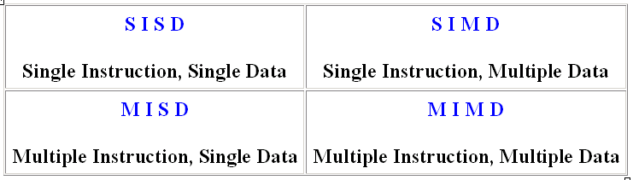
Flynn Matrix
The matrix below defines the 4 possible classifications according to Flynn

Slide 14
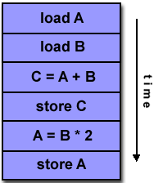
Single Instruction, Single Data (SISD)
A serial (non-parallel) computer
Single instruction: only one instruction stream is being acted on by the CPU during any one clock cycle
Single data: only one data stream is being used as input during any one clock cycle
Deterministic execution
This is the oldest and until recently, the most prevalent form of computer
Examples: most PCs, single CPU workstations and mainframes

Slide 15
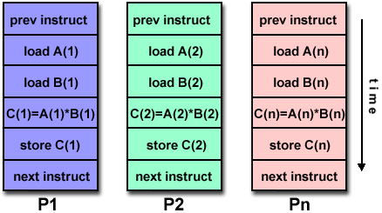
Single Instruction, Multiple Data (SIMD)
Single instruction: All processing units execute the same instruction at any given clock cycle
Multiple data: Each processing unit can operate on a different data element
Best suited for specialized problems characterized by a high degree of regularity, such as image processing.
Synchronous (lockstep) and deterministic execution
Examples:
  Processor Arrays: Connection Machine CM-2, Maspar MP-1, MP-2
  Vector Pipelines: IBM 9000, Cray C90, Fujitsu VP, NEC SX-2, Hitachi S820

Slide 16
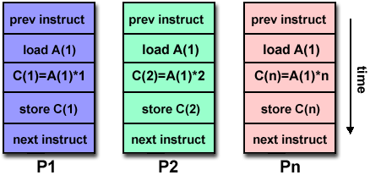
Multiple Instruction, Single Data (MISD)
A single data stream is fed into multiple processing units.
Each processing unit operates on the data independently via independent instruction streams.
Some conceivable uses might be:
  multiple frequency filters operating on a single signal stream.
  Actual use case: SITE@home
multiple cryptography algorithms attempting to crack a single coded message.

Slide 17
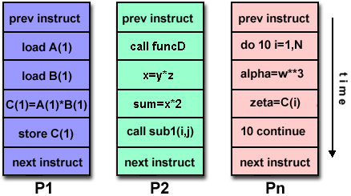
Multiple Instruction, Multiple Data (MIMD)
Currently, the most common type of parallel computer. Most modern computers fall into this category.
Multiple Instruction: every processor may be executing a different instruction stream
Multiple Data: every processor may be working with a different data stream
Execution can be synchronous or asynchronous, deterministic or non-deterministic
Examples: most current supercomputers, networked parallel computer "grids" and multi-processor SMP computers - including some types of PCs.

Slide 18
Task
  A logically discrete section of computational work. A task is typically a program or program-like set of instructions that is executed by a processor.
Parallel Task
  A task that can be executed by multiple processors safely (yields correct results)
Serial Execution
  Execution of a program sequentially, one statement at a time. In the simplest sense, this is what happens on a one processor machine. However, virtually all parallel tasks will have sections of a parallel program that must be executed serially.

Slide 19
Parallel Execution
  Execution of a program by more than one task, with each task being able to execute the same or different statement at the same moment in time.
Shared Memory
  From a strictly hardware point of view, describes a computer architecture where all processors have direct (usually bus based) access to common physical memory. In a programming sense, it describes a model where parallel tasks all have the same "picture" of memory and can directly address and access the same logical memory locations regardless of where the physical memory actually exists.

Slide 20
Distributed Memory
  In hardware, refers to network based memory access for physical memory that is not common. As a programming model, tasks can only logically "see" local machine memory and must use communications to access memory on other machines where other tasks are executing.
Communications
  Parallel tasks typically need to exchange data. There are several ways this can be accomplished, such as through a shared memory bus or over a network, however the actual event of data exchange is commonly referred to as communications regardless of the method employed.

Slide 21
Synchronization
  The coordination of parallel tasks in real time, very often associated with communications. Often implemented by establishing a synchronization point within an application where a task may not proceed further until another task(s) reaches the same or logically equivalent point.
  Synchronization usually involves waiting by at least one task, and can therefore cause a parallel application's wall clock execution time to increase.

Slide 22
Granularity
  In parallel computing, granularity is a qualitative measure of the ratio of computation to communication.
  Coarse: relatively large amounts of computational work are done between communication events
  Fine: relatively small amounts of computational work are done between communication events
Observed Speedup
  Observed speedup of a code which has been parallelized, defined as:
  wall-clock time of serial execution
  wall-clock time of parallel execution
  One of the simplest and most widely used indicators for a parallel program's performance.

Slide 23
Parallel Overhead
  The amount of time required to coordinate parallel tasks, as opposed to doing useful work. Parallel overhead can include factors such as:
    Task start-up time
    Synchronizations
    Data communications
    Software overhead imposed by parallel compilers, libraries, tools, operating system, etc.
    Task termination time

Slide 24
Massively Parallel
  Refers to the hardware that comprises a given parallel system - having many processors. The meaning of many keeps increasing, but currently BG/L pushes this number to 6 digits.

Slide 25
Scalability
  Refers to a parallel system's (hardware and/or software) ability to demonstrate a proportionate increase in parallel speedup with the addition of more processors. Factors that contribute to scalability include:
    Hardware - particularly memory-cpu bandwidths and network communications
    Application algorithm
    Parallel overhead related
    Characteristics of your specific application and coding

Slide 26
Memory Architectures

Slide 27
Memory architectures
Shared Memory
Distributed Memory
Hybrid Distributed-Shared Memory

Slide 28
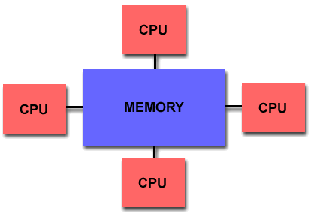
Shared Memory
Shared memory parallel computers vary widely, but generally have in common the ability for all processors to access all memory as global address space.
Multiple processors can operate independently but share the same memory resources.
Changes in a memory location effected by one processor are visible to all other processors.
Shared memory machines can be divided into two main classes based upon memory access times: UMA and NUMA.

Slide 29
Shared Memory : UMA vs. NUMA
Uniform Memory Access (UMA):
  Most commonly represented today by Symmetric Multiprocessor (SMP) machines
  Identical processors
  Equal access and access times to memory
  Sometimes called CC-UMA - Cache Coherent UMA. Cache coherent means if one processor updates a location in shared memory, all the other processors know about the update. Cache coherency is accomplished at the hardware level.
Non-Uniform Memory Access (NUMA):
  Often made by physically linking two or more SMPs
  One SMP can directly access memory of another SMP
  Not all processors have equal access time to all memories
  Memory access across link is slower
  If cache coherency is maintained, then may also be called CC-NUMA - Cache Coherent NUMA

Slide 30
Shared Memory: Pro and Con
Advantages:
  Global address space provides a user-friendly programming perspective to memory
  Data sharing between tasks is both fast and uniform due to the proximity of memory to CPUs
Disadvantages:
  Primary disadvantage is the lack of scalability between memory and CPUs. Adding more CPUs can geometrically increases traffic on the shared memory-CPU path, and for cache coherent systems, geometrically increase traffic associated with cache/memory management.
  Programmer responsibility for synchronization constructs that insure "correct" access of global memory.
  Expense: it becomes increasingly difficult and expensive to design and produce shared memory machines with ever increasing numbers of processors.

Slide 31
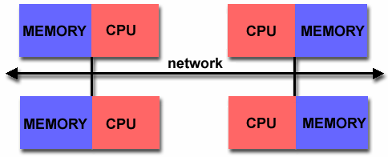
Distributed Memory
Processors have their own local memory. Memory addresses in one processor do not map to another processor, so there is no concept of global address space across all processors.
Because each processor has its own local memory, it operates independently. Changes it makes to its local memory have no effect on the memory of other processors. Hence, the concept of cache coherency does not apply.
When a processor needs access to data in another processor, it is usually the task of the programmer to explicitly define how and when data is communicated. Synchronization between tasks is likewise the programmer's responsibility.
The network "fabric" used for data transfer varies widely, though it can can be as simple as Ethernet.

Slide 32
Distributed Memory: Pro and Con
Advantages
  Memory is scalable with number of processors. Increase the number of processors and the size of memory increases proportionately.
  Each processor can rapidly access its own memory without interference and without the overhead incurred with trying to maintain cache coherency.
  Cost effectiveness: can use commodity, off-the-shelf processors and networking.
Disadvantages
  The programmer is responsible for many of the details associated with data communication between processors.
  It may be difficult to map existing data structures, based on global memory, to this memory organization.
  Non-uniform memory access (NUMA) times

Slide 33
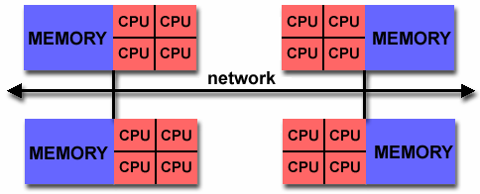
Hybrid Distributed-Shared Memory
The largest and fastest computers in the world today employ both shared and distributed memory architectures.
The shared memory component is usually a cache coherent SMP machine. Processors on a given SMP can address that machine's memory as global.
The distributed memory component is the networking of multiple SMPs. SMPs know only about their own memory - not the memory on another SMP. Therefore, network communications are required to move data from one SMP to another.
Advantages and Disadvantages: whatever is common to both shared and distributed memory architectures.

Slide 34
Parallel Programming Models

Slide 35
Shared Memory Model
Threads Model
Message Passing Model
Data Parallel Model
Other Models

Slide 36
Shared Memory Model
On shared memory platforms, the native compilers translate user program variables into actual memory addresses, which are global.

Slide 37
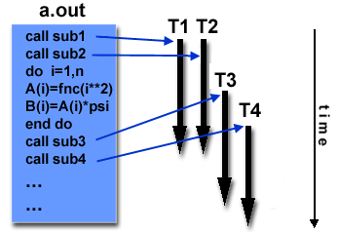
Threads Model
In the threads model of parallel programming, a single process can have multiple, concurrent execution paths.
Threads are commonly associated with shared memory architectures and operating systems.

Slide 38
Message Passing Model
  A set of tasks that use their own local memory during computation. Multiple tasks can reside on the same physical machine as well across an arbitrary number of machines.
  Tasks exchange data through communications by sending and receiving messages.
  The programmer is responsible for determining all parallelism.

Slide 39
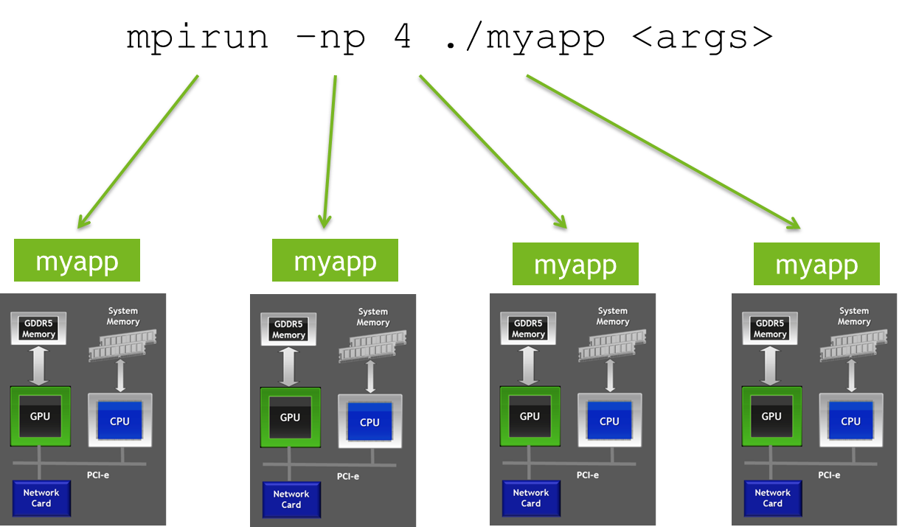

Slide 40
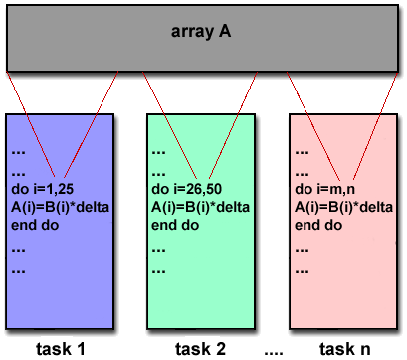

Slide 41
Computing Platforms

Slide 42
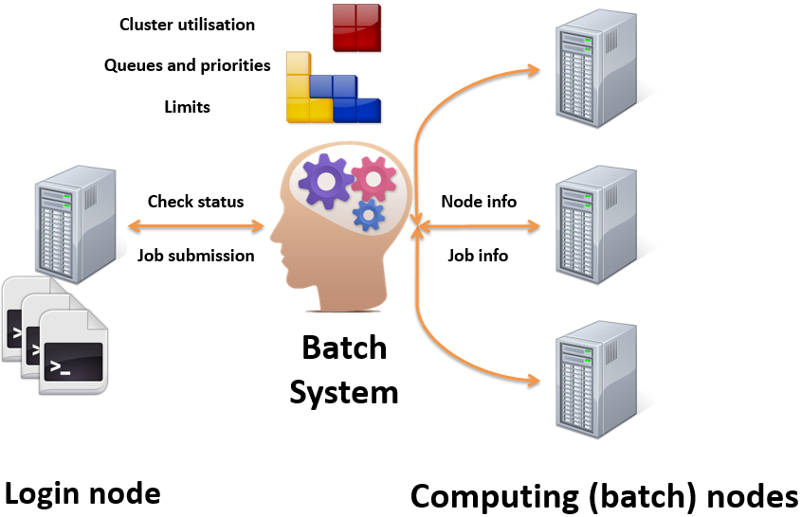
High Performance Computing (HPC)
Huge parallel tasks (how much my task would take?).

Slide 43
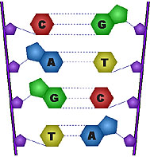



High Throughput Computing (HTC)
Huge number of tasks (how many tasks can I submit?).
I need a Scientific Linux
with 2GB RAM!
I have scientific linux
With 3 GB Ram
Broker
Take Hero
Submit
Resource:Hero
User: Ali

Slide 44


HPC on the Cloud
Scheduler
Scheduler
W
W
W
W
W
W
W
W
W
W
W
W

Slide 45
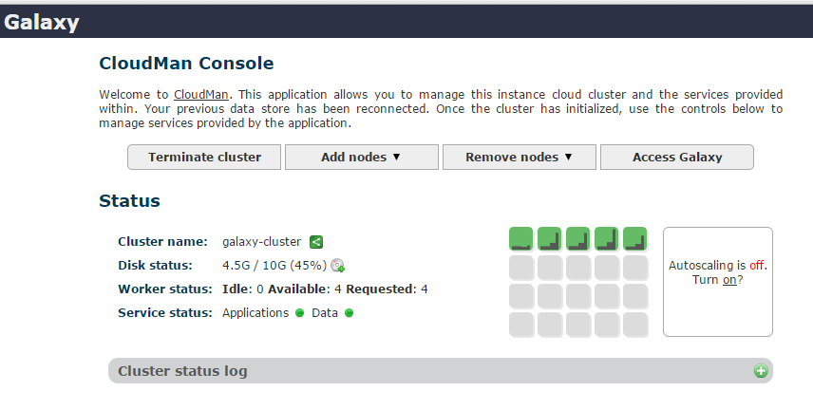
Galaxy on a cloud HPC Cluster

Slide 46

2 CPU cores → 2 Concurrent runs

Slide 47

8 CPU cores → 8 Concurrent runs

Slide 48


