Slide 1


CO₂ Forecasting Model
Karishma Changlani, Martin Grunnill
Kevin Kakolla, Akshay Sapra

Slide 2

Problem Statement
Climate change is ones of the biggest challenges of our time
A lot of policy decisions are often based around cutting back CO₂
If we can predict CO₂ using information like imports and exports we can mitigate matters.
Notes:
Martin

Slide 3
Methodology-Data Sources
Sources (merged on year & iso code):
Our World in Data:
CO2: https://github.com/owid/co2-data
Energy: https://github.com/owid/energy-data
Land use, Median Age & Military Spending: https://ourworldindata.org/
World Bank Development Indexes:
Demographics, Imports & Exports: https://databank.worldbank.org/reports.aspx?source=world-development-indicators
Notes:
Martin

Slide 4
Methodology-Features: Engineering
% Male out of all males in 5 yearly age groups to:
% Male: Children (0-14)
% Female Working age Adults (15-64)
% Female Retired (>64)
% Female out of all females in 5 yearly age groups to:
% Female Children (0-14)
% Female Working age Adults (15-64)
% Female Retired (>64)
Notes:
Martin

Slide 5
Methodology-Features:
Removing Data Leaks, Spurious
Data leaks
CO₂ from particular sources or changes from previous years.
Whole Greenhouse Gasses (e.g. total ghg, ghg per capita).
Other Greenhouse Gasses (nitrous oxide and methane), often same industrial source .
Overlapping energy consumption listing:
e.g. x_consumption, x_share, x_per_gdp, x_per_capita & x_electricity.
Removed but for x_consumption.
Spurious
Year: why build a model to look at past when you can look it up.
Country:
Could be dependent on government policies that change.
What about a new country that broke away from an old one.
Notes:
Karishma

Slide 6
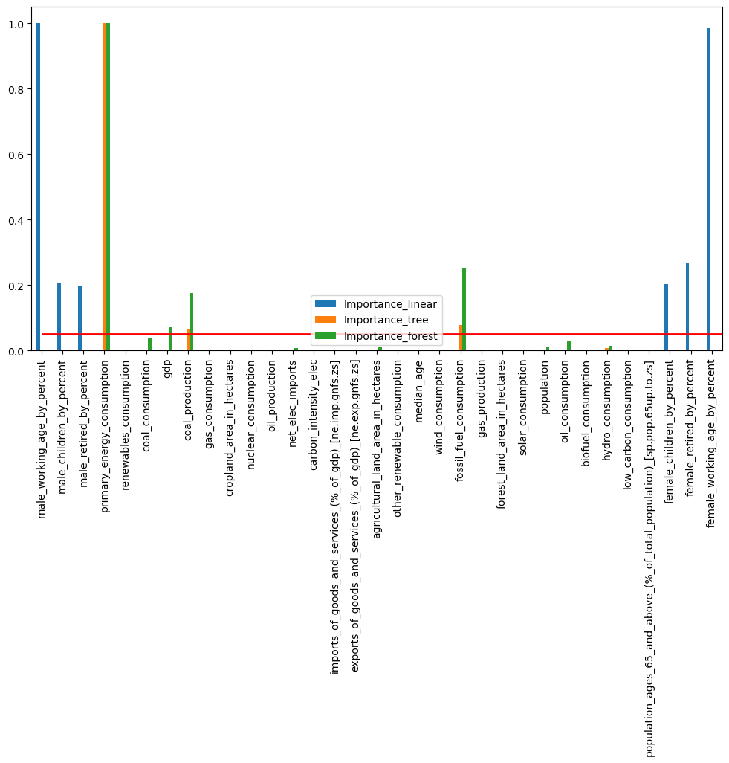
Methodology-Feature Selection
Fitted linear, decision tree & random forest regressor(ion) models to training data (default hyper parameters).
Obtained feature importance (or coefficients) for each model and scaled:
Converting to absolute value
Min-Max scaled
Plotted and chose a cut off value to select a set of top 10-20 features.
0.05
10 features
Notes:
Karishma

Slide 7
Methodology-
Hyper-Parameter Tuning (Cross Validation)
Model | Grid used | Optimal value for hyper-parameters
Linear Regression | Fit intercept True or False | Fit_intercept: True
Lasso Regression | Alpha: 0.1, 2; Max iterations: 100 2000 tolerance: 0.01, 0.0001 | Alpha :0.1, max Iterations 2000 Tolerance 0.0001
Ridge Regression | Alpha: 0.1, 2; Max iterations: 100 2000 tolerance: 0.01, 0.0001 | Alpha :0.1, max Iterations 100 Tolerance 0.01
Decision Tree | Max Depth: 10, 20, 50, 100; Max Features: sqrt, log2 Min Samples Split 2, 5, 10; Min samples leaf: 1, 2, 4 | Max Depth: 50; Max Features: sqrt Min Samples Split 2; Min samples leaf: 1
Random Forest | Max Depth: 10, 20, 50, 100; Max Features: sqrt, log2 Min Samples Split 2, 5, 10; Min samples leaf: 1, 2, 4 Bootstrap True/False; | Max Depth: 20; Max Features: sqrt Min Samples Split: 1; Min samples leaf: 2
Notes:
Karishma

Slide 8
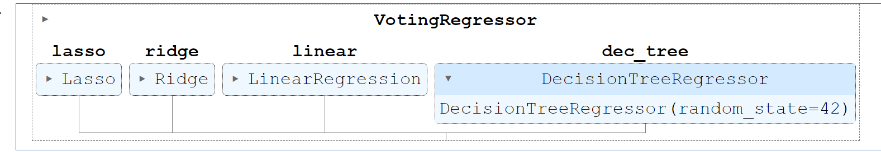
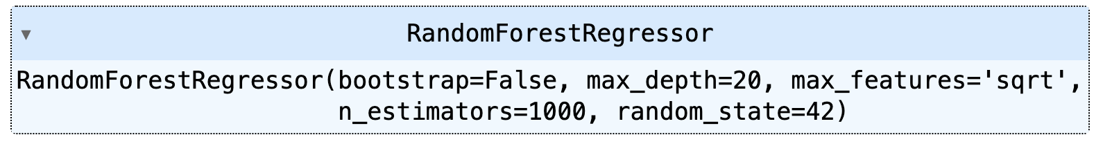
Methodology - Ensemble Model
Notes:
Akshay

Slide 9
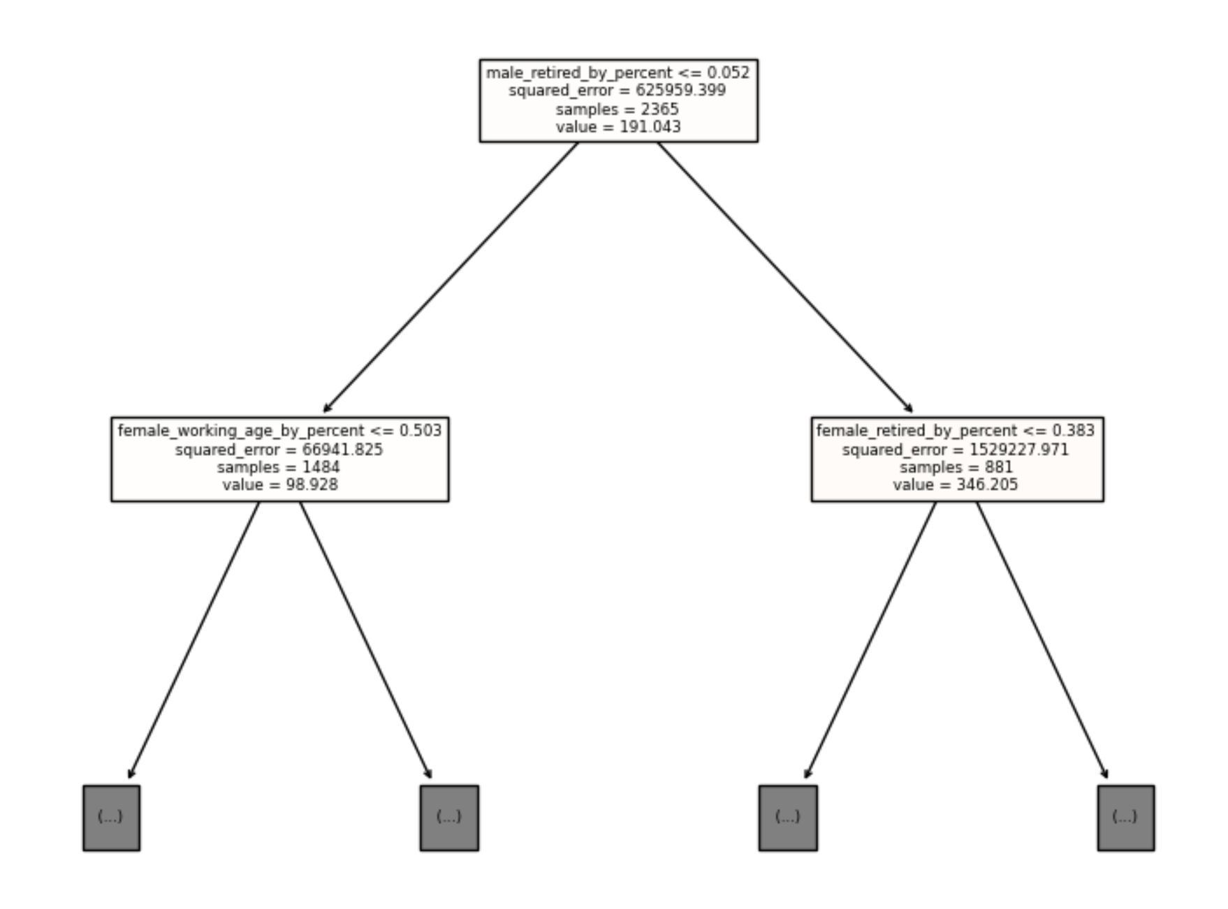
Notes:
Akshay

Slide 10
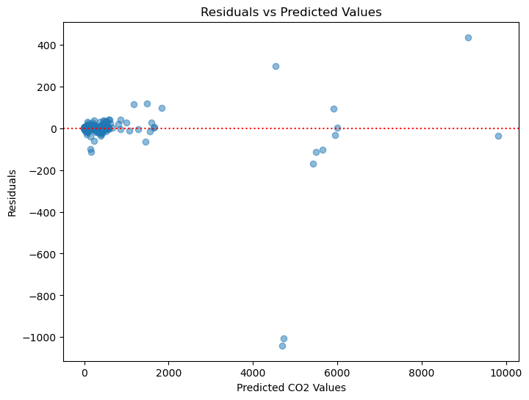
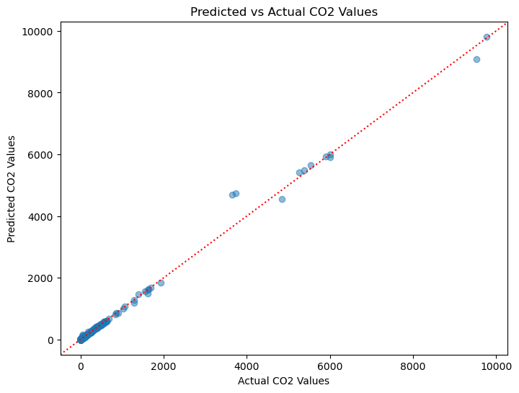
Results from Random Forest
Notes:
Akshey

Slide 11
Conclusion - Decision Tree Overfit
Random Forest Better
Fit to Training data (80%)
Fit to Test data (20%)
Lasso | MAE: 26.7
Ridge | MAE: 26.9
Linear Regression | MAE: 26.9
DecisionTreeRegressor | MAE: 0.05
VotingRegressor | MAE: 20.0
RandomForestRegressor | MAE: 2.2
Lasso | MAE: 31.9
Ridge | MAE: 31.9
Linear Regression | MAE: 31.9
DecisionTreeRegressor | MAE: 18.1
VotingRegressor | MAE: 25.9
RandomForestRegressor | MAE: 9.7
Notes:
Kevin

Slide 12
Challenges/Lessons (potential solutions)
Challenges
Lessons (potential solutions)
Locating data sources, limited years 2000-2018 | Merging data from different sources.
Limiting data leakage with so many features. | This could be mitigated by learning about the data and its sources.
Differences between people running the same code. | Listing package requirements, google colab, conda environments or docker.
Notes:
Kevin

