Slide 1



Ontario Trans I.D. Workshop
May 2025 | Presented by Dana Rosamund Teagle (she/her)
Slides and documents are available for download at https://tg-id.ca
- Legal name changes
- Birth certificates
- Health cards
- Driver’s licenses & photo cards
- Travel documents
& more

Slide 2
A quick background on me
I’m Dana Rosamund Teagle, and I’m a designer, web/software developer, and trans woman based in Tkaronto (Toronto), Ontario. I’ve led workshops on name and gender marker changes since 2021, and now run a online resource called TG I.D., which collects information on how to update legal names, gender markers, and identity documents in Ontario.
The level of bureaucracy currently in place across the country for these vital services and processes makes them fundamentally inaccessible, and I believe that communities coming together to share our experiences and resources with one another is an act of resistance, so that mentality is embedded in my approach.
TG I.D. is still a work in progress that I maintain in my spare time, but I’m hoping it can help to break down some of these access barriers that prevent people from filing this paperwork.

Slide 3
Our itinerary today
Over the next 45 minutes or so, I will give an overview of:
- Ontario legal name changes
- Requests for Ontario birth registrations & certificates
- Sex designation changes on Ontario driver’s licenses & photo cards
- Ontario health card updates
- Passport updates
- Permanent residency card updates
- Updates to the S.I.N. registry and the C.R.A.
I will also point to resources I recommend for commissioning and notarizing, and other information and assistance for making these changes.

Slide 4
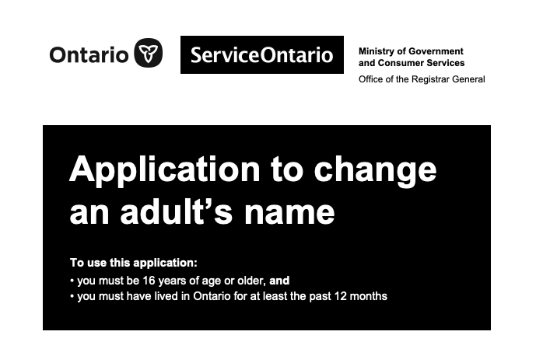
Ontario legal name changes
https://www.ontario.ca/page/change-name
https://tg-id.ca/on/name-changes
You will need to fill out the Ontario Application to Change an Adult’s Name (11155E).
The application is nineteen pages long, and divided into seven parts, but you may not need to fill out all of them. You must also submit a fee of $137 with your application.
Note: This is based on 2024 edition of the application. Always make sure you are filling out the most recent version of any given document.

Slide 5

Ontario legal name changes
Requirements
This application requires you to fill out a lot of your personal information, including:
- Full current legal name
- New chosen name
- Mailing address
- Date and location of birth
- Marital/relationship status
- Parental information
- Details of any previous name change
- Information about any current or past criminal offences
- Information about any current or past financial judgments, fines, or bankruptcy

Slide 6

Ontario legal name changes
Additional sections
- If you are married or in a joint conjugal relationship, you are required to notify your partner or spouse about your name change and must complete Part 2
- If you are 16 or 17 and changing your own name, you will require the consent of every individual who holds legal custody over you and must complete Part 3
- If you have any outstanding law enforcement orders against you, have ever been convicted of a criminal offence, or have any pending criminal charges against you, you will need a police record check as part of your application
- If you were born in another part of Canada and want a new birth certificate, you must contact the province or territory where you were born after you receive your change of name certificate

Slide 7

Ontario legal name changes
Guarantor statement
You will also require a guarantor who can prove that you have lived in Ontario for 12 months prior to your application.
In my experience, most applicants will use a medical professional such as their primary care doctor for this category. However, there are several other options such as municipal clerks, school principals, and Indigenous elders. If you cannot find anyone that meets the requirements, you can use someone *other than a relative* who has known you for at least five years and can speak to your residency in Ontario for the past year.
Make sure you remove the Guarantor’s statement section and have the chosen individual complete and return it to you before you submit the application.

Slide 8
Ontario legal name changes
Previous identity documents and additional requirements
If you were born in Ontario and have a valid birth certificate, you must include the originals of all previously issued short- or long-form certificates with your application
If you were born outside of Ontario but within Canada, you can submit either an original birth certificate or certified copy issued by the province or territory of your birth
If you do not have a birth certificate, you will likely need to apply for a new certificate before you can submit this application
If all or part of a document sent in support of your change of name application is not written in English or French, you must send an English or French translation

Slide 9
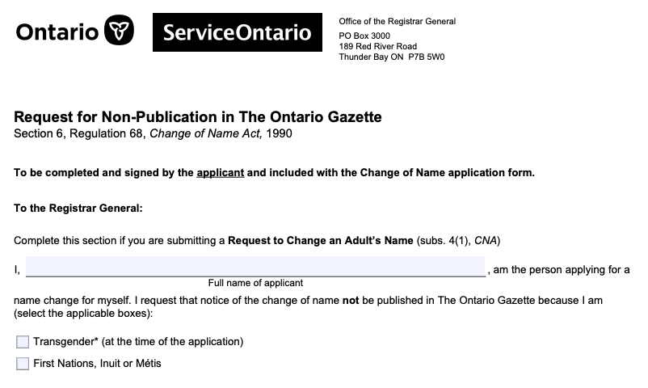
Ontario legal name changes
Request for non-publication
All name changes registered under Ontario’s Change of Name Act are generally published in The Ontario Gazette, however you can request non-publication if you are transgender, First Nations, Inuit, or Métis by submitting a completed Request for Non-Publication form with your change of name application.
They currently publish information both in paper and online, so if publication of your previous name is not desirable, I would strongly recommend adding this into your process.

Slide 10
Ontario legal name changes
Commissioning
You must sign the statutory declaration on page 16 in front of a commissioner for taking affidavits, who will seal or stamp the document at that time to verify your identity and the accuracy of the information as written. The commissioner does not have to know the person signing the application.
Several notary/commissioner’s offices in Ontario will commission these documents for trans individuals for no charge; however, the typical charge if applicable is $30-45.

Slide 11
Ontario legal name changes
Submitting your application
If possible, we recommend sending the entire application in a tracked envelope using Canada Post, to ease the stress of your application getting lost in the mail, and to allow for an update when it is likely beginning to be processed.
Send your completed form, payment, and required documents to:
Office of the Registrar General P.O. Box 3000 189 Red River Road Thunder Bay, ON P7B 5W0

Slide 12
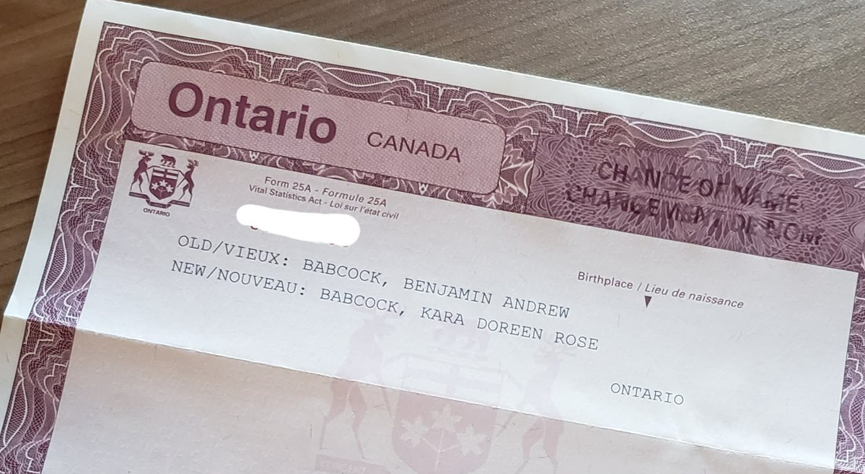
Ontario legal name changes
Submitting your application
If it is more accessible for you to submit the application in person and you are located in Toronto, you can bring your completed form, payment, and required documents to:
ServiceOntario
47 Sheppard Avenue East, Unit 417, 4th Floor
Toronto, ON
M2N 5N1
If your application is complete and accurate, you should receive a certificate of name change in 6-8 weeks. This document will show your previous name and your new name. You can use this certificate to change your name on other personal documents.
If possible, I recommend sending the entire application in a tracked envelope using Canada Post, to ease the stress of your application getting lost in the mail, and to allow for an update when it is likely beginning to be processed.

Slide 13

Ontario legal name changes
Some suggestions
- Give yourself time (it will likely take several weeks to gather all the information you need, and to complete, double-check, and submit the forms)
- Print clearly using a pen with blue or black ink
- Do not use correction fluid on any forms
- If you make a mistake or want to change information, you must do the following:
- Put brackets around the wrong information
- Enter the correct information
- Put your initials beside each change
- Have the commissioner initial each change before it is sworn

Slide 14
Ontario legal name changes
Checklist
Fill out the Application to Change an Adult's Name (all relevant sections, excluding Guarantor’s Statement) and Request for Non-Publication in the Ontario Gazette (DO NOT SIGN YET)
Collect all required identification photocopies and/or original documents, including translations, if necessary
Receive consent from every person who has legal custody of you, if applicable
Give your partner/spouse notice that you are changing your name, if applicable
Receive a police check, if necessary
Secure the $137 + shipping to submit the application
Secure a guarantor and have them fill out the Guarantor’s statement
Make an appointment with a commissioner, having them witness you sign and then commission the document
Mail the document to the Office of the Registrar General in Thunder Bay, ON or submit in person in Toronto, ON

Slide 15
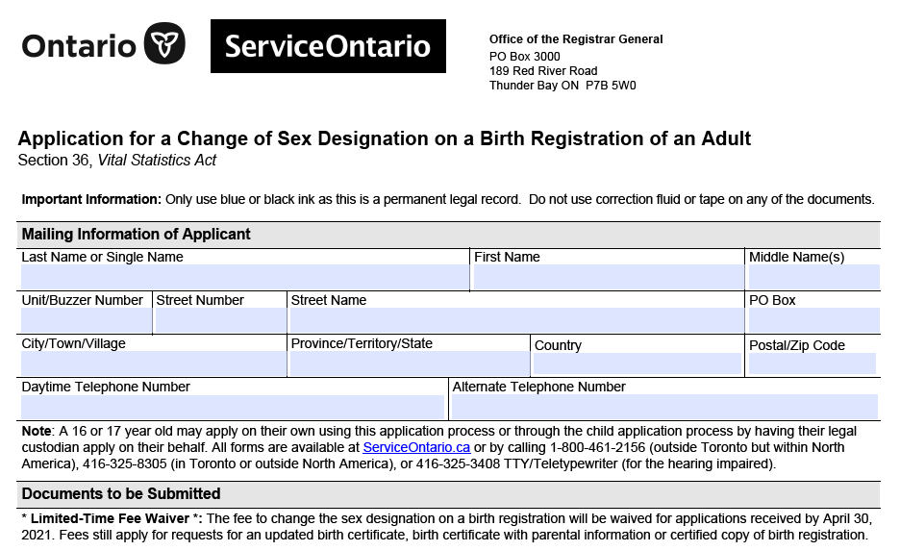
Ontario birth certificates
https://www.ontario.ca/page/changing-your-sex-designation-your-birth-registration-and-birth-certificate
https://tg-id.ca/on/birth-certificates
To update the sex designation on your Ontario birth registration or certificate, you will need to complete the Ontario Application for Change of Sex Designation on a Birth Registration of an Adult (11325E) as well as the Statutory Declaration for a Change of Sex Designation on a Birth Registration of an Adult (11324E).
The application is two pages long, and the declaration is a single page. They can be submitted at the same time as your Ontario name change, if applicable.
Note: This is based on 2022 edition of the application. Always make sure you are filling out the most recent version of any given document.

Slide 16
Ontario birth certificates
Requirements
When changing your sex designation, you have the options of M (male), F (female), or X (gender neutral) or not to display the sex designation field at all. Depending on your chosen designation, your process will be different.
You must be born in Ontario, and 16 years of age or older to complete this application. Along with the forms, you must provide:
A letter from a licensed doctor or psychologist in good-standing, written on the doctor’s letterhead, stating that the doctor has examined or treated you and they can attest that the updated designation is appropriate, and signed by the doctor
All previously issued short- and long-form birth certificates and certified copies of your birth registration
A completed application form and declaration, along with any applicable fees

Slide 17

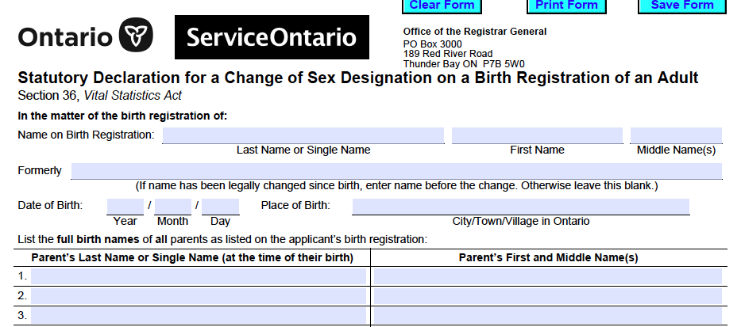
Ontario birth certificates
Commissioning
Just like the name change application, you must sign the statutory declaration of this application in front of a commissioner for taking affidavits, so please factor that into your plan as you begin to work through your documents.

Slide 18
Ontario birth certificates
Submitting your application
You can mail your application to:
Office of the Registrar General
189 Red River Road, P.O. Box 3000
Thunder Bay, Ontario
P7B 5W0
If mailing at the same time as a name change, you can mail all documents in one envelope to the address listed under that section.
If being filed without a name change, I recommend a tracked envelope as with that application. Photocopied, faxed, or e-signed documents will not be accepted.
While there used to be a fee for changing your sex designation, ServiceOntario began waiving this fee back in 2021. They have continued to periodically extend the window for free applications, and currently do not list a fee, however please make sure to double-check this policy is still in standing at the time of submission.
There also may be fees applicable for copies of short- or long-form birth certificates or registrations (unless submitting at the same time as an Ontario name change for an individual born in Ontario, which will be included in that fee).

Slide 19
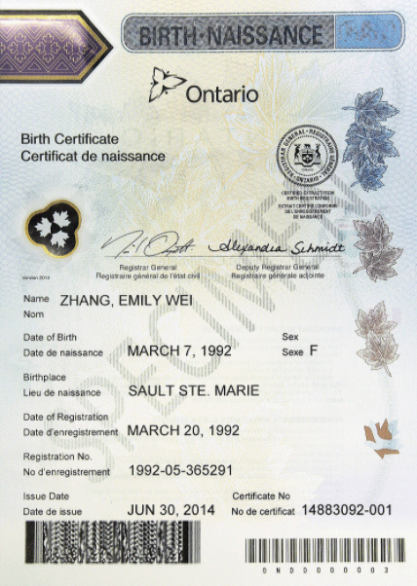
Ontario birth certificates
Important considerations
Birth certificates with a sex designation of X or no sex displayed are recognized by the Government of Ontario, who claim they do not endorse any rejection of valid Ontario birth certificates by any official body. However, unfortunately they also claim they cannot guarantee that these documents will be accepted by organizations in Ontario or in other jurisdictions.
If your application is complete and all requirements are met, you should receive your new birth certificate or registration in 6-8 weeks.

Slide 20
Driver’s licenses and photo cards
https://www.ontario.ca/page/change-sex-designation-your-government-ids
https://tg-id.ca/on/drivers-licenses
When updating the sex designation on your driver’s licence or photo card, you have the options of M (male), F (female), or X (gender neutral). Depending on your chosen designation, your process will be different.
The driver’s license changes are free for anyone with an existing license. For those who do not drive, the photo card comes with a $35 fee.
To change the sex designation on your driver’s licence to an X (gender neutral), you can simply visit a ServiceOntario. You do not require any supporting documents.
For binary sex designation changes, you can go to a ServiceOntario and bring an original document that indicates the updated sex designation. This can be your short or long-form birth certificate or a certified copy of a birth registration.

Slide 21
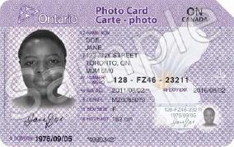
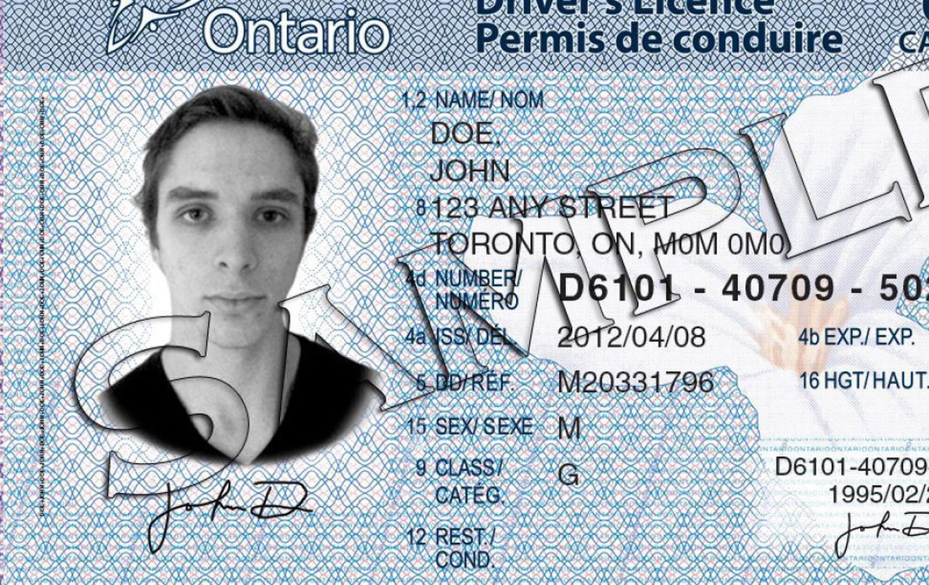
Driver’s licenses and photo cards
Other documentation
If you do not have a birth certificate or registration that represents the desired sex designation, you will need to bring the following two documents:
A letter from a licensed doctor or psychologist that is written on the doctor’s letterhead, states that the doctor has examined or treated you and they can attest that the updated designation is appropriate, and is signed by the doctor
A letter from you that includes the change you want to make, your full name and current address, your driver’s license number, and the name and address of the doctor or psychologist who has signed the other letter
Surgery is no longer required as a condition for sex designation changes. However, if you have had surgery, you are able to present documentation from a recognized specialist instead of a letter from a doctor or psychologist.

Slide 22
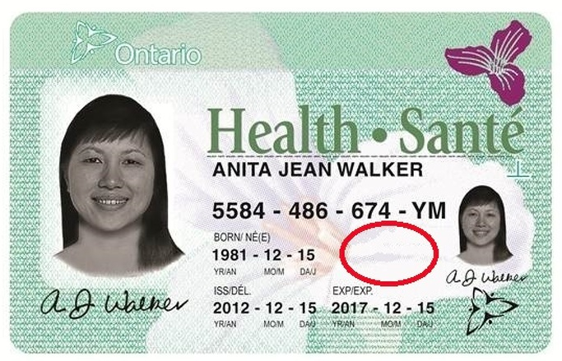
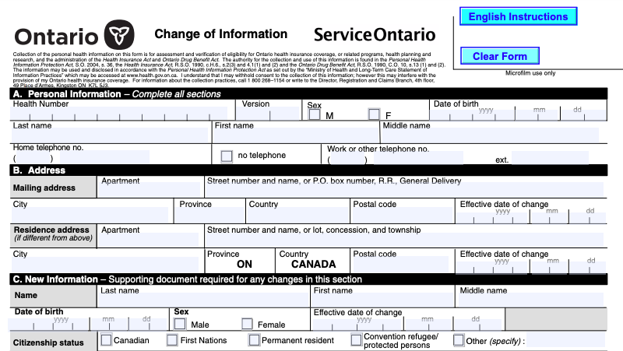
Ontario health cards
https://www.ontario.ca/page/replace-cancel-or-change-information-your-health-card#section-3
https://tg-id.ca/on/health-cards
To change your name on your health card, you must visit a ServiceOntario and bring a completed Change of Information form (0280-82) as well as an original copy of one of the following documents:
Canadian birth certificate
Canadian change of name certificate
citizenship/immigration status document in the name
Sex designation is no longer listed on health cards.

Slide 23
Canadian passports
https://www.canada.ca/en/immigration-refugees-citizenship/services/canadian-passports/new-adult-passport/required-documents-photos
https://www.canada.ca/en/immigration-refugees-citizenship/services/canadian-passports/change-sex
https://travel.gc.ca/travelling/health-safety/lgbt-travel
https://tg-id.ca/on/birth-certificates
There are 3 options for gender/sex identification on Canadian passports: F (female), M (male), or X (another gender).
Depending on whether your supporting documents have the gender/sex identifier you want, the application process for your passport will vary.

Slide 24
Canadian passports
Process with supporting documents
If your name or gender/sex identifier have already been changed on your proof of citizenship, you are not eligible for the Canadian passport renewal process and will need to apply for a brand new passport.
You can do so by filling out the Adult General Paspport Application (pptc-153) and providing the required proof of citizenship. Learn more about passport applications at this link.
You will not need to provide any additional documentation of your new gender/sex identifier if:
- your proof of citizenship (such as a Canadian birth certificate or Canadian citizenship certificate), your proof of immigration status, or your previous passport has the gender/sex identifier that you want for your new passport
- your previous passport has the X marker

Slide 25
Canadian passports
Process without supporting documents
Important considerations
If your gender/sex identifier has not been updated on your proof of citizenship, you will need to provide a completed Sex or Gender Identifier Update Request Form (pptc-643) along with your application.
Unfortunately, the Government of Canada states they cannot guarantee that other countries you visit or travel through will accept the sex or gender identifier on your Canadian passport, especially in regards to the X marker, and you may still be asked to provide your sex as either male or female when travelling.

Slide 26
Permanent resident cards
https://www.canada.ca/en/immigration-refugees-citizenship/services/application/application-forms-guides/guide-5445-applying-permanent-resident-card-card-first-application-replacement-renewal-change-gender-identifier
https://tg-id.ca/permanent-resident-cards
If you need to update the name on your permanent resident card, you are not eligible for a reissued card, and must apply for a new card. You can do so by filling out the PR Card Application (IMM 5445).
In addition to the identity documents requested in Step 1 of the PR Card Application, you will need to provide a copy of your Record of Landing (IMM 1000) or Confirmation of Permanent Residence (IMM 5292 or IMM 5688), as well as a legal document proving your name change (such as the Ontario Change of Name certificate).
If your name change document was not issued by a province within Canada, then you will also need to provide a provincial I.D. in the name requested (including a driver's license/photo card or a health card).

Slide 27
Social Insurance Registry
https://www.canada.ca/en/employment-social-development/services/sin/receiving-updating
https://tg-id.ca/social-insurance-registry
By law, you must update your SIN record when you change your name.
To do this you will need to submit an application either online, by mail, or in person.
There are several documents required for this process, which may vary greatly depending on your citizenship/residency. I recommend visiting the online portal for the requirement and submission guidelines: https://www.canada.ca/en/employment-social-development/services/sin/apply.html
If you are updating your sex designation, you may now choose an X marker or choose to not declare your gender. Service Canada will add a note to your record with your choice. However, please note that they have stated for the last 4+ years that until their computer systems are upgraded to register this information, "male" or "female" will still appear on your SIN record.

Slide 28
Canada Revenue Agency
https://www.canada.ca/en/revenue-agency/services/tax/individuals/topics/about-your-tax-return/should-you-tell-cra-about-your-change-name
https://tg-id.ca/canada-revenue-agency
You are currently able to update your information by phone, mail, or fax.
You will need to provide the CRA with a letter containing the following:
an original or certified true copy of one of the following documents:
- a name change certificate from a provincial/territorial vital statistics department
- a court order issued under an act on change of name
your old and new names
your social insurance number
your signature
For information on the different processes for submission via phone, or mail/fax, I recommend visiting the online portal (link above) for addresses and phone numbers relevant to your area

Slide 29
Other important updates
Once you have legally changed your name, remember to update:
- Elections Canada
- your electricity provider
- your phone provider
- your internet provider
- your bank
- anyone else who may possess your personal information
All these companies and registries will have different methods of updating your information, but generally require a valid Canadian Change of Name Certificate.

Slide 30
TG I.D. and other resources
TG I.D.
https://tg-id.ca
An online resource collecting information on how to update legal names, gender markers, and identity documents as a trans, non-binary, Two-Spirit, or gender non-conforming individual living in Ontario, Canada.
JusticeTrans
https://justicetrans.org/en/
An organization founded by trans people for trans people providing accessible legal education by challenging transphobic policy and advocating for social justice. They have great province/territory-specific & nation-wide resources including information on name changes and gender marker updates, and legal advice for trans people dealing with housing, policing, and employment inequalities.

Slide 31
This workshop was written and presented by Dana Rosamund Teagle. You can get in touch with her via email at contact@danateagle.com.
Please reach out if you have any questions or concerns about the materials presented today, and good luck with getting your IDs updated!
Slides and documents are available for download at https://tg-id.ca.

