Slide 1
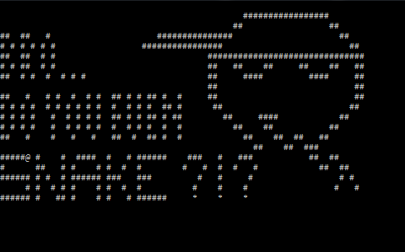
Snake Game
By IRIDONIA

Slide 2
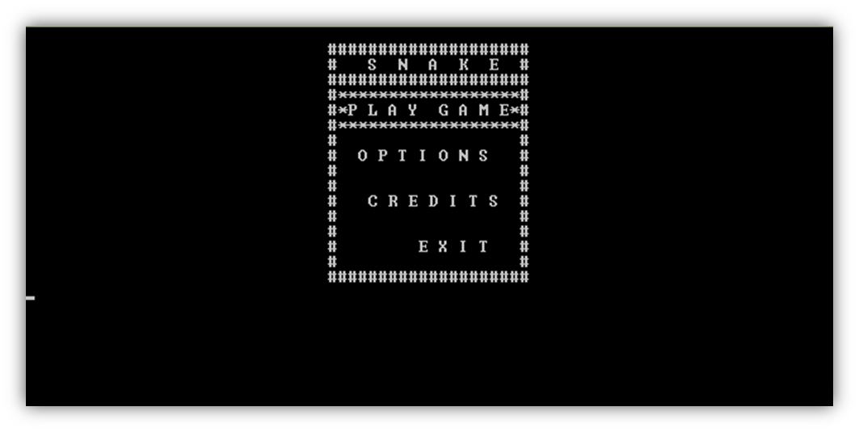
Menu
Play Game
Options
Credits
Exit

Slide 3

Play game
The game starts in easy mode by default.
You can change the starting speed of the snake from the options.

Slide 4

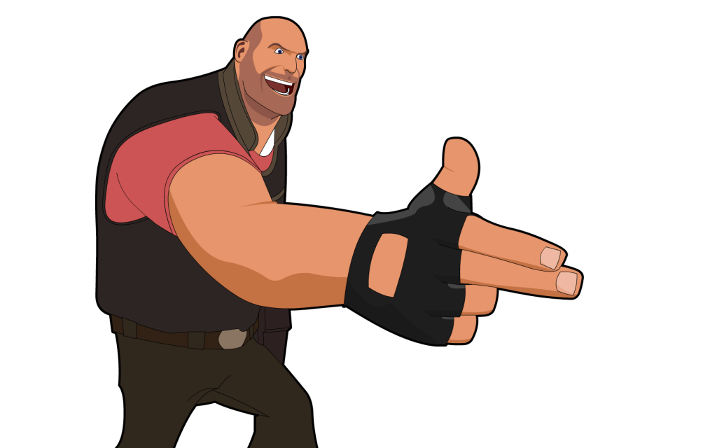
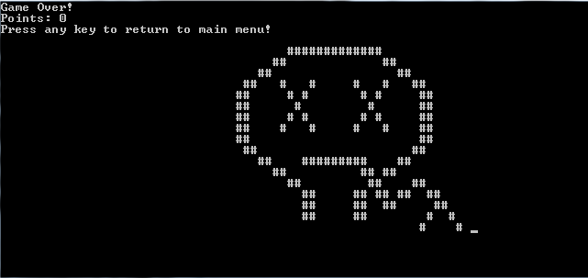
You are dead !.. Not big surprise !

Slide 5
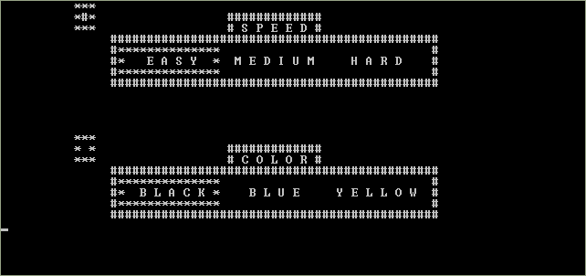
Options
You can change the starting speed.
You can change the color of the console and the snake.

Slide 6
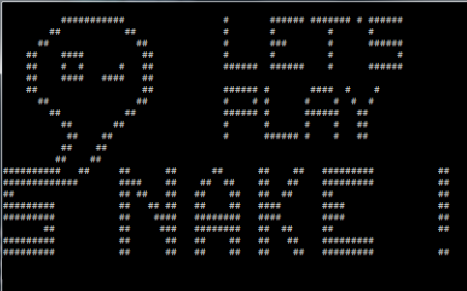
Let’s Get started !

