Slide 1
All About Tor

Slide 2
Agenda
Fill in this section
With your agenda for the day
To help your audience stay focused!

Slide 3
Let’s begin
Do you use Tor?
If not, why not?
If yes, do you have any questions, concerns, issues, or doubts about using it?
Do you teach others about Tor?

Slide 5
What is Tor?
Free software and an open network
Mitigates against tracking, surveillance and censorship
Run by a US non-profit and volunteers from all over the world
It’s Tor, not TOR

Slide 6
Why do we need Tor?
Government mass and targeted surveillance
The business model of the internet: big data, advertising, non-consensual tracking
Surveillance threats from family, bosses, bad people on the internet

Slide 7

Why do you need Tor?
Let’s discuss the work you do
Adversaries and challenges
Mitigations
How Tor can help

Slide 8
little-t Tor or core tor
Tor the network daemon (a computer program)
Presents a SOCKS or http proxy
Location and source anonymity, similar to a VPN or regular proxy (but better!)
Network of relays in many parts of the world

Slide 9
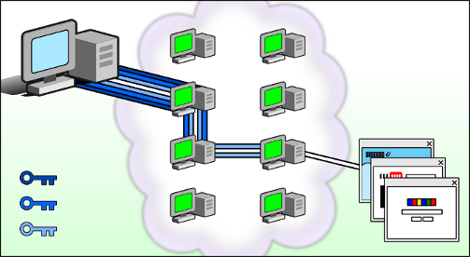
How Tor relays work

Slide 10
Tor Browser
little-t tor plus patched Firefox
Anyone snooping can’t see the websites you visit
Websites can’t track you or see other sites you visit
Prevents other privacy violations like fingerprinting or 3rd party cookies
Writes nearly nothing to disk
No browser history
Cross platform: Windows, macOS, Linux and Android

Slide 11
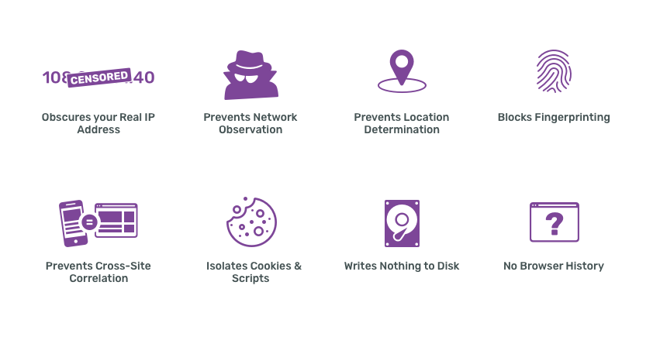

Slide 12
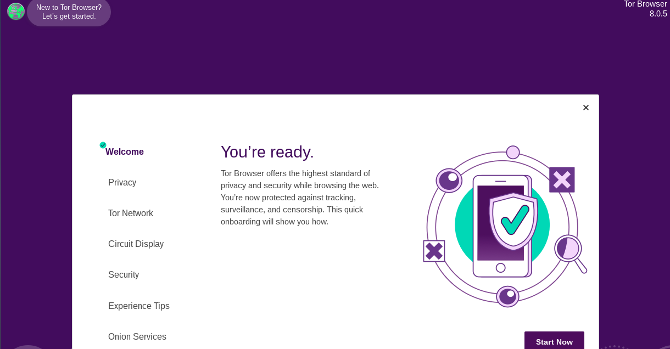
Tor Browser

Slide 13
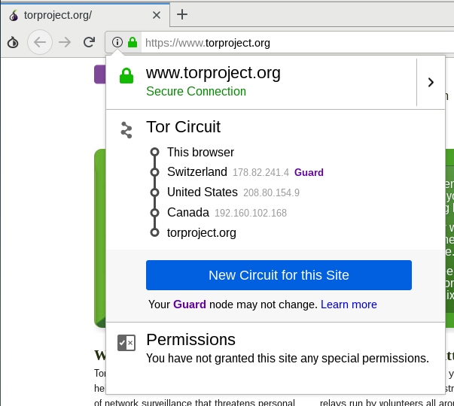
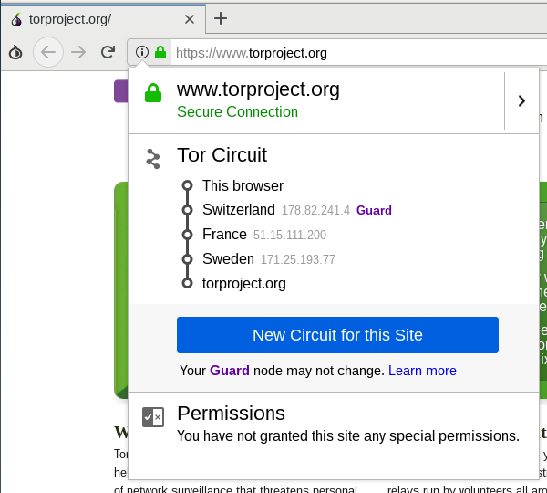
Clicking on the site information menu will show your current circuit (and “New Circuit for this site” option)

Slide 14
Using Tor Browser
Default search engine: DuckDuckGo
Bundled with NoScript, HTTPS Everywhere
You should not add any other extensions nor enable any plugins (eg Flash)!
Best practices
  Websites won’t know anything about you unless you login and tell them

Slide 15
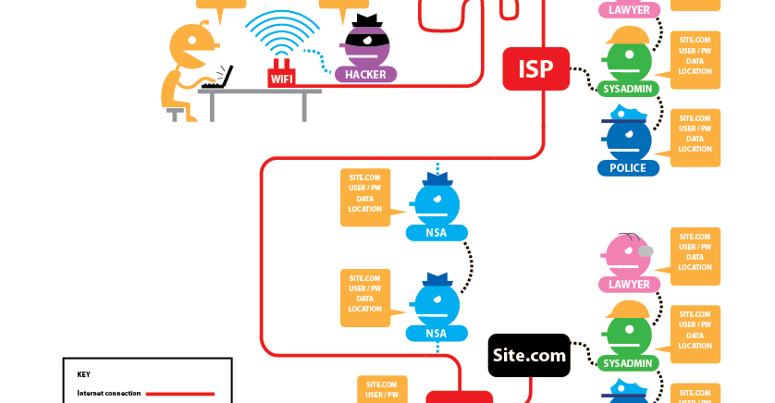
Who can see your activity without Tor or HTTPS?

Slide 16
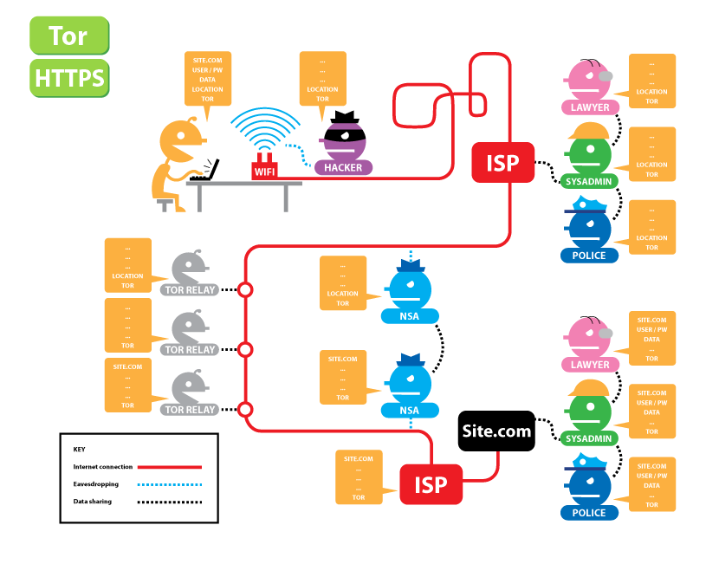
Who can see your activity with Tor and HTTPS?

Slide 17
Downloading Tor Browser
The safest way to download is from torproject.org
If torproject.org is blocked, try mirrors
  http://tor.calyxinstitute.org/
  https://tor.eff.org/
Or try GetTor
  email gettor@torproject.org and in the message write “windows”, “osx” or “linux” (no quotes, no subject line)
  Or message @get_tor on twitter with eg “osx ar” (include two letter language code)

Slide 18

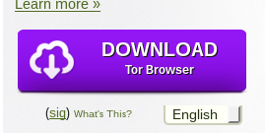
Tor Browser in other languages
Go to https://torproject.org
Click “Download Tor”
Dropdown menu for languages

Slide 19
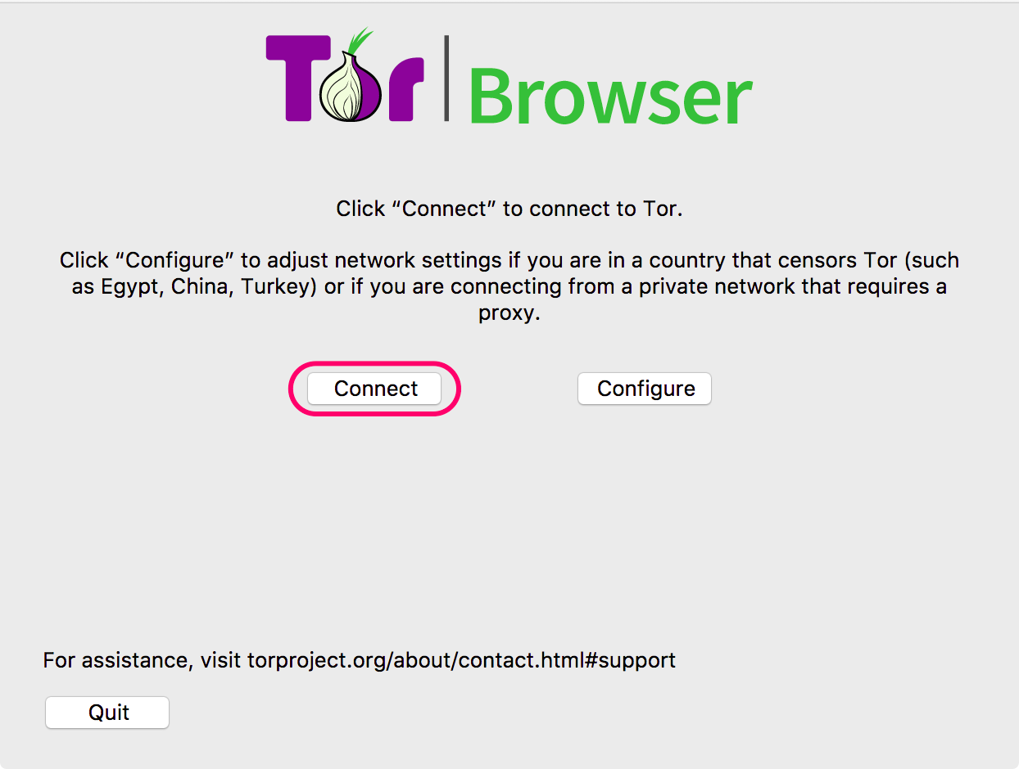
Running Tor Browser the first time

Slide 20
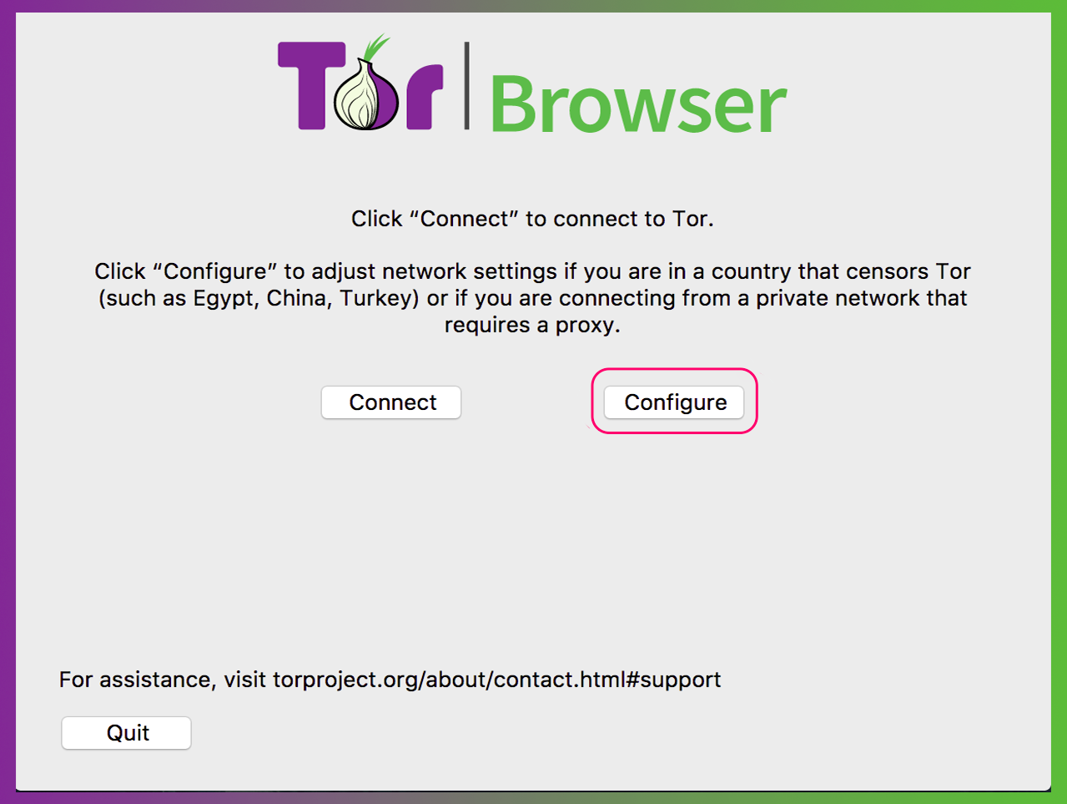
Running Tor Browser the first time

Slide 21
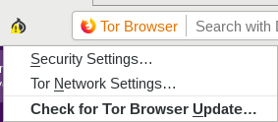
Updating Tor Browser

Slide 22
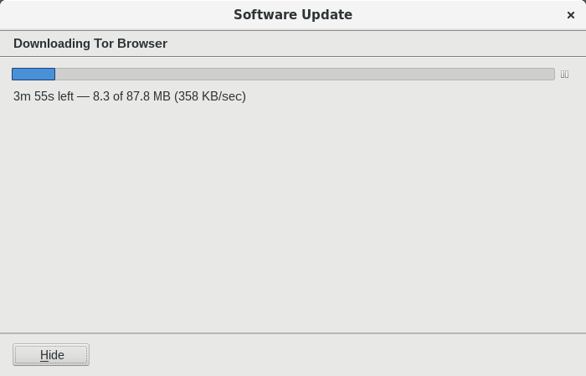
Updating Tor Browser

Slide 23
Uninstalling Tor Browser
Uninstalling Tor Browser is as easy as moving the folder to the trash! Then, empty the trash.
Default Tor Browser folder locations:
  Windows: desktop
  MacOS: applications folder
  Linux: home, or look for a name like “tor-browser_en-US”

Slide 24
Troubleshooting Tor Browser
Is your system clock correct?
Is the browser already running?
Are you being censored?
Is your antivirus or firewall blocking Tor?
Do you have a very old operating system?
Try uninstalling and reinstalling
Get help at https://support.torproject.org

Slide 25

More Tor Browser

Slide 26
The “onion” menu
New Identity: completely refreshes Tor Browser and its circuits; wipes all history; closes all tabs
Security settings: change slider
Tor network settings: censorship mitigation options; access to Tor log
Check for Tor Browser update

Slide 27
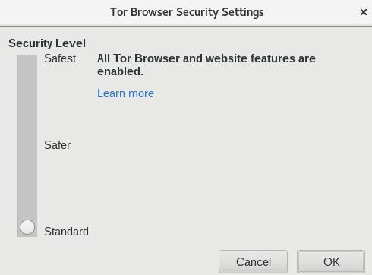
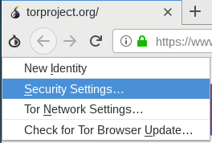
Security Slider

Slide 28
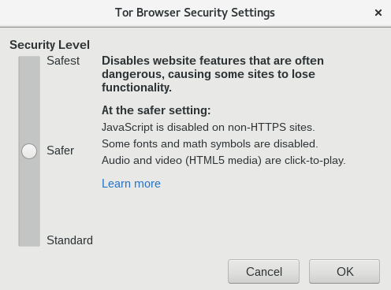
Security Slider

Slide 29
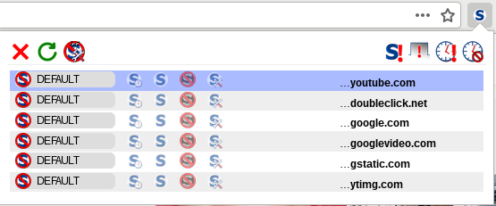
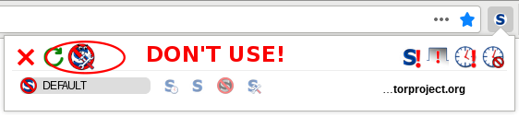
NoScript
It’s not advisable to change settings in the “options” menu
For example, adding sites to the “whitelist” can result in fingerprinting
Instead, only “temporarily trust” blocked objects
← click here!

Slide 30

DuckDuckGo
DuckDuckGo is the default search engine in Tor Browser
Using Tor Browser prevents DDG from tracking users, even if they wanted to (they claim not to)
Duckduckgo.com or https://3g2upl4pq6kufc4m.onion/

Slide 31
Plugins, add-ons, Javascript
Do not add any new add-ons/extensions to Tor, and don’t enable any plugins
  For example, Flash plugin can reveal your real location
Javascript is enabled by default, but is sanitized to preserve anonymity
To prevent possible Javascript vulnerabilities, use the “safest” setting in the security slider

Slide 32



Mobile Tor

Slide 33
Things to know about mobile Tor
The design of mobile devices makes full privacy impossible
Mobile Tor is best for censorship prevention
Can also provide better privacy for some threat models
We’re making it better all the time and better options for mobile devices are coming out soon

Slide 34
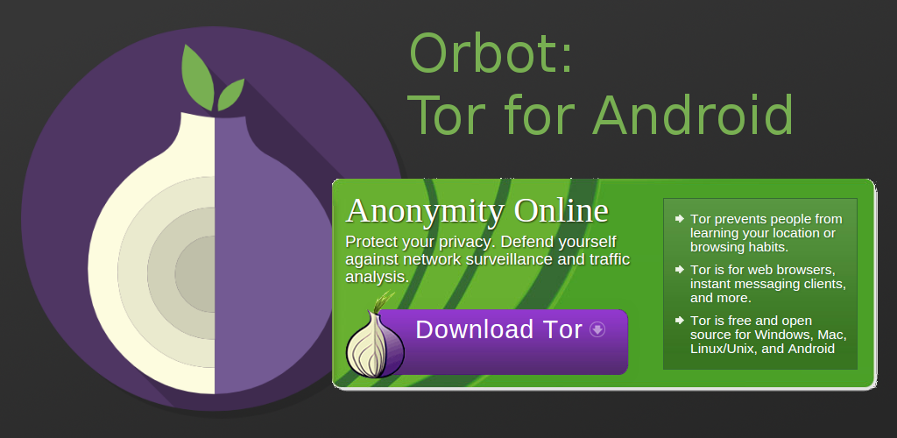
Orbot pic

Slide 35
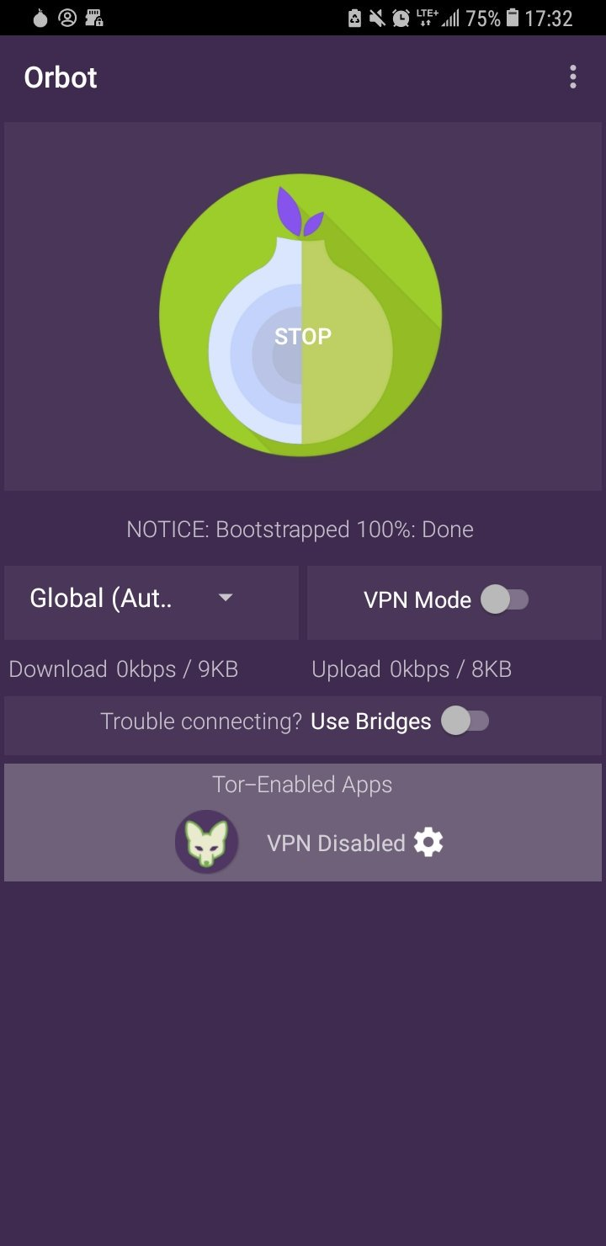
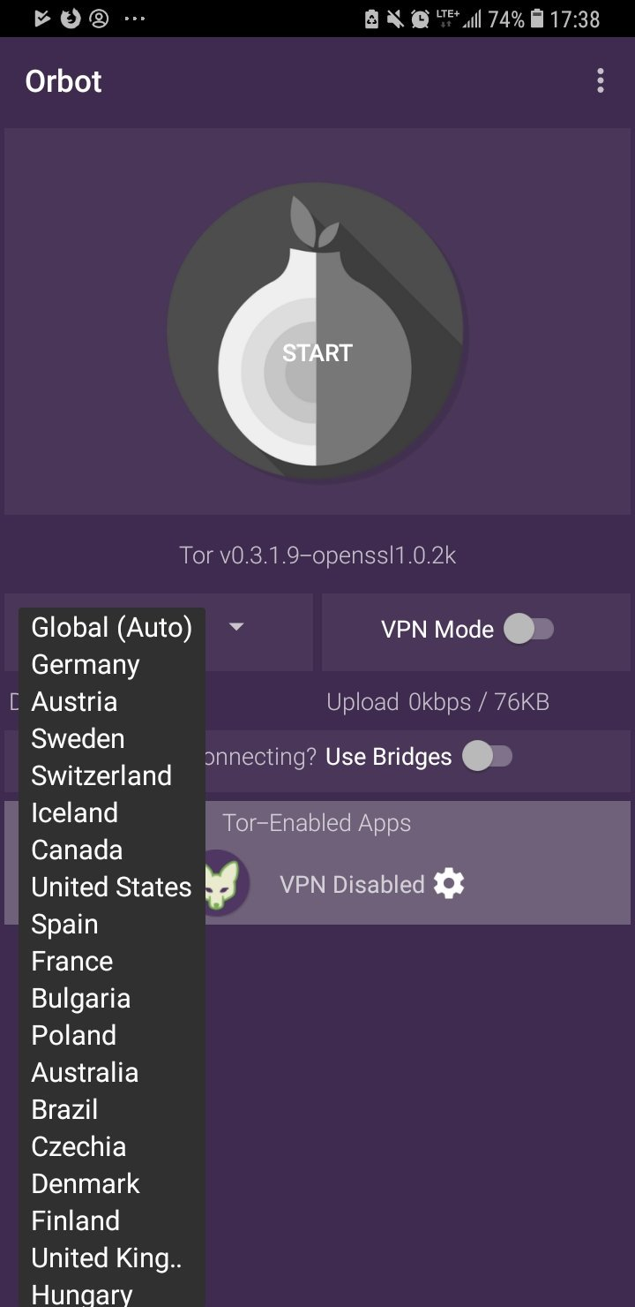
Using Orbot
Tor proxy for Android
Find it on the Play Store
Use it to run other apps through Tor (like Twitter)
Click start to run
You can choose your exit country if you want (some countries don’t have exits!)

Slide 36
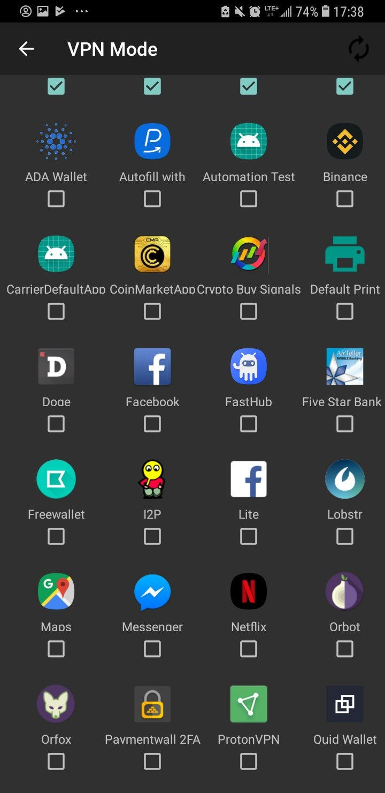
Using Orbot
Toggle “VPN mode” on main screen
Then click “Orbot-enabled apps”
Then select the apps you want to proxy with Tor

Slide 37

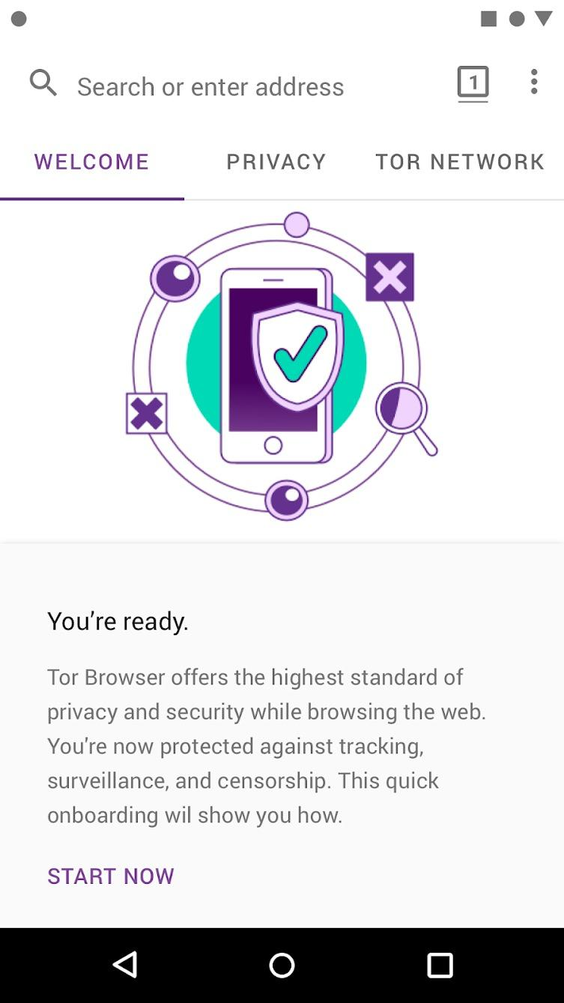

Using Tor
Browser for
Android
Find it in the Play Store

Slide 38
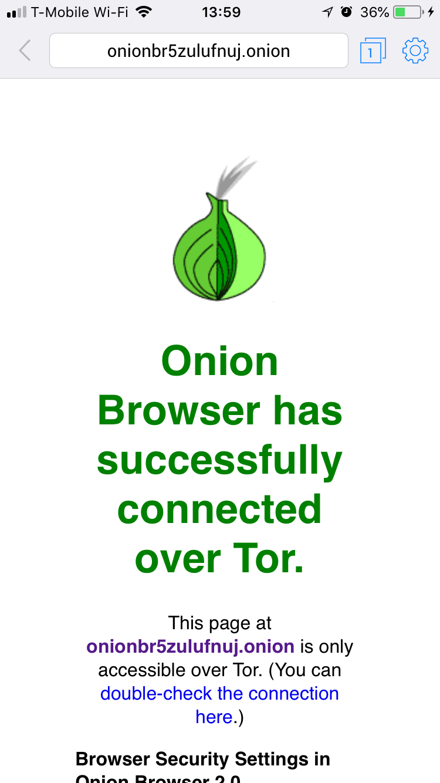
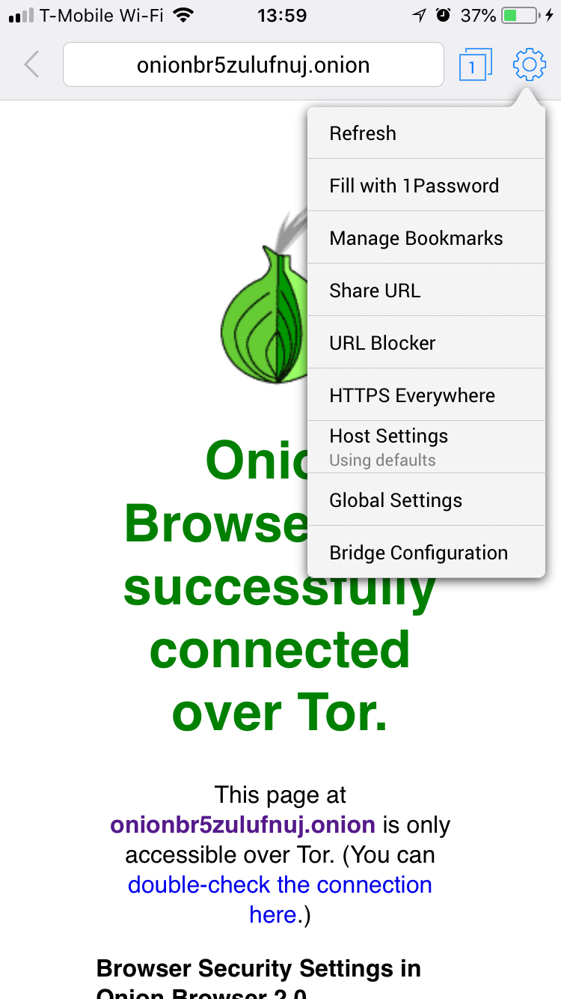
Onion Browser
Tor Browser for iOS
Find it in the app store
Lots of fake Tor Browsers in the iOS store
Very rudimentary
Crashes on sleep

Slide 39
How do I get help using Tor?

Slide 40
Help using Tor
Tor Browser Manual: tb-manual.torproject.org
(TB Manual is in 17 languages)
Support Portal: https://support.torproject.org
Open mailing lists: https://lists.torproject.org
Chat: IRC OFTC network - easy access through https://webchat.oftc.net channel #tor
https://tor.stackexchange.com

Slide 41
If you find a bug in Tor
https://trac.torproject.org
Create a login
Search for your issue to find any existing tickets
If no ticket opened, open a new ticket with detailed description of the problem

Slide 42

Circumventing censorship with Tor

Slide 43
What do you do when Tor is blocked?

Slide 44
When torproject.org is blocked
Mirrors
  https://tor.eff.org/
  http://tor.calyxinstitute.org/ (if https is blocked)
GetTor email: gettor@torproject.org
  Contact from a Yahoo, Gmail, or Riseup account
GetTor Twitter: send a direct message to @get_tor with operating system and two letter language code
Flash drive with Tor on it from someone you trust
Get the EXE, DMG, tar.xz, don’t copy the installed folder
Downloading Tor from a random website is dangerous!

Slide 45
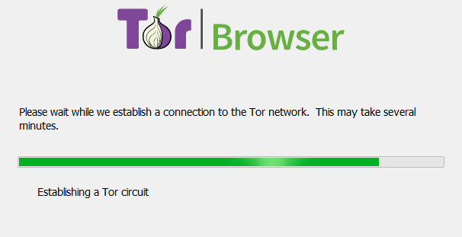
I downloaded Tor Browser, but it won’t connect
If this screen takes a long time and does not connect, you may need a bridge or pluggable transport

Slide 46
Bridges and pluggable transports
Bridges are relays that are not listed publicly
Get bridges directly from Tor Browser (moat)
Or from the website https://bridges.torproject.org or send an email to bridges@torproject.org from a Gmail, Yahoo, or Riseup.net account
Or get a bridge address from a trusted person
Pluggable transports can be used like bridges to disguise Tor traffic (also called “built-in bridges”)

Slide 47
Bridges and pluggable transports

Slide 48
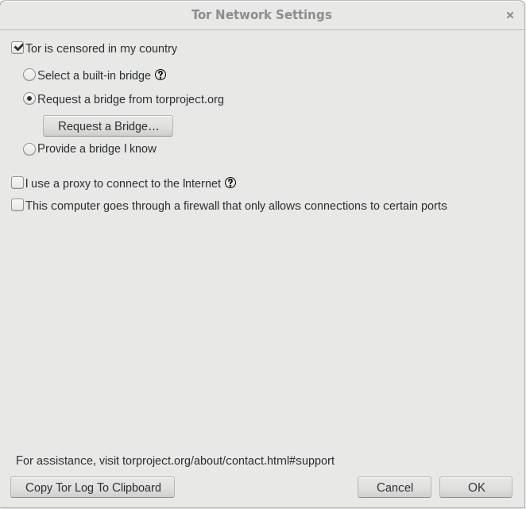
Bridges and pluggable transports
moat method

Slide 49
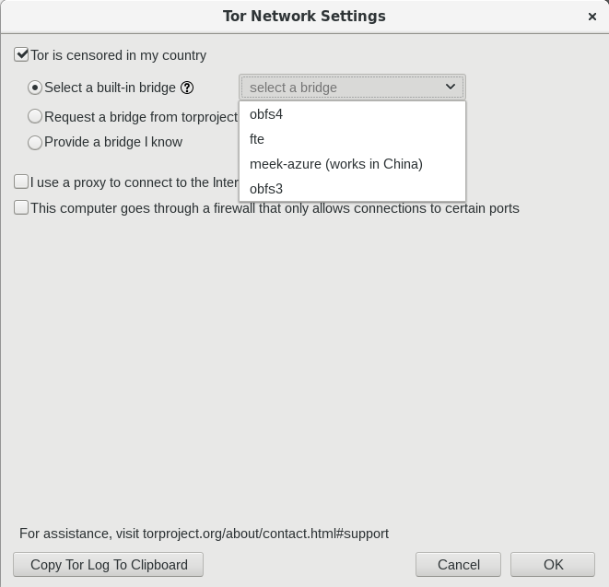
Bridges and pluggable transports

Slide 50
Pluggable transports
obfs4: makes Tor traffic look random; works in many situations including China (if not, try meek)
fte: makes Tor traffic look like regular HTTP traffic
meek-azure: makes it look like Microsoft traffic; works in China
obfs3: makes Tor traffic look random

Slide 51
OONI
Open Observatory of Network Interference (https://ooni.torproject.org)
Country-level reports of specific censorship tools in use on certain websites
View their reports (https://explorer.ooni.torproject.org)
Or use your own OONI Probe to test websites

Slide 52

Sharing content anonymously with Tor

Slide 53
What are onion services?

Slide 54
The regular internet allows adversaries to see what you are sharing and with whom, whether you're using Dropbox etc, downloading it from email or through your browser...

Slide 55
...so Tor devised a sneaky way to hide both the file data and the related metadata!

Slide 56

Onion services
Protection for both the user and the server
User learns about xyz.onion
Client and service meet at rendezvous point in the Tor cloud
End-to-end encrypted without HTTPS
Connections never go out to the “vanilla” internet

Slide 57
OnionShare
Secure, private, anonymous file sharing done easy, built on top of the Tor network
Uses onion services to securely send files
Creates an onion service where the file can be downloaded
No need to trust third parties like Dropbox
Download from https://onionshare.org

Slide 58
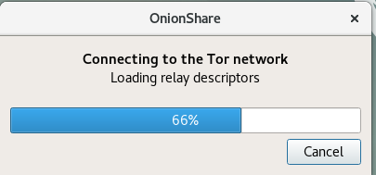
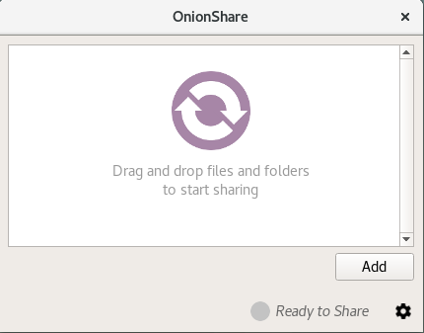
OnionShare connects to Tor network
Click “add” then find the file you want to share.

Slide 59
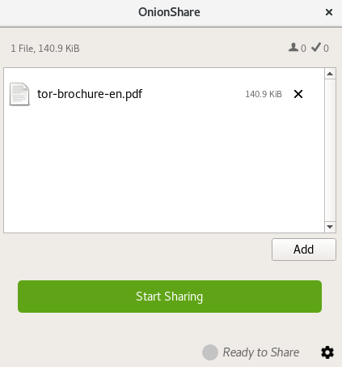
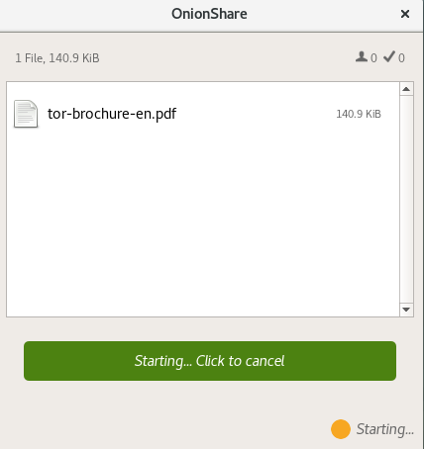
Once the file is added, click “start sharing”

Slide 60
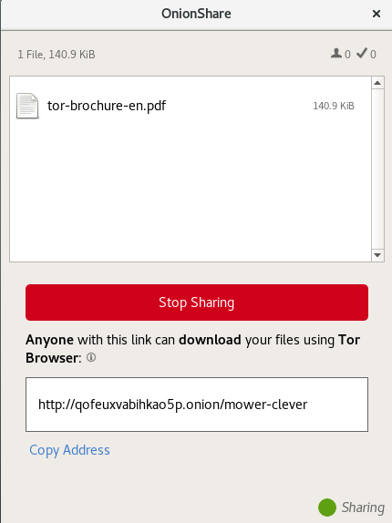
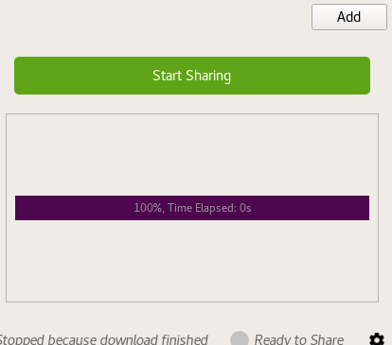
Copy the xyz.onion link and send it to your contact
Contact installs Tor Browser
When they finish downloading you’ll see this →

Slide 61
Thank You
Your contact here

