Slide 1
Online Anonymity
  The Tor Project
  https://torproject.org/

Slide 2
Outline
Why anonymity?
Crash course on Tor
Future

Slide 3
Informally: anonymity means you can't tell who did what
“Who wrote this blog post?”
“Who's been viewing my webpages?”
“Who's been emailing patent attorneys?”

Slide 4
Formally: anonymity means indistinguishability within an “anonymity set”
Alice1
Alice2
Alice3
Bob
Alice4
Alice5
....
Alice6
Attacker can't tell which
Alice is talking to Bob!
Alice7
Alice8

Slide 5
Anonymity isn't cryptography: Cryptography just protects contents.
Alice
“Hi, Bob!”
“Hi, Bob!”
<gibberish>
Bob
attacker

Slide 6
Anonymity isn't steganography:
Attacker can tell that Alice is talking; just not to whom.
Anonymity
network
Alice1
Bob1
Alice2
Bob2
...
AliceN
(Strong high-bandwidth
steganography may not exist.)

Slide 7
Anonymity isn't just wishful thinking...
“You can't prove it was me!”
“Promise you won't look!”
“Promise you won't remember!”
“Promise you won't tell!”
“I didn't write my name on it!”
“Isn't the Internet already anonymous?”

Slide 8
...since “weak” anonymity... isn't.
“You can't prove it was me!”
Promise you won't look!”
“Promise you won't remember!”
“Promise you won't tell!”
“I didn't write my name on it!”
“Isn't the Internet already anonymous?”
Proof is a very strong word.
With statistics,
suspicion becomes certainty.
Will others parties have the ability and incentives to keep their promises?
Not what we're talking about.
Nope!
(More info later.)

Slide 9
Anonymity serves different interests for different user groups.
Anonymity
Private citizens
“It's privacy!”

Slide 10
Regular citizens don't want to be watched and tracked.
Blogger
Alice
Hostile Bob
“I sell the logs.”
Incompetent Bob
8-year-old
Alice
“Oops, I lost the logs.”
Indifferent Bob
Sick
Alice
“Hey, they aren't
my secrets.”
Name, address,
age, friends,
interests
(medical, financial, etc),
unpopular opinions,
illegal opinions....
Consumer
Alice
(the network can track too)
....
Oppressed
Alice

Slide 11
Anonymity serves different interests for different user groups.
Businesses
Anonymity
“It's network security!”
Private citizens
“It's privacy!”

Slide 12
Businesses need to keep trade secrets.
Competitor
“Oh, your employees are reading
our patents/jobs page/product sheets?”
Competitor
“Hey, it's Alice! Give her the 'Alice' version!”
AliceCorp
Compromised
network
“Wanna buy a list of Alice's suppliers?
What about her customers?
What about her engineering department's
favorite search terms?”

Slide 13
Anonymity serves different interests for different user groups.
“It's traffic-analysis
resistance!”
Governments
Businesses
Anonymity
“It's network security!”
Private citizens
“It's privacy!”

Slide 14
Law enforcement needs anonymity to get the job done.
Investigated
suspect
“Why is alice.localpolice.gov reading my website?”
Officer
Alice
Sting
target
“Why no, alice.localpolice.gov!
I would never sell counterfeits on ebay!”
Organized
Crime
“Is my family safe if I
go after these guys?”
Witness/informer
Alice
Anonymous
tips
“Are they really going to ensure
my anonymity?”

Slide 15
Governments need anonymity for their security
Untrusted
ISP
“What will you bid for a list of Baghdad
IP addresses that get email from .gov?”
Agent
Alice
Compromised
service
“What does the CIA Google for?”
Coalition
member
Alice
Shared
network
“Do I really want to reveal my
internal network topology?”
Defense in
Depth
“What about insiders?”

Slide 16
Anonymity serves different interests for different user groups.
Blocked users
“It's reachability!
“It's traffic-analysis
resistance!”
Governments
Businesses
Anonymity
“It's network security!”
Private citizens
“It's privacy!”

Slide 17
You can't get anonymity on your own: private solutions are ineffective...
Alice's small
anonymity net
...
Citizen
Alice
“One of the 25 users
on AliceNet.”
Municipal
anonymity net
Officer
Alice
Investigated
suspect
“Looks like a cop.”
AliceCorp
AliceCorp
anonymity net
Competitor
“It's somebody at
AliceCorp!”

Slide 18
... so, anonymity loves company!
Shared
anonymity net
...
Citizen
Alice
“???”
Officer
Alice
Investigated
suspect
“???”
AliceCorp
Competitor
“???”

Slide 19
Current situation: Bad people on the Internet are doing fine
Trojans
Viruses
Exploits
Botnets
Zombies
Espionage
DDoS
Extortion
Phishing
Spam

Slide 20
IP addresses can be enough to bootstrap knowledge of identity.
Alice
18.244.x.x
Hotlinked ad
Amazon account
Wikipedia post

Slide 21
Tor is not the first or only design for anonymity.
Low-latency
High-latency
Single-hop
proxies
Chaum's Mixes
(1981)
Crowds
(~96)
anon.penet.fi (~91)
V1 Onion
Routing (~96)
ZKS
“Freedom”
(~99-01)
Remailer networks:
cypherpunk (~93),
mixmaster (~95),
mixminion (~02)
Java Anon Proxy
(~00-)
Tor
(01-)
...and more!

Slide 22
Outline
Why anonymity?
Crash course on Tor
Future

Slide 23
What is Tor?
online anonymity software and network
open source, freely available
active research environment

Slide 24
The Tor Project, Inc.
501(c)(3) non-profit organization dedicated to the research and development of tools for online anonymity

Slide 25
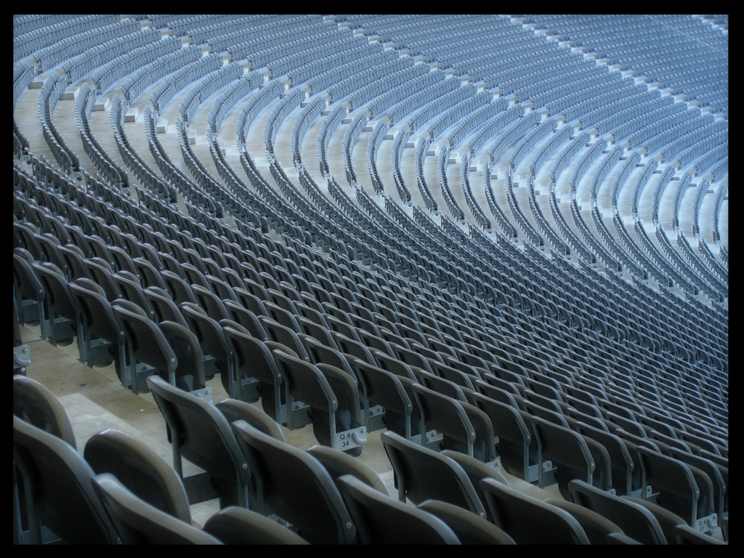
Estimated 300,000 daily Tor users

Slide 26
The simplest designs use a single relay to hide connections.
Alice1
Bob1
E(Bob3,“X”)
“Y”
Relay
Alice2
Bob2
E(Bob1, “Y”)
“Z”
“X”
E(Bob2, “Z”)
Alice3
Bob3
(example: some commercial proxy providers)

Slide 27
But a single relay is a single point of failure.
Alice1
Bob1
E(Bob3,“X”)
“Y”
Evil
Relay
Alice2
Bob2
E(Bob1, “Y”)
“Z”
“X”
E(Bob2, “Z”)
Alice3
Bob3
Eavesdropping the relay works too.

Slide 28
So, add multiple relays so that no single one can betray Alice.
Alice
Bob
R1
R3
R4
R5
R2

Slide 29
A corrupt first hop can tell that Alice is talking, but not to whom.
Alice
Bob
R1
R3
R4
R5
R2

Slide 30
A corrupt final hop can tell that somebody is talking to Bob, but not who.
Alice
Bob
R1
R3
R4
R5
R2

Slide 31
Alice makes a session key with R1
...And then tunnels to R2...and to R3
Alice
Bob
R1
R3
Bob2
R4
R5
R2

Slide 32

Who uses Tor?
Normal people
Law Enforcement
Human Rights Activists
Business Execs
Militaries
Abuse Victims
https://torproject.org/torusers

Slide 33
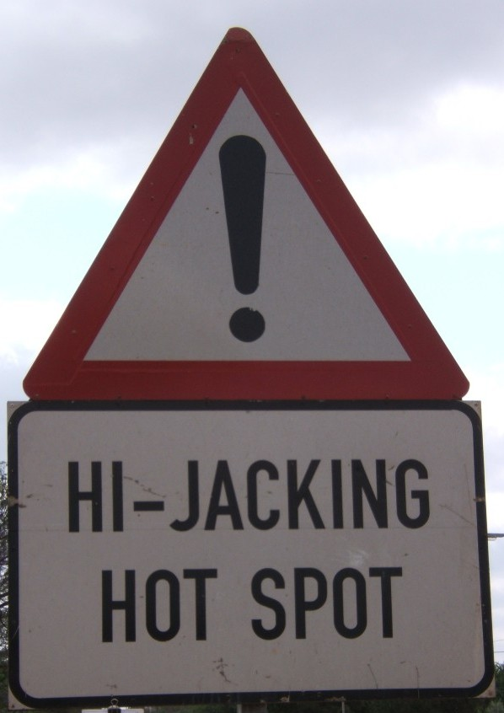
Tor doesn't magically encrypt the Internet
Operating Systems and Applications leak your info
Browser Plugins, Cookies, Extensions, Shockwave/Flash, Java, Quicktime, and PDF all conspire against you

Slide 34
Outline
Why anonymity?
Crash course on Tor
Future

Slide 35
Community
Many tools make a big splash in the press
  Censors need to feel in control; publicity removes the appearance of control
Increase community diversity
  Strong social network
Funding
  Donations, grants, contracts

Slide 36
3-Year Development Roadmap
Improve Performance
Client Safety
Ease of Use and Understanding
Core Research & Development
https://torproject.org/press/ for details

Slide 37
Copyrights
who uses tor? http://www.flickr.com/photos/mattw/2336507468/sizes/l/, Matt Westervelt, CC-BY-SA
danger!,http://flickr.com/photos/hmvh/58185411/sizes/o/, hmvh, CC-BY-SA
300k, http://flickr.com/photos/tochis/1169807846/sizes/o/, tochis, CC-BY-NC

