Slide 1
Newcastle JBug
git clone https://github.com/mtaylor/jbug
Open up doc/rdoc/0_index_rdoc.html
rvm use jruby@torquebox
Network:
  SSID: JBUG
  P/W:

Slide 2
Ruby on Rails on TorqueBox
Martyn Taylor,
Software Engineer, RedHat
Notes:
Good afternoon-enthusiasim

Slide 3
About this talk
Background RoR
TorqueBox
Create Rails Application
  Face Blog

Slide 4


What is RoR?
Ruby Web Framework
Focus on Convention over Configuration
MVC
Open Source (MIT License)
David Heinemeir Hansson
Released as Open Source 2004
> 2100 Contributors
Version 3.2

Slide 5
The Good Stuff
Rapid Development
Interpreted
    Removes Compile, Build, Deploy Cycle
Shallow Learning Curve
Large Ruby Community
    (> 40000 Gems since 2009)
Applications: Twitter, GitHub, Groupon...
    (www.rubyonrails.org/applications)

Slide 6
The Not so Good Stuff
Convention only covers 95% Use Case
Version upgrades often not backward compatible
Maturity brings Complexity
Fanatical Community
No Decent IDE Support
    Emacs
    Aptana (eclipse)

Slide 7
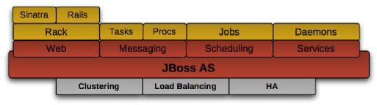
TorqueBox

Slide 8
Face Blog

