Slide 1

Simplify Your Infrastructure with TorqueBox
Benjamin Browning
Senior Software Engineer
Red Hat
Creative Commons BY-SA 3.0

Slide 2
Who am I?
Benjamin Browning
Senior Software Engineer @ Red Hat
TorqueBox Lead
JRuby contributor

Slide 3
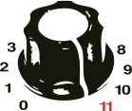
TorqueBox

Slide 4
TorqueBox
Ruby Application Server
Notes:
An application server is a web server plus some extra goodies

Slide 5

Notes:
Ruby on the JVM - don’t miss Charlie and Tom’s keynote tomorrow morning for more on JRuby

Slide 6

Notes:
JBoss Application Server 7, or AS7- if you have a Java background, you may have heard of previous versions of JBoss AS - AS7 is smaller and faster than previous versions

Slide 7
Simplify Your Infrastructure

Slide 8
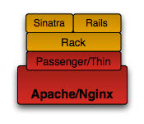
Ruby Application
Notes:
The typical Ruby web application starts out as above - a Rails app running in Passenger maybe

Slide 9
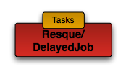
Ruby Application
Notes:
Then the application needs support for asynchronous tasks so we bring in DelayedJob or Resque

Slide 10
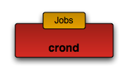
Ruby Application
Notes:
And the application needs to periodically perform some task so you add some cron scripts that call some Ruby code

Slide 11
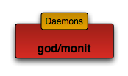
Ruby Application
Notes:
And maybe eventually you also need some background daemon and a tool to start/stop and monitor that daemon.
This is just the tip of the iceberg for many applications - add a memcached cluster, databases, load balancers, etc

Slide 12
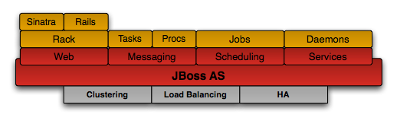
TorqueBox

Slide 13
TorqueBox
Rails, Sinatra, and Rack applications
Messaging
Scheduled Jobs
Daemons
Caching
Clustering
Supported by Red Hat

Slide 14
TorqueBox Installation
$ rvm install jruby-1.7.0
$ rvm use jruby-1.7.0
$ gem install torquebox-server
Not using RVM?
On Windows?
Prefer .zip download?
http://torquebox.org/getting-started/2.1.2/

Slide 15
TorqueBox Rails Template
$ torquebox rails /path/to/my_app
http://torquebox.org/getting-started/2.1.2/
Notes:
session storage to TorqueBox clustered session storage
Rails cache to TorqueBox clustered cache
adds torquebox to your Gemfile
optional step

Slide 16
TorqueBox Usage
$ torquebox deploy /path/to/my_app
$ torquebox run
http://torquebox.org/getting-started/2.1.2/

Slide 17
Background Jobs

Slide 18
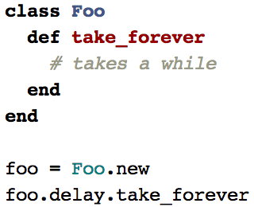
Delayed::Job
Don’t forget to setup the database table and
run the worker processes

Slide 19
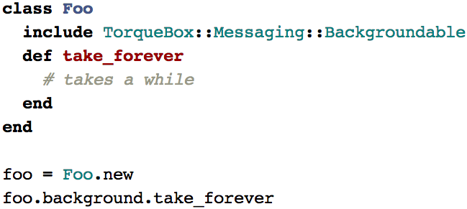
TorqueBox Backgroundable
No other setup required
Notes:
The code is simple and no setup needed. Works out of the box on TorqueBox. Also benefits from clustering. Several options you can pass to control priority, check status of backgrounded jobs, get results, etc.

Slide 20
Scheduled Jobs

Slide 21
Cron
What if you want to run a job more than once a minute?
What about Windows?
rake tasks? rails runner?
https://www.ruby-toolbox.com/categories/scheduling

Slide 22
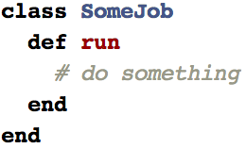
TorqueBox Scheduled Jobs

Slide 23
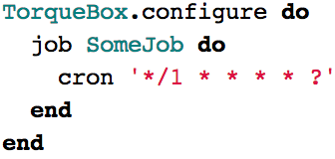
TorqueBox Scheduled Jobs
Notes:
No cron, no external scheduling process, all self-contained inside TorqueBox

Slide 24
Long-Running Daemons

Slide 25
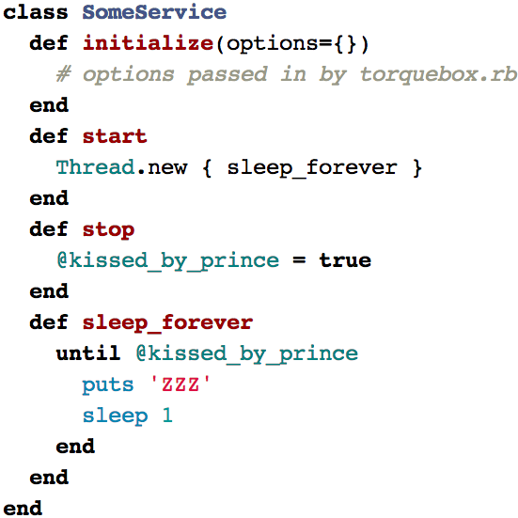
TorqueBox Services

Slide 26
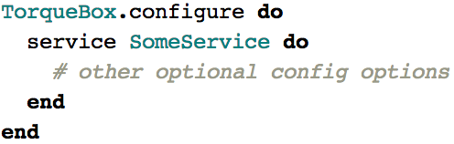
TorqueBox Services

Slide 27
Deploying JRuby
http://pragprog.com/book/jkdepj/deploying-with-jruby
Discount code “JRubyJoeKutner”

Slide 28
Resources
http://torquebox.org
https://github.com/torquebox
#torquebox on IRC freenode
@torquebox on Twitter
Notes:
Distributed team, decisions made in the open via IRC or email

Slide 29
TorqueBox Stickers
Down front
Don’t be shy
Seriously

Slide 30
Questions?
(Answers?)

