Slide 1

TorqueBox
Benjamin Browning
Senior Software Engineer
Red Hat

Slide 2
Who am I?
Benjamin Browning
TorqueBox Lead
JRuby contributor
Senior Software Engineer at Red Hat
https://twitter.com/bbrowning
https://github.com/bbrowning

Slide 3
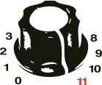
TorqueBox

Slide 4
TorqueBox
JRuby and JBoss Application Server

Slide 5


Notes:
Replace AS7 with EAP if you’re a Red Hat supported customer.

Slide 6
Ruby on the JVM
Notes:
Has anyone here used Ruby or JRuby before?

Slide 7
Ruby?
Aren’t most JBoss developers Java developers?
Notes:
While most JBoss developers are Java developers, JBoss projects and products can appeal to a much wider audience. Java is not the right tool for every job.

Slide 8
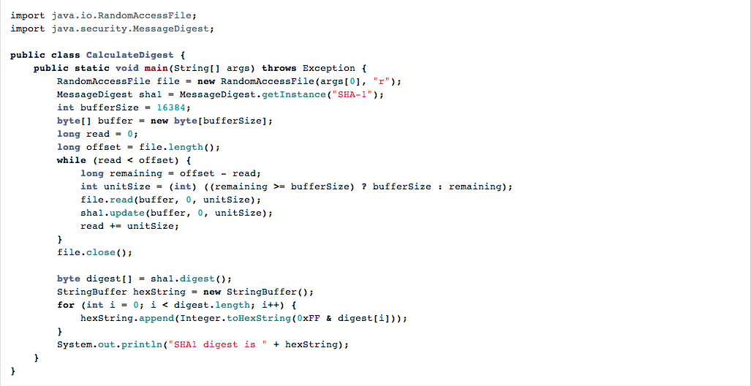
Java
Notes:
Here’s one of many examples of Ruby’s expressiveness compared to Java. This is a real-world example I ran into with TorqueBox recently.

Slide 9
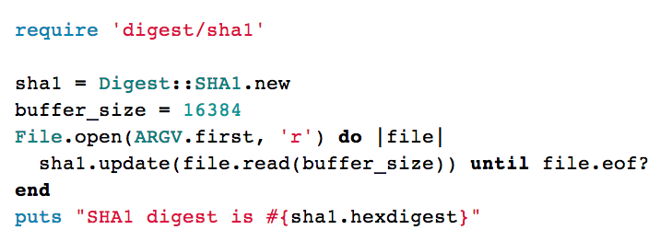
Ruby
Notes:
Java and Ruby both have their strengths and weaknesses, but Ruby has a large developer community and, more importantly, a growing number of companies using it.

Slide 10
TorqueBox
Rails, Sinatra, and Rack applications
Messaging
Scheduled Jobs
Daemons
Caching
Clustering
WebSockets / STOMP
Supported by Red Hat
Notes:
We provide everything needed to deploy complex Ruby applications in one stack

Slide 11
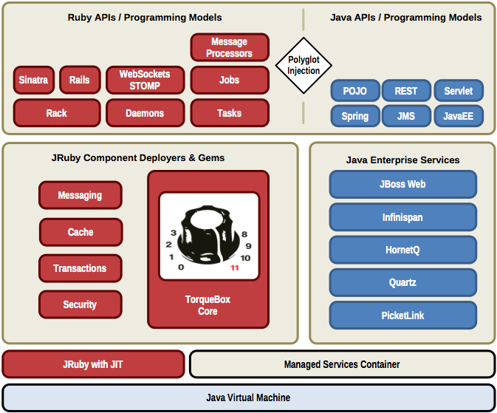

Slide 12

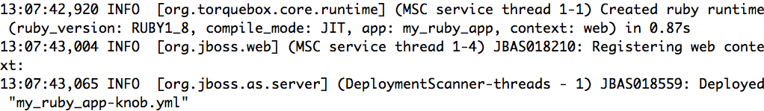
TorqueBox usage

Slide 13
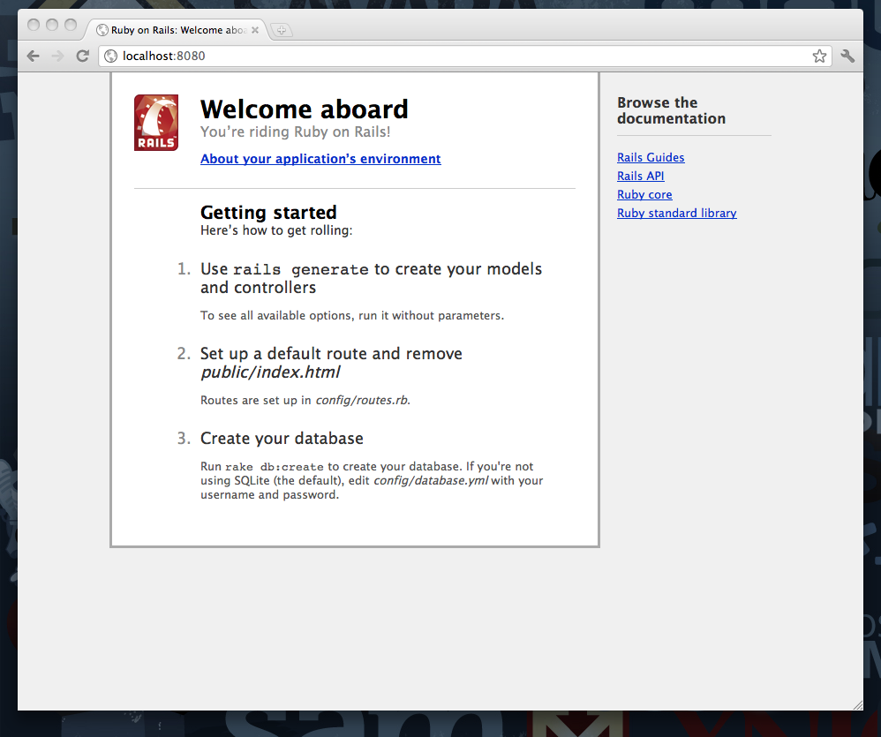

Slide 14
TorqueBox Getting Started
http://torquebox.org/getting-started/current/

Slide 15
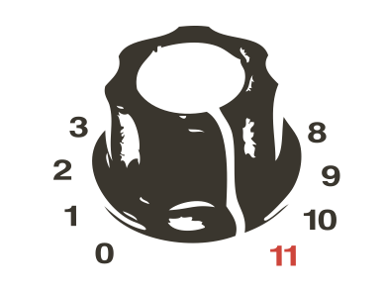

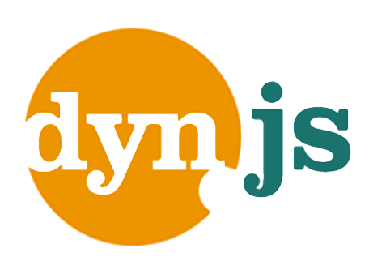
Polyglot
http://torquebox.org
http://immutant.org
http://escalante.io/
http://dynjs.org/

Slide 16
Questions?

