Slide 1

www.makeithappen.club

Slide 2

Inspiring ideas

Slide 3
Add photo(s) of inspiring ideas

Slide 4
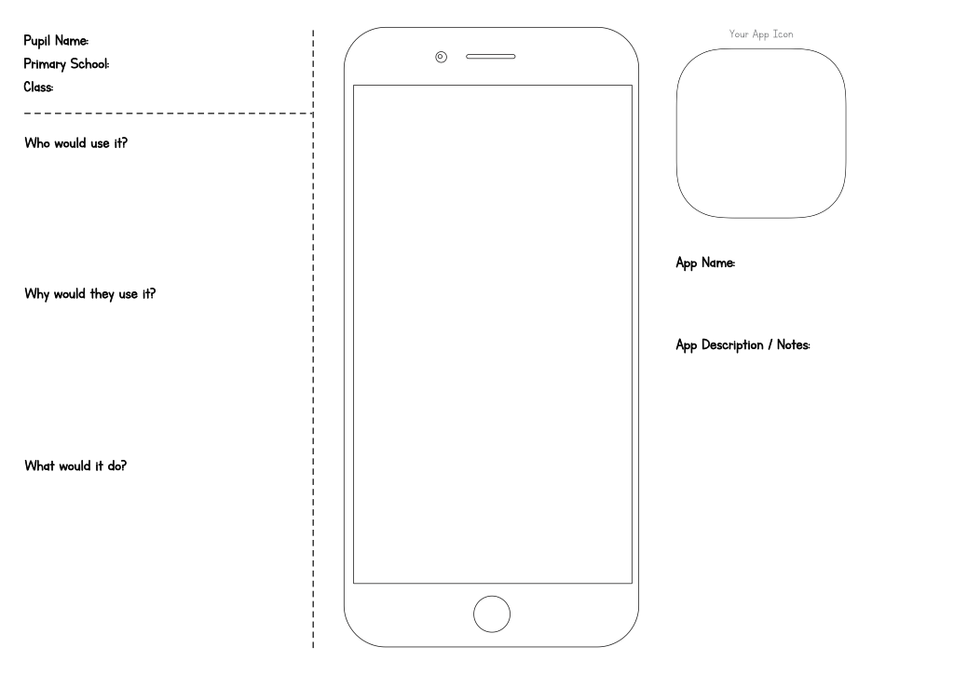
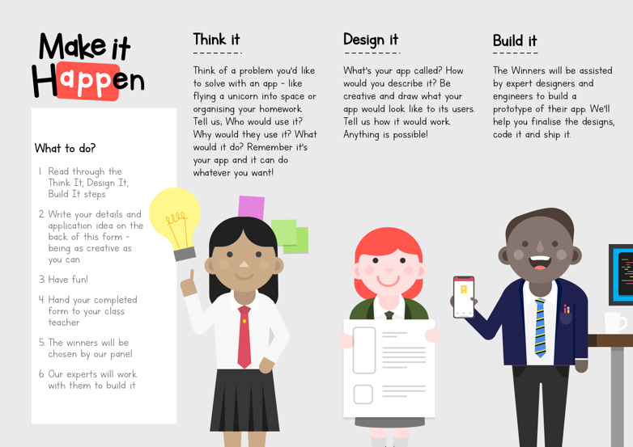
Runners up - 1

Slide 5
Runner up – [pupil name and class]
[app name]
Picture of entry

Slide 6
Runners up - 2

Slide 7
Runner up – [pupil name and class]
[app name]
Picture of entry

Slide 8

Winner

Slide 9
Winner – [pupil name + class]
[app name]
Picture of entry
Screenshot
Screenshot
Icon

Slide 10
What’s next…
Finish the winning app idea today
Download and play the winning app
You can take all your ideas forward – thunkable.com
www.makeithappen.club

