Slide 1

www.makeithappen.club

Slide 2

Think It
Design It
Build It

Slide 3
Sample Submission

Slide 4
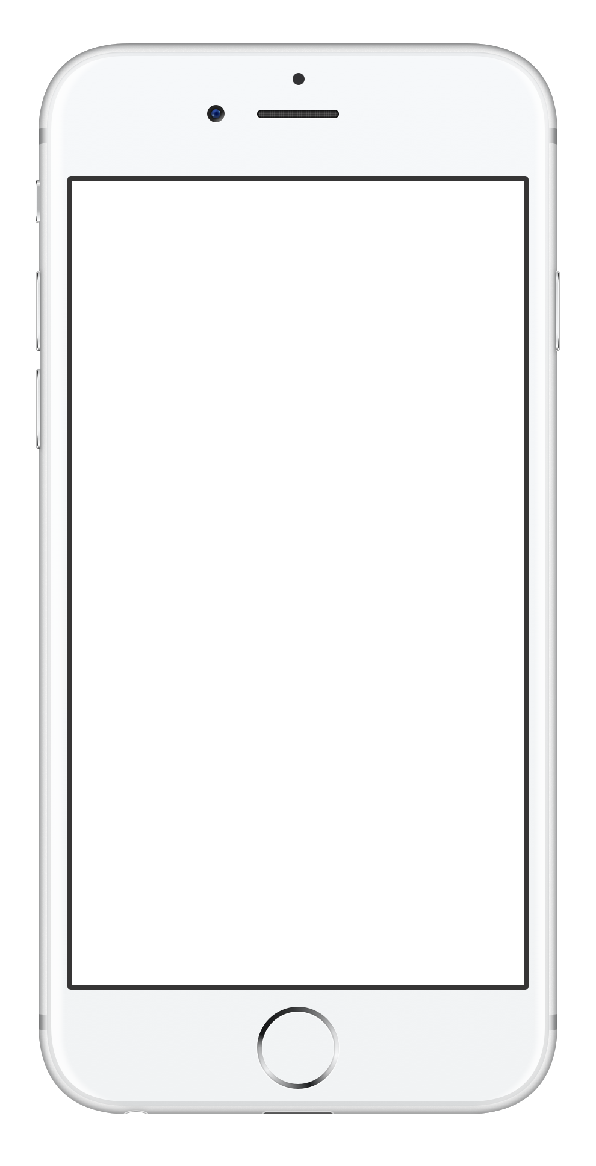
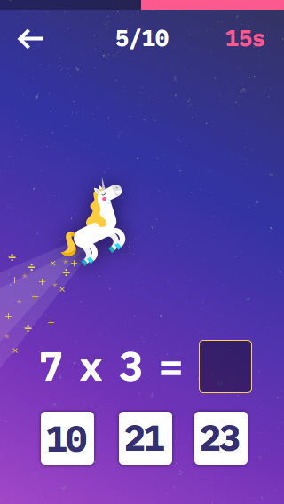

Make It Happen Winner

