Slide 1
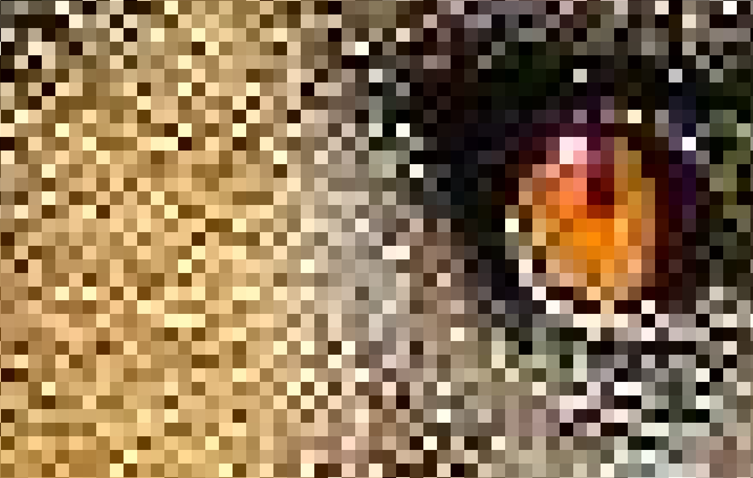
steganography
By Mark Torrens
https://goo.gl/e7HLiK

Slide 2
Steganography
Overview
How to do it
Implementation Strategy
Have a go

Slide 3
Steganography
Steganography means data hiding.
Not the same as cryptography, but cryptography is often involved.
Data can be hidden in images, videos, network protocols and anything else that’s digital.
We will be talking about steganography in images.

Slide 4
Uses in the wild
Data exfiltration and transport
Hiding malware payloads
Hiding botnet commands
Difficult to detect
Trends in steganography, 2014
Exploring steganography: Seeing the unseen, 1998

Slide 5
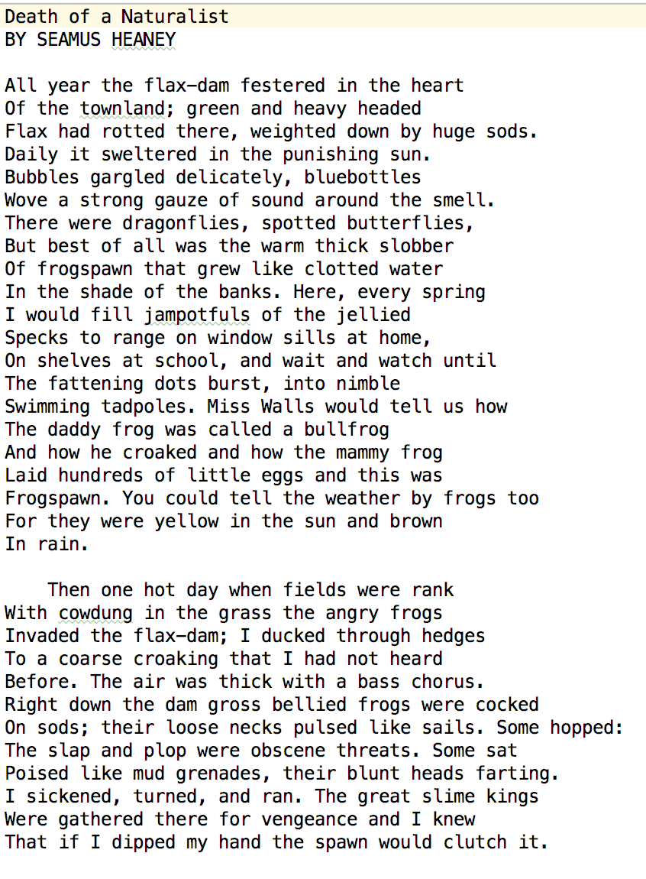
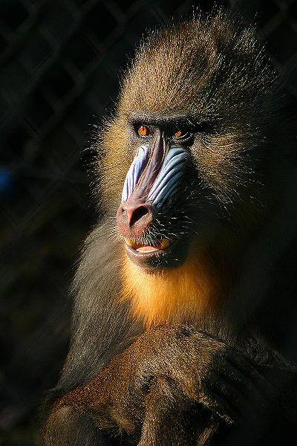
Steganography in images
Data to hide
Cover Image
Stego Image

Slide 6
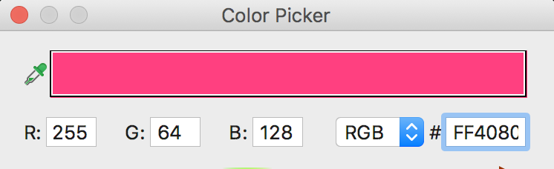
Pixels made of red, green & blue colour values
Each R, G, B part is a byte ranging from 0 - 255

Slide 7
Least significant bit (LSB)
Bit 8 | Bit 7 | Bit 6 | Bit 5 | Bit 4 | Bit 3 | Bit 2 | Bit 1
128 | 64 | 32 | 16 | 8 | 4 | 2 | 1
0 | 1 | 0 | 0 | 0 | 0 | 0 | 1
These 8 bits (a byte) represent 65 ASCII A
LSB – Bit 1

Slide 8
Altering the LSB
RGB( 255, 0, 0 )
RGB( 254, 0, 0 )
RGB( 0, 255, 0 )
RGB( 0, 254, 0 )
RGB( 0, 0, 255 )
RGB( 0, 0, 254 )

Slide 9
Hiding one byte in 8 pixels
A
0 1 0 0 0 0 0 1
RED | GREEN | BLUE
11111111 | 00000000 | 11111111
11111111 | 00000000 | 11111111
11111111 | 00000000 | 11111111
11111111 | 00000000 | 11111111
11111111 | 00000000 | 11111111
11111111 | 00000000 | 11111111
11111111 | 00000000 | 11111111
11111111 | 00000000 | 11111111
RED | GREEN | BLUE
11111111 | 0000000 1 | 11111111
11111111 | 0000000 0 | 11111111
11111111 | 0000000 0 | 11111111
11111111 | 0000000 0 | 11111111
11111111 | 0000000 0 | 11111111
11111111 | 0000000 0 | 11111111
11111111 | 0000000 1 | 11111111
11111111 | 0000000 0 | 11111111

Slide 10
Implementation Pseudocode
Create the Stego Image
Read the secret file
Read the cover image.
Write the size of the secret file to the cover image.
Using LSB, write the secret file to the cover image.
Write the stego image.
Extract the secret file
Read the stego file
Read the secret file header.
Read the LSBs.
Write the secret file.

Slide 11
Utility functions provided
def get_pixel_coordinates(index, cols) - Given an index, return the x, y coordinates in an image
def set_lsb(byte, bit) – Set the LSB of a byte
def set_bit(byte, value, position) – Set a bit position of a byte
def bit_from_byte(byte, position) – Get a bit value from a byte
def get_bit_from_byte_array(secret_data, position) – Get a bit from a byte array

Slide 12
Challenge
Hide the poem Death of a Naturalist, by Seamus Heaney in the image mandril.jpg
Death of a Naturalist 1,494 bytes, mandril.jpg 60,149 bytes
How much of the book Frankenstein, by Mary Shelley 450,755 bytes can you hide in cover image? Use more parts of the pixel or compression. Does the stego image look suspect?

