Slide 1
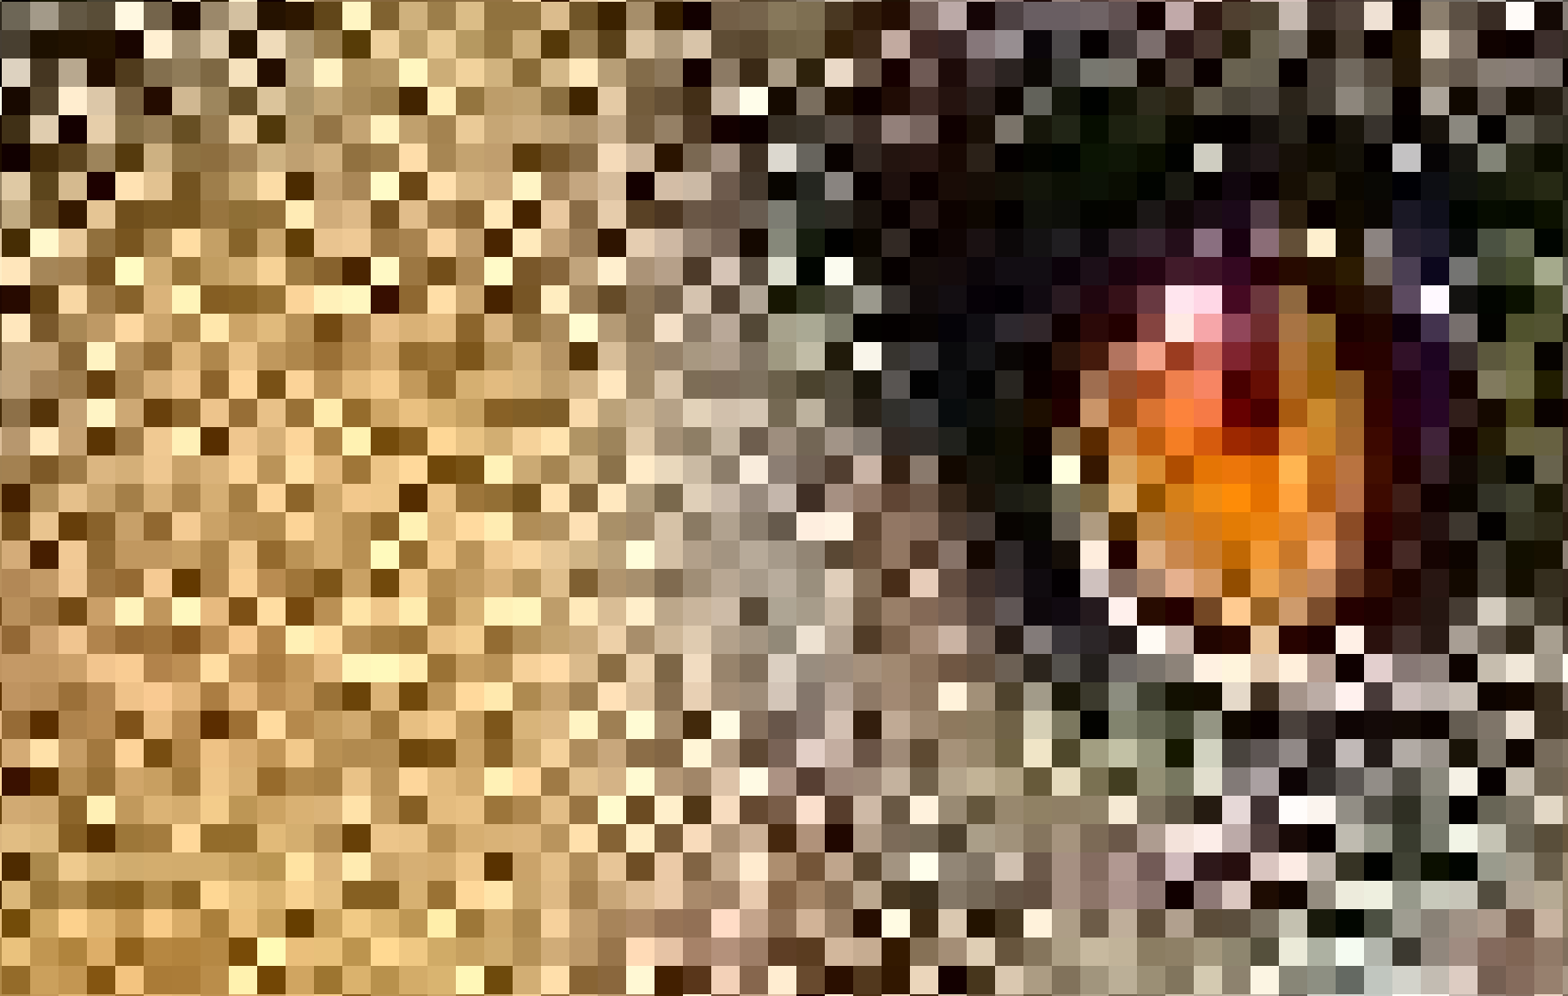
steganography
By Mark Torrens
Reviewed By: James Taylor

Slide 2
Steganography
Overview
How to do it
Implementation Strategy
Have a go

Slide 3
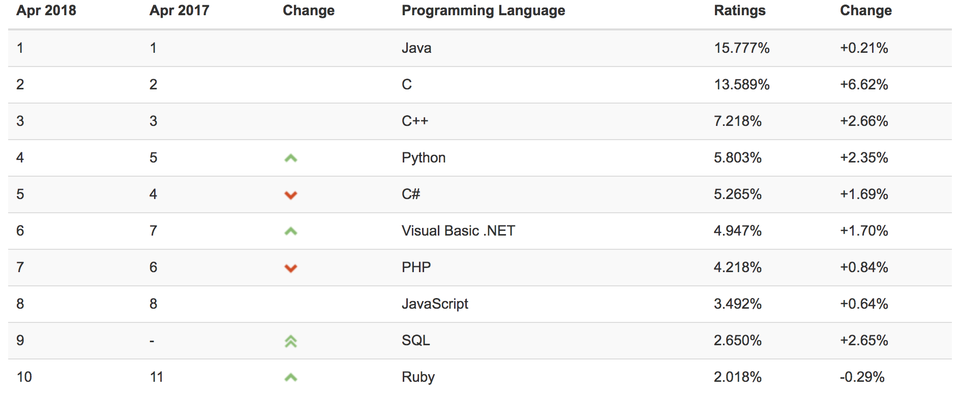
Python
https://www.tiobe.com/tiobe-index/

Slide 4
Steganography
Steganography means hiding data.
Not the same as cryptography, but cryptography is often involved.
Data can be hidden in images, videos, network protocols and anything else that’s digital.
We will be talking about steganography in images.

Slide 5
Uses in the wild
Data exfiltration and transport
Hiding malware payloads
Hiding botnet commands
Difficult to detect
Trends in steganography, 2014
Exploring steganography: Seeing the unseen, 1998

Slide 6
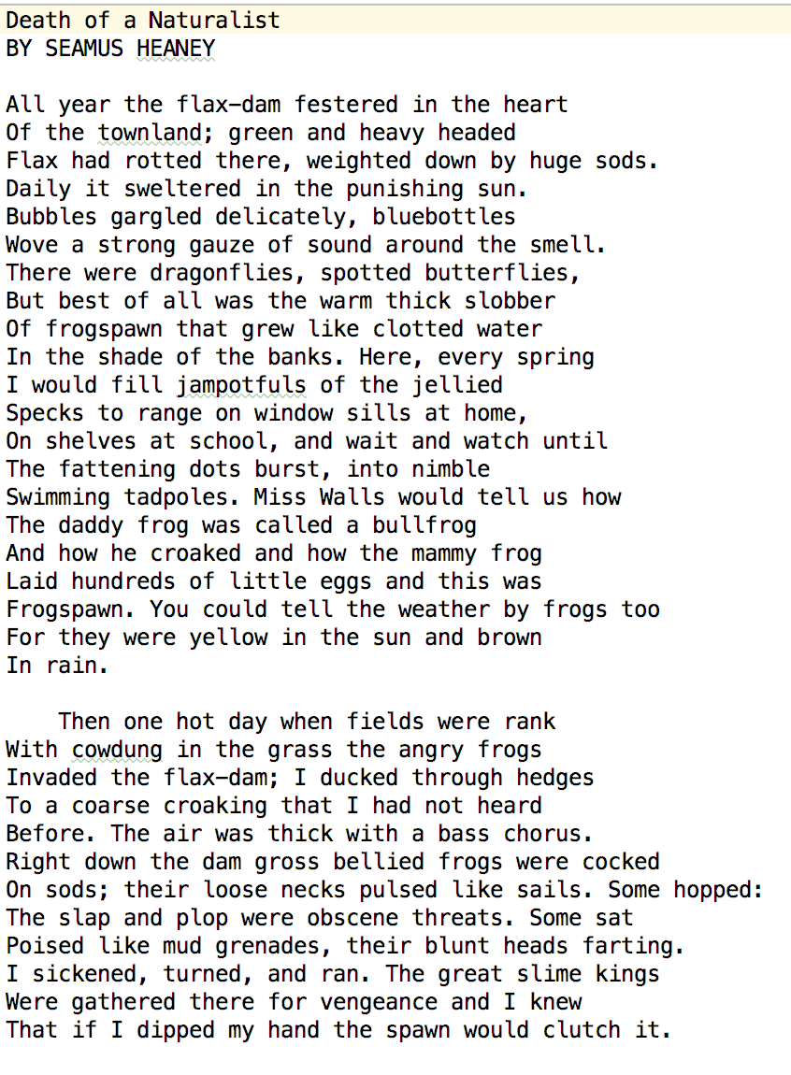
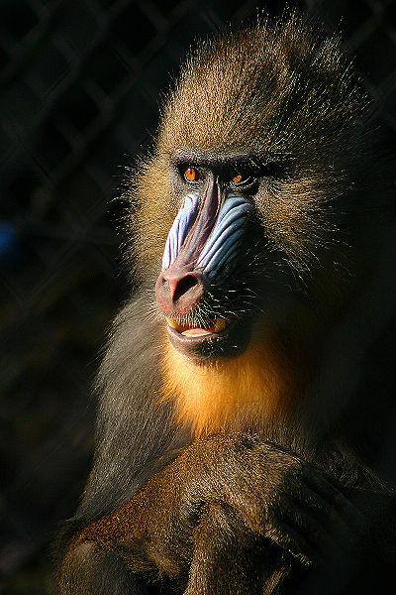
Steganography in images
Data to hide
Cover Image
Stego Image

Slide 7
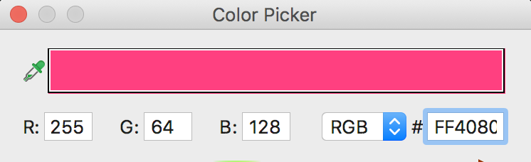
Pixels made of red, green & blue colour values
Each R, G, B part is a byte ranging from 0 - 255

Slide 8
Reminder about how a byte is made
Bit 8 | Bit 7 | Bit 6 | Bit 5 | Bit 4 | Bit 3 | Bit 2 | Bit 1
128 | 64 | 32 | 16 | 8 | 4 | 2 | 1
0 | 1 | 0 | 0 | 0 | 0 | 0 | 1
These 8 bits (a byte) represent 65 ASCII A
LSB – Bit 1

Slide 9
Altering the 4 Least Significant Bits
RGB( 255, 0, 0 )
RGB( 240, 0, 0 )
RGB( 0, 255, 0 )
RGB( 0, 240, 0 )
RGB( 0, 0, 255 )
RGB( 0, 0, 240 )
Bit 8 | Bit 7 | Bit 6 | Bit 5 | Bit 4 | Bit 3 | Bit 2 | Bit 1
128 | 64 | 32 | 16 | 8 | 4 | 2 | 1
1 | 1 | 1 | 1 | 0 | 0 | 0 | 0

Slide 10
Hiding one picture in another
Cover Image – 1 pixel
RED | GREEN | BLUE
11111111 | 11111111 | 11111111
Stego Image – 1 pixel
RED | GREEN | BLUE
1111 0000 | 1111 0000 | 1111 0000
Secret Image – 1 pixel
RED | GREEN | BLUE
00000000 | 00000000 | 00000000

Slide 11
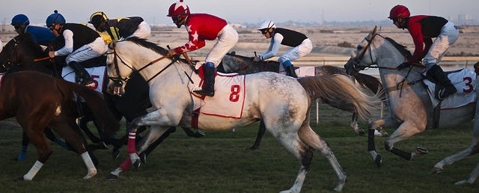
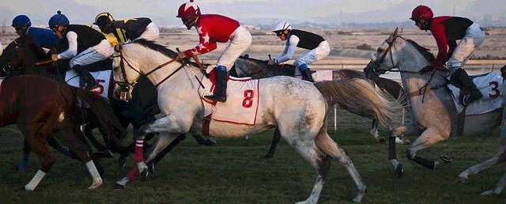
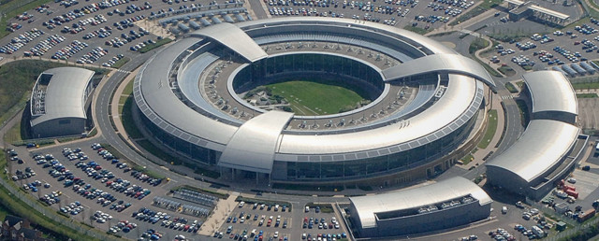
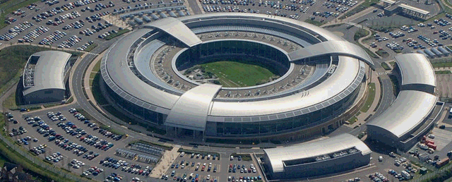
Hiding one picture in another
Cover Image
Stego Image
Secret Image
Retrieved Image

Slide 12
Hiding one byte in 8 pixels
A
0 1 0 0 0 0 0 1
RED | GREEN | BLUE
11111111 | 00000000 | 11111111
11111111 | 00000000 | 11111111
11111111 | 00000000 | 11111111
11111111 | 00000000 | 11111111
11111111 | 00000000 | 11111111
11111111 | 00000000 | 11111111
11111111 | 00000000 | 11111111
11111111 | 00000000 | 11111111
RED | GREEN | BLUE
11111111 | 0000000 1 | 11111111
11111111 | 0000000 0 | 11111111
11111111 | 0000000 0 | 11111111
11111111 | 0000000 0 | 11111111
11111111 | 0000000 0 | 11111111
11111111 | 0000000 0 | 11111111
11111111 | 0000000 1 | 11111111
11111111 | 0000000 0 | 11111111

Slide 13
Implementation Pseudocode
Create the Stego Image
Read the secret file.
Read the cover image.
Write the size of the secret file to the cover image.
Using LSB, write the secret file to the cover image.
Write the stego image.
Extract the secret file
Read the stego file
Read the secret file header.
Read the LSBs.
Write the secret file.

Slide 14
Utility functions provided
def get_pixel_coordinates(index, cols) - Given an index, return the x, y coordinates of an image
def set_lsb(byte, bit) – Set the LSB of a byte
def set_bit(byte, value, position) – Set a bit position of a byte
def get_bit_from_byte(byte, position) – Get a bit value from a byte
def get_bit_from_byte_array(secret_data, position) – Get a bit from a byte array

Slide 15
Challenge 1
Clone sample code from https://github.com/torrens/kainosSteg
Install python3 - brew install python
Install python image library - pip3 install pillow
Prove that your environment can execute image_run.sh to see image hiding work.
Try and understand how the code is working

Slide 16
Challenge 2
Hide the poem Death of a Naturalist, by Seamus Heaney (1,494 bytes) in the image mandril.png using file_steg.py as a base.
You only need to get the combine method working.
Comments should guide you.
A solution is in file file_steg_solution.py

Slide 17
Challenge 3
How much of the book Frankenstein, by Mary Shelley (450,755 bytes) can you hide in cover image?
Technique 1 - Use compression.
Technique 2 – Use more parts of the pixel.
Does the stego image look suspect?

