Slide 1
MIT LiftLab 2026 · Tec de Monterrey, Campus SLP
From nanostores
to classrooms
What keeps people from buying healthy products in Mexico's nanostores?
Carlos Torres · Fernanda Ita · Alexis Marcos
Campus SLP
Notes:
[SLIDE 1 — TÍTULO]
Fernanda: 'MIT nos lanzó una pregunta. Esta es nuestra respuesta en cuatro actos — y empezamos por el fracaso.'

Slide 2
STARTING POINT
·
The MIT LiftLab field dataset
3,040 real records from Mexican nanostores · National study · ~13 campuses
221
1,135
236
1,448
Nanostores
Shoppers
Shopkeepers
Last-mile deliveries
+ 104 own survey responses · San Luis Potosí · Dec 2025–Jan 2026
The story that follows is the real path we took: including the model that failed. Because that failure was exactly what led us to the right answer.
Notes:
[S2 — DATASET]
Carlos: 'El MIT nos dio acceso a 3,040 registros de campo reales.'

Slide 3
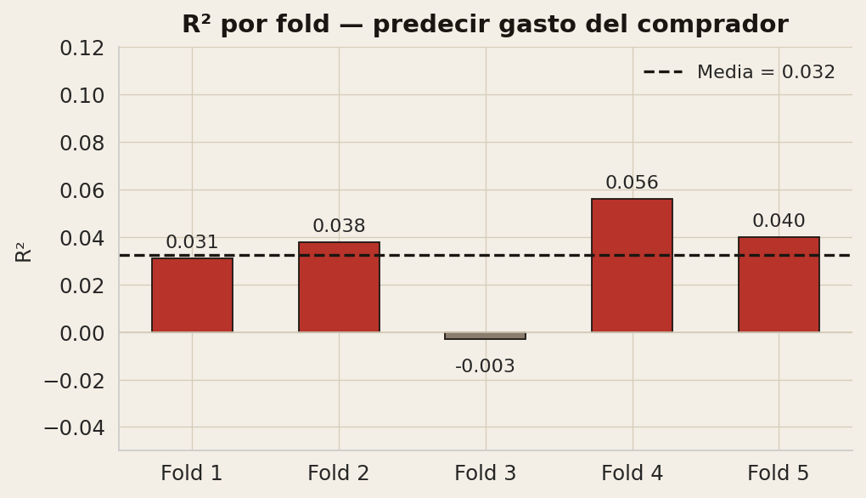
01
ACT 1 — THE REGRESSION THAT FAILED
We started where every analyst starts
Linear regression · Predicting shopper spend from demographics and budget
R² = 0.032
the model explains nothing
FIRST REAL FINDING
An R² of 0.03 is not a mistake — it's evidence that shopper behaviour is not a simple linear function of who you are. Something more structural is at play.
→ Something more structural is going on.
Notes:
[S3 — ACTO 1]
Carlos: 'R²=0.032. El modelo no explica casi nada. Ese fracaso fue el primer hallazgo real.'

Slide 4
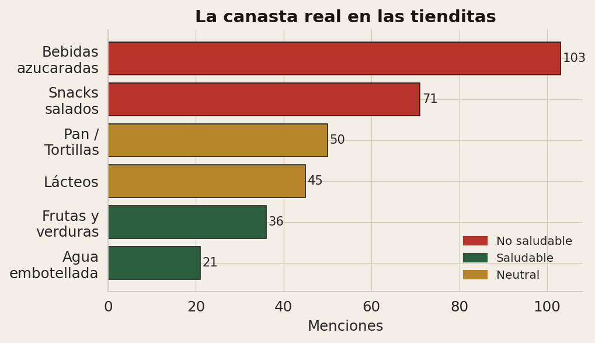
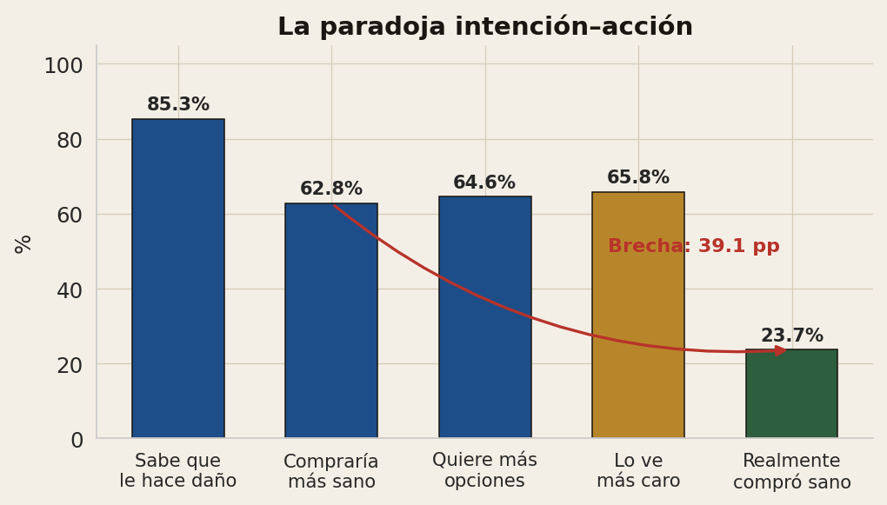
02
ACT 2 — THE REAL INSIGHT
We changed the question
Instead of 'how much does this person spend?', we asked what really gets bought and how the whole system looks.
60.8%
50.3%
23.7%
66%
buys ≥1 unhealthy item
buys ONLY unhealthy
buys something healthy
deliveries w/o healthy offer
Notes:
[S4 — ACTO 2 STATS]
Carlos: '60.8% compra al menos un producto no saludable. 50.3% SOLO no saludable. Solo 23.7% compra algo sano.'

Slide 5
ACT 2 — THE HEART OF THE FINDING
People are not ignorant and not indifferent.
THE HEART OF THE PROJECT
85% know · 63% would buy healthier · 65% want more options. But only 24% actually buy anything healthy.
The dominant declared barrier is price perception. Neither the regression (R²=0.032) nor a Random Forest (AUC≈0.55) predicts healthy purchasing from individual traits. The problem is not the people — it's the conditions around them.
Random Forest · AUC ≈ 0.55
Last mile · 66% with no healthy offer
Barely better than a coin flip. Healthy purchasing is not explained by who you are.
2 out of 3 deliveries offered no healthy products to the store. The problem starts before the counter.
Notes:
[S5 — CALLOUT]
Carlos: 'El sistema está diseñado para empujar lo no saludable — no es una falla de las personas.'

Slide 6
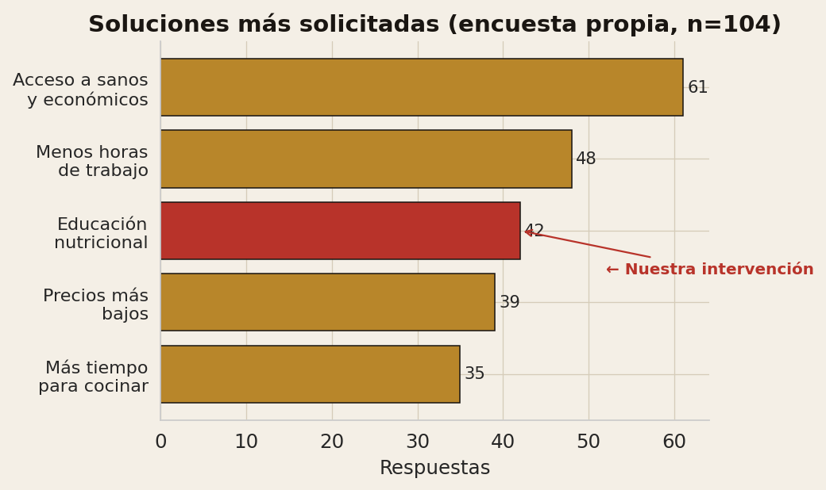
03
ACT 3 — OUR OWN SURVEY
A single dataset is a single lens
We ran our own independent survey to triangulate without anchoring on the MIT data.
80 out of 94 respondents would change their habits with more time or resources.
· Root cause: lack of time
· Heavy nanostore use: soda and snacks
· Parents: very worried about their children's diet
· Exact convergence with MIT dataset
Convergence: same root cause from an independent sample. Respondents themselves name nutrition education as a solution.
Notes:
[S6 — ACTO 3]
Alexis: '104 personas en SLP. El resultado convergió exactamente con lo que el MIT nos dijo.'

Slide 7
THE LOGICAL BRIDGE
The data is about adults. The solution targets adolescents.
The bridge is honest and explicit:
Current ecosystem pushes unhealthy choices
People know and want — but can't close the gap
Lever: educate the next generation of shoppers
→
→
Why lower secondary school (ages 12–15)?
· Higher obesity in adolescents (40.1%) than in children (36.6%) — ENSANUT 2020–2024
· They handle their own money and visit nanostores independently: tomorrow's shoppers
· Adolescent habits consolidate into adult life
We don't regulate the nanostores. We educate those who will visit them for life.
Notes:
[S7 — PUENTE]
Fernanda: 'Nuestros datos son de adultos — somos honestos con eso. El punto de palanca es formarlos antes de que lleguen al mostrador.'

Slide 8
04
ACT 4 — THE SOLUTION
Strengthen Physical Education and Healthy Living in secondary school
Complement to NEM Plan 2022 · Not a new subject — reinforcing what the curriculum already names
A
Extended PE (2h → 3h)
B
Critical environment module
Active lifestyle literacy: reading labels, planning a healthy snack on a real budget
Audit of nanostores around the school · Every two weeks · Connects learning to real environment
C
Teacher training
D
Family bridge
8h async package + optional 4h workshop · Without trained teachers, nothing works
Monthly activity: guided conversation + affordable recipe · Respects family time constraints
Est. cost: ~MXN 9,500 / school / year · ~35,000 schools → ≈ MXN 330M/year · < 0.05% of the federal education budget
Notes:
[S8 — PROPUESTA]
Fernanda: 'Cuatro componentes. Ninguno requiere crear una materia nueva — todo se alinea con Vida Saludable de la NEM.'

Slide 9
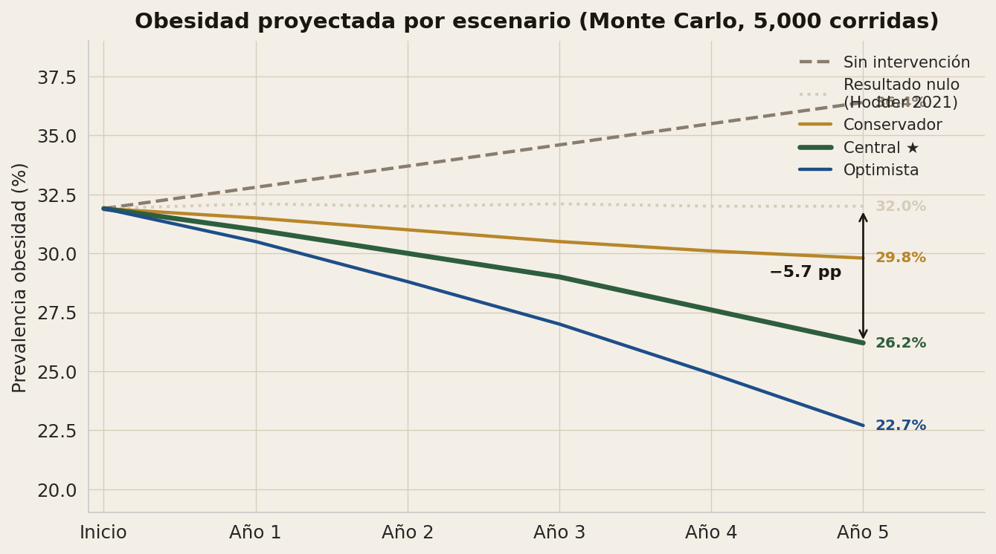
ACT 4 — IMPACT PROJECTION
Monte Carlo · 1,000 students · 5,000 runs per scenario
Year 5 · % obesity
No intervention
36.4%
Null (Hodder)
32.0%
Conservative
29.8%
Central ★
26.2%
Optimistic
22.7%
★ Central: −5.7 pp vs baseline
The null-result scenario is included intentionally — epistemic honesty over hype.
Notes:
[S9 — MONTE CARLO]
Carlos: 'El escenario central: la obesidad baja de 31.9% a 26.2% a 5 años. Incluimos el resultado nulo porque la honestidad no es opcional.'

Slide 10
EPISTEMIC HONESTY
What we know · What we assume · What we don't know
What we know
What we assume
What we don't know
· Structural barrier confirmed (2 datasets)
· Literature effects are transferable
· Whether effects hold beyond 5 years
· R²=0.032 — linear regression fails
· 80% adherence (model assumption)
· How it scales to 35,000 schools
· AUC=0.55 — ML also can't predict
· 1h extra PE/week (minimum dose)
· Teacher fidelity in real implementation
· 66% last-mile w/o healthy options
· Healthy Living axis exists — needs reinforcing
· Whether Hodder 2021 applies to Mexico
· Central effect −0.17 kg/m² (Cochrane)
This simulation is a literature-based projection — not a prediction. Any deployment requires a piloted study with follow-up.
Notes:
[S10 — HONESTIDAD]
Carlos: 'En el MIT esperan rigor intelectual. Por eso somos explícitos sobre lo que sabemos, asumimos y no sabemos.'

Slide 11
EXPERT VALIDATION
Five independent perspectives
▶
▶
▶
▶
VIDEO
VIDEO
VIDEO
VIDEO
Dr. Leopoldo Zúñiga Silva
Principal Sec. Técnica 78
PE Teacher (fitness practitioner)
Education student (fitness practitioner)
Tec de Monterrey Education research
Matehuala, SLP Implementation
Secondary school Classroom practice
Tec de Monterrey Student voice
Convergence reported when 4 experts independently raise the same theme.
Notes:
[S11 — EXPERTOS]
Alexis: 'Para no quedarnos solo con nuestros datos, llevamos la propuesta a cinco expertos con perspectivas radicalmente distintas.'

Slide 12
From nanostores to classrooms
"The current ecosystem pushes unhealthy consumption.
The most effective long-term lever is educating the next generation of shoppers."
Carlos Torres · Fernanda Ita · Alexis Marcos
Tecnológico de Monterrey · Campus San Luis Potosí · MIT LiftLab 2026
Notes:
[S12 — CIERRE]
Fernanda: 'La pregunta del MIT fue: ¿qué impide la compra saludable? Nuestra respuesta: no es ignorancia — es estructura. Y la solución más efectiva está en las aulas.'

