Slide 1
From Nanostores
DATA FOUNDATION
3,040 real field records (MIT dataset: 4 actor types) + 104 own survey responses (San Luis Potosí)
to Classrooms
What keeps people from buying healthy products in Mexico's nanostores?
Fernanda Ita · Alexis Marcos · Carlos Torres
MIT LiftLab 2026 · Tec de Monterrey, Campus SLP
"We start with a failure — because the failure was the first answer."

Slide 2
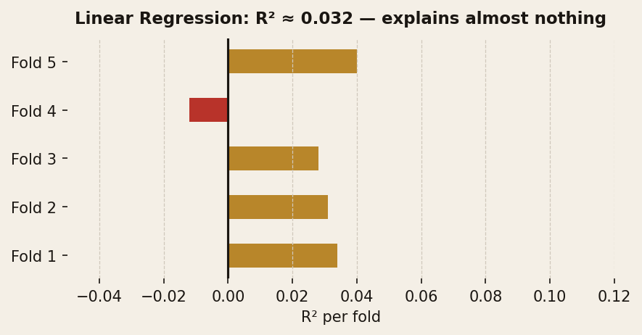
METHODOLOGY & DATA ANALYSIS
MIT LiftLab 2026 · Tec de Monterrey SLP
01
ACT 1 — The model that failed first
ACT 2 — We changed the question
Linear regression: predict spending from demographics & budget. R² = 0.032 — explains almost nothing.
Instead of how much someone spends, we asked: what gets bought, and why?
R² = 0.032
AUC = 0.55
Random Forest (AI) → AUC = 0.55 Barely better than a coin flip. The barrier is systemic, not personal.
Not a failure. Our first finding: behavior doesn't depend on WHO you are.
1 of 2 — QUANTITATIVE METHODS

Slide 3
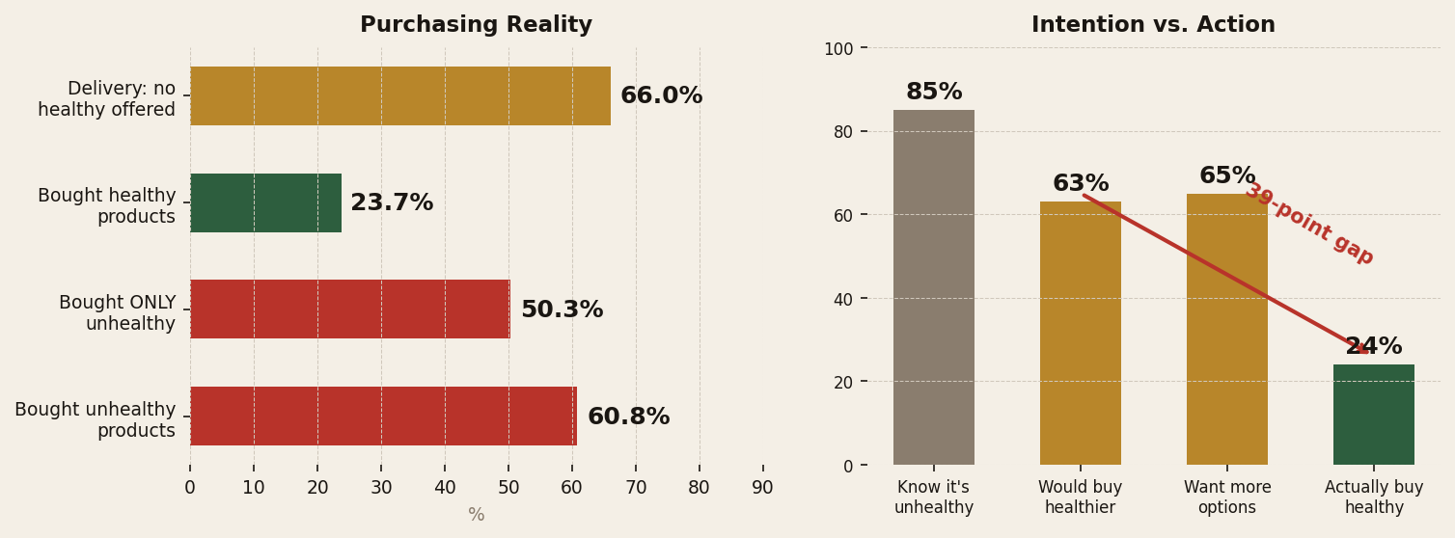
RESULTS — THE REAL PICTURE
MIT LiftLab 2026 · Tec de Monterrey SLP
What the data actually shows
85% know it's unhealthy 63% say they'd buy healthier Only 24% actually do → 39-point intention-action gap
The problem is NOT who they are. The problem is what the system offers them.
2 of 2 — FINDINGS

Slide 4
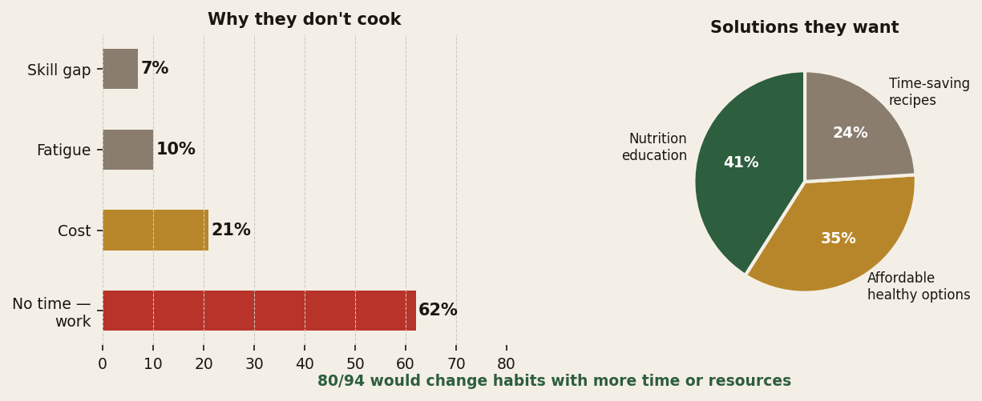
OWN SURVEY — INDEPENDENT VALIDATION
MIT LiftLab 2026 · Tec de Monterrey SLP
03
Two independent sources. Same answer.
Our respondents named nutrition education as their #1 solution — the exact intervention we were designing.
80 / 94
would change habits with more time or resources
MIT dataset + Our own survey → Same diagnosis

Slide 5
ACT 4 — THE SOLUTION
MIT LiftLab 2026 · Tec de Monterrey SLP
The structural answer: educate future shoppers
People already know and already want. The system doesn't give them the conditions. High-leverage fix: form habits at ages 12–15.
WHY SECONDARY SCHOOL?
Ages 12–15 already: • Handle their own money • Visit nanostores independently • Form lifelong habits
4 COMPONENTS — within Mexico's National Curriculum (NEM)
A
B
C
D
Extra PE hour: label literacy + healthy snack planning with real budget
Environment audit: students map nanostores around their school
Teacher training: without prepared teachers, nothing reaches class
Monthly family bridge: respects the time constraints families named
MXN 9,500 / school / year < 0.05% federal education budget

Slide 6
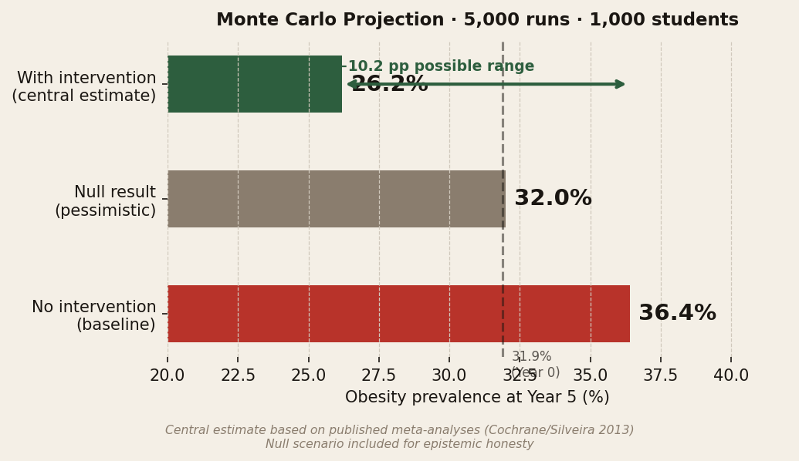
IMPACT PROJECTION — MONTE CARLO
MIT LiftLab 2026 · Tec de Monterrey SLP
Projected impact at 5 years
EPISTEMIC HONESTY
1,000 students · 5,000 simulation runs · effect sizes from published meta-analyses
We know: Purchasing behavior + system stats We assume: Effect sizes from literature (not measured in Mexico) We don't know yet: Long-term maintenance Teacher fidelity at scale
"Being honest about limitations doesn't weaken the proposal. It makes it credible."

Slide 7
Not ignorance. Not lack of willpower.
The system is structured to push unhealthy choices.
The solution is not in the nanostores.
It's in the classrooms.
APPLICABILITY
INNOVATION
QUANT. KNOWLEDGE
ACADEMIC POTENTIAL
Latin America · 1M+ nanostores
Structural diagnosis, not behavioral blame
R²=0.032 · AUC=0.55 · Monte Carlo 5k runs
Scalable model · NEM-aligned · costed
Thank you.
MIT LiftLab 2026 · Tec de Monterrey, Campus SLP

