Slide 1

Hr Management (Payroll System)
Mojgan Ahmadi –Juan Lucas Torres

Slide 2
User's perspective
One of the main problems that companies faces is managing their employees and their information.
This is a complicated task to handle and our application could fill this gap by creating an employee database and be able to manipulate the information to reach the company’s needs.
Our Goal was to emulate only the payroll process in particular since a complete HR system is a huge application that covers many areas and not only payroll.

Slide 3
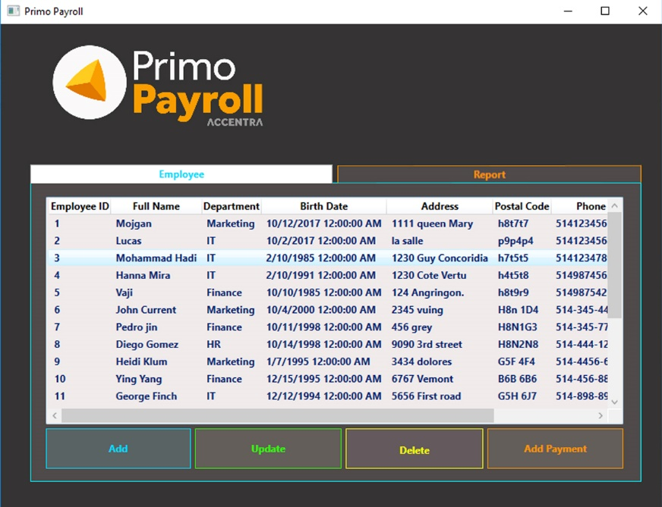
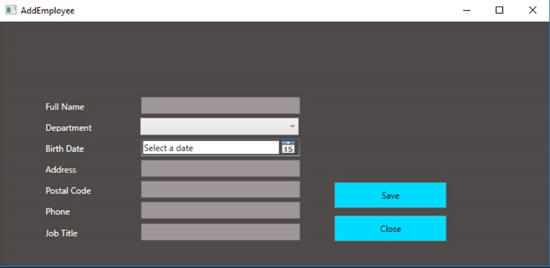
solution from high level

Slide 4
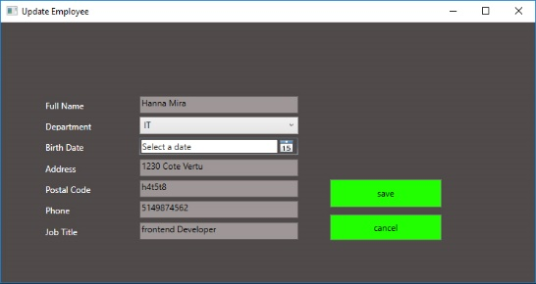
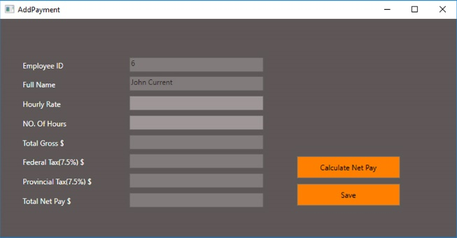
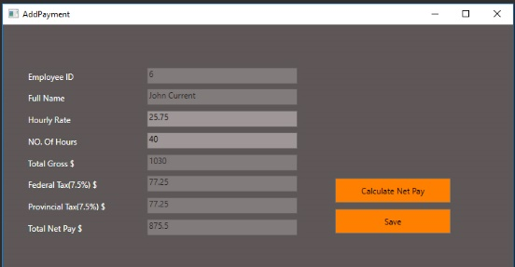
solution from high level

Slide 5
4 slides: Challenges and solutions - what we learned - talk about each of the technologies you used and each major problem you had to solve on your own to make the solution work. - talk about specific, low-level solutions and teach them to the students and teacher = Teach me how to solve ONE problem.

Slide 6
4 slides: Challenges and solutions - what we learned - talk about each of the technologies you used and each major problem you had to solve on your own to make the solution work. - talk about specific, low-level solutions and teach them to the students and teacher = Teach me how to solve ONE problem.

Slide 7
4 slides: Challenges and solutions - what we learned - talk about each of the technologies you used and each major problem you had to solve on your own to make the solution work. - talk about specific, low-level solutions and teach them to the students and teacher = Teach me how to solve ONE problem.

Slide 8
4 slides: Challenges and solutions - what we learned - talk about each of the technologies you used and each major problem you had to solve on your own to make the solution work. - talk about specific, low-level solutions and teach them to the students and teacher = Teach me how to solve ONE problem.

Slide 9
1 slide: Future work
Reports
Data tables
Charts

Slide 10
Summary and Thank you

Slide 12
Add a Slide Title - 4

Slide 13
Add a Slide Title - 5

