Slide 1

Hr Management (Payroll System)
Mojgan Ahmadi –Juan Lucas Torres

Slide 2
User's perspective(1 page)
-------------------------------------

Slide 3
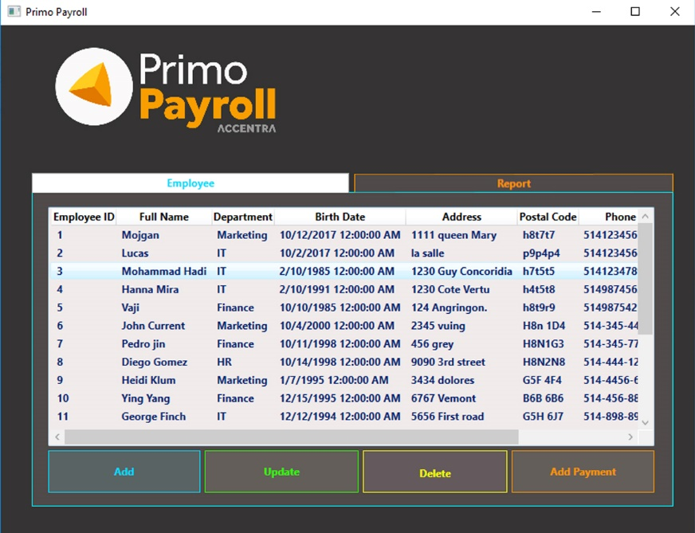
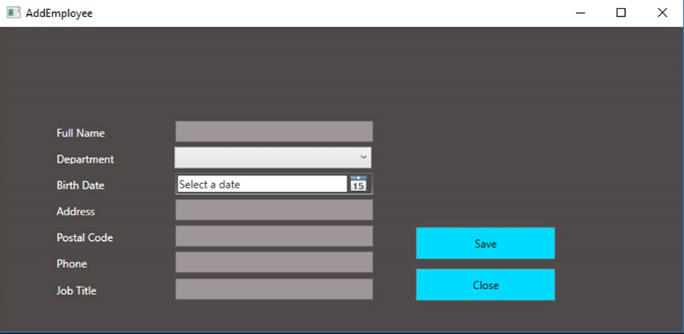
solution from high level (1)

Slide 4
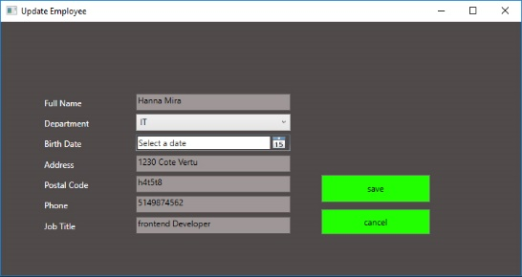
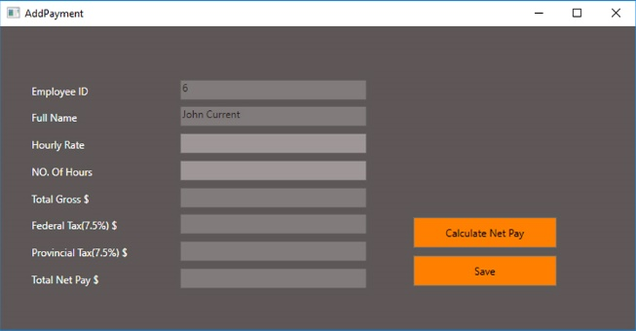
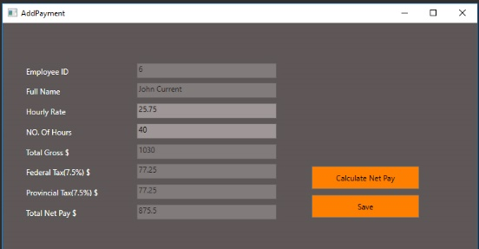
solution from high level (2)

Slide 5
4 slides: Challenges and solutions - what we learned - talk about each of the technologies you used and each major problem you had to solve on your own to make the solution work. - talk about specific, low-level solutions and teach them to the students and teacher = Teach me how to solve ONE problem.

Slide 6
4 slides: Challenges and solutions - what we learned - talk about each of the technologies you used and each major problem you had to solve on your own to make the solution work. - talk about specific, low-level solutions and teach them to the students and teacher = Teach me how to solve ONE problem.

Slide 7
4 slides: Challenges and solutions - what we learned - talk about each of the technologies you used and each major problem you had to solve on your own to make the solution work. - talk about specific, low-level solutions and teach them to the students and teacher = Teach me how to solve ONE problem.

Slide 8
4 slides: Challenges and solutions - what we learned - talk about each of the technologies you used and each major problem you had to solve on your own to make the solution work. - talk about specific, low-level solutions and teach them to the students and teacher = Teach me how to solve ONE problem.

Slide 9
1 slide: Future work
Reports
Data tables
Charts

Slide 10
Summary and Thank you

Slide 12
Add a Slide Title - 4

Slide 13
Add a Slide Title - 5

