Slide 1

Hr Management (Payroll System)
Mojgan Ahmadi –Juan Lucas Torres

Slide 2
User's perspective
One of the main problems that companies faces is managing their employees and their information.
This is a complicated task to handle and our application could fill this gap by creating an employee database and be able to manipulate the information to reach the company’s needs.
Our Goal was to emulate only the payroll process in particular since a complete HR system is a huge application that covers many areas and not only payroll.

Slide 3
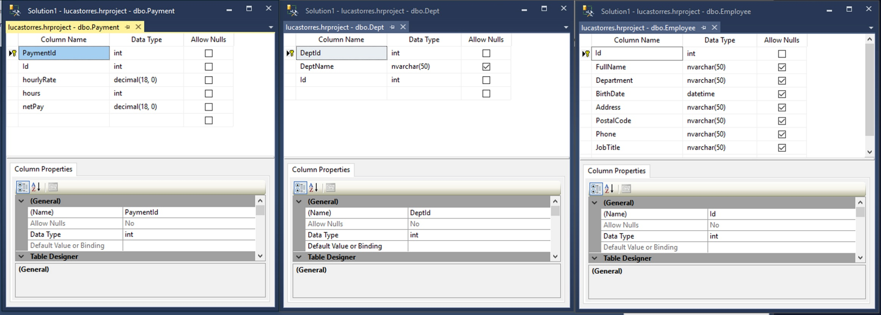
Database

Slide 4
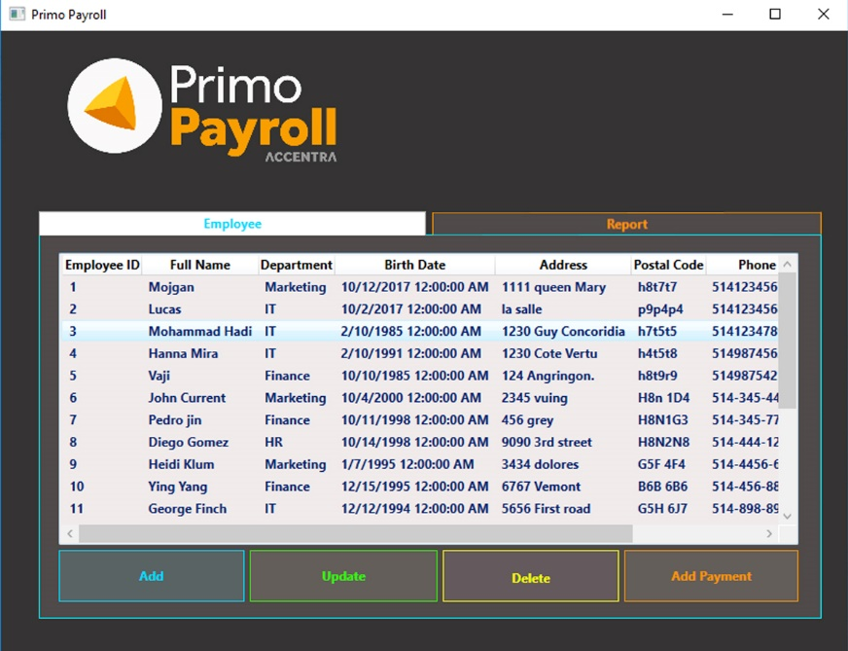
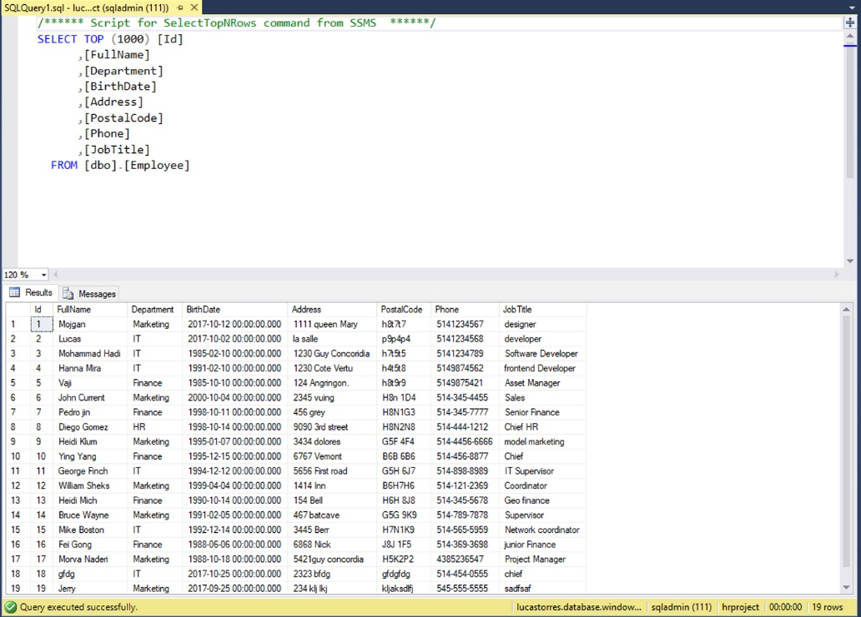
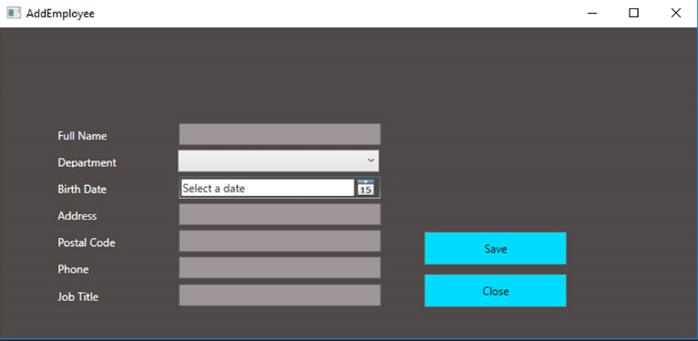
solution from high level

Slide 5
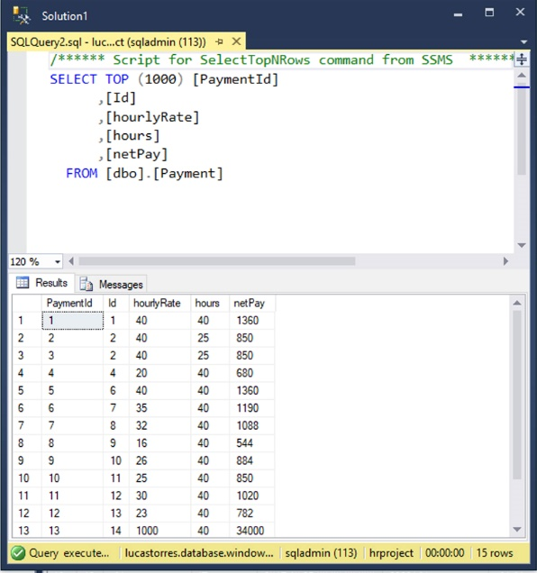
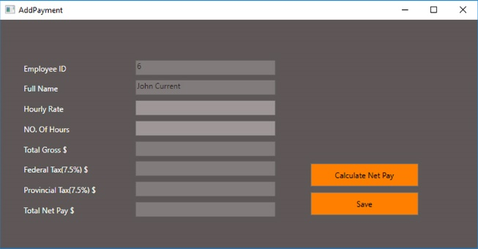
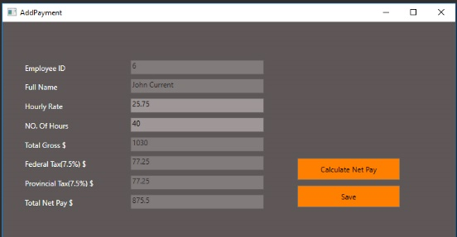
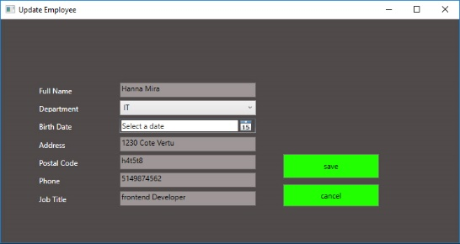
solution from high level

Slide 6
Challenges and solutions - the technologies you used: C#, WPF. and each major problem you had to solve on your own to make the solution work. - talk about specific, low-level solutions and teach them to the students and teacher

Slide 7
Challenges and solutions
How to get the database connected
how we went through the steps of -making tables in visual studio
then tried it with SQL server
Implement the code behind for any single part was really challenging.
Poor editing support for XAML

Slide 8
Future work
Data Warehouse Inquiry and Download Frequently Asked Questions in Electronic Document Library.
Classify or re-classify an individual's position and track the request.
Job Description Library An online database of thousands of approved UCI job descriptions.
Hiring managers use Quick Requisition to post job openings (requisitions) The posting is usually done within one business day of the request.
Time Reporting System
Title and Pay Queries and Reports

Slide 9
Summary
As an authorized user you can inquire and update employee and payroll related information, view post-authorization notifications (PAN), and enter timecards using a number of applications
Thank you
We want to thank Vaji for the helping us with the main part of the implementation of the code ,
And Mohammad helped us with database connection,
Georgio helped with tables, Hanna helped with some issues we faced.
Thank you all for listening.

Slide 11
Add a Slide Title - 4

Slide 12
Add a Slide Title - 5

