Slide 1
Image Classification Project
Natalia E. Torres

Slide 2
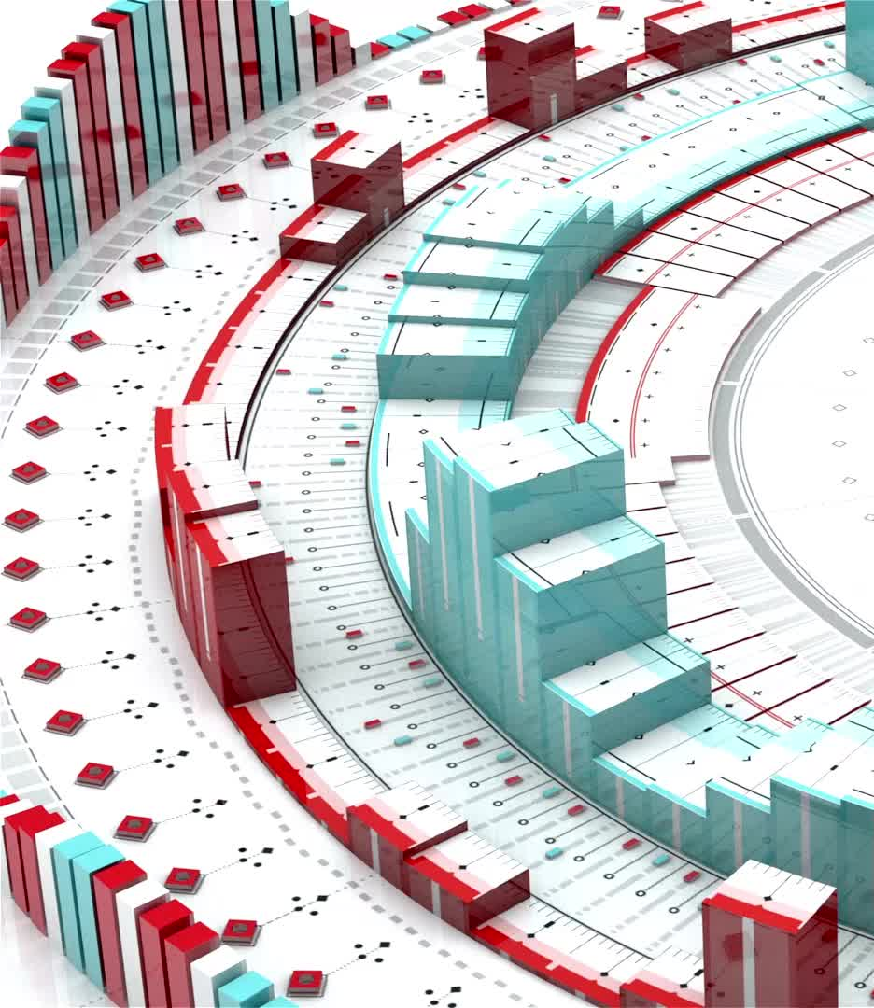
Introduction
This presentation covers the CNN architectures, preprocessing steps, training details, and model performance analysis.

Slide 3
CNN Architectures
1. Custom CNN Model
- Conv2D (32, ReLU) → MaxPooling
- Conv2D (64, ReLU) → MaxPooling
- Flatten → Dense (64, ReLU) → Dense (10, Softmax)
2. VGG16-based Model
- Pretrained VGG16
- Flatten → Dense (256, ReLU) → Dropout (0.5) → Dense (10, Softmax)

Slide 4
Preprocessing Steps
• Batch-wise preprocessing and storage
• Efficient data loading using tf.data.Dataset
• Batching with size 16 for memory optimization

Slide 5
Training Process
• Optimizer: Adam
• Loss Function: Categorical Crossentropy
• Batch Size: 16
• Epochs: 50
• MLflow tracking for training metrics

Slide 6
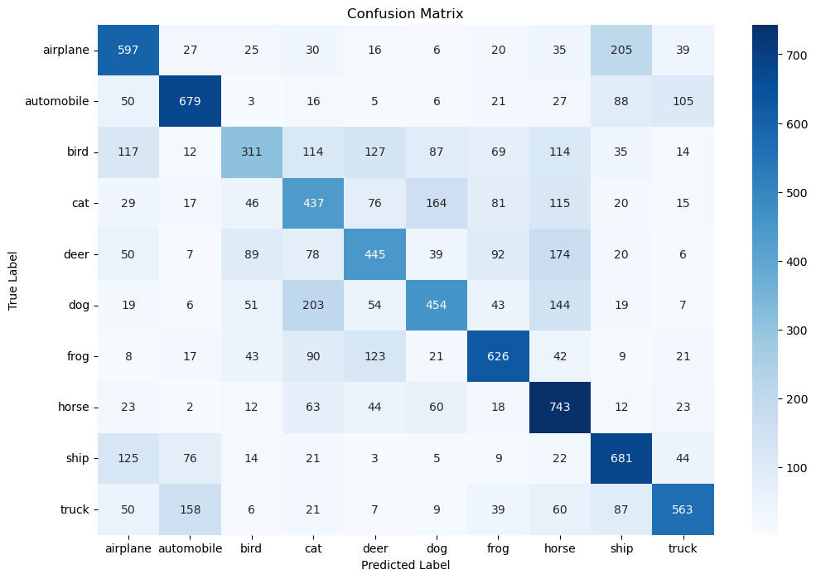

Slide 7
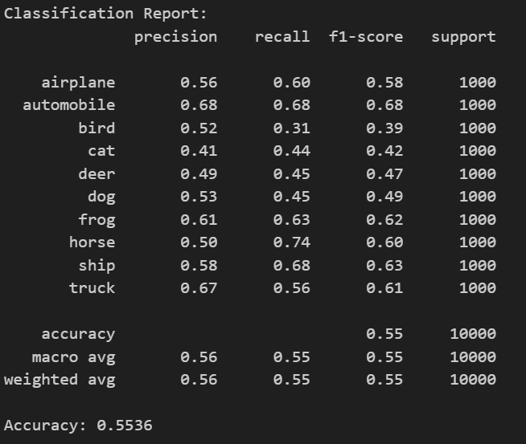

Slide 8
Model Performance
• Test Accuracy and Loss evaluated
• Classification report and confusion matrix generated
• MLflow used for logging and visualization

Slide 9
Best Model Selection
• VGG16-based model with 256-neuron dense layer and dropout (0.5) performed best
• Transfer learning provided better feature extraction
• Dropout improved generalization and reduced overfitting

Slide 10
Insights Gained
• Preprocessing improved memory efficiency
• Transfer learning significantly enhanced accuracy
• Dropout was useful in preventing overfitting

Slide 11
Conclusion
The VGG16-based model with a 256-neuron dense layer and dropout (0.5) was the best performer, demonstrating superior accuracy and generalization capability.

