Slide 1
Jacki Torres
Senior Product Designer | Healthtech + AI
Portfolio Deep Dive — Jiro Health
May 2026
jackelinetorres.co

Slide 2
Architecture taught me how to think in systems. Product design taught me how to ship them. Healthtech and AI taught me what's actually at stake. I've been the sole designer twice — at early-stage startups, working directly with CPOs, building from zero in environments where the foundation didn't exist yet.

Slide 3
Why I care about this space
My grandmother and mother don't speak English. For most of my life I've been their translator in healthcare settings — appointments, phone calls, discharge instructions, prescriptions. That's not a niche problem. It's a systemic one. And it's what pushed me toward healthtech. I'm currently building a live voice transcription and translation app for non-English speakers in clinical settings. Not as a side project — as a design conviction. Healthcare software has a trust problem, a complexity problem, and a communication problem. That's exactly where I want to work.

Slide 4
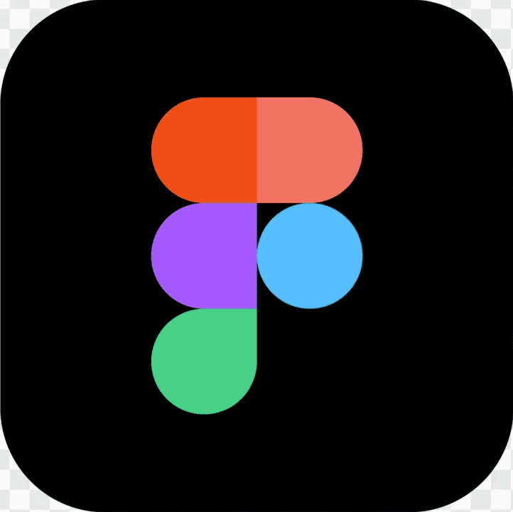



How I work
Four things that don't change regardless of the project
Foundation before velocity
If the design system, the component library, and the handoff process aren't solid, you pay for it on every sprint. I build the rails first.
Design and code in lockstep
I don't throw files over a wall. I work in the same tools as engineers, speak the same language, and make sure what's in Figma exists in code — and vice versa.
Problem definition is not optional
I push back on jumping to solutions. Not to slow things down, but because the wrong solution built fast is still the wrong solution.
Feedback loops as infrastructure
User research has to be a habit. Fast, lightweight, and tied directly to what ships next.

Slide 5
Why Jiro, why now
Jiro is giving individual clinicians access to practice intelligence that's usually locked inside larger health systems. That's an equity problem disguised as a data problem — and it's the kind of problem worth solving. When I talked to Chris, I heard something I recognized immediately: a team moving fast, shipping real product, but without enough time to build the foundation underneath. Design system and code out of sync. Research function not yet established. Process that's more hodgepodge than habit. I've been in that exact situation — twice. I know how to fix it without slowing the team down. Pre-scale, post-MVP is exactly the moment where getting the foundation right determines how fast you can move for the next two years.

Slide 6
First 90 days
How I'd approach it
Days 1–30
Audit and align
Map every component in Figma against what exists in code. Document the gaps. Ship one quick win that proves design and engineering can move in lockstep.
Days 31–60
Install the feedback loop
Set up a lightweight post-MVP evaluative testing cadence with clinicians. Not a research program — a research habit. Fast, repeatable, tied to decisions.
Days 61–90
Fix the process upstream
Work with PMs to install a problem definition phase before anyone opens Lovable or starts prototyping. Establish the ideation-to-prototype-to-code workflow using Claude and the design system so nothing is throwaway.

Slide 7
Let me show you how I work.

Slide 8
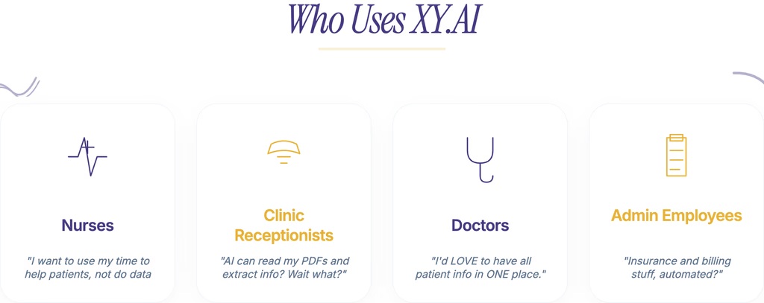
XY Corp: Context & Problem
XY's platform runs on AI agents that handle verification, scheduling, and claims for healthcare operations teams — admins, practice managers, coordinators. The agents worked. The problem was configuration. The only way to set them up was through a sales call. Every hour sales spent walking a customer through setup was an hour they couldn't spend selling. The UI had been built for engineers, not healthcare teams. My job: make AI orchestration something healthcare teams could set up themselves — in four months, as the sole designer.

Slide 9

XY Corp: My Role
What I owned
Sole product designer, reporting directly to the CPO and CEO.
Team of four engineers.
I owned the full design surface: the AI agent orchestration UI, the component library, the design system, and the design-to-engineering pipeline.
When I joined, none of these existed in any structured form. The workflow, the standards, and the foundation were mine to build.

Slide 10
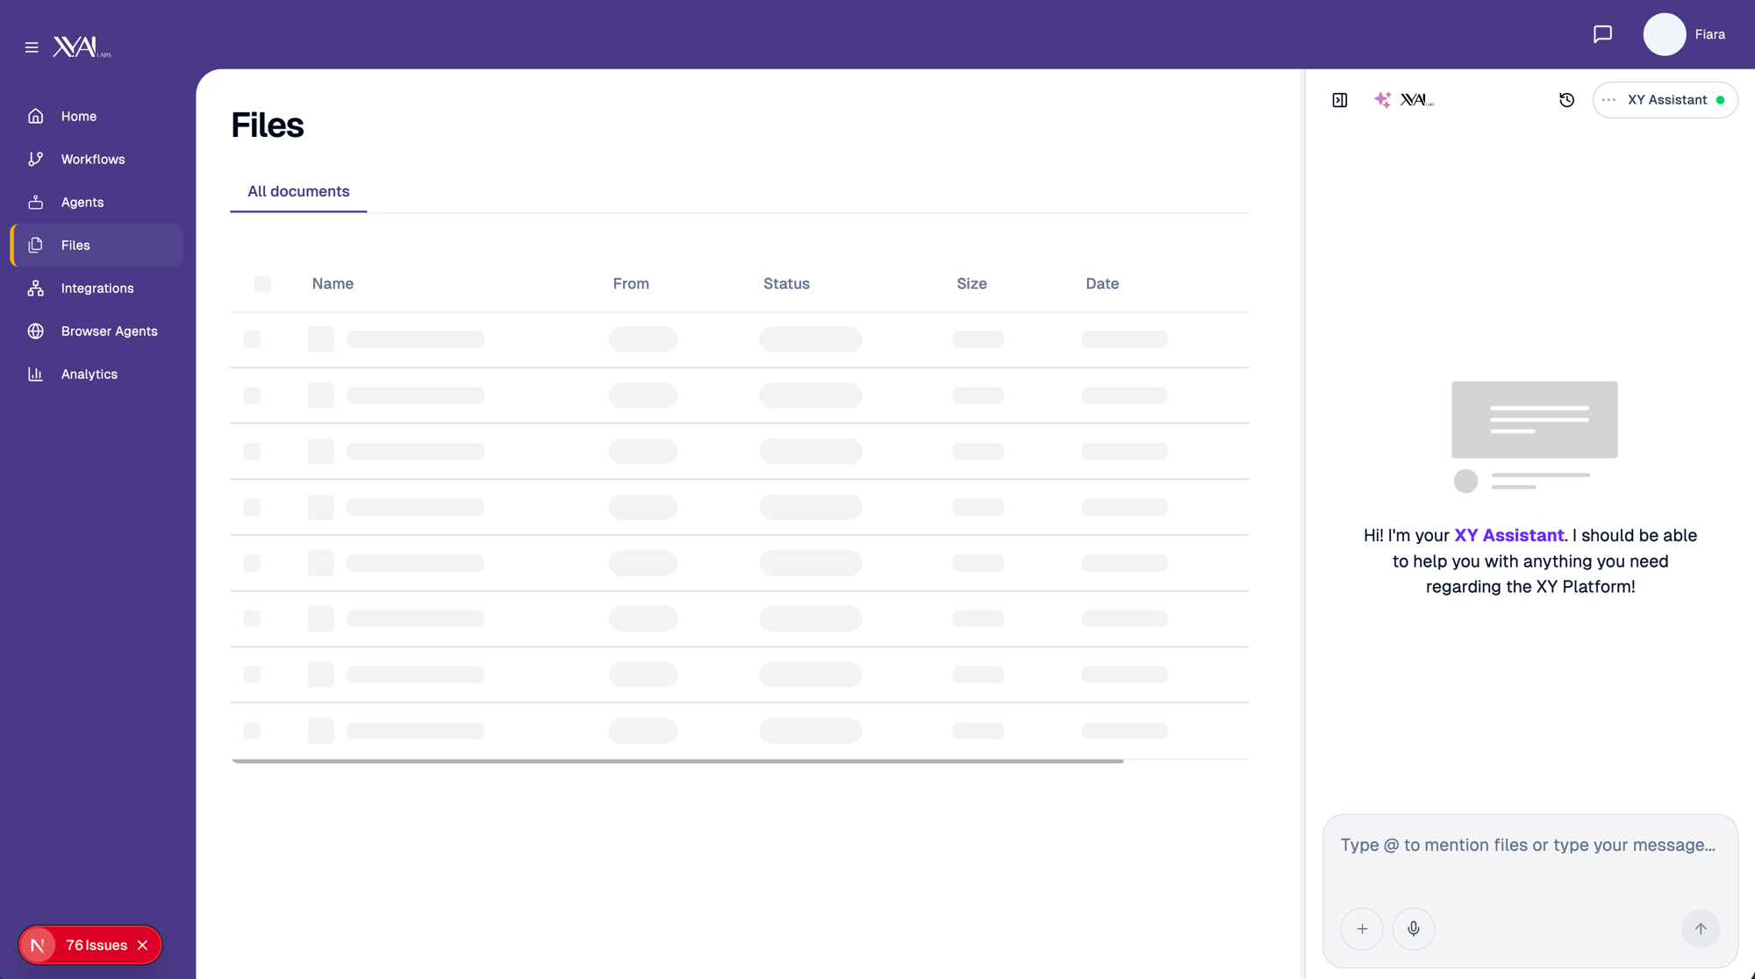
XY Corp: What I found
I didn't have a formal research budget. What I had was direct access to the CPO, customer calls, and a product that users described as "incredibly useful, impossibly confusing to use without a demo." That quote told me everything. The underlying system was valuable. The surface layer was the problem. I identified three blockers: 1. Every agent configuration required a human from XY to facilitate
2. The UI had been built for engineers, not healthcare teams
3. There was no way to orchestrate multiple agents without a sales call

Slide 11
XY Corp: The reframe that changed everything
BEFORE — FORMS
AFTER — CHAT
The brief was: improve the configuration UI. Users had to navigate forms, understand agent models, and make decisions they didn't have context for.
A conversational layer. Users describe what they need. The system routes to the right agent. A multi-hour onboarding call becomes a five-minute conversation.
Healthcare operations teams don't think in configurations. They think in tasks.

Slide 12
XY Corp: Process & Exploration
LOWER RISK, LOWER IMPACT
MIDDLE GROUND
THE WINNER
Forms-first
Wizard / guided
Chat-first ✓
Clean up the existing configuration UI. Reduce cognitive load. Lower risk, but users would still need to understand the agent model.
Step-by-step onboarding flow. Better than forms but still required decisions users lacked context for.
Users describe intent in natural language. System interprets and routes. Highest lift, but the only pattern matching how healthcare teams actually communicate.
I pressure-tested the chat-first direction with the CPO and two customer conversations. Healthcare ops teams are comfortable with conversational interfaces — forms are the foreign language.

Slide 13
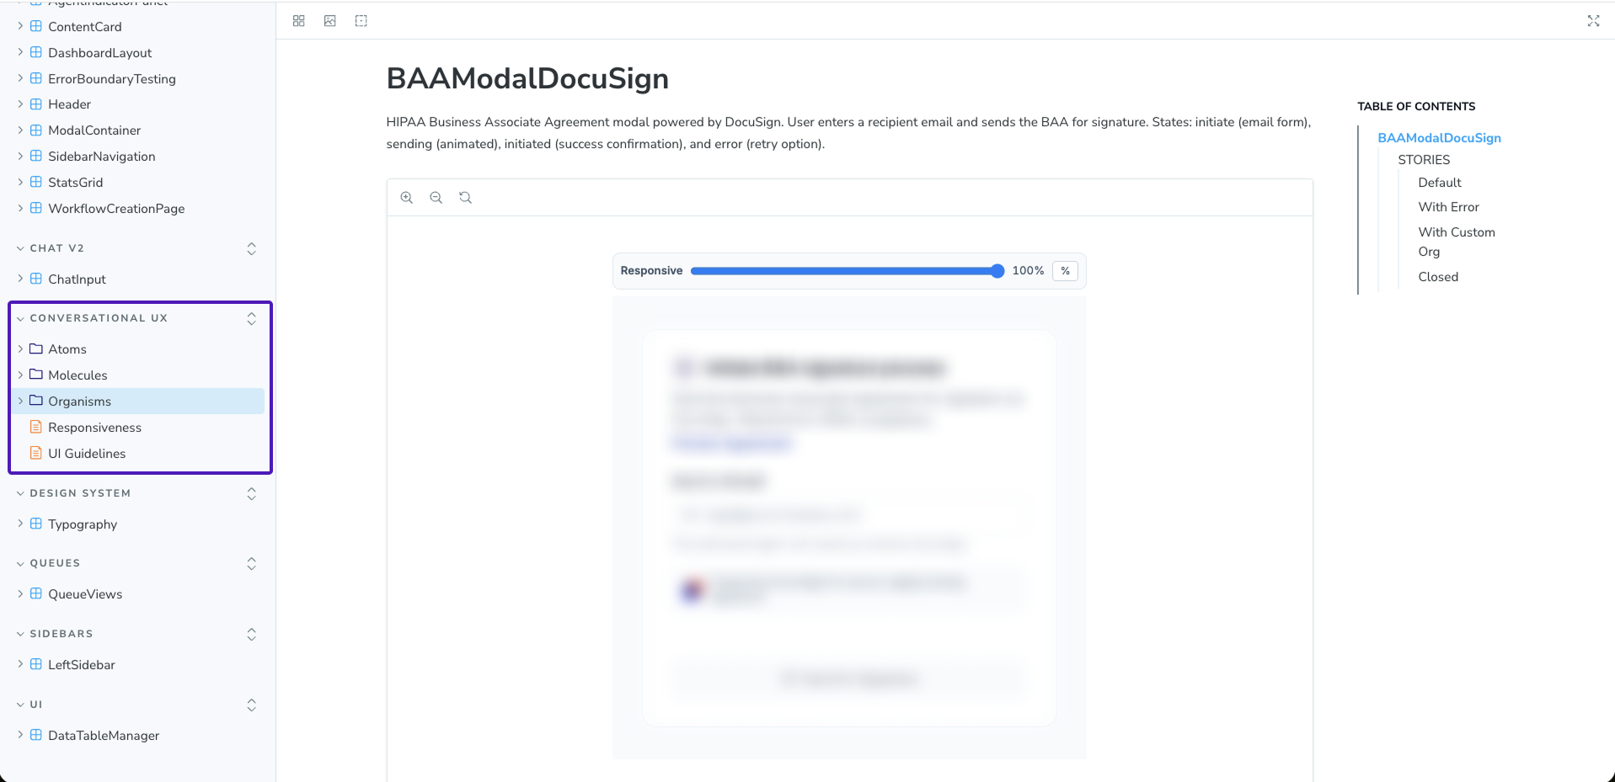
XY Corp: What I built
01
02
AI agent orchestration via chat
60+ production-ready components
Three agents, one conversation. Users describe what they need, the system routes, actions are confirmed — no configuration knowledge required.
Agent config cards, workflow status indicators, data extraction previews. Built for fullscreen, sidebar, and embedded contexts.
03
04
The company's first design system
AI-native pipeline
8px grid, semantic tokens, typography, spacing, language guidelines, motion docs. Engineers pulled directly from Storybook.
Figma → Figma Make / Magic Patterns → GitHub → Engineering. Prototype to production in hours when a demo needed it.
60+ components, production-wired to Temporal

Slide 14
XY Corp: Impact
"Your design instinct is really strong, and that's hard to teach. The visual design combined with the UX — you did some really good work here."
— Scott Cressman, CPO at XY
▸ The self-serve AI orchestration experience became a core sales asset. The CEO pitched it directly to enterprise customers — no engineer needed in the room.
▸ Components were production-wired to Temporal for live agent orchestration — not prototypes, not mockups.
▸ Users during testing: "This is so cool. It makes perfect sense to make these complex flows chat-friendly."

Slide 15
XY Corp: What I'd do differently
I built fast and I built real — but I was heads down with the CPO and didn't have enough visibility into what engineering was building in parallel. Components were getting created for demos that I never saw, which meant the design system and the codebase drifted faster than I could close the gap. If I did it again: I'd establish a weekly design-engineering sync from day one. Not a status meeting — a component review. Fifteen minutes to surface anything new in code that design needs to absorb. That's also exactly what I'd bring to Jiro on day one.

Slide 16
A few other things I've built.

Slide 17
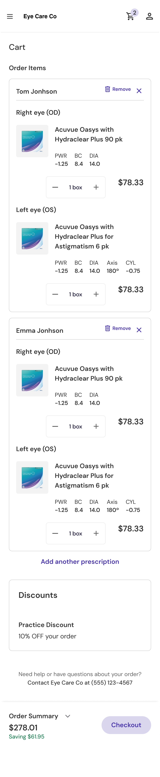
Waldo Health — Zero-to-one patient app
Waldo is an eye care company — later acquired by Specsavers — selling prescription contact lenses direct to consumer. I was the sole designer on the patient-facing mobile app. Doctor portal on one side, patient app on the other — a dual ecosystem where both sides had to work together. I owned 100% of the patient app from zero: research, IA, flows, high-fidelity UI, handoff. Under tight budget constraints ($5 in V0 credits), I built an AI-augmented design workflow to move faster without sacrificing quality. Delivered 1 month early.

Slide 18
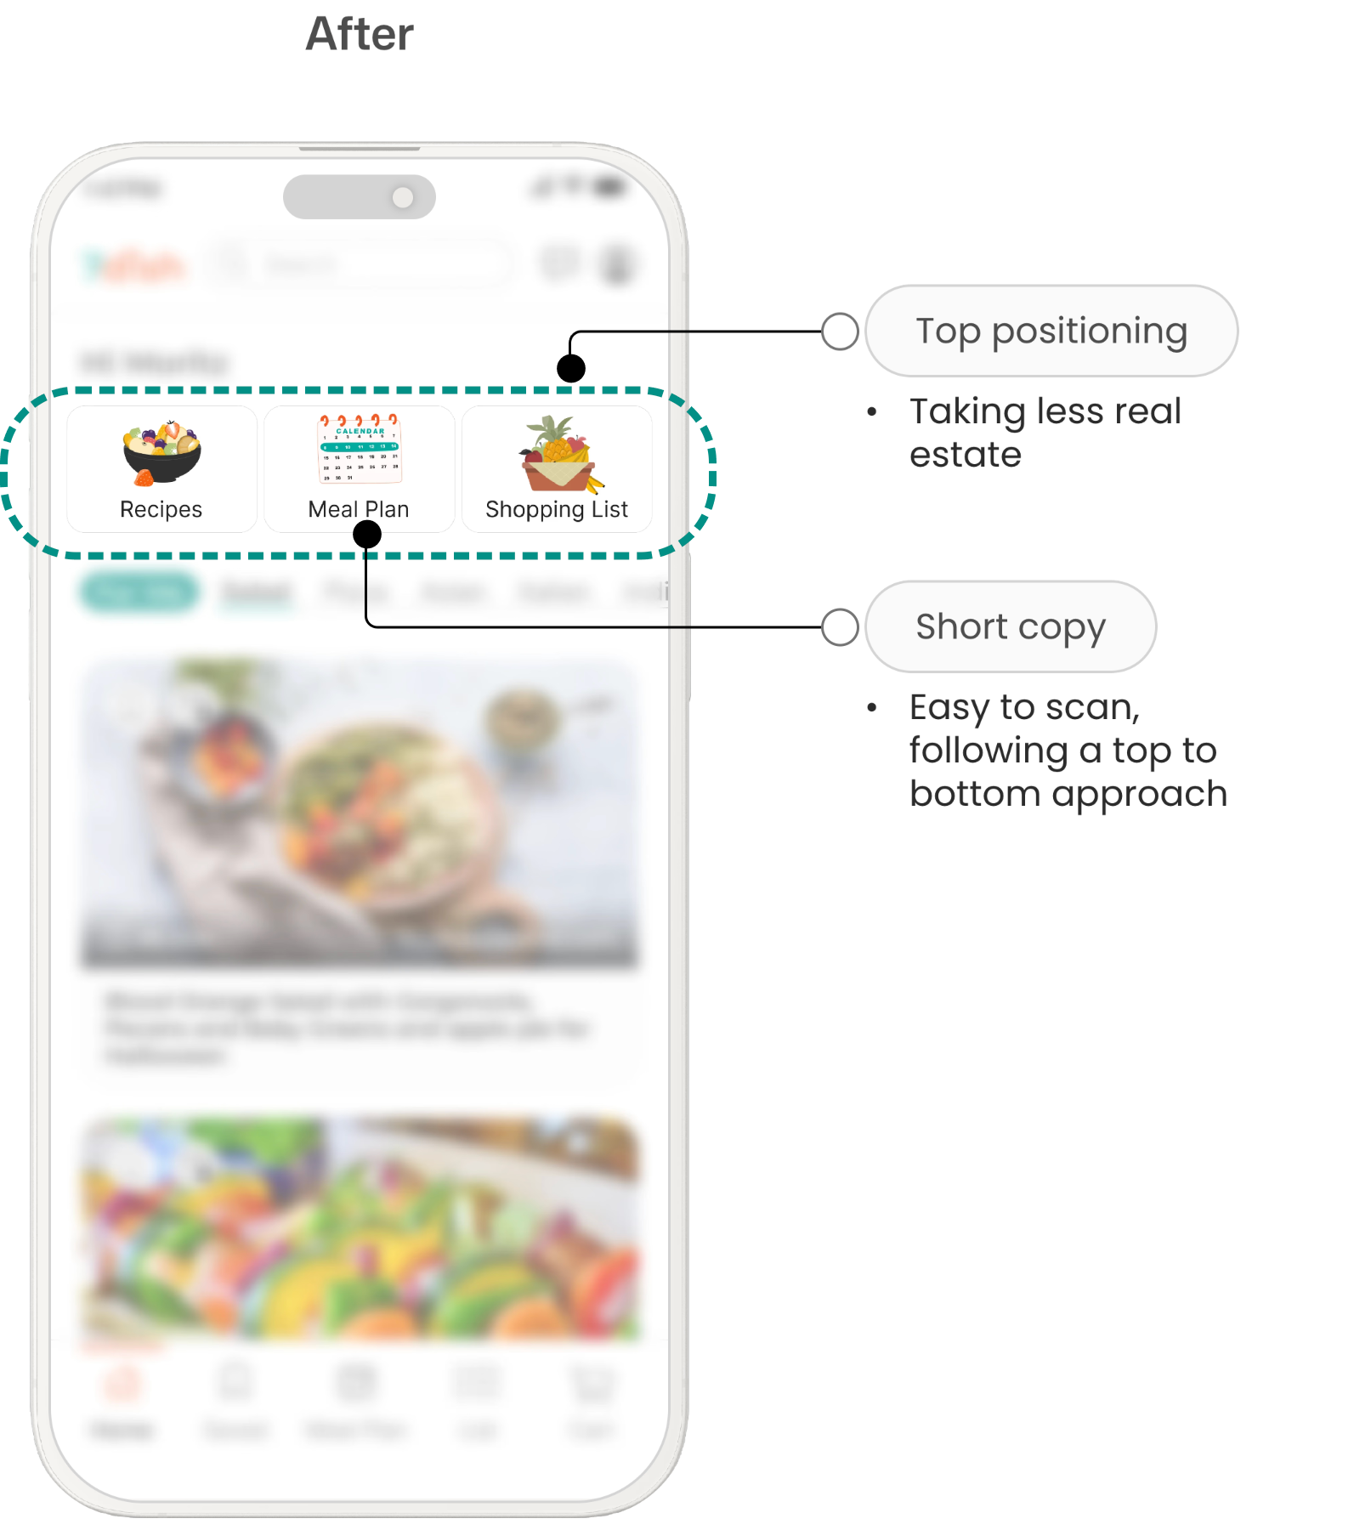
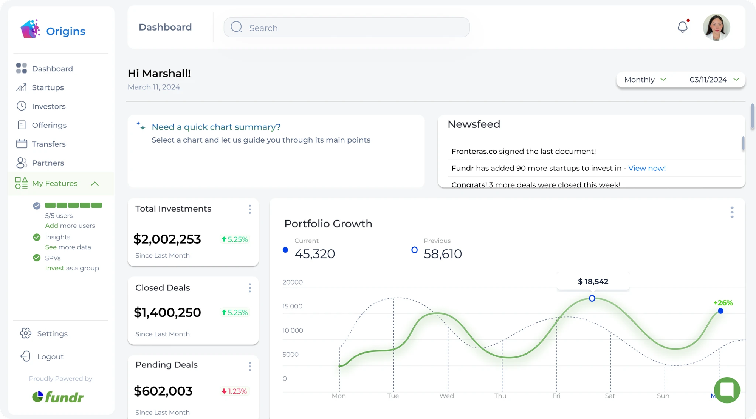
More from the portfolio
FOODTECH
MAC APP
FINTECH · AI
7dish
SideNook
Fundr
Meal planning app for working parents. End-to-end product design from research through high-fidelity UI. 3 core flows redesigned, A/B tested, 10/10 users scored 8+.
macOS terminal emulator I designed and built end-to-end as the sole product designer + SwiftUI developer. v1.0 shipped April 2026. AI-native design workflow.
SaaS paywall redesign replacing a sales-call funnel with self-serve upgrade flows. 20% increase in upgrade rates, ~50% fewer sales calls.

Slide 19
Here's how I plug in
Chris's need
What I bring
Design system + code out of sync
Built XY's first design system and 60+ component Storybook library from zero. Mapped directly to engineering output.
No time to build the foundation
I've been the sole designer twice. I build the foundation while still shipping. That's not a mode I switch into — it's how I work.
Research function is missing
I install lightweight feedback loops — fast, repeatable, tied to decisions. Not a research program, a research habit.
Process is hodgepodge
I bring structure upstream without adding bureaucracy. Problem definition before prototyping is non-negotiable for me.
PMs jumping straight to Lovable
I work with PMs before anyone opens a tool — reframe the brief, pressure-test the problem, align on what we're actually solving.
Prototypes disconnected from code
I built an AI-native pipeline at XY: Figma → Figma Make → GitHub → Engineering. Prototype to production in hours.
Volume of execution
I execute. This isn't a consulting engagement. I'm here to ship.
Scaling design without slowing down
Small team, fast pace, high quality bar. That's my default setting.

Slide 20

I came ready to get into the weeds.
Jacki Torres
hello@jackelinetorres.co
jackelinetorres.co

