Slide 1
Installing and Developing Programs in Python

Slide 2
Installing
Python is pre-installed on most Unix systems, including Linux and MAC OS X
The pre-installed version may not be the most recent
Two “latest versions”
2.7 released 7/10 & 3.2 released 10/10
Python 3 is a non-backward compatible version which you should use for CS2021
Download from http://python.org/download/

Slide 3
Running Interactively on UNIX
On Unix…
% python
>>> 3+3
6
Python prompts with ‘>>>’.
To exit Python (not Idle):
In Unix, type CONTROL-D
In Windows, type CONTROL-Z + <Enter>
Evaluate exit()

Slide 4
Running Programs on UNIX
Call python program via the python interpreter
% python fact.py
Make a python file directly executable by
Adding the appropriate path to your python interpreter as the first line of your file
#!/usr/bin/python
Making the file executable
% chmod a+x fact.py
Invoking file from Unix command line
% fact.py

Slide 5
Python IDEs
There are many Integrated Development Environments and Package Management Systems
IDLE
Emacs
Anaconda / Spyder
Enthought Canopy
Komodo
PyCharm
Eclipse + PyDev
TextMate

Slide 6
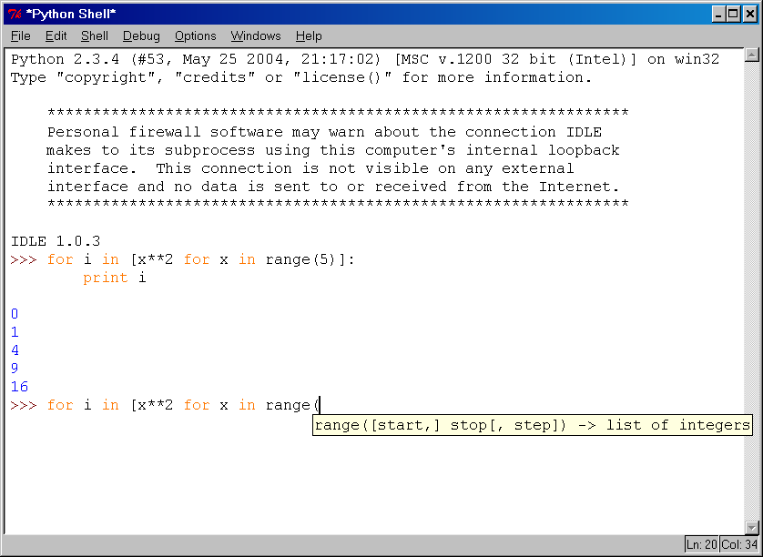
IDLE Development Environment
IDLE is the “official” IDE distributed with Python
Preinstalled on MAC OS X
Written in Python with the Tkinter GUI package
Multi-window text editor with syntax highlighting, auto-completion, smart indent and other features
Python shell with syntax highlighting, line recall, …
Integrated debugger with stepping, persis- tent breakpoints, and call stack visi- bility

Slide 7
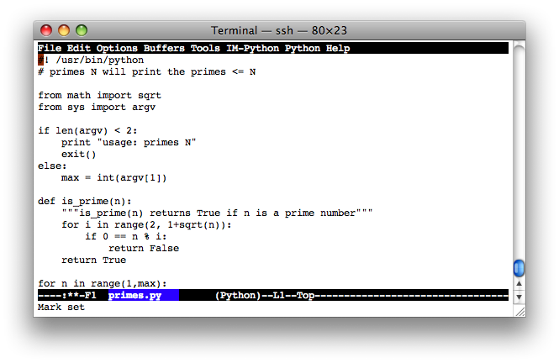
Developing Python in Emacs
Emacs python-mode.el has good support for editing Python, by default for .py files
Features: syntax completion, symbol help, eldoc, and inferior interpreter shell, etc.
Configuring emacs for python
http://pedrokroger.net/configuring-emacs-python-ide/

Slide 8
Anaconda
Anaconda is the leading Python distribution for supporting SciPy for large-scale data processing, predictive analytics, and scientific computing
Download Anaconda: https://store.continuum.io/cshop/anaconda/
Quickstart: https://store.continuum.io/static/img/Anaconda-Quickstart.pdf

Slide 9
Installing and Running 3rd Party Libs
Power of Python is in 3rd Party Packages. Python has several alternatives for installing 3rd party packages.
PyPI - the Python Package Index is a repository of software for the Python programming language. There are currently 65204 packages.
How to Get and Install Packages:
To use a package from the PyPI index either use shell command
$ pip install package-name
or explicitly download, unpack, and "python setup.py install" it.

Slide 10
Python Package Terminology
“Programs are composed of modules.
Modules contain statements.
Statements contain expressions.
Expressions create and process objects.”
module
the basic unit of code reusability in Python: a block of code imported by some other code. Three types of modules concern us here: pure Python modules, extension modules, and packages.
pure Python module
a module written in Python and contained in a single .py file (and possibly associated .pyc and/or .pyo files). Sometimes referred to as a “pure module.”
extension module
a module written in the low-level language of the Python implementation
package
a module that contains other modules; typically contained in a directory in the filesystem and distinguished from other directories by the presence of a file __init__.py.

Slide 11
Using the Module System: import and from
Clients of module (.py file) that use import get a module with attributes, while clients that use from get copies of the file’s names. Generally, you will prefer to use import.
Python programs are composed of multiple module files linked together by import statements, and each module has attributes -- a collection of variables—call it a namespace.
#file threenames.py
a = 'dead' # Define three attributes
b = 'parrot # to export to other files
c = 'sketch'
print(a, b, c)
% python threenames.py # run from the command line here
dead parrot sketch
% python
>>> import threenames # Grab the whole module: it runs here too
dead parrot sketch
>>>
>>> threenames.b, threenames.c # but now we can access module attributes
('parrot', 'sketch')
>>>
>>> from threenames import a, b, c # Copy multiple names out of module
>>> b, c
('parrot', 'sketch')”
“>>> dir(threenames)
['__builtins__', '__doc__', '__file__', '__name__', '__package__', 'a', 'b', 'c']”

Slide 12
https://pypi.python.org/pypi/nltk - A natural language processing toolkit
bash-3.2$ pip install nltk
Requirement already satisfied bash-3.2$ python
Python 2.7.10 |Anaconda 2.3.0 (x86_64)| (default, May 28 2015, 17:04:42) [GCC 4.2.1 (Apple Inc. build 5577)] on darwin
>>> import nltk
>>> sentence = """At eight o'clock on Thursday morning
... Arthur didn't feel very good."""
>>> tokens = nltk.word_tokenize(sentence)
>>> tokens
['At', 'eight', "o'clock", 'on', 'Thursday', 'morning',
'Arthur', 'did', "n't", 'feel', 'very', 'good', '.']
>>> tagged = nltk.pos_tag(tokens)
>>> tagged[0:6]
[('At', 'IN'), ('eight', 'CD'), ("o'clock", 'JJ'), ('on', 'IN'),
('Thursday', 'NNP'), ('morning', 'NN')]

Slide 13
>>> from nltk.book import *
*** Introductory Examples for the NLTK Book ***
Loading text1, ..., text9 and sent1, ..., sent9
Type the name of the text or sentence to view it.
>>> text1
<Text: Moby Dick by Herman Melville 1851>
>>> type(text1)
<class 'nltk.text.Text'>
>>> help(text1.concordance)
Help on method concordance in module nltk.text:
concordance(self, word, width=79, lines=25) method of nltk.text.Text instance
Print a concordance for ``word`` with the specified context window.
Word matching is not case-sensitive.
:seealso: ``ConcordanceIndex``
>>> text1.concordance("monstrous")
Displaying 11 of 11 matches:
ong the former , one was of a most monstrous size . …

Slide 14
>>> from nltk.corpus import reuters
>>> help(reuters.categories)
Help on method categories in module nltk.corpus.reader.api:
categories(self, fileids=None) method of nltk.corpus.reader.plaintext.CategorizedPlaintextCorpusReader instance
Return a list of the categories that are defined for this corpus,
or for the file(s) if it is given.
>>> reuters.categories()
[u'acq', u'alum', u'barley', u'bop', u'carcass', u'castor-oil', u'cocoa', u'coconut', u'coconut-oil', u'coffee', u'copper', u'copra-cake', u'corn', u'cotton', u'cotton-oil', u'cpi', u'cpu', u'crude', u'dfl', u'dlr', u'dmk', u'earn', u'fuel', u'gas', u'gnp', u'gold', u'grain', u'groundnut', u'groundnut-oil', u'heat', u'hog', u'housing', u'income', u'instal-debt', u'interest', u'ipi', u'iron-steel', u'jet', u'jobs', u'l-cattle', u'lead', u'lei', u'lin-oil', u'livestock', u'lumber', u'meal-feed', u'money-fx', u'money-supply', u'naphtha', u'nat-gas', u'nickel', u'nkr', u'nzdlr', u'oat', u'oilseed', u'orange', u'palladium', u'palm-oil', u'palmkernel', u'pet-chem', u'platinum', u'potato', u'propane', u'rand', u'rape-oil', u'rapeseed', u'reserves', u'retail', u'rice', u'rubber', u'rye', u'ship', u'silver', u'sorghum', u'soy-meal', u'soy-oil', u'soybean', u'strategic-metal', u'sugar', u'sun-meal', u'sun-oil', u'sunseed', u'tea', u'tin', u'trade', u'veg-oil', u'wheat', u'wpi', u'yen', u'zinc']
>>>

