Slide 1
CS2021 Python Programming Week 3
Systems Programming
PP-Part II

Slide 2
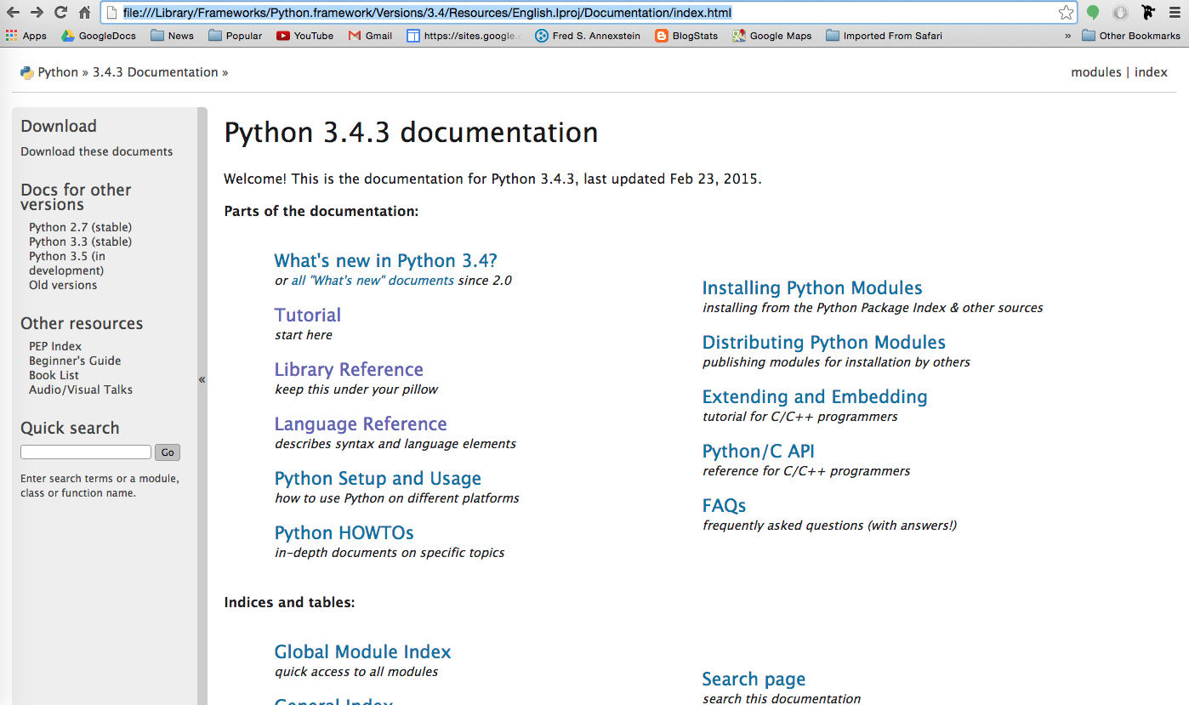
Python Documentation
$open /Library/Frameworks/Python.framework/Versions/3.4/Resources/English.lproj/Documentation/index.html

Slide 3
Searching and Finding Documents
If you cannot locate docs on local machine use web address
http://www.python.org or
https://docs.python.org/3/
Search for docs on
sys.getrecursionlimit()

Slide 4
Exploring Sys Module
Run the following
>>> import sys
>>> dir(sys)
>>> help(sys)
>>>help(sys.getrecursionlimit)

Slide 5
Experiment with recursion limit
>>> sys.setrecursionlimit(50)
>>> sys.getrecursionlimit()
=>50
>>>def countdownrec(n):
if n >0:
print(n)
countdownrec(n-1)
>>>countdown(52)

Slide 6
More.py
Load PP4E/System/more.py ___________________________________________________
def more(text, numlines=15):
lines = text.splitlines() # like split('\n') but no '' at end
while lines:
chunk = lines[:numlines]
lines = lines[numlines:]
for line in chunk: print(line)
if lines and input('More?') not in ['y', 'Y']: break
if __name__ == '__main__’:
import sys # when run, not imported
more(open(sys.argv[1]).read(), 10) # page contents of file on cmdline

Slide 7
2 ways for running more.py
$cd PP4E/System
$python
>>>from more import more
>>>import sys
>>>more(sys.__doc__)
$cd PP4E/System
$python more.py more.py

Slide 8
sys.argv
#file arguments.py
import sys
# it's easy to print this list of course:
print sys.argv
# or it can be iterated via a for loop:
for i in range(len(sys.argv)):
if i == 0:
print ("Function name: %s" % sys.argv[0])
else:
print ("%d. argument: %s" % (i,sys.argv[i]))

Slide 9
Experiment with sys.argv
$ python arguments.py arg1 arg2
['arguments.py', 'arg1', 'arg2']
Function name: arguments.py
1. argument: arg1
2. argument: arg2
$

Slide 10
PP4E/System/testargv2.py
"collect command-line options in a dictionary"
def getopts(argv):
opts = {}
while argv:
if argv[0][0] == '-': # find "-name value" pairs
opts[argv[0]] = argv[1] # dict key is "-name" arg
argv = argv[2:]
else:
argv = argv[1:]
return opts
if __name__ == '__main__':
from sys import argv # example client code
myargs = getopts(argv)
if '-i' in myargs:
print(myargs['-i'])
print(myargs)
$C:\...\PP2E\System>python testargv2.py
{}
$C:\...\PP2E\System>python testargv2.py -i data.txt -o results.txt
{'-o': 'results.txt', '-i': 'data.txt'}

Slide 11
CWD and Import Paths
#whereami.py
import os, sys
print('my os.getcwd =>', os.getcwd())
print('my sys.path =>', sys.path[:6])
# shows first 6 import paths
input()
Testing whereami.py
$cd PP4E/System $python whereami.py $cd .. $python System/whereami.py
$cd System/temp $python ../whereami.py

Slide 12
Directory Tools (PP pg 163)
A common system task is to process a set of files in a directory (a folder)
Three ways to scan a directory
os.popen(‘ls’)
os.listdir(‘.’)
glob.glob(‘*’)
>>> os.chdir('/Users/fredannexstein/Google Drive/PP4E')
>>> os.popen('ls').readlines()
['Ai\n', 'Dbase\n', 'Dstruct\n', 'Gui\n', 'Integrate\n', 'Internet\n', 'Lang\n', 'LaunchBrowser.pyw\n', 'Launch_PyDemos.pyw\n', 'Launch_PyGadgets_bar.pyw\n', 'Launcher.py\n', 'Preview\n', 'PyDemos-pil-note.txt\n',…..

Slide 13
>>> os.listdir(‘.’)
['.DS_Store', '__init__.py', '__init__.pyc', '__pycache__', '_pymailerrlog.txt', 'Ai', 'Dbase', 'Dstruct', 'echo.py', 'Gui', 'Integrate', 'Internet', 'Lang', 'Launch_PyDemos.pyw', 'Launch_PyGadgets_bar.pyw', 'LaunchBrowser.pyw', 'Launcher.py', 'launchmodes.py', 'Preview', 'PyDemos-pil-note.txt', 'PyDemos.pyw', 'PyGadgets.py', 'PyGadgets_bar.pyw', 'README-PP4E.txt', 'System', 'TempParts', 'textConfig.py', 'Tools']
>>> import glob
>>> glob.glob('*')
['__init__.py', '__init__.pyc', '__pycache__', '_pymailerrlog.txt', 'Ai', 'Dbase', 'Dstruct', 'echo.py', 'Gui', 'Integrate', 'Internet', 'Lang', 'Launch_PyDemos.pyw', 'Launch_PyGadgets_bar.pyw', 'LaunchBrowser.pyw', 'Launcher.py', 'launchmodes.py', 'Preview', 'PyDemos-pil-note.txt', 'PyDemos.pyw', 'PyGadgets.py', 'PyGadgets_bar.pyw', 'README-PP4E.txt', 'System', 'TempParts', 'textConfig.py', 'Tools']

Slide 14
glob
Glob uses usual filename syntax of many shells for matching:
? –single char, * -any pattern , []- set of chars
>>> for path in glob.glob(‘*.py'):
... print(path)
__init__.py
echo.py
Launcher.py
launchmodes.py
PyGadgets.py
textConfig.py
>>> for path in glob.glob('./*/*.py'):
... print(path)
./Ai/__init__.py
./Dbase/__init__.py
./Dbase/castdump.py
./Dbase/castinit.py
./Dbase/filepickle.py
./Dbase/person-start.py
./Dbase/person.py
./Dbase/testdata.py
./Dstruct/__init__.py
./Gui/__init__.py
./Integrate/__init__.py

Slide 15
Walking Directory Trees
Application :Find all files with a global variable name
os.walk yields a sequence of 3-tuples
Current directory
All subdirectories
All files within current directory
Recursively walks subdirectories
import os
for (dirname,subdirs,files) in os.walk
('/Users/fredannexstein/Google Drive/PP4E'):
print ('[' + dirname +']')
for f in files:
print(os.path.join(dirname,f))

Slide 16
Exercise
Using the str.endswith() function, write a python script that counts and prints all python files (ending with .py) in PP4E that reference name ‘tkinter’.
You may run into the error:
UnicodeDecodeError: 'ascii' codec can't decode byte 0xef in position 0: ordinal not in range(128)
We will see later how to process such files, for now you will pass over errors by adding try-except handler
try:
if 'tkinter' in open(pname).read():
print(pname)
count = count +1
except:
pass

