Slide 1
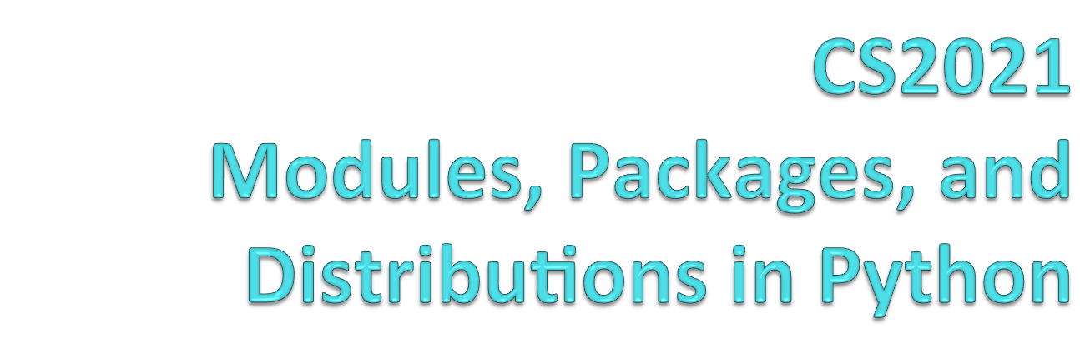

Slide 2
Core Python is small by design
One of the key features of Python is that the actual core language is fairly small. This is an intentional design feature to maintain simplicity. Much of the powerful functionality comes through external modules and packages.
Installing library distributions or packages supplements the core Python with useful modules

Slide 3
Python Standard Library + more
The Python installers for the Windows platform usually include the entire standard library and often also include many additional components.
For Unix-like operating systems Python is normally provided as a collection of packages, so it may be necessary to use the packaging tools provided with the operating system to obtain some or all of the optional components.
In addition to the standard library, there is a growing collection of several thousand components (from individual modules to packages and entire application development frameworks), available from the Python Package Index.

Slide 4
10 Famous Python 3rd Party Libs
1. Requests. the most famous http library
2. Scrapy. For webscraping
3. wxPython. A gui toolkit for python
4. Pillow. A friendly fork of PIL (Python Imaging Library)
5. SQLAlchemy. A database library.
6. BeautifulSoup. xml and html parsing library
7. Twisted. The most important tool for any network application developer
8. NumPy. provides some advance math
9. SciPy. library of algorithms and mathematical tools
10. Matplotlib. A numerical plotting library.

Slide 5
What are Python Modules?
Libraries and Packages are collections of Modules
Modules are files containing Python definitions and statements
A module’s definitions can be imported into other modules by using “import name” where name.py is in recognized directory path
The module’s name is then available as a global variable value
To access a modules functions, type “name.function()”

Slide 6
More on Modules
Modules can contain executable statements along with function definitions
Each module has its own private symbol table used as the global symbol table by all functions in the module
Modules can import other modules
Each module is imported once per interpreter session
  reload(name)
Can import names from a module into the importing module’s symbol table
  from mod import m1, m2 (or *)
  m1()

Slide 7
Executing Modules
python name.py <arguments>
  Runs code as if it was imported
  Setting _name_ == “_main_” the file can be used as a script and an importable module

Slide 8
The Module Search Path
The interpreter searches for a file named name.py
  Current directory given by variable sys.path
  List of directories specified by PYTHONPATH
  Default path (in UNIX - .:/usr/local/lib/python)
Script being run should not have the same name as a standard module or an error will occur when the module is imported

Slide 9
“Compiled” Python Files
If files mod.pyc and mod.py are in the same directory, there is a byte-compiled version of the module mod
The modification time of the version of mod.py used to create mod.pyc is stored in mod.pyc
Normally, the user does not need to do anything to create the .pyc file
A compiled .py file is written to the .pyc
  No error for failed attempt, .pyc is recognized as invalid
Contents of the .pyc can be shared by different machines

Slide 10
Standard Modules
Python comes with a large library of standard modules described in the Python Library Reference
https://docs.python.org/3/py-modindex.html
Python 3 Module of the Week
https://pymotw.com/3/
PyMOTW-3 is a series of articles written by Doug Hellmann to demonstrate how to use the modules of the Python 3 standard library.
Find Math, Algorithms, Data Structures, File System, Crypto, Email, Networking, Internet,+++

Slide 11
The dir() Function
Used to find the names a module defines and returns a sorted list of strings
  >>> import mod
  >>> dir(mod)
  [‘_name_’, ‘m1’, ‘m2’]
Without arguments, it lists the names currently defined (variables, modules, functions, etc)
Does not list names of built-in functions and variables
  Use _bulltin_to view all built-in functions and variables

Slide 12
Packages
Python has a simple packaging system for organizing collections of modules
Uses “dotted module names”--a.b says submodule b in package a
Saves authors of multi-module packages from worrying about each other’s module names
Python searches through sys.path directories for the package subdirectory
Users of the package can import individual modules from the package
Ways to import submodules
  import sound.effects.echo
  from sound.effects import echo
Submodules must be referenced by full name
An ImportError exception is raised when the package cannot be found

Slide 13
Intra-package References
Submodules can refer to each other
  Surround might use echo module
  import echo also loads surround module
import statement first looks in the containing package before looking in the standard module search path
Absolute imports refer to submodules of sibling packages
  sound.filters.vocoder uses echo module
  from sound.effects import echo
Can write explicit relative imports
  from . import echo
  from .. import formats
  from ..filters import equalizer

Slide 14
Installation of 3rd Party Packages
There are two standard methods for installing a package.
pip install
python setup.py install
Some packages may fail to install via pip install. Most often there will be some obvious (or not) error message about compilation or missing dependency. In this case the likely next step is to download the installation tar file and untar it. Go into the package directory and look for files setup.py.

Slide 15
Virtualenv
Virtualenv is a very useful tool for creating isolated Python environments. It provides a way to make a virtual clone of an existing Python environment. This clone can then be used as the package installation location.
One use case is wanting to install a new or experimental version of a package without overwriting the existing production version in your baseline environment.

Slide 16
Project Exercises:
Building a Twitter Bot
Project using pip to install tweepy, apscheduler
Make AmericaTweet Again
http://joedevelops.com/2016/07/30/make-america-tweet-again-part-1/
A Common Pattern for projects
$ mkdir MATA
$ cd MATA
$ virtualenv env
$ source env/bin/activate
$ pip install tweepy
$ pip install apscheduler

