Slide 1

Assignment- Analysis of Local Track Discontinuities in Railway
Presenter: Amin Adoul

Slide 2
What Students Will Learn
Understanding Real-World Data
Data Handling and Preprocessing
Machine Learning Basics
Feature Selection Techniques
Evaluation and Analysis

Slide 3
Skills Students Will Gain
Skill Category | Specific Skills Learned
Data Science | Data cleaning, preprocessing, normalization, feature selection
Python Programming | Working with pandas, numpy, matplotlib, scikit-learn, scipy
Machine Learning | Train/test split, k-fold cross-validation, SVM, model evaluation
Problem Solving | Applying ML techniques to solve a practical, safety-critical engineering problem
Analytical Thinking | Understanding which features matter and why, interpreting model results
Presentation/Reporting | Explaining methods, results, and comparisons in a clear, logical way

Slide 4
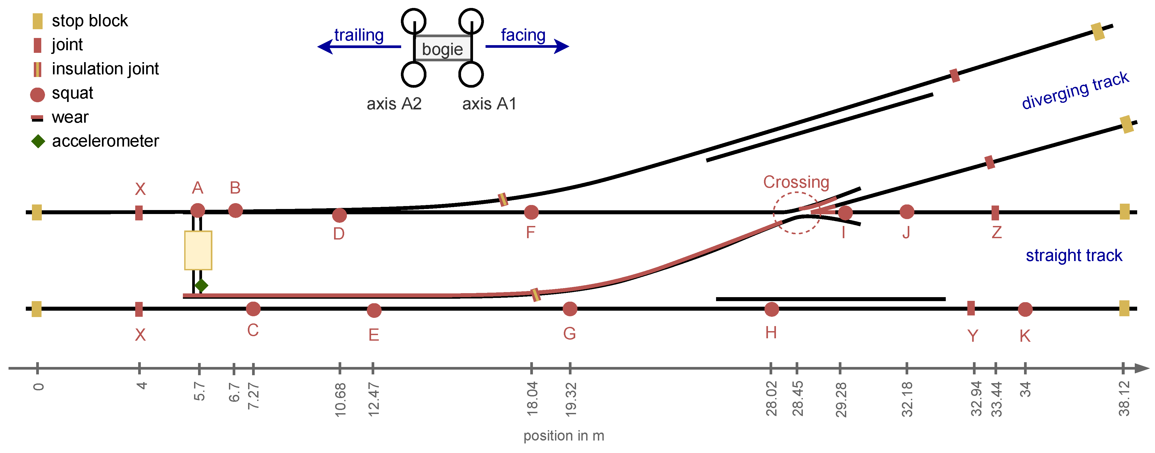
The setup (Figure 1) features a railway switch with track-side acceleration sensors on the point machine rods. A manually pushed bogie simulates train passages over the straight track, which includes rail joints and artificial squats.
Data recording starts before movement and ends after the bogie reaches the stop block.

Slide 5
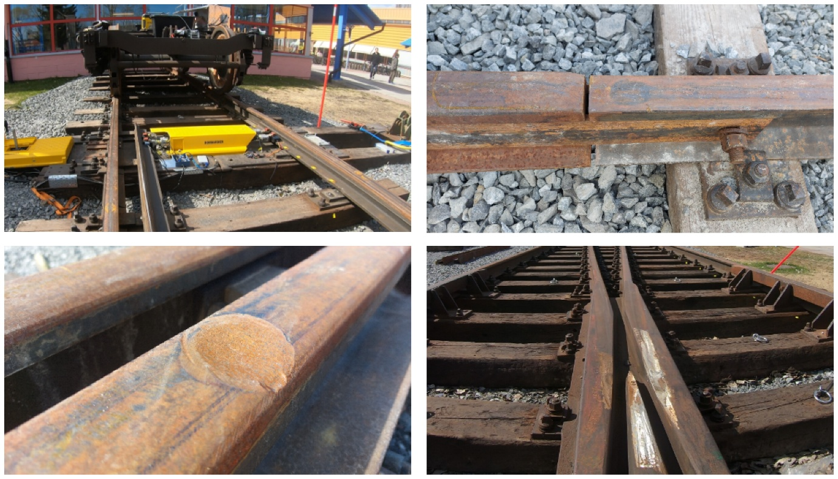

Slide 6
Acceleration Sensor Data and Feature Extraction
What is a Signal?
A signal is a function that conveys information about a phenomenon. Signals can represent physical quantities such as sound, light, temperature, or electrical voltage.

Slide 7
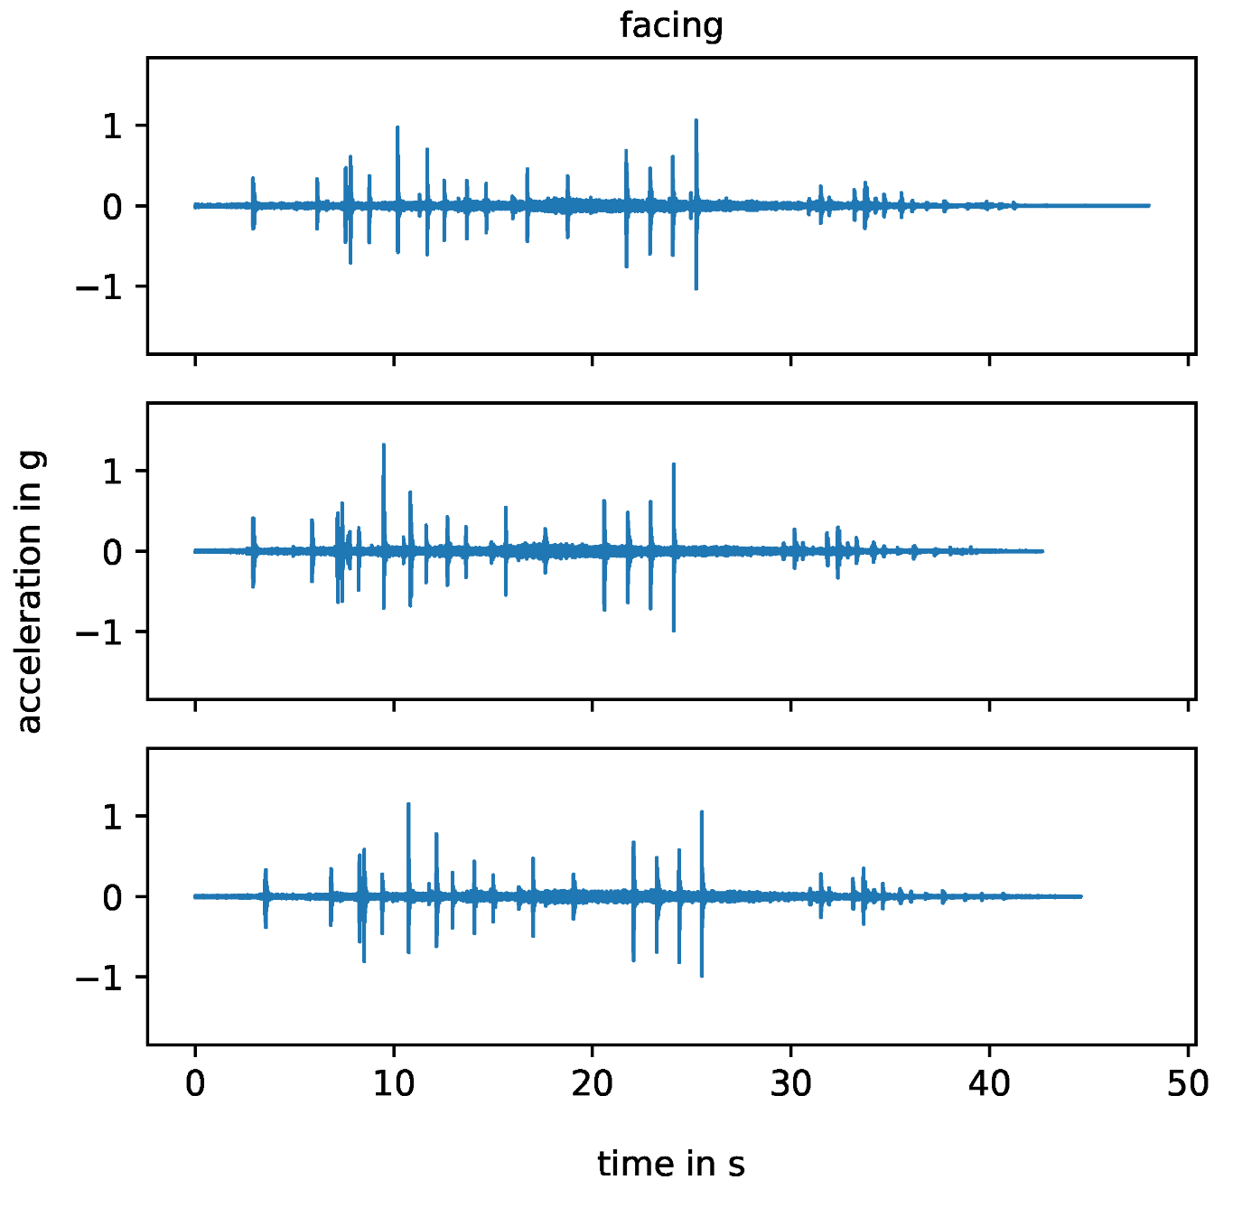
Acceleration Sensor Data and Feature Extraction
The dataset for this assignment includes three files containing precomputed features from 1D acceleration sensor signals.

Slide 8
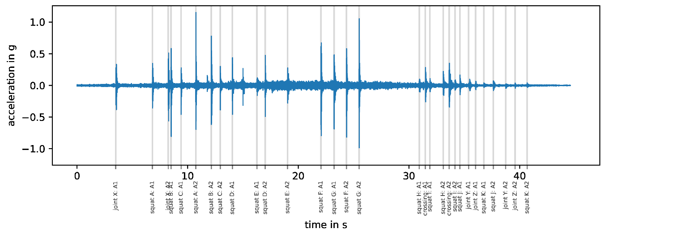
Acceleration Sensor Data and Feature Extraction

Slide 9
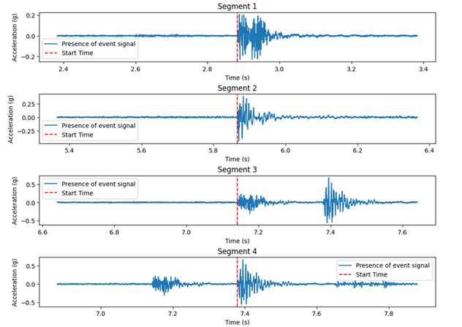
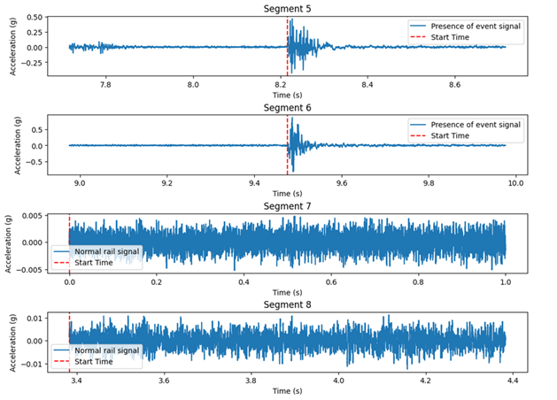
Acceleration Sensor Data and Feature Extraction

Slide 10
Acceleration Sensor Data and Feature Extraction
The features are divided into:
Statistical Features (They describe how the signals behave)
Frequency Features (They describe the signal in terms of waves)

Slide 11
Acceleration Sensor Data and Feature Extraction
Statistical Features:
Mean – The average value (sum of all numbers divided by how many numbers there are).
Standard Deviation (std) – Tells us how much the numbers spread out from the average. Example: If most numbers are close to the mean, std is small. If they are far apart, std is big.
Max & Min – The biggest and smallest numbers in the dataset.
Range – The difference between the max and min.
Skewness – Tells us if the data leans more to one side (not balanced). Example: If most students score low but a few score very high, the data is skewed.
Kurtosis – Measures whether the data has sharp peaks or flat areas. Example: sharp peaks mean high kurtosis.

Slide 12
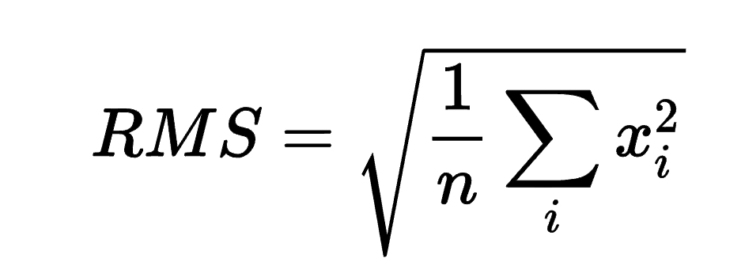
Acceleration Sensor Data and Feature Extraction
Root Mean Square (RMS) A special way of averaging numbers that considers both positive and negative values.
Crest Factor – Tells us how sharp or smooth a signal is by comparing the peak value to RMS.
Example: A smooth wave has a low crest factor; a sharp peak has a high crest factor.
Variance – Another way to measure spread, like standard deviation, but squared. Example: If data points are close together, variance is low; if they are far apart, variance is high.
Zero Crossings – How many times a signal crosses the zero line. Example: A fast-changing wave crosses zero more often than a slow one.

Slide 13
Acceleration Sensor Data and Feature Extraction
Frequency Features
Dominant Frequency – The most common frequency in the signal.
Spectral Energy – Tells us how much "power" is in the signal. Example: Louder sounds have more energy.
Spectral Centroid – Think of it like the "center of gravity" of the sound. Example: High-pitched sounds have a higher centroid than low-pitched ones, meaning their energy is concentrated more toward the higher frequencies.
Spectral Bandwidth – Measures how wide the range of frequencies is. Example: A single beep has low bandwidth; a mix of sounds has high bandwidth.
Spectral Flatness – Tells us if a sound is smooth (like a whistle) or noisy (like static). Example: White noise (like TV static) has high spectral flatness; a pure tone has low spectral flatness.

Slide 14
Data Preprocessing
Data Loading and Combination:
Load the three datasets using Python.
Combine the datasets into a single unified dataset.
Data Cleaning:
Remove non-relevant columns (e.g., start_time, axle, cluster, tsne_1, and tsne_2).
Map the labels such that all normal events become 0 and any other events become 1.
Data Transformation:
Normalize the dataset (using techniques such as min-max scaling or standardization) to prepare for further analysis.
Dataset Splitting:
Split the data into training and testing sets using an 80/20 ratio, ensuring proper distribution of events.

Slide 15
Evaluating SVM Performance: 80/20 Train-Test Split vs. K-Fold Cross-Validation
Cross-Validation: Perform k-fold cross-validation (e.g., 5-fold) on the training set to evaluate model stability.
Comparison task: Compare between the 80/20 train-test split and k-fold cross-validation using SVM (Support Vector Machine). Train an SVM model using both methods and evaluate its performance.

Slide 16
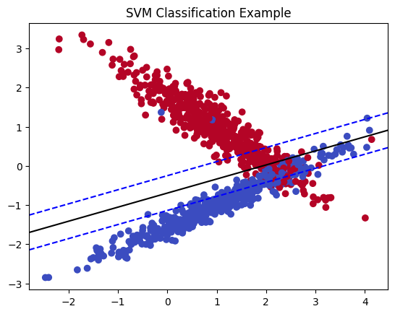
Binary Classification Using Machine Learning
Binary classification means sorting things into two groups.
Support Vector Machines (SVM)
What it does: Draws a boundary (line or curve) that best separates two groups.

Slide 17
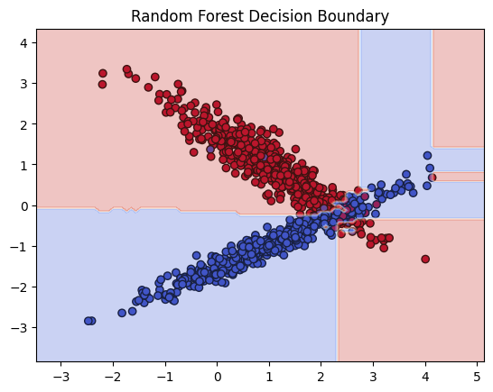
Binary Classification Using Machine Learning
What is Random Forest?
Random Forest is an ensemble learning method that builds multiple decision trees and combines their predictions to improve accuracy and reduce overfitting. It is commonly used for classification and regression tasks.

Slide 18

Binary Classification Using Machine Learning
Gradient Boosting Classifier is a machine learning technique that builds models in stages, where each new model corrects the errors of the previous ones. It starts with a simple model (usually a decision tree), identifies where it made mistakes, and then adds new trees to fix those errors. This process continues until the model becomes highly accurate. By combining multiple weak models, GBM creates a strong predictive model that performs well on complex data. However, it requires careful tuning to avoid overfitting and can be computationally expensive.

Slide 19
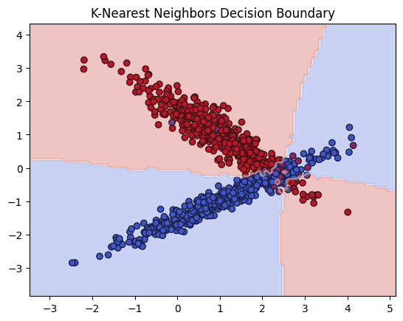
Binary Classification Using Machine Learning
K-Nearest Neighbors (KNN) is a simple machine learning algorithm used for classification and regression. The basic idea behind KNN is that it makes predictions based on the similarity of data points.

Slide 20
Binary Classification Using Machine Learning
In Summary:
SVM: Best for smaller datasets but slow with larger datasets.
Random Forest: Works well on large datasets, reduces overfitting, but is slow and complex.
Gradient Boosting: Often provides high accuracy but takes time to train and requires tuning.
KNN: Simple and intuitive, but can be slow and sensitive to data noise.

Slide 21
Feature Selection and Dimensionality Reduction
Reducing the feature space is central to improving model performance and reducing noise.
What is Feature Selection?
Think of a machine learning model like a student taking a test. If there are too many questions, the student may get confused and not do well. But if we remove unimportant questions and keep only the useful ones, the student can focus better and perform well.
Similarly, in machine learning, we remove unnecessary features (columns in data) to make the model work better and faster.

Slide 22
Feature Selection and Dimensionality Reduction
Techniques for Feature Selection:
1. Filter Methods (Picking Features Based on Statistics)
These methods quickly check which features are useful before using a model.
Techniques Used:
Pearson Correlation: Measures how strongly two things are related.
Chi-Square Test: Checks if one thing affects another.

Slide 23

Feature Selection and Dimensionality Reduction
2. Wrapper Methods (Trying Different Feature Combinations)
These methods use a model to test different feature sets and see which work best.
Example: Imagine you’re packing for a trip. You try different sets of clothes to see what fits best in your suitcase.
Technique Used:
Recursive Feature Elimination (RFE): Starts with all features, removes the least useful one, checks the model's performance, and repeats the process until only the best features remain.

Slide 24

Feature Selection and Dimensionality Reduction
3. Embedded Methods (Letting the Model Decide Important Features)
These methods let the model figure out which features matter most while training.
Example: A teacher gives students a test and later checks which questions helped most in grading their performance.
Techniques Used:
LASSO (L1 Penalty): A method that makes the model automatically ignore unimportant features.
Tree-Based Models (Random Forests): These models can tell us which features are most important by checking how often they are used in decision-making.

Slide 25
Thank you for your attention

