Slide 1
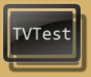
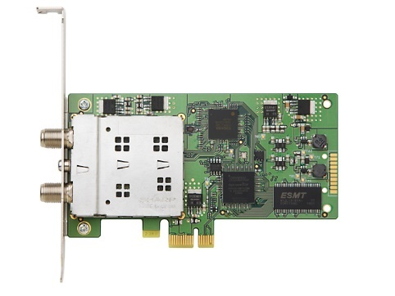

リアルタイム視聴
Tuning
PT3
Bon Driver
Scrambled Airwave
Scrambled Signal
BonDriver_PT3-*.dll
Scrambled
Channel
Unscramble
Display
Smart
Card Reader
Unscrambled Channel
Direct Show
winscard.dll
LAV Filters

Slide 2
リアルタイム視聴の場合
1.Tuning
Bon Driver
Select the Channel
BonDriver_PT3-*.dll
PT3
2.Unscramble
3.Display
Scrambled Airwave
Scrambled
Channel
Smart
Card Reader
Unscrambled Channel
Direct Show
winscard.dll
LAV Filters

Slide 3
録画
EpgTimer
1.Wake UP
Rec Scheduler
EPG
Start the EpgDataCap_Bon
EpgDataCap_Bon
2.Tuning
Bon Driver
Select the Channel
BonDriver_PT3-*.dll
PT3
3.Unscramble
4.Save
Scrambled Airwave
Scrambled
Channel
Unscramble
Module
Unscrambled Channel
Storage Driver
winscard.dll
B25Decoder.dll

Slide 4

録画＋リアルタイム視聴
EpgDataCap_Bon
Bon Driver
Save
Select the Channel
BonDriver_PT3-*.dll
Unscrambled Channel
Storage Driver
PT3
Unscramble
Module
Scrambled Airwave
Scrambled
Channel
Unscrambled Channel
UDP
Transmitter
winscard.dll
B25Decoder.dll
ネットワーク上に流すため、別PCでも視聴が可能となる
Unscrambled Channel Packet
Display
Unscrambled Channel
Bon Driver
Direct Show
BonDriver_UDP.dll
LAV Filters

Slide 5
リアルタイム視聴

Slide 6
リアルタイム視聴

