Slide 2
1
2
3
4
10
CIE1931
5
9
8
7
6

Slide 3

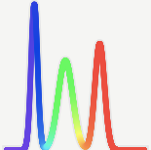

Display 1
Display 2
match
mismatch
A
B

Slide 4



Spectroradiometer
(x_{CIE1931}, y_{CIE1931}) = (0.313, 0.329)
(x_{CIE1931}, y_{CIE1931}) = (0.313, 0.329)
Illuminant D65
colorchecker
White patch
$$p$$
Display (calibrated to D65)
(x_{p}, y_{p}) = (0.313, 0.330)
(x_{p}, y_{p}) = (0.317, 0.338)
Observer $p$

Slide 5
Spectroradiometer
(x_{CIE1931}, y_{CIE1931}) = (0.313, 0.329)
(x_{CIE1931}, y_{CIE1931}) = (0.313, 0.329)
Illuminant D65
予備
colorchecker
White patch
$$p$$
Display (calibrated to D65)
(x_{p}, y_{p}) = (0.313, 0.330)
(x_{p}, y_{p}) = (0.317, 0.338)
Observer $p$

Slide 6


Illuminant D65
(x₁, y₁) = (0.313, 0.329)
(x₁, y₁) = (0.313, 0.329)
1
(x_{CIE1931}, y_{CIE1931}) = (0.306, 0.321)
colorchecker
White patch
Display (adjusted by Observer 1)
(x_{CIE1931}, y_{CIE1931}) = (0.302, 0.306)
Illuminant D65
(x₂, y₂) = (0.315, 0.332)
(x₂, y₂) = (0.315, 0.332)
2
colorchecker
White patch
Display (adjusted by Observer 2)
CIE 1931 standard
colorimetric observer
・・・・・
・・・・・
・・・・・
(x_{CIE1931}, y_{CIE1931}) = (0.312, 0.338)
Illuminant D65
(x_{P}, y_{P}) = (0.309, 0.325)
(x_{P}, y_{P}) = (0.309, 0.325)
$$P$$
colorchecker
White patch
Display (adjusted by Observer $P$)

Slide 10
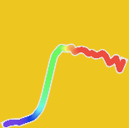
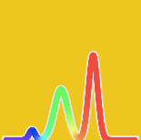
Spectroradiometer
(x_{CIE1931}, y_{CIE1931}) = (0.313, 0.329)
(x_{CIE1931}, y_{CIE1931}) = (0.313, 0.329)
Illuminant D65
colorchecker
color patch (i = 16)
$$p$$
Display (n = 1)
(x_{p}, y_{p}) = (0.313, 0.330)
(x_{p}, y_{p}) = (0.317, 0.338)
Observer $p$

