Slide 1
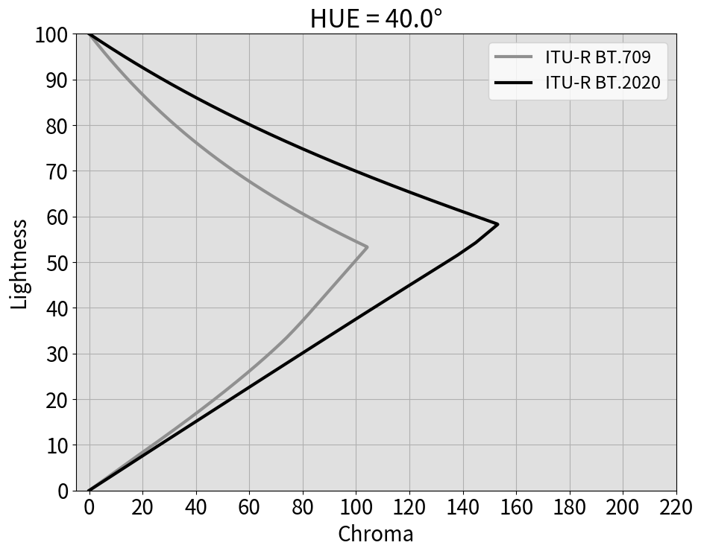
(B)
(A)
(D)
(C)

Slide 2
RGB = (1001, 509, 321)
RGB = (158, 421, 759)
Lab = (68.0, 76.6, 64.4)
Lab = (40.0, 0.0, -60.0)
LCH = (68.0, 100.0, 40.1°)
LCH = (40.0, 60.0, 270°)

Slide 3
Lab = (64.0, 53.5, 45.0)
LCH = (64.0, 69.9, 40.1°)
LCH = (44.8, 43.6, 270°)
Lab = (44.8, 53.4, -43.6)
RGB = (1023, 470, 349)
RGB = (0, 471, 733)

Slide 4
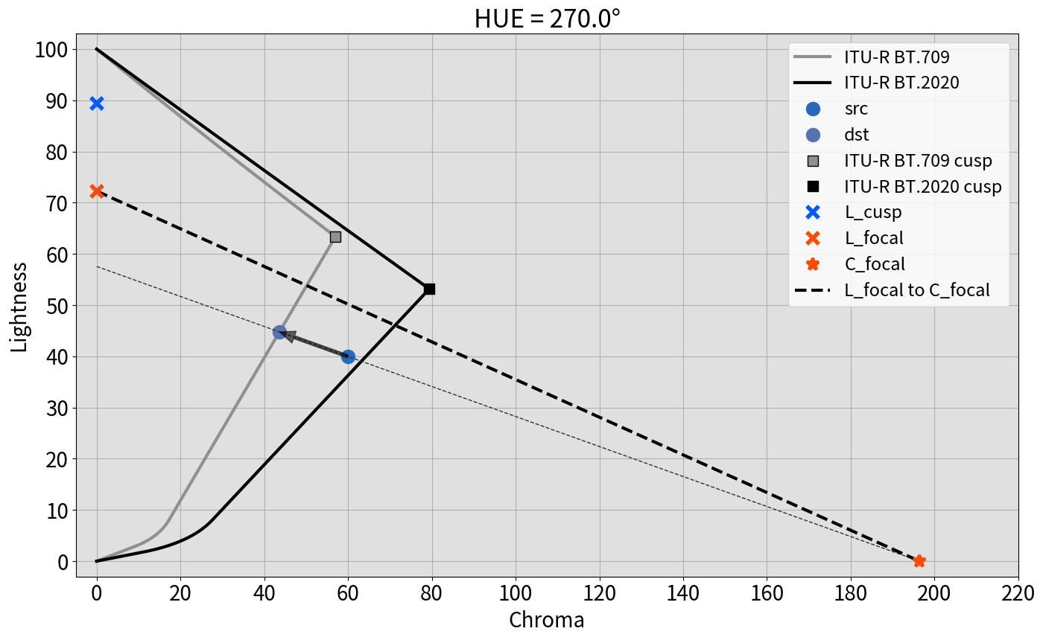
R_c
D_c
D_c_max
D_c_min

Slide 5
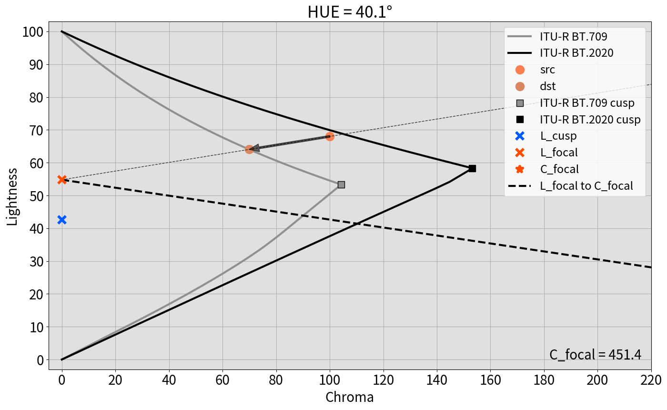
R_l
D_l
D_l_max
D_l_min

