Slide 2
1
2
3
4
10
CIE1931
5
9
8
7
6

Slide 3
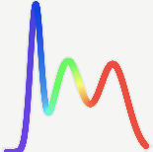
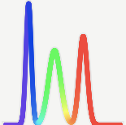

Display 1
Display 2
match
mismatch
A
B

Slide 4



Spectroradiometer
(x_{CIE1931}, y_{CIE1931}) = (0.313, 0.329)
(x_{CIE1931}, y_{CIE1931}) = (0.313, 0.329)
Illuminant D65
colorchecker
White patch
$$p$$
Display (calibrated to D65)
(x_{p}, y_{p}) = (0.313, 0.330)
(x_{p}, y_{p}) = (0.317, 0.338)
Observer $p$

Slide 5
Spectroradiometer
(x_{CIE1931}, y_{CIE1931}) = (0.313, 0.329)
(x_{CIE1931}, y_{CIE1931}) = (0.313, 0.329)
Illuminant D65
予備
colorchecker
White patch
$$p$$
Display (calibrated to D65)
(x_{p}, y_{p}) = (0.313, 0.330)
(x_{p}, y_{p}) = (0.317, 0.338)
Observer $p$

Slide 6


Illuminant D65
(x₁, y₁) = (0.313, 0.329)
(x₁, y₁) = (0.313, 0.329)
1
(x_{CIE1931}, y_{CIE1931}) = (0.306, 0.321)
colorchecker
White patch
Display (adjusted by Observer 1)
(x_{CIE1931}, y_{CIE1931}) = (0.302, 0.306)
Illuminant D65
(x₂, y₂) = (0.315, 0.332)
(x₂, y₂) = (0.315, 0.332)
2
colorchecker
White patch
Display (adjusted by Observer 2)
CIE 1931 standard
colorimetric observer
・・・・・
・・・・・
・・・・・
(x_{CIE1931}, y_{CIE1931}) = (0.312, 0.338)
Illuminant D65
(x_{P}, y_{P}) = (0.309, 0.325)
(x_{P}, y_{P}) = (0.309, 0.325)
$$P$$
colorchecker
White patch
Display (adjusted by Observer $P$)

Slide 10
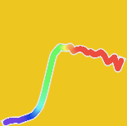
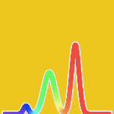




Spectroradiometer
(x_{CIE1931}, y_{CIE1931}) = (0.449, 0.476)
(x_{CIE1931}, y_{CIE1931}) = (0.449, 0.476)
Illuminant D65
colorchecker
Δx_{p}y_{p} = 6.52 x 10⁻³
Yellow patch ($i=16$)
$$2$$
DCI-P3 Display ($n=1$)
(x_{p,} y_{p}) = (0.452, 0.478)
(x_{p,} y_{p}) = (0.454, 0.485)
Observer $(p=2)$

Slide 11
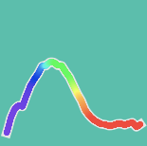
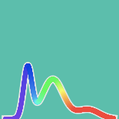






Illuminant D65
(x₁, y₁) = (0.263, 0.362)
(x₁, y₁) = (0.263, 0.362)
1
(x_{CIE1931}, y_{CIE1931}) = (0.259, 0.354)
colorchecker
Bluish green patch $(i=6)$
BT.709 Display $(n=0)$
Adjusted by Observer 1
(x_{CIE1931}, y_{CIE1931}) = (0.256, 0.343)
Illuminant D65
(x₂, y₂) = (0.269, 0.370)
(x₂, y₂) = (0.269, 0.370)
2
colorchecker
Bluish green patch $(i=6)$
BT.709 Display $(n=0)$
Adjusted by Observer 2
CIE 1931 standard
colorimetric observer
・・・・・
・・・・・
・・・・・
Illuminant D65
(x₁₀, y₁₀) = (0.248, 0.349)
(x₁₀, y₁₀) = (0.248, 0.349)
(x_{CIE1931}, y_{CIE1931}) = (0.265, 0.364)
10
colorchecker
Bluish green patch $(i=6)$
BT.709 Display $(n=0)$
Adjusted by Observer 10

