Slide 2
1
2
3
4
10
CIE1931
5
9
8
7
6

Slide 3

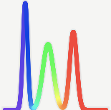

Display 1
Display 2
match
mismatch
A
B

