Slide 1
Collections in Java
The Collection in Java is a framework that provides an architecture to store and manipulate the group of objects.
Java Collections can achieve all the operations that you perform on a data such as searching, sorting, insertion, manipulation, and deletion.
Java Collection means a single unit of objects. Java Collection framework provides many interfaces (Set, List, Queue, Deque) and classes (ArrayList, Vector, LinkedList, PriorityQueue, HashSet, LinkedHashSet, TreeSet).

Slide 2
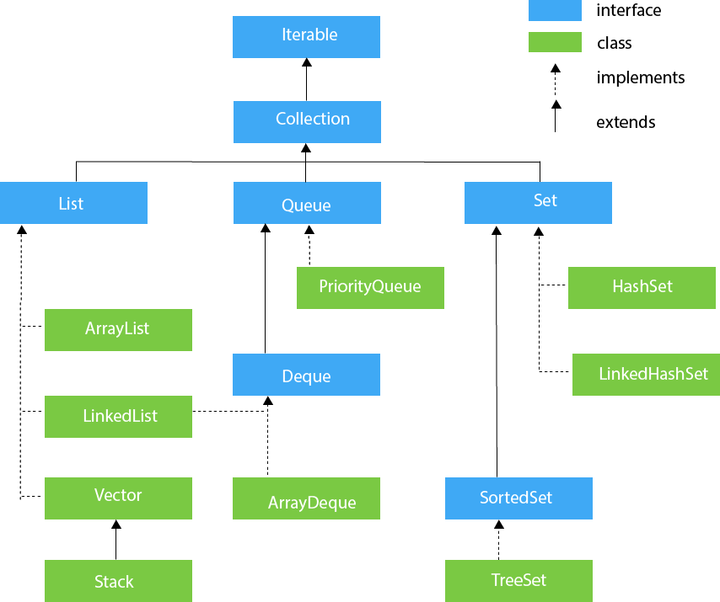

Slide 3
Collection Interface method
add(E e)→It is used to insert an element in this collection.
addAll(Collection<? extends E> c)→It is used to insert the specified collection elements in the invoking collection.
remove(Object element)→It is used to delete an element from the collection.
removeAll(Collection<?> c)→It is used to delete all the elements of the specified collection from the invoking collection.
removeIf(Predicate<? super E> filter)→It is used to delete all the elements of the collection that satisfy the specified predicate.

Slide 4
size()→It returns the total number of elements in the collection.
clear()→It removes the total number of elements from the collection.
contains(Object element)→It is used to search an element.
containsAll(Collection<?> c)→It is used to search the specified collection in the collection.
iterator()→It returns an iterator. Etc,..

Slide 5
Iterator Interface
Iterator interface provides the facility of iterating the elements in a forward direction only.
Methods of Iterator interface
hasNext()→It returns true if the iterator has more elements otherwise it returns false.
next()→It returns the element and moves the cursor pointer to the next element.
remove()It removes the last elements returned by the iterator.

Slide 6
The Iterable interface is the root interface for all the collection classes. The Collection interface extends the Iterable interface and therefore all the subclasses of Collection interface also implement the Iterable interface.

Slide 7
List Interface
List interface is the child interface of Collection interface. It inhibits a list type data structure in which we can store the ordered collection of objects. It can have duplicate values.
List interface is implemented by the classes ArrayList, LinkedList, Vector, and Stack.

Slide 8
List <data-type> list1= new ArrayList();
List <data-type> list2 = new LinkedList();
List <data-type> list3 = new Vector();
List <data-type> list4 = new Stack();

Slide 9
ArrayList
Java ArrayList class uses a dynamic arrayfor storing the elements. It inherits AbstractList class and implements List interface.
Java ArrayList class can contain duplicate elements.
Java ArrayList class maintains insertion order.
Java ArrayList class is non synchronized.
Java ArrayList allows random access because array works at the index basis.
In Java ArrayList class, manipulation is slow because a lot of shifting needs to occur if any element is removed from the array list.

Slide 10
Methods of Array list
add(int index,E element) →It is used to insert the specified element at the specified position in a list.
boolean add(E e)→It is used to append the specified element at the end of a list.
addAll(int index,Collection<?extends E>c)
isEmpty()
get(int index),lastIndexOf(Object o),indexOf(Object o),remove(int index),int size()..etc

