Slide 1

Chat application
Torz Iulian Marius
CAL 4

Slide 2
Tehnologi folosite
Springboot
JPA
Websockets
Framework Java folosit pentru backend
Java Persistence API folosit pentru comunicarea cu baza de date si ORM
Protocol folosit pentru a asigura comunicarea in timp real
Thymeleaf
web sessions
Security
Framework folosit pentru frontend
Gestionarea sesiunilor utilizatorilor prin cookies stocate in browser
Pentru autentificare si alocarea accesului la anumite resurse

Slide 3
Flux utilizator
Inregistrare
Creare
Trimitere
Alegerea unui username si parola
Utilizatorul poate creea o conversatie cu orice alt utilizator
Odata deschisa conversatia se pot trimite mesaje gestionate prin websockets
Logare
Alegere
Folosirea datelor de la inregistrare pentru conectare
Utilizatorul poate alege in care conversatie sa trimita mesaje

Slide 4



Functionalitati
Cele mai importante feature-uri ale aplicatiei
Conversatii 1 la 1
Conversatii de grup
Conversatie generala

Slide 5
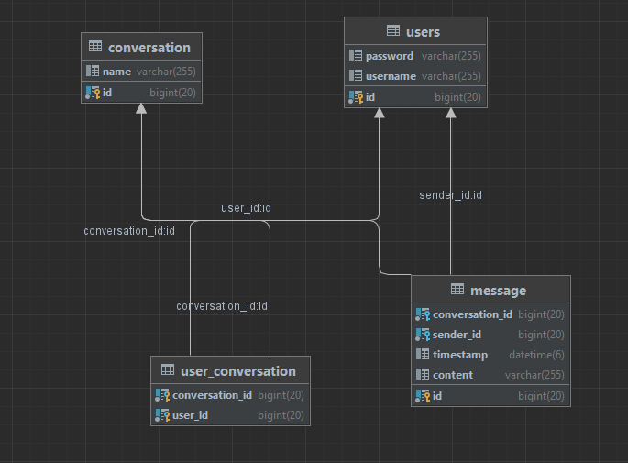



Data model
Architects must navigate a multitude of challenges throughout the design process, like understanding client requirements, incorporating sustainable design principles, and collaborating with various stakeholders.
Balancing creativity with practicality and addressing the diverse needs of clients and users are constant challenges that architects must tackle to deliver successful architectural solutions.
By examining the importance of efficient design, environmental considerations, and technological advancements, we can understand how architects play a pivotal role in shaping the future of our built environment.
Architectural drafting involves creating precise and accurate two-dimensional (2D) or three-dimensional (3D) representations of architectural designs, while architectural planning encompasses the strategic considerations, spatial organization, and functional layout of a structure, taking into account factors such as aesthetics, building codes, safety regulations, and sustainability.

Slide 6
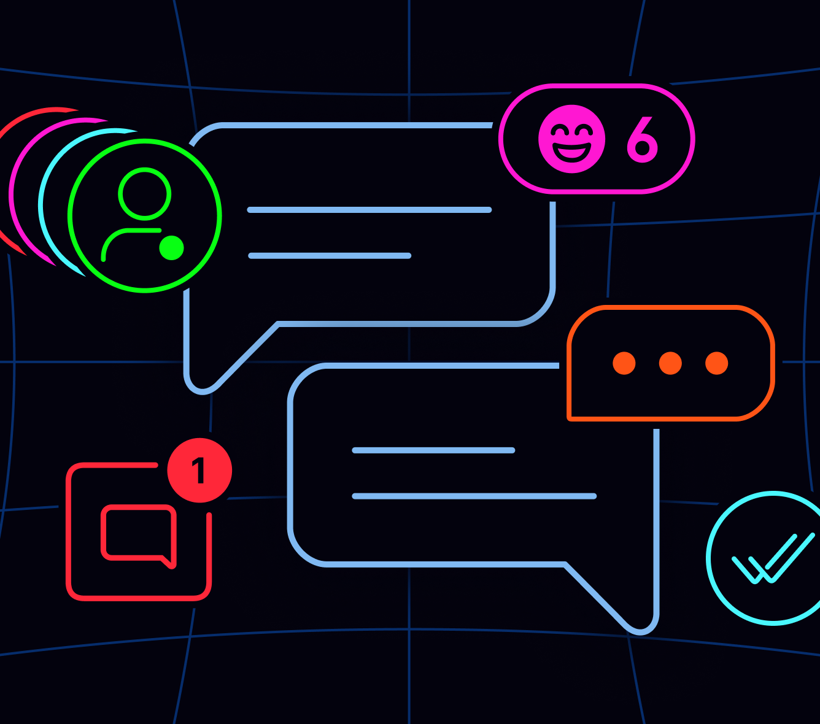
Multumesc pentru atentie!

