Slide 1

Solutions
S
Notes:
About this chapter
General description
Units
Time Schedule
Related Documentation

Slide 2

by Software AG
Notes:
Method
Next Topic / Section
(Default: next slide)

Slide 3
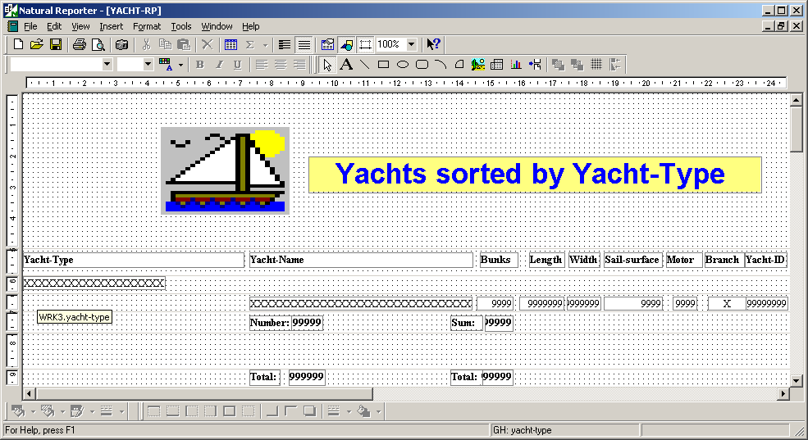
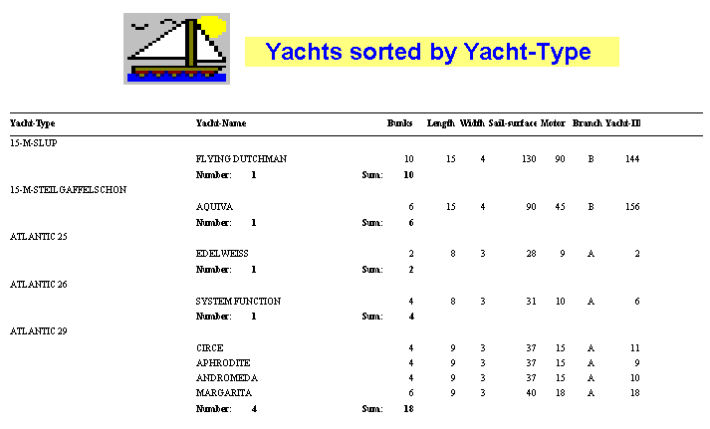
Solution Natural Reporter
by Software AG
Notes:
Method
Next Topic / Section
(Default: next slide)

Slide 4
by Software AG
Notes:
Method
Next Topic / Section
(Default: next slide)

