Slide 1
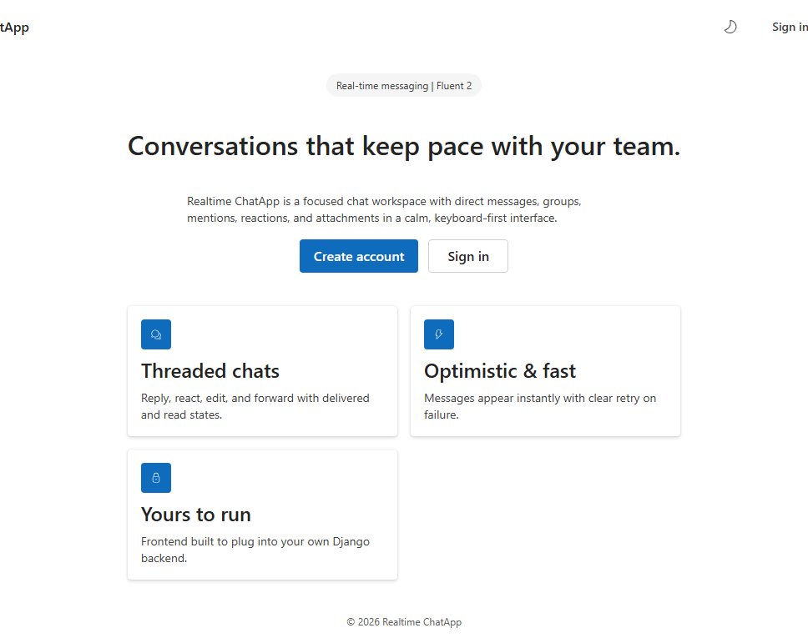
PROJECT OVERVIEW
Realtime
ChatApp
A calm, real-time workspace for direct and group conversations.
Django · React · Fluent UI · SQLite3
Project presentation
Realtime ChatApp · Django + React + Fluent UI + SQLite3
01

Slide 2
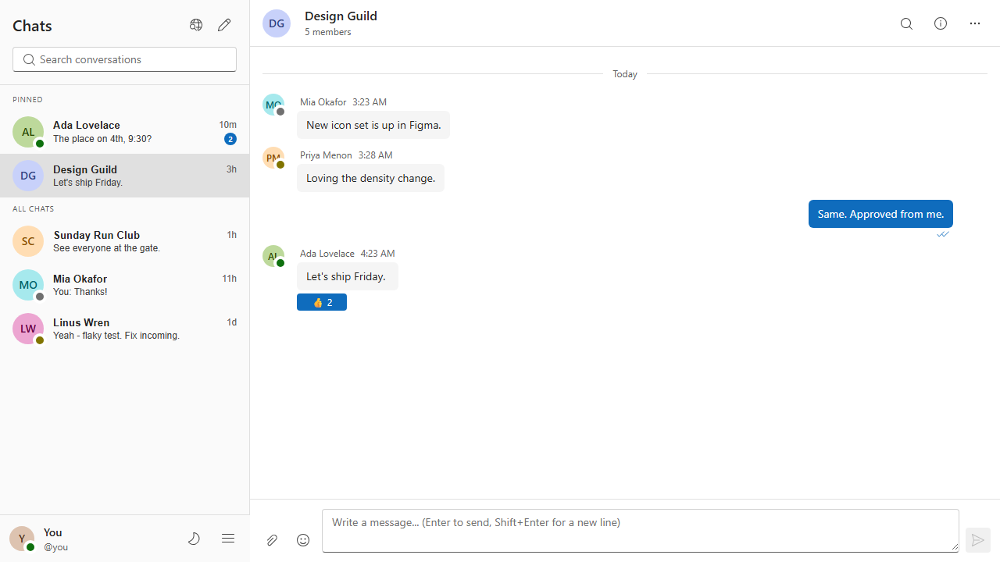
WHY THIS PROJECT
One focused surface keeps conversation moving.
Realtime ChatApp turns messaging primitives into a small, testable product surface.
The product promise
•
Direct messages and group conversations in one workspace.
•
Replies, reactions, forwarding, typing, and read states feel native.
•
Keyboard-first interaction with light and dark Fluent UI themes.
Outcome: a credible demo foundation that is easy to extend.
Realtime ChatApp · Django + React + Fluent UI + SQLite3
02

Slide 3
FRONTEND MODULES
React keeps the interaction model modular.
Vite bundles the app; Fluent UI supplies accessible controls and tokens.
Routes & pages
Chat workspace
Services
State & theme
Landing, auth, chat, profile, settings, password reset.
Sidebar, chat header, timeline, composer, dialogs and drawers.
Auth, users, conversations, messages, attachments and settings APIs.
Auth context, API client, WebSocket hook, FluentProvider and tokens.
01
02
03
04
UI composition
Pages → feature components → API + realtime hooks
The result is a frontend that can plug into the Django backend or be replaced by another client.
Realtime ChatApp · Django + React + Fluent UI + SQLite3
03

Slide 4
BACKEND MODULES
Django owns the data model, API contract, and realtime events.
The backend is intentionally explicit: each chat capability maps to a small module.
Django / DRF / Channels
Storage and boundaries
Domain
User · Conversation · Membership · Message · Reaction · Attachment
•
SQLite3 is the local development database.
REST API
Auth, users, conversations, messages, settings and search
•
Token authentication protects REST requests.
Realtime
ASGI WebSocket consumer, typing and delivery events
•
Channels keeps WebSocket delivery separate from CRUD.
Operations
Seed demo command, migrations, test suite and CORS settings
•
Environment variables control API URL and CORS.
Realtime ChatApp · Django + React + Fluent UI + SQLite3
04

Slide 5
ARCHITECTURE
Two transport paths, one source of truth.
REST handles commands and queries; WebSocket carries events to every connected client.
React client
Django ASGI
SQLite3
REST →
Pages
Fluent UI
API + WS hooks
queries + commands
DRF endpoints
Channels consumer
Auth middleware
Persist
Users
Conversations
Messages + events
WS events →
broadcast delivery
The UI can optimistically render a message, then reconcile with the server response.
Realtime ChatApp · Django + React + Fluent UI + SQLite3
05

Slide 6
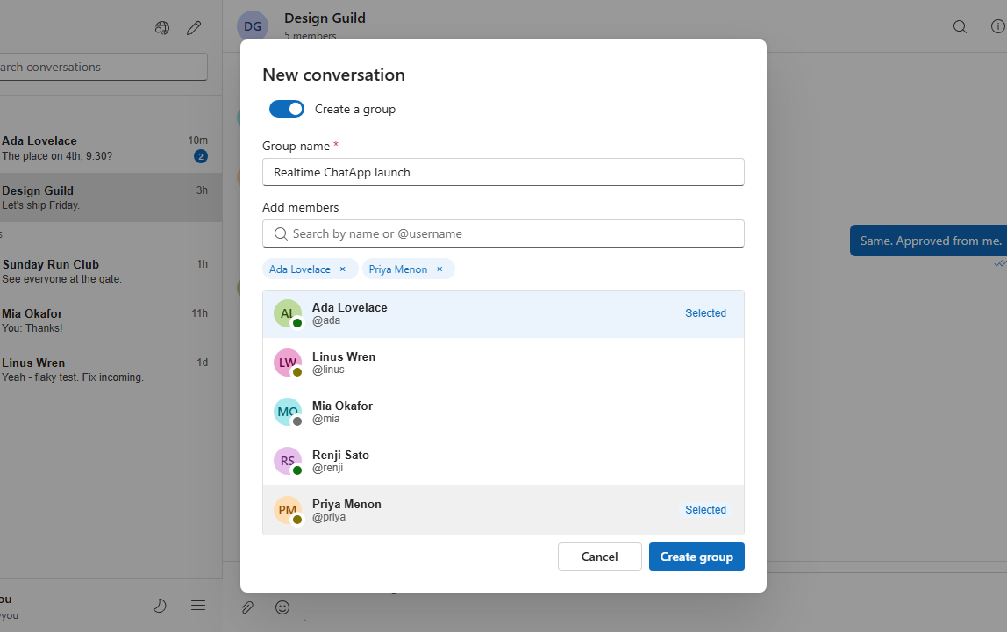
DESIGN SYSTEM
Fluent UI makes the product feel consistent in both themes.
Design tokens keep contrast, spacing, and interaction states predictable.
Theme building blocks
FluentProvider
Light / dark theme switching at the app boundary
Tokens
Neutral foregrounds, brand surfaces, spacing and typography
Griffel
@griffel/react generates scoped, theme-aware CSS
Accessibility
Fluent controls, focus states and readable contrast
Visual check: dark-theme labels and feature icons use semantic foreground tokens, not hard-coded black.
Realtime ChatApp · Django + React + Fluent UI + SQLite3
06

Slide 7
QUALITY & DELIVERY
The repo is demoable because the workflow is testable.
Local commands and GitHub Actions cover the same critical paths a contributor uses.
01
02
03
04
Django tests
Playwright E2E
Lint + build
CI on GitHub
Models, auth, message and API behavior
Sign in, reload, send, group, WebSocket flow
ESLint checks and Vite production bundle
Runs on push and pull request
npm run lint · npm run build · python backend/manage.py test chat · npm run e2e
CI validates the application; deployment remains a separate environment decision.
Realtime ChatApp · Django + React + Fluent UI + SQLite3
07

Slide 8
NEXT STEP
Ready to run, test,
and extend.
Extend next
•
Deploy the frontend and backend separately.
•
Move SQLite to a durable production datastore or volume.
A compact full-stack baseline for a production-minded chat experience.
•
Add monitoring, notifications, and richer presence.
Local URLs
Frontend http://127.0.0.1:4173/
API http://127.0.0.1:8000/api/
github.com/toscani-tenekeu/Realtime_ChatApp_Django_ReactJS_SQLite3
Realtime ChatApp · Django + React + Fluent UI + SQLite3
08

