Slide 1
Traffic Analysis Attack over HTTPS Traffic

Slide 2
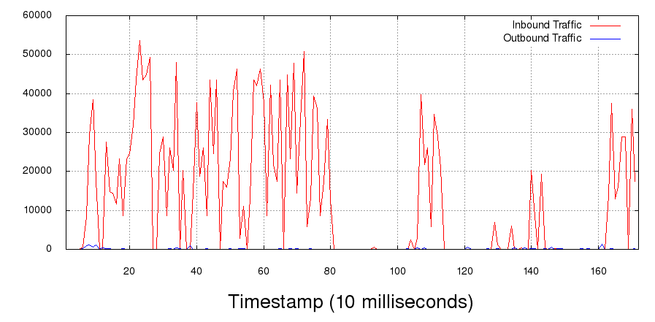
Attack
Dataset Building
Tcpdump for 10 days – packet traces for training.
Extracted features -
Number of incoming packets.
Number of outgoing packets as a fraction of the total number of packets.
Number of incoming packets as a fraction of the total number of packets.
Standard deviation of the outgoing packet ordering list.
Number of outgoing packets.
Average of the outgoing packet ordering list.
Sum of incoming, outgoing, and total number of packet.
Standard deviation of the incoming packet ordering list.
Average of incoming packet ordering list.
Reference: Jamie Hayes, George Danezis. k-fingerprinting: a Robust Scalable Website Fingerprinting Technique. USENIX Security Symposium, 1187-1203, 2006.

Slide 3
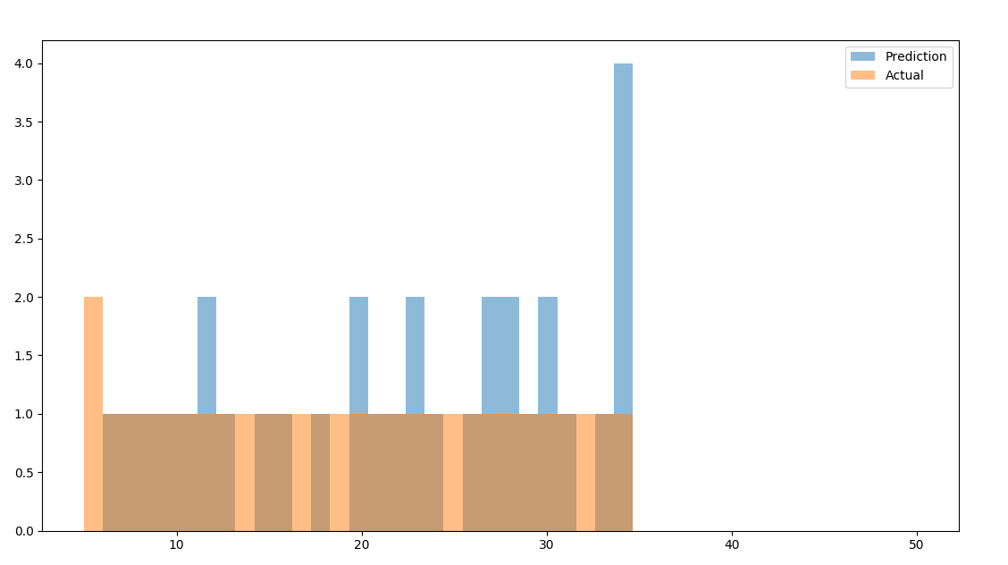
Attack
k-NN Classifier
Distance metric – Euclidean distance
Weights – inverse of distance (closer neighbors having greater influence)

