Slide 1
BrAna – Brand Analysis Platform
Group No. 11
Project Guide:
Dr. A. J. Agrawal
Group Members:
Megha Gupta \ (ROLL NO. 12)
Toshal Patel (ROLL NO. 31)

Slide 2
Current Scenario
PROBLEMS FACED
Each brand/company needs basic strategies for excelling among their competition.
Social Media in today’s world is an excellent and prime means to reach maximum people.
Many startups/ small scale companies cannot understand the actual reactions of people.
Many online, offline surveys conducted are not very honest, does not reflect true customer emotions
NEED
Branding
Competition
Understand the audience.
Identify and improve growth opportunities (Sentiment analysis and data driven strategies).
Connect to the customers and Expand the market

Slide 3
BrAna
What is Brana?
It is a brand analysis platform which helps the user to understand the audience reaction towards the company’s products.

Slide 4
Methodology
How will BrAna be built?

Slide 5
BrAna consits of three phases –
PHASE 1 –
Building the Data Set
Extracting the twitter data related to the brand/ company/ startup.
PYTHON
REST- API
NLP tools developed by University of Washington
Linux
PHASE 2 –
Named Entity Recognition
Performing Named Entity Recognition, identifying the entities and chunking out the important data.
PYTHON
NLP tools developed by University of Washington
Linux
PHASE 3 –
Sentiment Analysis
Performing Sentiment Analysis on chunks of data for extracted, and report the results.
PYTHON
Linux

Slide 6
Example for Brand Analysis
“Most products launched by Ramdevâ™ Patanjali are below standard! Many fail quality test, RTI inquiry finds... https://t.co/4PLtDf2ias.”
Helps in brand analysis
Key terms –
Patanjali
Fails
Below standard

Slide 7
Targets
Present state:
Twitter Data extraction.
Background work required for Named-Entity Recognition – Research and algorithms.
By the end of this semester:
Entire execution of Named-Entity Recognition for Twitter Data.
By next semester:
Sentiment Analysis for Brands.
Compilation of all phases.

Slide 8
Building the Data Set
Python and REST API

Slide 9
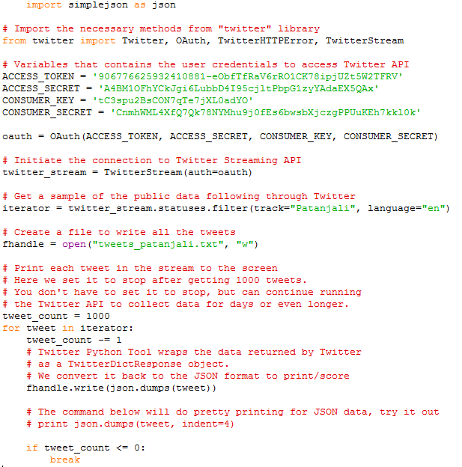
Using REST-API to extract data from Twitter

Slide 10
Twitter data extracted
Using ‘jq’ for extracting ‘text’ of tweets json
jq is like sed for JSON data - you can use it to slice and filter and map and transform structured data
jq query –
type tweetspatanjali.txt | jq -r ".text".

Slide 11
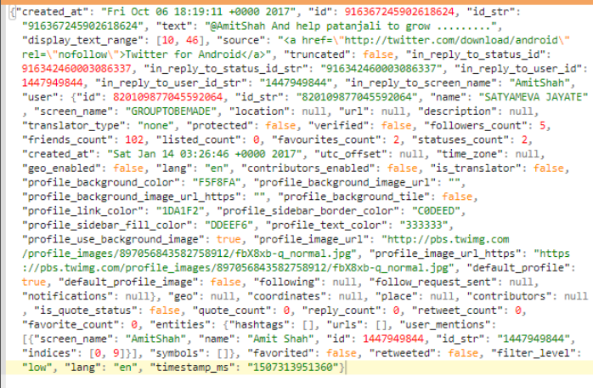

Slide 12
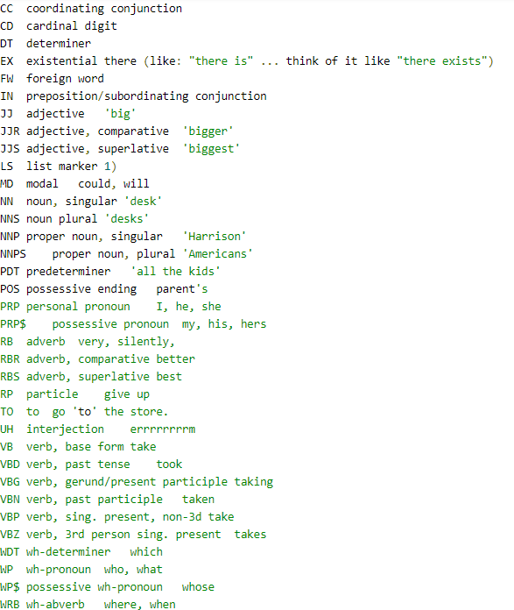
1. Part Of Speech (POS) tagging
Each word assigned to its most frequent tag and assign each Out of Vocabulary (OOV) to the most common POS tag.
My dog also likes eating sausage.
Tagging -
My/PRP$ dog/NN also/RB likes/VBZ
eating/VBG sausage/NN ./.
Tweets contain greater OOVs
Eg. the use of the word “n” for “in”
Drawbacks of state-of-the-art Stanford Tagger:
Misclassification due to unreliable capitalization.
common nouns misclassified as proper noun, vice versa.
Different grammar of tweets – “watching angels and demons”.

Slide 13
1. Part Of Speech (POS) tagging (contd.)
Lexical variations -
‘2m’, ‘2ma’, ‘2mar’, ‘2mara’, ‘2maro’,‘tmmrw’, ‘tmo’, ‘tmoro’, ‘tmorrow’, ‘tmoz’, ‘tmr’, ‘tmro’, ‘tmrow’, ‘tmrrow’, ‘tmrrw, ‘tomorro’, ‘tomorrw’, ‘tomoz’, ‘tomrw’, ‘tomz’
T-POS : POS tagging system with new tags for retweets, @usernames, #hashtags, urls.
Uses Contitional Random Fields
Conditional random fields (CRFs) are a probabilistic framework for labelling and segmenting structured data, such as sequences, trees and lattices. Often applied in pattern recognition and machine learning and used for structured prediction.
Brown clusters
(A method used to create clusters of words that are similar. It is an instance of a Clustering algorithm which generates a hierarchical cluster of words.)

Slide 14
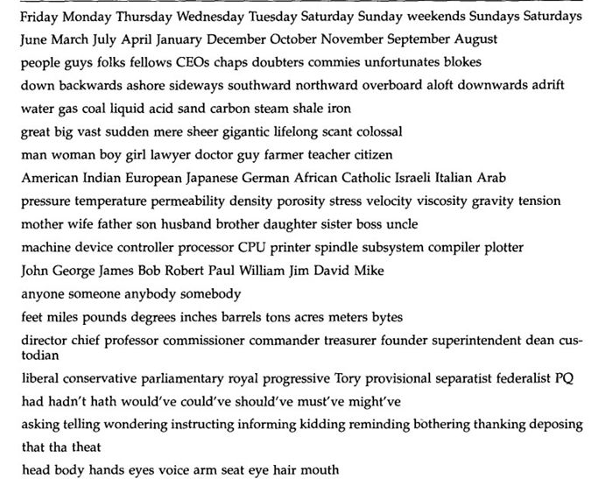
Brown clusters example
1. Part Of Speech (POS) tagging (contd.)

Slide 15
1. Part Of Speech (POS) tagging (contd.)
POS dictionaries
Spelling and contextual features
Better than Stanford tagger, obtaining 26% reduction in error.

Slide 16
2. Shallow Parsing (or Chunking)
Identifying non-recursive phrases – noun, verb, prepositional phrases in text
Parser forms tree, POS tagger returns the lowest level of the tree, but, Shallow Parsing returns a specific part of the tree (eg. noun phrase) and eliminated the need to form an entire parsing tree.
For example an adjective and a noun might combine to be a 'Noun Phrase', which might combine with another adjective to form another Noun Phrase (e.g. quick brown fox) (the exact way the pieces combine depends on the parser in question).
Source: Research paper, Named Entity Recognition in Tweets: An experimental study.

Slide 17
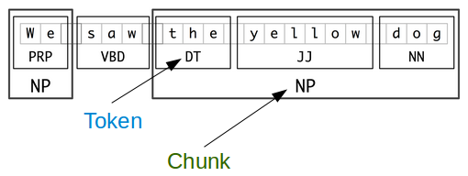
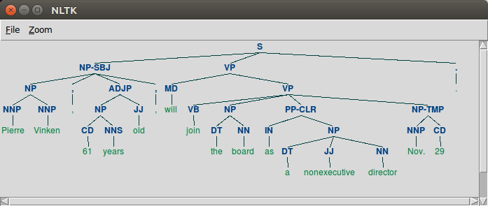

Slide 18
3. Capitalization
Key feature for recognizing named entities is capitalization, but tweets have random capitalization.
T-CAP – capitalization classifier
Either informative or uninformative labels
Uninformative – non-entity capitalized words, or entity words which are not capitalized.
Use Support Vector Machines for learning
Features used –
the fraction of words in the tweet which are capitalized,
the fraction which appear in a dictionary of frequently lowercase/capitalized words but are not lowercase/capitalized in the tweet,
the number of times the word ‘I’ appears lowercase
whether or not the first word in the tweet is capitalized.

Slide 19
Named Entity Recognition

Slide 20
The state-of-the-art Stanford NER performs poorly on Twitter data – misclassifying data.
Here, treating classification and segmentation as separate tasks.
Using large number of randomly sampled tweets, because most words found in tweets are not part of an entity.

Slide 21
1. Segmenting Named Entities
T-SEG – a sequence labelling task using IOB encoding for representing segments
Each word either begins, is inside, or outside of a named entity.
Conditional Random Fields for learning and inference.
Brown clusters, and output of T-POS, T-CHUNK, and T-CAP are used in generating features.

Slide 22
2. Classifying Named Entities
Twitter data contains many distinctive infrequent entity types, in any random sample of tweets, many types will occur a few times.
Individual tweets often do not contain enough context to determine the type of entity. (Problem of many infrequent types)
“KKTNY in 45 mins………..” – without any prior knowledge it is not enough context to determine what kind of entity “KKTNY” refers to.
But we can determine it to be a TV show since it often occurs with verbs watching or premieres.
For this problem – leverage large lists of entities and their types gathered from any open-domain ontology as a source of distant supervision, allowing large amount of unlabelled data in learning.
Apply LabeledLDA – makes each entity string as a mixture of types rather than single hidden variable to represent the type of each mention.

Slide 23
References:
Source: Research paper, Named Entity Recognition in Tweets: An experimental study.
http://blog.echen.me/2012/01/03/introduction-to-conditional-random-fields/
https://github.com/aritter/twitter<underscore>nlp

