Slide 1
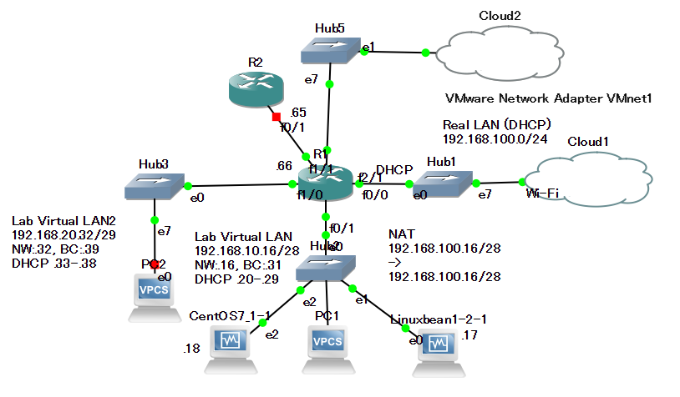

Oct. 14th, 2020
Cisco CSR1000V

Slide 2
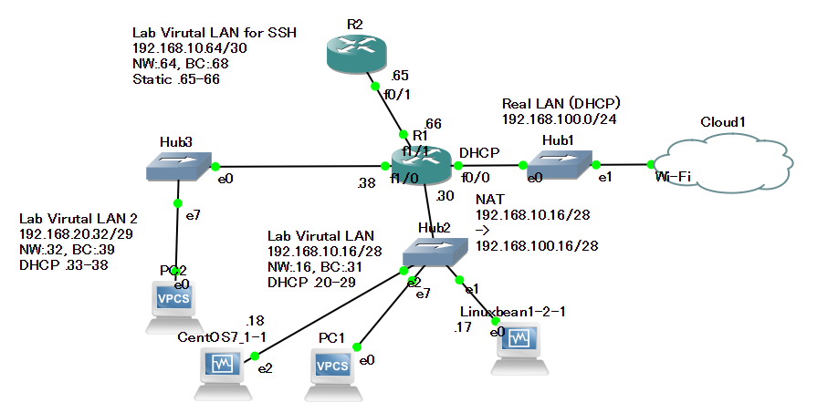
Aug. 11th, 2020

Slide 3
DHCP - Linuxbean
/etc/dhcp/dhcpd.conf
subnet 192.168.10.16 netmask 255.255.255.240 {
pool{
option routers 192.168.10.30;
range 192.168.10.20 192.168.10.29;
}
}
subnet 192.168.20.32 netmask 255.255.255.248 {
pool{
option routers 192.168.20.38;
range 192.168.20.33 192.168.20.37;
}
}
ddns-update-style interim;
zone toshi.com. {
primary 127.0.0.1;
}
zone 168.192.in-addr.arpa. {
primary 127.0.0.1;
}
DHCP Range 01:
NW: 192.168.10.16/28
DHCP Host: .20 - .29
Default GW: 192.168.10.30
DHCP Range 02:
NW: 192.168.20.32/29
DHCP Host: .33 - .37
Default GW: 192.168.10.38

Slide 4
DNS - Linuxbean
$ /etc/bind/named.conf.options
allow-query { 127.0.0.1;192.168.0.0/16; };
allow-query-cache { 127.0.0.1; 192.168.0.0/16; };
allow-update { 127.0.0.1; };
forwarders { 192.168.100.1; };
$ /etc/bind/named.conf
zone "toshi.com" IN {
type master;
file "toshi.com.zone";
notify no;
};
zone "168.192.in-addr.arpa" IN {
type master;
file "168.192.zone";
notify no;
};
Zone toshi.com
192.168.10.17 = linuxbean1
192.168.10.18 = cento-server
$ /var/cache/bind/toshi.com.zone
@ IN SOA linuxbean1.toshi.com. root.toshi.com. (
IN NS linuxbean1.toshi.com.
IN NS centos-server.toshi.com.
IN NS speedwifi.home.
IN NS toshi.oppo.
linuxbean1 IN A 192.168.10.17
centos-server IN A 192.168.10.18
$ /var/cache/bind/168.192.zone
IN NS linuxbean1.toshi.com.
IN NS centos-server.toshi.com.
IN NS speedwifi.home.
IN NS toshi.oppo.
17.10 IN PTR linuxbean1.toshi.com.
18.10 IN PTR centos-server.toshi.com.

Slide 6


































Modem
vAnalytics
vManage
vBond
vSmart Controllers
vEdge

