Slide 1
RNN learning group
Toshiaki Asakura
Tabata Youtarou

Slide 2
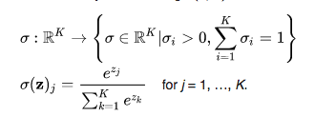
-ReLU ( Rectified Linear Unit Rectifier ,正規化線形関数)
2011年、Xavier Glorotが提唱
ReLU := max(0,x)
-softmax function : often used in multiclass classification methods.
-what is difference between placeholder and variable in tensorflow.
X = tf.placeholder("float")
W = tf.Variable(rng.randn(), name="weight")
Placeholders are for variables that you want to feed your model with.
Variables are for parameters of your model (like weights).

Slide 3
MNIST classification task using RNN ( 14.3.1 )
y
y
-simplest RNN structure
Y(t) = φ( X(t) * Wx + Y(t-1) * Wy + b )
We use data as 28 input and 28 lines.
-150 recurrent neurons
-the last time step, combine usigng densely connected layers. (10 category)
and softmax function.
The number of parameters we have to estimate is
28*150(Wx) + 150*150 ( Wy ) + 150 (b) + 150*10 ( densely connected layers )
= 28350 !!
28350/28/28 = 36.16
h
X
X

Slide 4
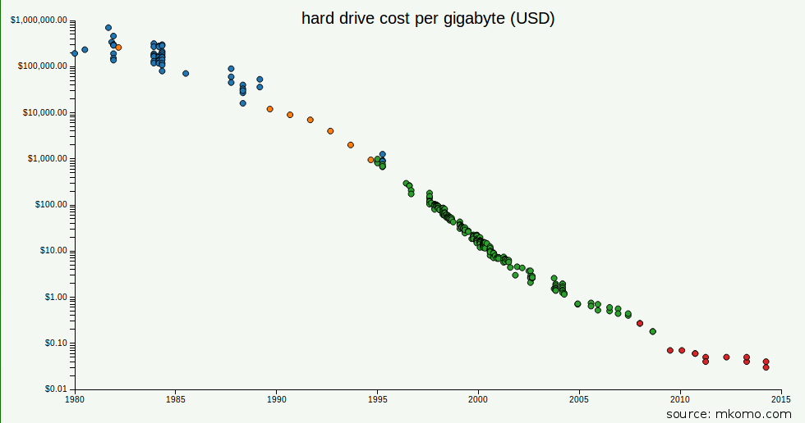
Skybox Imaging
OpenRefine
Companies that are serious about rich data should look to open source tools like OpenRefine, which enable data scientists to create semi-automated process to clean, enrich and de-duplicate data sets
Tools such as MuleSoft, IFTTT and Zapier are also starting to make it easier to import large sets of disparate data sources into the same place.
From Lukas Biewald blog

Slide 5
BPTT。
勾配消失、勾配爆発。
Tensorflow のグラフの確認。
14.3.2を実装する。(10月19日)
Deep learningをやる。
14.3.4以降をやる。
kaggle

Slide 6
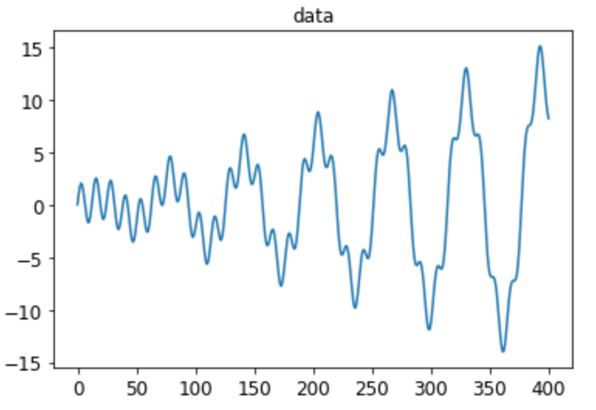
Model Explanation
itemss | explanations
data | t * sin(t)/3 + 2 * sin(5t)
Training data | t = np.linspace(0,300,30*10 + 1)
Model structure | Basic RNN with outputprojectionwrapper
n_steps | 20
n_inputs | 1 ( training data only)
n_nuerons | 100
n_outputs | 6
Model type | Sequence-vector
Learning_rate | 0.001
Cost function | The 20th vector SSE of outputs[:,19,:] - y[:,19,:]
Optimizer | Adamoptimizer

Slide 7
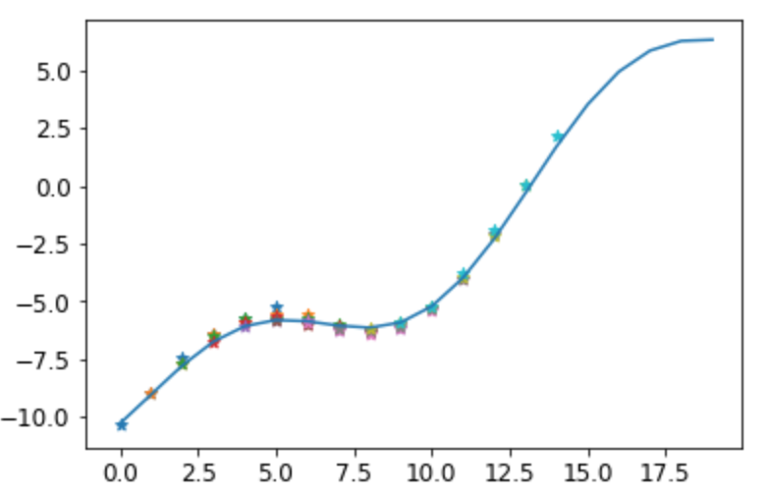
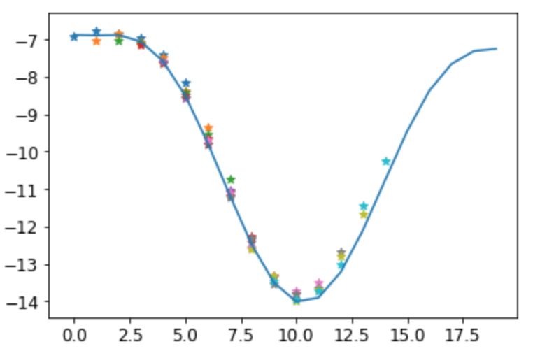
Results
items | Explanation
n_pred_steps | 6
N_times_eval | 10
test_fisrt | 301
SSE | 2.527
items | Explanation
n_pred_steps | 6
N_times_eval | 10
test_fisrt | 351
SSE | 2.93986

Slide 8
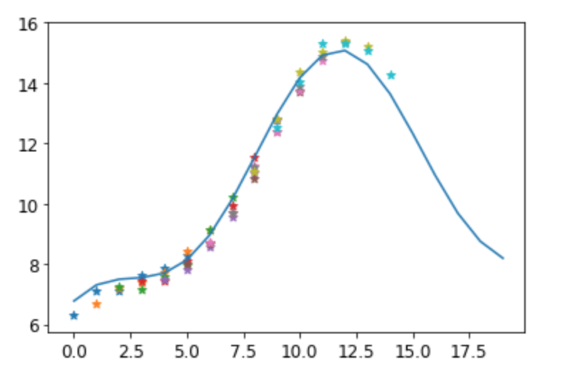
items | Explanation
n_pred_steps | 6
N_times_eval | 10
test_fisrt | 381
SSE | 6.84191
Test_first | SSE(3step ahead) | SSE(6step ahead)
301 | 0.70616363 | 2.527807882255659
311 | 0.993034633 | 2.729093721051414
321 | 0.75755105 | 1.8715785060368635
331 | 0.521867525 | 1.4547071811108074
341 | 0.344418635 | 2.994333728404959
351 | 0.235748643 | 2.9398671908057574
361 | 2.639574095 | 7.344554093440187
371 | 1.463410131 | 4.7720963733195525
381 | 3.063350228 | 6.841913386724094

Slide 9
Task 1. Predicting Topix
-Topixの値の将来予測をする。
-用いるデータの種類はeconomic_data.xlsを用いたもののみ。
-Training data ( training set + validation set) はDec-99 まで。
-Test set は四種類。 3ヶ月予測(Jan-00 ~ Mar-00) 、半年予測( Jan-00 ~ Jun-00) 、
一年予測(Jan-00 ~ Dec-00) 、二年予測(Jan-00 ~ Dec-01) 。
-まずは3ヶ月予測の性能が良くなることを目指す。Training dataをどう扱うは自由。
-性能の評価は各月毎の実測値と予測値の最小二乗法は最低限用いること。

Slide 10
Model Explanation
itemss | explanations
data | topix from jan-75 to Apr-05
Training data | Topix from jan-75 to Dec-99 ( 299)
Model structure | Basic RNN with outputprojectionwrapper
n_steps | 20
n_inputs | 1 ( training data only)
n_nuerons | 100
n_outputs | 3
Model type | Sequence-vector
Learning_rate | 0.001
Cost function | The 20th vector SSE of outputs[:,19,:] - y[:,19,:]
Optimizer | Adamoptimizer

Slide 11
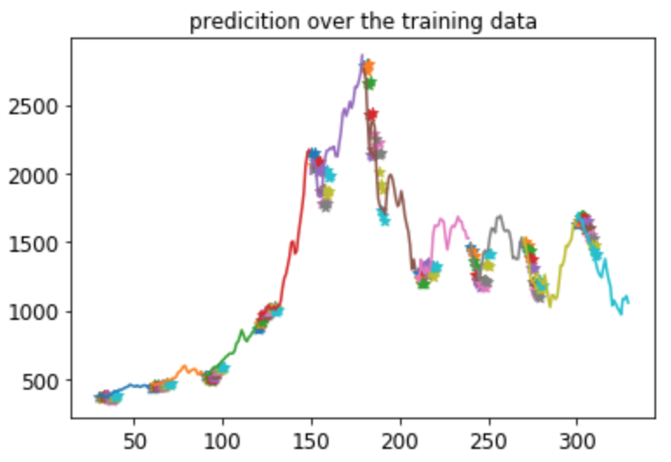
Test_first | SSE(3step ahead)
30 | 18939.45682
60 | 16313.99507
90 | 63327.47356
120 | 63926.26359
150 | 1129615.932
180 | 2028014.164
210 | 636249.7663
240 | 412813.1923
270 | 285002.9085
300 | 106366.5056

Slide 12
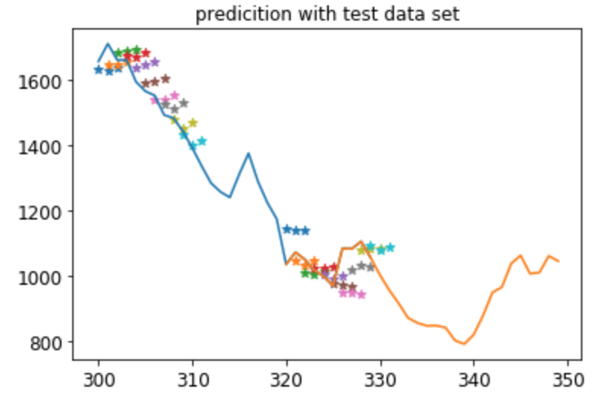
Test_first | SSE(3step ahead)
300 | 106366.505
320 | 169174.047

Slide 13
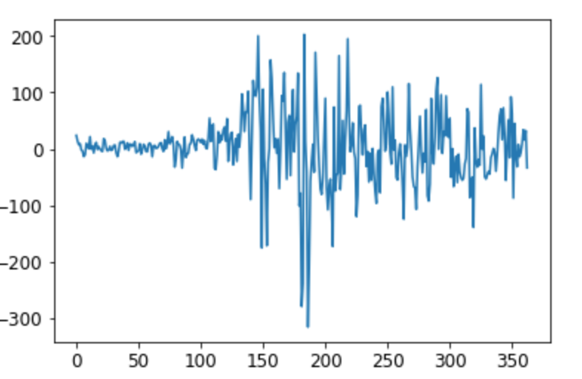
Model Explanation
() is index number in python, starting from 0
itemss | explanations
data | Dif. of topix from jan-75 to Apr-05 (362)
Training data | Dif . of Topix from jan-75 to Dec-99 ( 298)
Model structure | Basic RNN with outputprojectionwrapper
n_steps | 20
n_inputs | 1 ( training data only)
n_nuerons | 100
n_outputs | 3
Model type | Sequence-vector
Learning_rate | 0.001
Cost function | The 20th vector SSE of outputs[:,19,:] - y[:,19,:]
Optimizer | Adamoptimizer

Slide 14
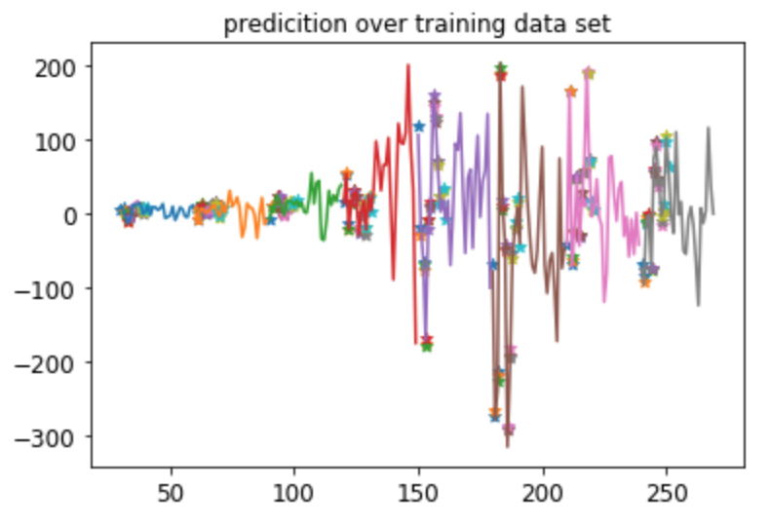
Test_first | SSE(3step ahead)
30 | 1114.09022
60 | 697.954297
90 | 341.5605824
120 | 445.1503414
150 | 1000.438699
180 | 996.2453328
210 | 721.1372202
240 | 279.8965671

Slide 15
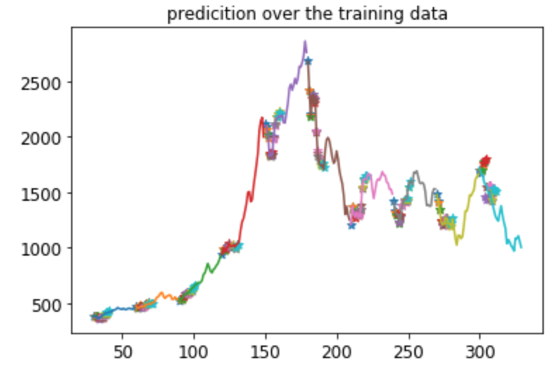
Test_first | SSE By dif prediction
30 | 3317.688343
60 | 2041.62219
90 | 840.3761699
120 | 1134.412204
150 | 2787.171885
180 | 2294.22124
210 | 1268.480569
240 | 458.3077365
270 | 585.8987762
300 | 292727.5804

Slide 16
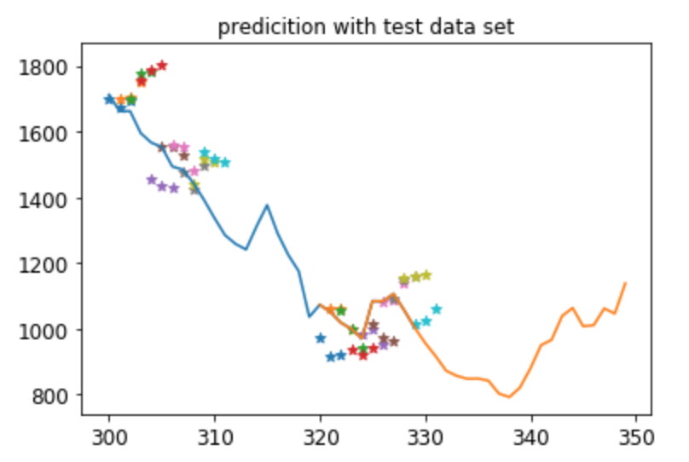
Test_first | SSE(3step ahead)
300 | 292727.5804
320 | 180074.106
Prediction is quite bad
But better than with original data!!!

Slide 17
Model Explanation
With original and dif of sequence.
Pattern1 -> cost function includes only original sequence ( may be better than pattern2 )
Pattern2 -> cost function includes original and dif of sequence
itemss | explanations
data | Dif. of topix from jan-75 to Apr-05 (362)
Training data | Dif . of Topix from jan-75 to Dec-99 ( 298)
Model structure | Basic RNN with outputprojectionwrapper
n_steps | 20
n_inputs | 2 ( original and dif of training data )
n_nuerons | 100
n_outputs | 3 or 6 ( pattern1 or 2 )
Model type | Sequence-vector
Learning_rate | 0.001
Cost function | The 20th vector SSE of outputs[:,19,:] - y[:,19,:]
Optimizer | Adamoptimizer

Slide 18
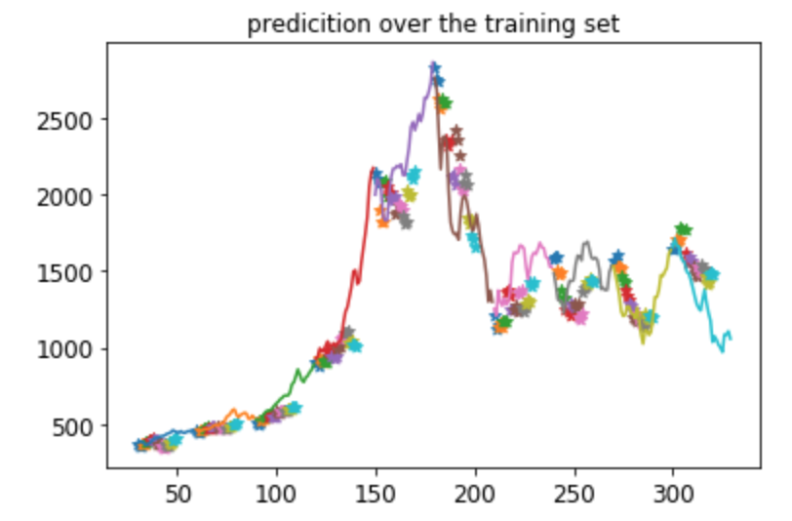
Pattern1
Test_first | SSE(3step ahead)
30 | 19487.73507
60 | 3642.109749
90 | 10158.68299
120 | 91362.09225
150 | 682086.6174
180 | 1206169.789
210 | 618541.1191
240 | 335285.6146
270 | 237055.1137
300 | 117339.7525

Slide 19
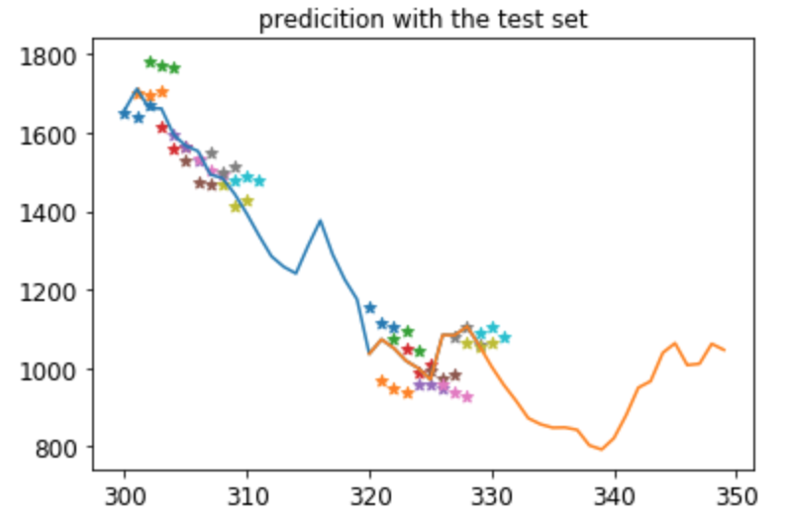
Pattern1
Test_first | SSE(3step ahead)
300 | 117339.7525
320 | 200476.8008
Sometimes better,
But other times not better …

Slide 20
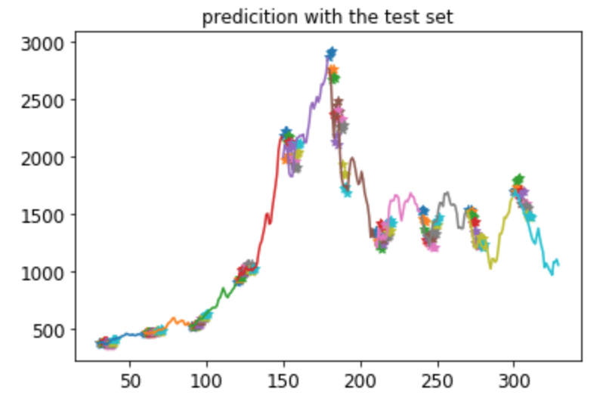
Pattern2
Test_first | SSE(3step ahead)
30 | 19487.73507
60 | 3642.109749
90 | 10158.68299
120 | 91362.09225
150 | 682086.6174
180 | 1206169.789
210 | 618541.1191
240 | 335285.6146
270 | 237055.1137
300 | 117339.7525

Slide 21
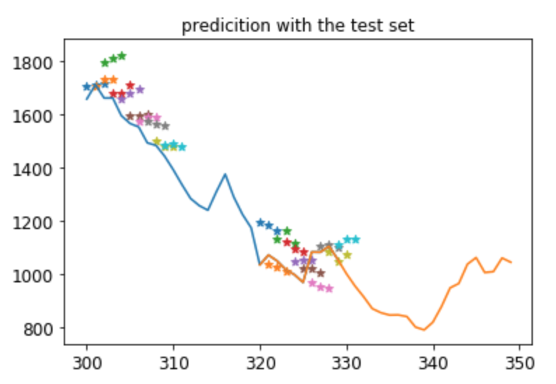
Pattern2
Test_first | SSE(3step ahead)
300 | 271543.8077749644
320 | 264088.6912603053
As predicted,
Extra fitting yields bad result.

Slide 22
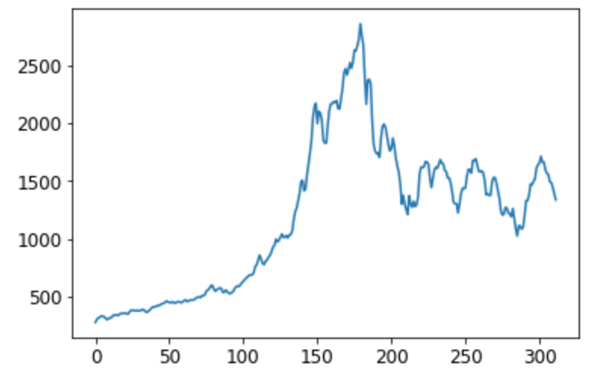
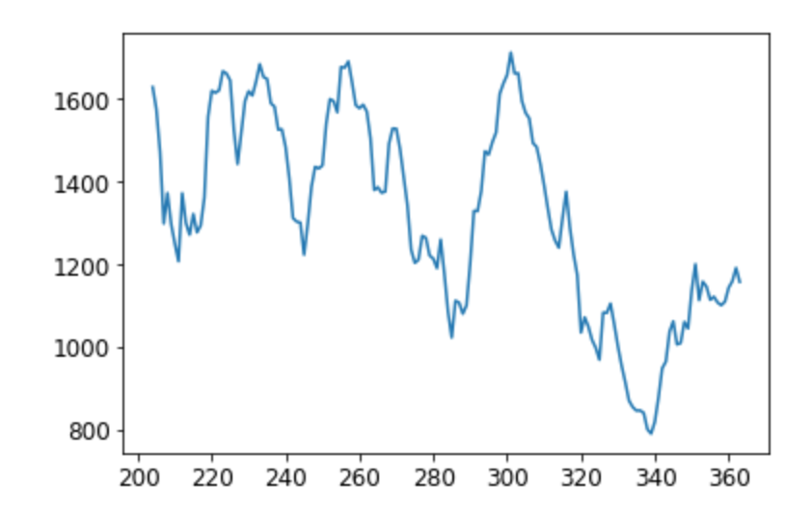
Model Explanation
Limit data from jan-92 to Dec-99 for training data
itemss | explanations
data | Dif. of topix from jan-92(204) to Apr-05 (362)
Training data | Dif . of Topix from jan-92(204) to Dec-99 ( 298)
Model structure | Basic RNN with outputprojectionwrapper
n_steps | 20
n_inputs | 2 ( original and dif )
n_nuerons | 100
n_outputs | 3
Model type | Sequence-vector
Learning_rate | 0.001
Cost function | The 20th vector SSE of outputs[:,19,:] - y[:,19,:]
Optimizer | Adamoptimizer

Slide 23
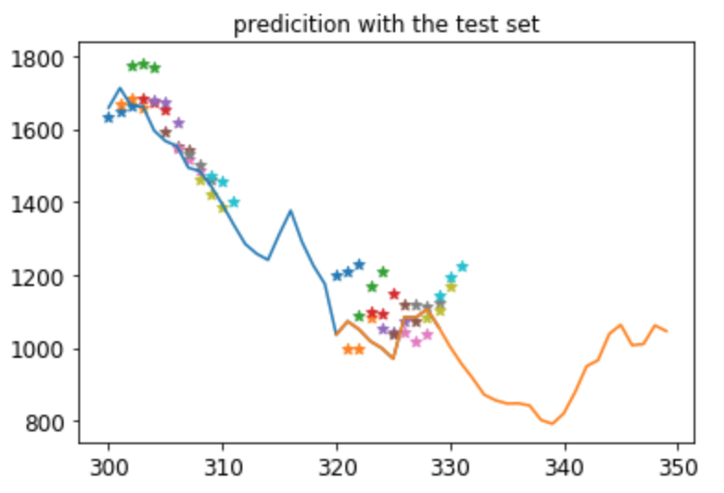
Test_first | SSE(3step ahead)
300 | 116236.1932
320 | 383525.4785
In a short range, fitting becomes better
But exotic dynamic in terms of training data
results become quite poorer than pattern1 case

Slide 24
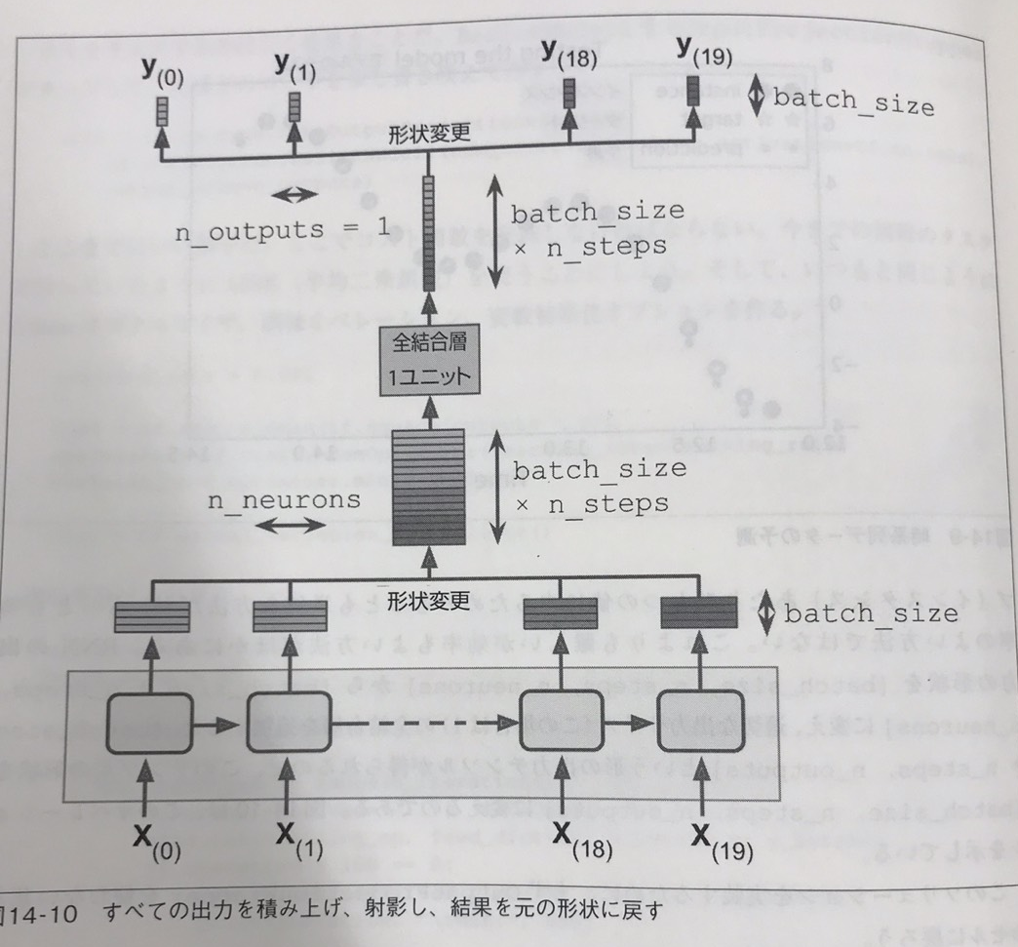
Model Explanation
Witout outputprojectionwrppper
itemss | explanations
data | Dif. of topix from jan-75 to Apr-05 (362)
Training data | Dif . of Topix from jan-75 to Dec-99 ( 298)
Model structure | See right pictures.
n_steps | 20
n_inputs | 2 ( original and dif )
n_nuerons | 100
n_outputs | 3
Model type | Sequence-vector
Learning_rate | 0.001
Cost function | The 20th vector SSE of outputs[:,19,:] - y[:,19,:]
Optimizer | Adamoptimizer

Slide 25
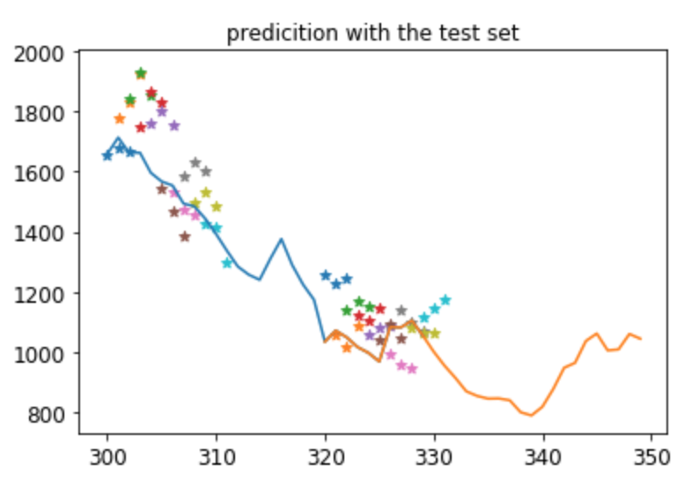
Test_first | SSE(3step ahead)
300 | 634255.4765
320 | 378100.7303

Slide 26
Model Explanation
Limit the data
itemss | explanations
data | topix from jan-92(204) to Apr-05 (362)
Training data | Topix from jan-92(204) to Dec-99 ( 298)
Model structure | Basic RNN with outputprojectionwrapper
n_steps | 20
n_inputs | 1 ( training data only)
n_nuerons | 100
n_outputs | 3
Model type | Sequence-vector
Learning_rate | 0.001
Cost function | The 20th vector SSE of outputs[:,19,:] - y[:,19,:]
Optimizer | Adamoptimizer

Slide 27
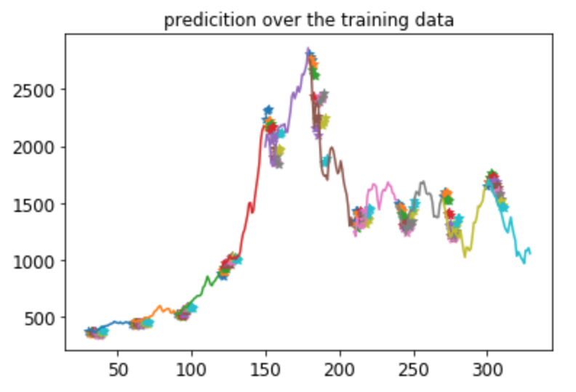
Test_first | SSE(3step ahead)
30 | 21225.40207
60 | 23855.18973
90 | 34759.02797
120 | 73473.36279
150 | 1126576.382
180 | 3401858.711
210 | 456284.3522
240 | 184813.0816
270 | 480497.9218
300 | 267459.8897

Slide 28
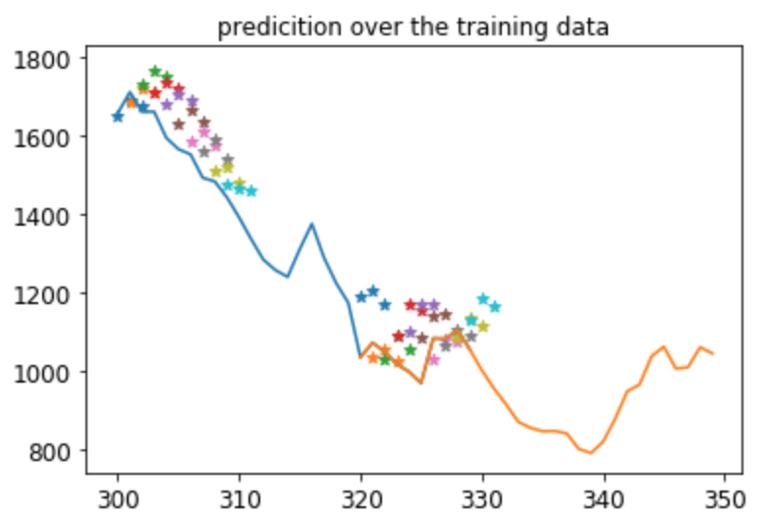
Test_first | SSE(3step ahead)
300 | 267459.8897
320 | 321195.0456

Slide 29
Model Explanation
items | explanations
data | topix from jan-75 to Apr-05
Training data | Topix from jan-75 to Dec-99 ( 299)
Model structure | See right picture
n_steps | 20
n_inputs | 1 ( training data only)
n_nuerons | 100
n_outputs | 3
Model type | Sequence-vector
Learning_rate | 0.001
Cost function | The 20th vector SSE of outputs[:,19,:] - y[:,19,:]
Optimizer | Adamoptimizer

Slide 30
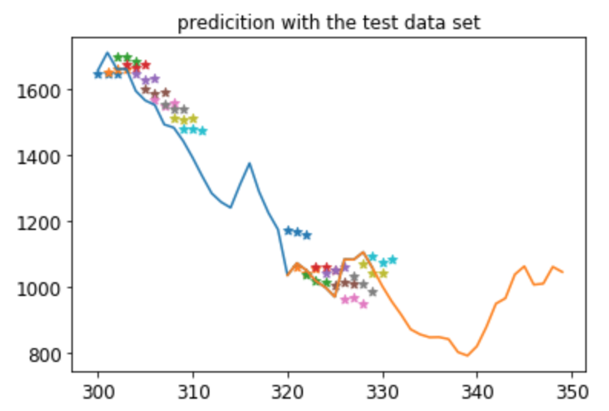
Test_first | SSE(3step ahead)
300 | 135059.030
320 | 168529.209

Slide 31
Model Explanation
items | explanations
data | topix from jan-75 to Apr-05
Training data | Topix from jan-75 to Dec-99 ( 299)
Model structure | Basic RNN with outputprojectionwrapper
n_steps | 20
n_inputs | 6 ( economic variables )
n_nuerons | 100
n_outputs | 3
Model type | Sequence-vector
Learning_rate | 0.001
Cost function | The 20th vector SSE of outputs[:,19,:] - y[:,19,:]
Optimizer | Adamoptimizer

Slide 32
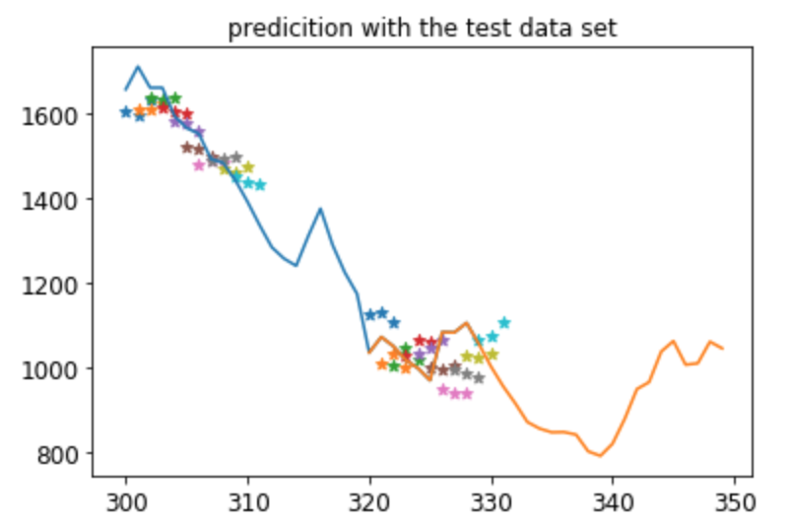
Test_first | SSE(3step ahead)
300 | 69829.144
320 | 188059.661

Slide 33
Summary of experiments
Index | Model | original | dif | Ori_fit | Pre_fit | Limit data | SSE at 300 | SSE at 320
1 | Basic | 1 | 0 | 1 | 0 | 0 | 112376.568 | 152396.644
2 | Dif | 0 | 1 | 0 | 1 | 0 | 292727.580 | 180074.106
3 | Ori + dif | 1 | 1 | 1 | 0 | 0 | 117339.752 | 200476.808
4 | Ori + dif | 1 | 1 | 1 | 1 | 0 | 271543.807 | 264088.693
5 | Ori + dif + lim | 1 | 1 | 1 | 0 | 1 | 116236.193 | 383525.475
6 | Ori + dif + dense | 1 | 1 | 1 | 0 | 0 | 634255.476 | 378100.730
7 | Basic + lim | 1 | 0 | 1 | 0 | 1 | 267459.889 | 321195.045
8 | Basic + dense | 1 | 0 | 1 | 0 | 0 | 135059.030 | 168529.209
9 | Basic + var6 | 1 | 0 | 1 | 0 | 0 | 69829.144 | 188059.661
10 | LSTM + var6 | 1 | 0 | 1 | 0 | 0 | 2178978.752 | 1200882.430
N_iterations = 10000
It does not work properly

Slide 34
Model Explanation
Long prediction
items | explanations
data | topix from jan-75 to Apr-05
Training data | Topix from jan-75 to Dec-99 ( 299)
Model structure | Basic RNN with outputprojectionwrapper
n_steps | 20
n_inputs | 6 ( economic variables )
n_nuerons | 100
n_outputs | 12
Model type | Sequence-vector
Learning_rate | 0.001
Cost function | The 20th vector SSE of outputs[:,19,:] - y[:,19,:]
Optimizer | Adamoptimizer

Slide 35
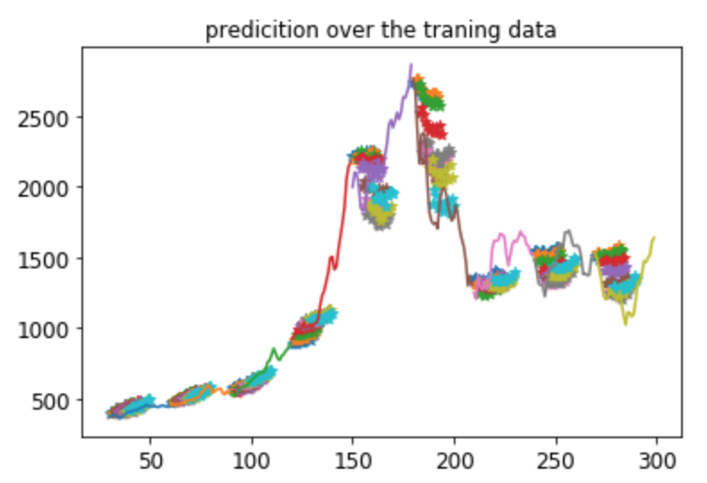
Test_first | SSE(12step ahead)
30 | 200325.6567
60 | 153939.6978
90 | 125326.0635
120 | 1459749.211
150 | 9572364.212
180 | 23236396.17
210 | 6028583.608
240 | 3,572,982.525
270 | 5,480,910.015
300 | 12,000,286.84

Slide 36
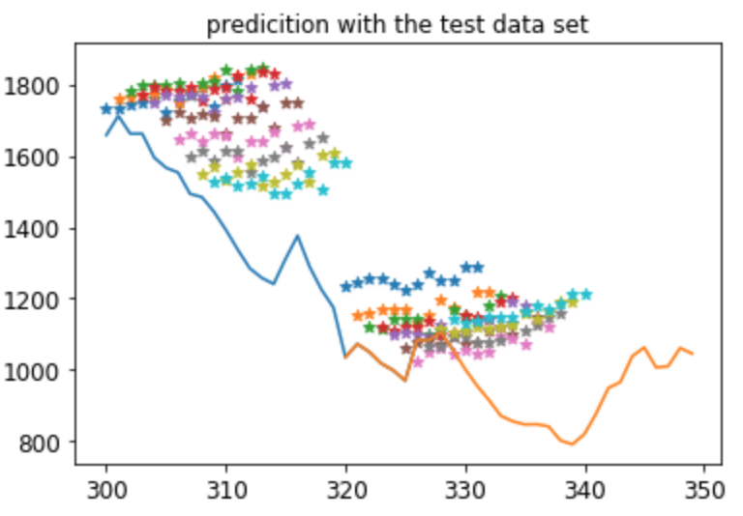
Test_first | SSE(12step ahead)
300 | 12000286.84
320 | 5199482.079

Slide 37
Task 2 ?
“ How much did it rain? Ⅱ” contest
https://www.kaggle.com/c/how-much-did-it-rain-ii
Hint !
Luis Andre Dutra e Silva
https://goo.gl/fTA90W,
http://blog.kaggle.com/2015/12/17/how-much-did-it-rain-ii-2nd-place-luis-andre-dutra-e-silva/
Good word
Begin small, progress slowly, target the stars and reach the Moon.

Slide 38
10章
Toshiaki Asakura
Tabata Youtarou

Slide 39
-古典的なパーセプトロン(単層のLTU)よりもロジスティック回帰分類を使った方が良いのはなぜか？
単層のLTUは線形分離可能な時にのみ収束可能、かつ各クラスに属する確率は算出できない。
ロジスティック回帰分類は線形分離可能でなくとも収束し、各クラスに属する確率を算出できる。
-古典的なパーセプトロンをロジスティック回帰分類と同等にするためにはどうすれば良いか？
活性化関数をロジスティック活性化関数、クラスが複数あればsoftmax関数を用いる。
-最初のMLPの訓練でロジスティック活性化関数が重要な構成要素だった理由は？
-バックプロパゲーションでロジスティック活性化関数を用いると全ての点において非0の傾きが得られるために
各ステップで前進することができるから。
-背景としては昔は活性化関数としてはstep関数を用いるのが一般的だったため、
傾きが算出できないことが問題であった。
-Broadcast とは？
1次元の配列(b)をX・W と同じ数の列を持つ二次元の行列に追加するとbが各行に加えられる操作をさす。

Slide 40
-バックプロパゲーションの別名は？ いつ誰が提唱した？
リバースモード自動微分を使った勾配降下法
1986年にD・E・ハメルハート
バックプロパゲーションとは？
機械学習の膨大なパラメータを推定するための推定方法
-バックプロパゲーションの仕組みは？数式を使わずに説明せよ
ここの訓練インスタンスを入力層に入れ、出力層まで計算させる。次に出力層と実際の値との誤差を計算し
その誤差は一つ前の隠れ層のどの部分が一番大きな影響を与えているか計算する。
それを一番最初まで繰り返しネットワーク全体の誤差勾配を得る。
その誤差勾配を用いて勾配降下法を行う。
-バックプロパゲーションとリバースモード自動微分の違いは？
バックプロパゲーションは機械学習のパラメーターの誤差勾配の計算から勾配降下法を用いたパラメーターの
推定までのプロセスを指す。
リバースモード自動微分は関数の誤差勾配を計算するための手法であり、バックプロパゲーションの
プロセスの一部でしかない。

Slide 41
-What I don’t know
勾配降下法の実装 by my self
リバースモード自動微分の具体的な関数の計算
切断正規分布とは？
2章ランダムサーチ、Oscar( 複雑なハイパーパラメータの良い組み合わせの発見)

